Slide 1
Scalatest

Slide 2
Test-Driven Development (TDD)
TDD is a technique in which you write the tests before you write the code you want to test
This seems backward, but it really does work better
When tests are written first,
  You have a clearer idea what to do when you write the methods
  The code is necessarily written to be testable
  You are encouraged to write simpler, single-purpose methods
  Methods tend to be more independent of the environment
    They are called from more than one environment (the “real” one, plus your test class)
  You are never far away from code that works
  You end up with a program that can be modified and maintained safely
To do TDD, it must be easy to create and run tests
  Scalatest and JUnit are frameworks that makes this much easier to do

Slide 3
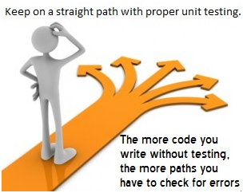
http://www.guru99.com/unit-testing.html

Slide 4
The basic TDD cycle
Martin Fowler puts it this way:
  Write a test for the next bit of functionality you want to add.
  Write the functional code until the test passes.
  Refactor both new and old code to make it well structured.
      (martinfowler.com/bliki/TestDrivenDevelopment.html)

Slide 5
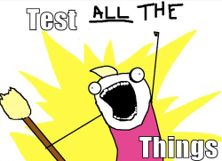
What to test
http://chimera.labs.oreilly.com/books/1234000000754/ch04.html#_programming_is_like_pulling_a_bucket_of_water_up_from_a_well

Slide 6
Simply Writing Tests Is Not Test Driven Development
Uncle Bob’s 3 basic rules of TDD are:
  You are not allowed to write any production code unless it is to make a failing unit test pass.
  You are not allowed to write any more of a unit test than is sufficient to fail; and compilation failures are failures.
  You are not allowed to write any more production code than is sufficient to pass the one failing unit test.
To summarize Uncle Bob’s rules:
  Only write code that is tested.
  Start your tests small, then work your way up.
  Only write enough production code to make a test pass.
The basic process of TDD has 3 steps: Red, Green, and Refactor
http://spin.atomicobject.com/2012/12/06/writing-tests-is-not-tdd/

Slide 7
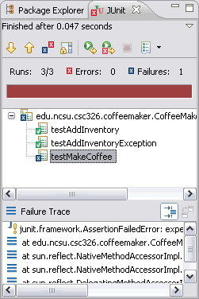
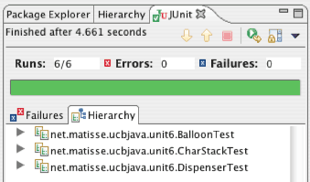
Red and green?

Slide 8
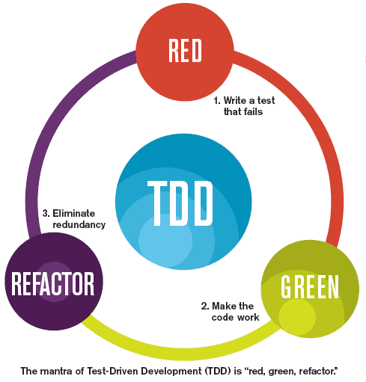
http://diogoosorio.com/blog/entry/test-driven-development-tdd-using-phpunit

Slide 9
http://c2.com/cgi/wiki?TestDrivenDevelopment
Think about what you want to do.
Think about how to test it.
Write a small test.
Think about the desired API.
Write just enough code to fail the test.
Run and watch the test fail. (The test-runner, if you're using something like JUnit, shows the "Red Bar"). Now you know that your test is going to be executed.
Write just enough code to pass the test (and pass all your previous tests).
Run and watch all of the tests pass. (The test-runner, if you're using JUnit, etc., shows the "Green Bar"). If it doesn't pass, you did something wrong, fix it now since it's got to be something you just wrote.
If you have any duplicate logic, or inexpressive code, refactor to remove duplication and increase expressiveness -- this includes reducing coupling and increasing cohesion.
Run the tests again, you should still have the Green Bar. If you get the Red Bar, then you made a mistake in your refactoring. Fix it now and re-run.
Repeat the steps above until you can't find any more tests that drive writing new code.

Slide 10
Getting Scalatest
Start with an up-to-date version of Scala IDE
  It is unlikely that anyone here has an old version
Google for scalatest and go to the download page
  Download the jar file (I’m using scalatest_2.10-2.0.M8) and save it somewhere you can find it again
In Eclipse go to Project -> Properties -> Java Build Path -> Libraries and add the Scalatest jar as an external jar
  You will have to do this step again for each new project

Slide 11
Test file format
package openingbid
import org.scalatest.FunSuite
class MyClassTest extends FunSuite {
// This is ordinary Scala code, with tests
// There are three main kinds of tests:
test("String to describe the test") {
assert(Code that should return a true value)
}
test("String to describe the test") {
assertResult(expectedResult) {
Code to compute actual result
}
}
test("String to describe the test") {
intercept[Type of exception] {
Code that should throw the exception
}
}
}

Slide 12
Example (abbreviated)
package openingbid
import org.scalatest.FunSuite
class BidTest extends FunSuite {
val hand = makeHand("5C 7H AS JD 9D 2C KH 10H 4C 8H 8C AD 10C")
test("Testing highCardPoints") {
assertResult(12) { Bid.highCardPoints(hand) }
}
test("Testing isBalanced") {
assert(! Bid.isBalanced(hand))
}
}

Slide 13
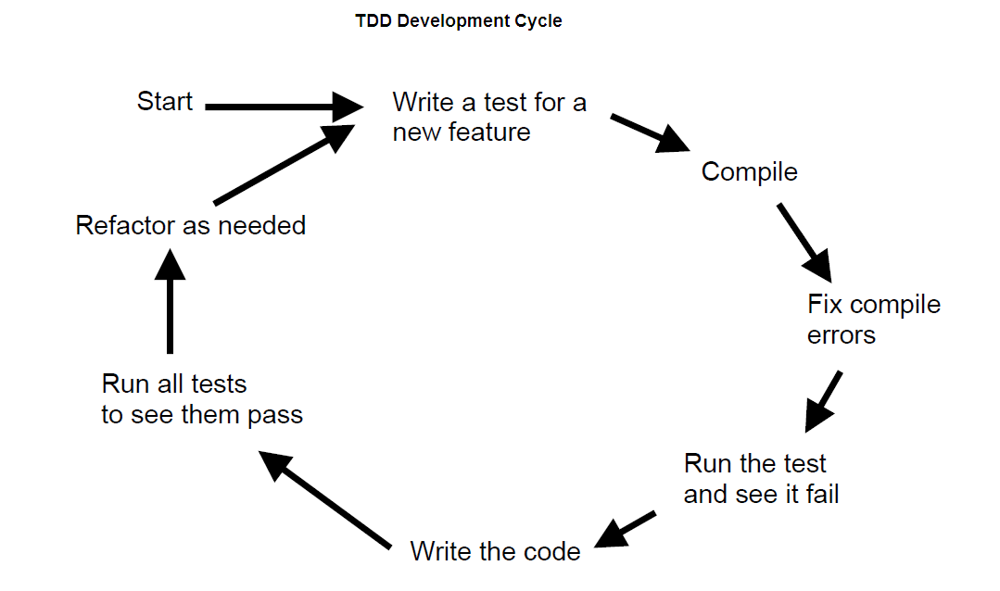
The End
http://www.seleniumwiki.com/testing-methodologies/agile-testing/unit-testing-in-a-test-driven-development/

