Slide 1
Introduction to Networks

Slide 3
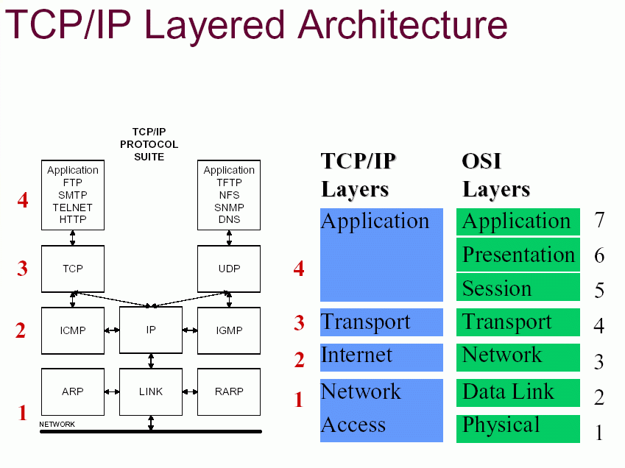

Slide 4
Network Access Layer
Specifies the physical signals (electrical, optical, etc...)
  Type,Levels,Speed
Cables if any
Range
How to transmit data between two stations in the same segment
Two components
  MAC (Media Access Control)
    Control which station receives which data
    Which station has permission to transmit
    MAC addresses uniquely identify stations (in theory)
  LLC (Logical Link Control)
    frame synchronization
      Data unit is called a frame
    flow control
    error checking

Slide 5
Internet Layer
Routing between segments
Forwarding
Addressing
Internetworking
Error handling
Congestion control
Packet sequencing
  Data units are called "packets"

Slide 6
Transport Layer
Reliability
  retransmissions, etc...
Error recovery
Flow control
Application Layer
Handles connections between applications
Handles encoding, encryption, etc...

Slide 7
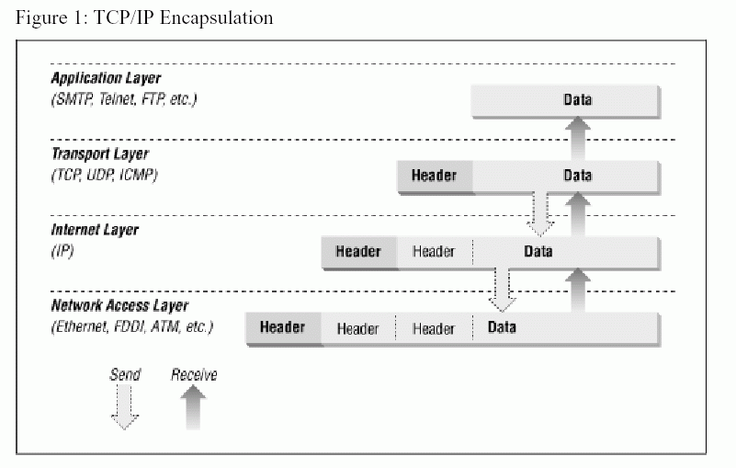

Slide 8
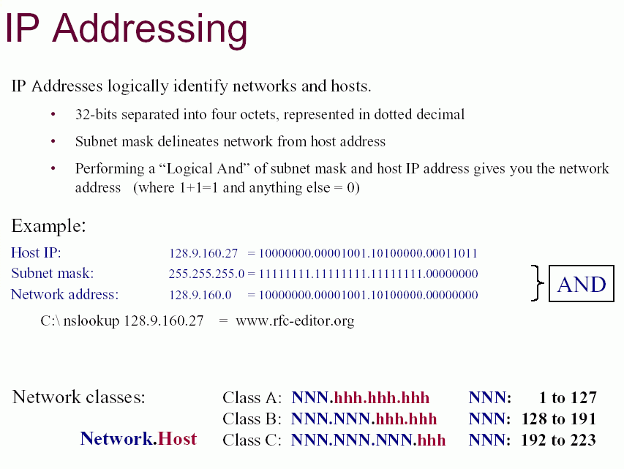

Slide 9
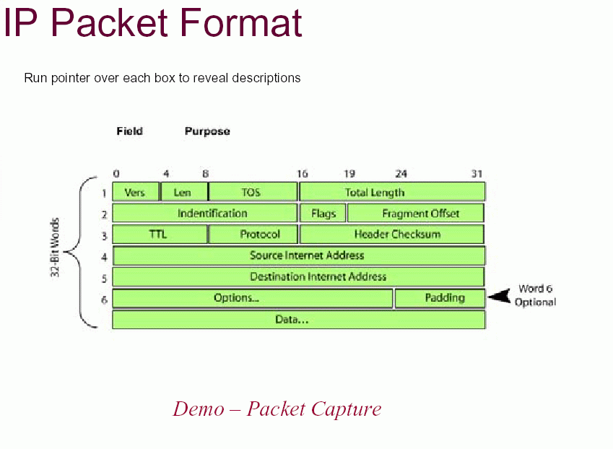

Slide 10
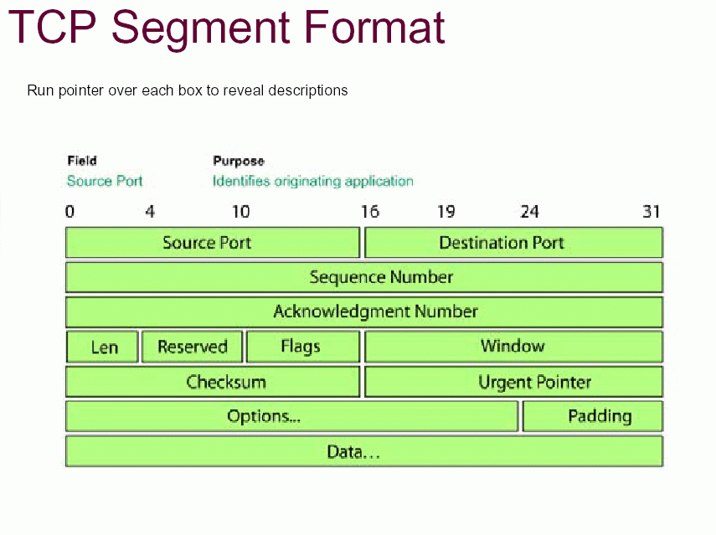

Slide 11
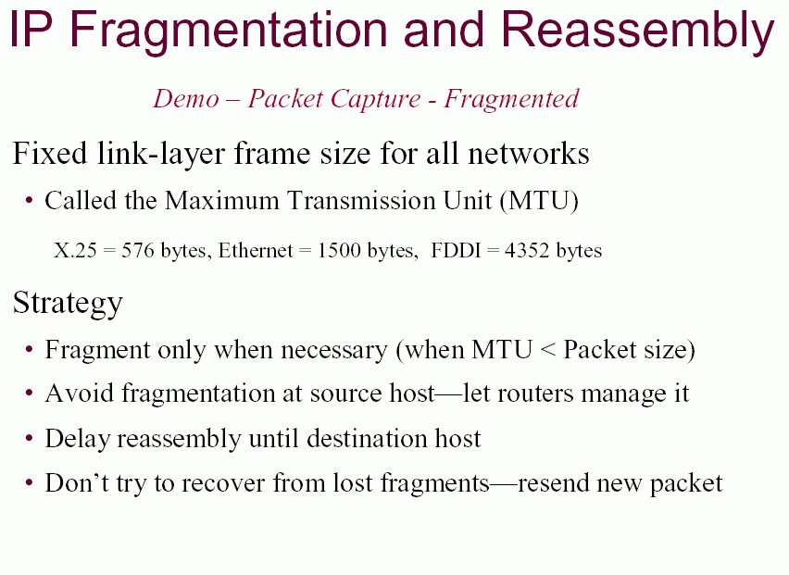

Slide 12
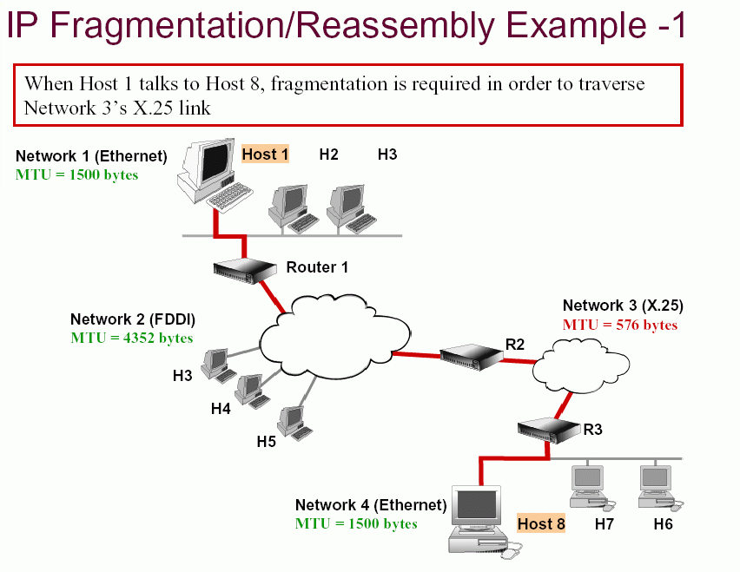

Slide 13
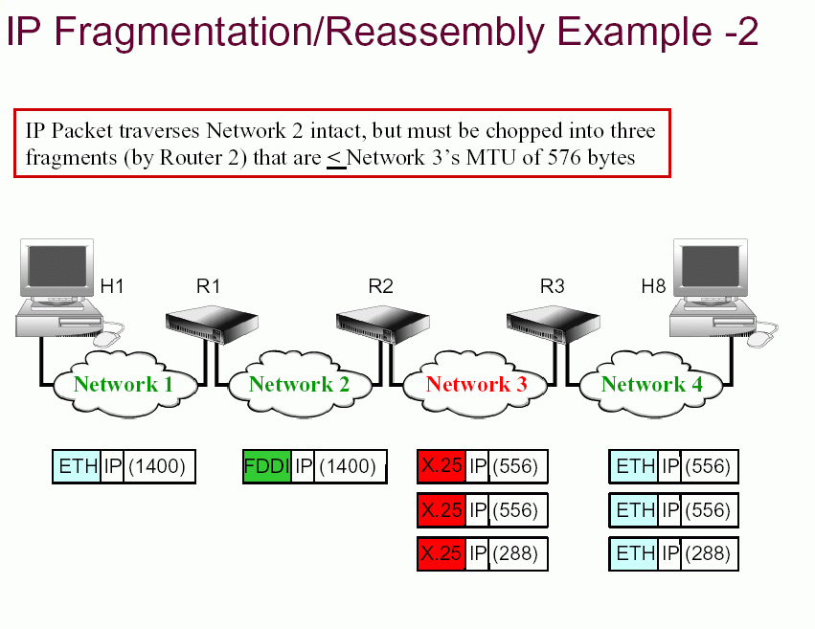

Slide 14
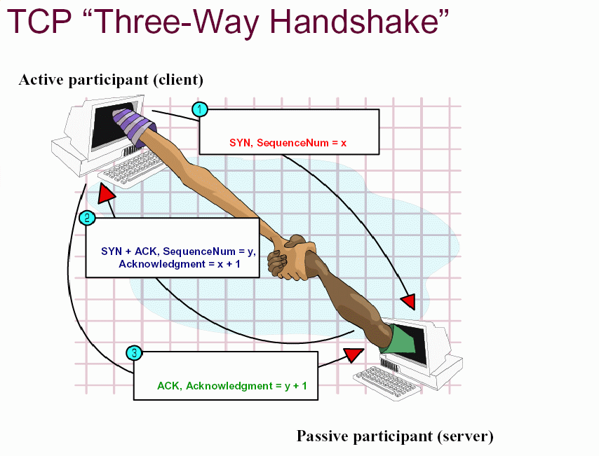

Slide 15
Summary
Hardware NIC
Base Protocols TCP/IP
Identification IP Address, Port
Communication Client-Server
Data Transmission Packets
Programming Sockets
Application Protocols SMTP,HTTP,POP3,FTP,telnet etc

Slide 16
Network Programming

Slide 17
Creating a TCP socket
int socket(int family,int type,int proto);
int sock;
sock = socket( AF_INET, SOCK_STREAM,
0);
if (sock<0) { /* ERROR */ }

Slide 18
Client
Server
Socket ()
Socket ()
Bind ()
Listen ()
Connect ()
Accept ()
Connection Established

Slide 19
Creating a TCP socket
int socket(int family,int type,int proto);
int sock;
sock = socket( AF_INET, SOCK_STREAM,
0);
if (sock<0) { /* ERROR */ }

Slide 20
Binding to well known address
int mysock;
struct sockaddr_in myaddr;
mysock = socket(AF_INET,SOCK_STREAM,0);
myaddr.sin_family = AF_INET;
myaddr.sin_port = htons( 80 );
bind(mysock, (sockaddr *) &myaddr, sizeof(myaddr));

Slide 21
TCP Sockets Programming
Creating a passive mode (server) socket.
Establishing an application-level connection.
send/receive data.
Terminating a connection.

Slide 22
Establishing a passive mode TCP socket
Passive mode:
  Address already determined.
  Tell the kernel to accept incoming connection requests directed at the socket address.
  Tell the kernel to queue incoming connections for us.

Slide 23
listen()
int listen( int sockfd, int backlog);
sockfd is the TCP socket (already bound to an address)
backlog is the number of incoming connections the kernel should be able to keep track of (queue for us).
listen() returns -1 on error (otherwise 0).

Slide 24
Accepting an incoming connection.
Once we call listen(), the O.S. will queue incoming connections
  Handles the 3-way handshake
  Queues up multiple connections.
When our application is ready to handle a new connection, we need to ask the O.S. for the next connection.

Slide 25
accept()
int accept( int sockfd,
struct sockaddr* cliaddr,
socklen_t *addrlen);
sockfd is the passive mode TCP socket.
cliaddr is a pointer to allocated space.
addrlen is a value-result argument
  must be set to the size of cliaddr
  on return, will be set to be the number of used bytes in cliaddr.

Slide 26
accept() return value
accept() returns a new socket descriptor (small positive integer) or -1 on error.
After accept returns a new socket descriptor, I/O can be done using the read() and write() system calls.
read() and write() operate a little differently on sockets (vs. file operation)!

Slide 27
Terminating a TCP connection
Either end of the connection can call the close() system call.
If the other end has closed the connection, and there is no buffered data, reading from a TCP socket returns 0 to indicate EOF.

Slide 28
Client Code
TCP clients can call connect() which:
  takes care of establishing an endpoint address for the client socket.
    don’t need to call bind first, the O.S. will take care of assigning the local endpoint address (TCP port number, IP address).
  Attempts to establish a connection to the specified server.

Slide 29
connect()
int connect( int sockfd,
const struct sockaddr *server,
socklen_t addrlen);
sockfd is an already created TCP socket.
server contains the address of the server (IP Address and TCP port number)
connect() returns 0 if OK, -1 on error

Slide 30
Reading from a TCP socket
int read( int fd, char *buf, int max);
By default read() will block until data is available.
reading from a TCP socket may return less than max bytes (whatever is available).
You must be prepared to read data 1 byte at a time!

Slide 31
Writing to a TCP socket
int write( int fd, char *buf, int num);
write might not be able to write all num bytes (on a nonblocking socket).

