Slide 1
System Calls

Slide 2
Definition
Services provided by OS
Communication interface between application program and kernel
System Calls codes built inside kernel
Examples
  open(),close(),create()

Slide 3
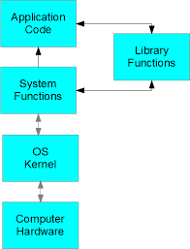
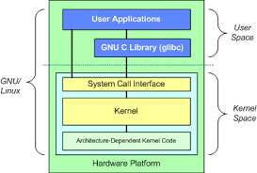

Slide 4
Categories
System Call for File management
System call for Process management
System call for Communication
System call for Device management
System call for information retrieving
Examples:
  access(),creat(),pipe(),open(),close(),fork(), exec(), write(), read(), time(), date()

Slide 5
Seeing manual pages
man 2 function/system call name
man 3 function for library function manuals
man function/system call/command –General manual pages

Slide 6
Creating a file
vi filename.c
        Or
vim filename.c
– for C program creation

Slide 7
Linux basic Commands
cc filename.c – to compile c programs which create default out put a.out.
ls – list files equivalent to dir in DOS
ll – list with showing the permission and link
cat > filename -to write to a file ctrl+ D to exit
cat < filename / cat filename – to view content of file
clear- to clear the shell
mkdir-cerate a directory
rm – remove file
See man pages for details

Slide 8
access
System call used to check user’s permission
int access(const char *pathname, int mode);
For help use #man 2 access
  R_OK -> file readable or not
  F_OK -> file existing or not
  W_Ok ->write to file or not
  X_OK ->execute the file or not

Slide 9
access – example
#include <unistd.h>
#include <errno.h>
main()
{
access(fil,F_OK);
perror(“perror”);
}
Note: perror will print the system error message of errno
eg: perror: No such file or directory

Slide 10
Chmod – system call
Linux is multi user multi tasking operating system;
Three users are there:
u- user
g – group
o – others
File permissions are
Read – 4
Write – 2
Execute -1
Edit permissions with chmod ugo f1 from shell or
int chmod(const char *path, mode_t mode);

Slide 11
Open()
#include <sys/types.h>
#include <sys/stat.h>
#include <fcntl.h>
int open(const char *pathname, int flags);
int open(const char *pathname, int flags, mode_t mode);

Slide 12
Open()
Given a pathname for a file, open() returns a file descriptor, a small, non-negative integer for use in subsequent system calls
(read(2), write(2), lseek(2), fcntl(2), etc.). The file descriptor returned by a successful call will be the lowest-numbered file
descriptor not currently open for the process.
A call to open() creates a new open file description, an entry in the system-wide table of open files. This entry records the file

Slide 13
The parameter flags must include one of the following access modes: O_RDONLY, O_WRONLY, or O_RDWR. These request opening the file read-only, write-only, or read/write, respectively.

Slide 14
Library functions
Library function can be called from user application programs
Proper header files are to be included
Header files defines the proper system call for each library function call.
Examples- related to file management operation
  Fopen(),fclose(),fprintf(),fgets(),fputc() etc.
  man 3 function name

