Slide 1
Optimization Methods in Data Mining

Slide 2
Overview
Optimization
Mathematical
Programming
Combinatorial
Optimization
Support
Vector
Machines
Steepest
Descent
Search
Genetic
Algorithm
Classification,
Clustering,
etc
Neural Nets,
Bayesian Networks
(optimize parameters)
Feature selection
Classification
Clustering

Slide 3
What is Optimization?
Problem
Formulation
  Decision variables
  Objective function
  Constraints
Solution
  Iterative algorithm
  Improving search
Formulation
Model
Algorithm
Solution

Slide 4
Combinatorial Optimization
Finitely many solutions to choose from
  Select the best rule from a finite set of rules
  Select the best subset of attributes
Too many solutions to consider all
Solutions
  Branch-and-bound (better than Weka exhaustive search)
  Random search

Slide 5
Random Search
Select an initial solution x⁽⁰⁾ and let k=0
Loop:
  Consider the neighbors N(x^{(k)}) of x^{(k)}
  Select a candidate x’ from N(x⁽⁰⁾)
  Check the acceptance criterion
  If accepted then let x^{(k+1)} = x’ and otherwise let x^{(k+1)} = x^{(k)}
Until stopping criterion is satisfied

Slide 6
Common Algorithms
Simulated Annealing (SA)
  Idea: accept inferior solutions with a given probability that decreases as time goes on
Tabu Search (TS)
  Idea: restrict the neighborhood with a list of solutions that are tabu (that is, cannot be visited) because they were visited recently
Genetic Algorithm (GA)
  Idea: neighborhoods based on ‘genetic similarity’
  Most used in data mining applications

Slide 7
Genetic Algorithms
Maintain a population of solutions rather than a single solution
Members of the population have certain fitness (usually just the objective)
Survival of the fittest through
  selection
  crossover
  mutation

Slide 8
GA Formulation
Use binary strings (or bits) to encode solutions:
0 1 1 0 1 0 0 1 0
Terminology
  Chromosomes = solution
  Parent chromosome
  Children or offspring

Slide 9
Problems Solved
Data Mining Problems that have been addressed using Genetic Algorithms:
  Classification
  Attribute selection
  Clustering

Slide 10
Classification Example
Sunny 100
Overcast 010
Rainy 001
Yes 10
No 01
Outlook
Windy

Slide 11
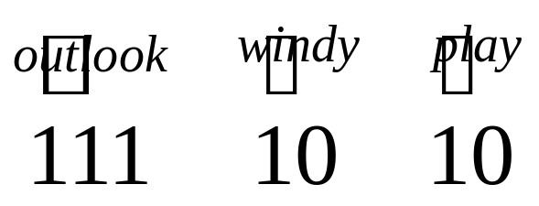
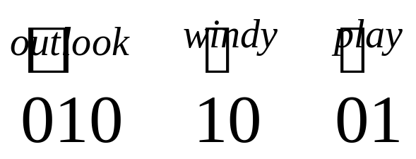
Representing a Rule
If windy=yes then play=yes
If outlook=overcast and windy=yes then play=no

Slide 12
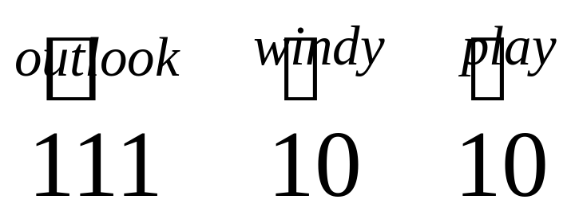
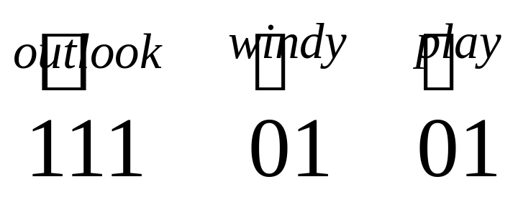
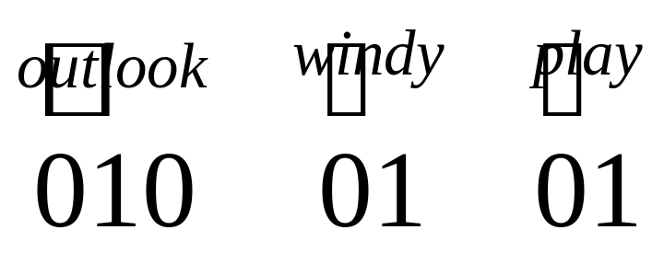
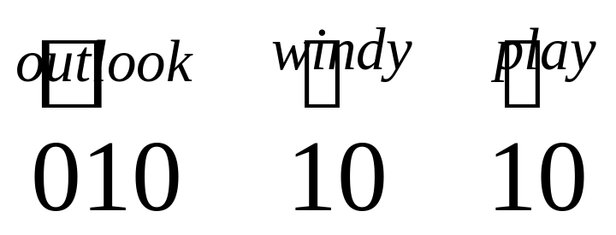
Single-Point Crossover
Parents Offspring
Crossover point

Slide 13
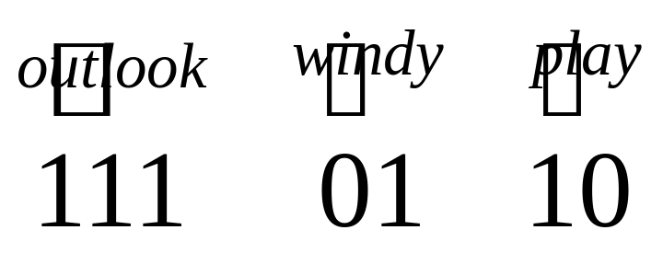
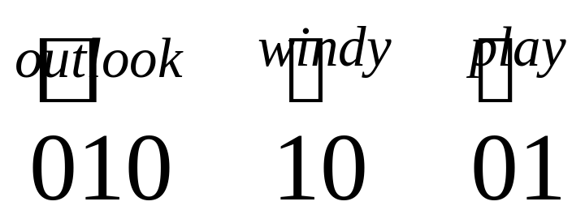
Two-Point Crossover
Parents Offspring
Crossover points

Slide 14
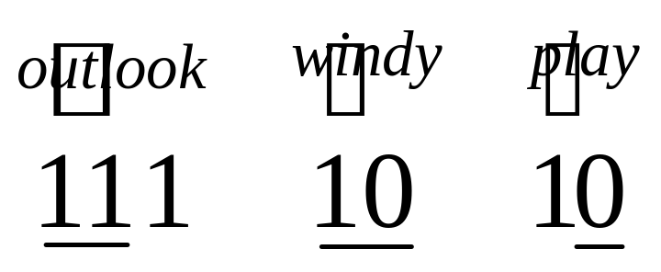
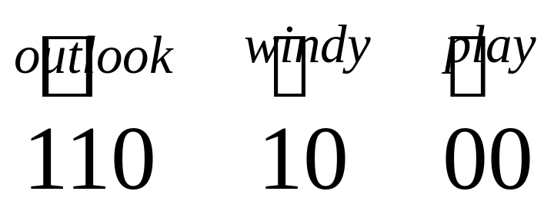
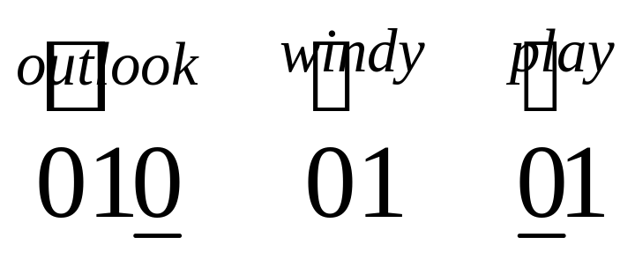
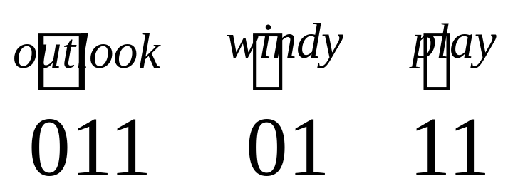
Uniform Crossover
Parents Offspring
Problem?

Slide 15
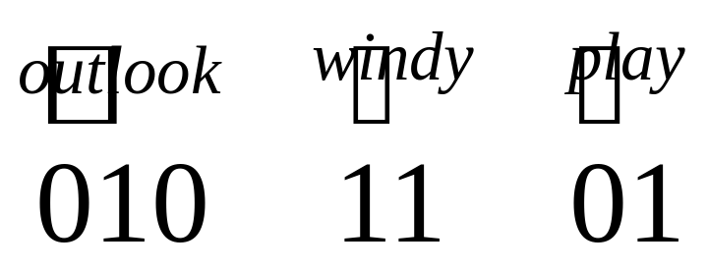
Mutation
Parent Offspring
Mutated bit

Slide 16
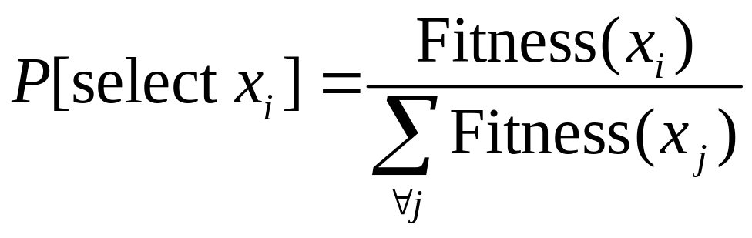
Selection
Which strings in the population should be operated on?
  Rank and select the n fittest ones
  Assign probabilities according to fitness and select probabilistically, say

Slide 17
Creating a New Population
Create a population P_{new} with p individuals
Survival
  Allow individuals from old population to survived intact
  Rate: 1-r % of population
  How to select the individuals that survive: Deterministic/random
Crossover
  Select fit individuals and create new once
  Rate: r% of population. How to select?
Mutation
  Slightly modify any on the above individuals
  Mutation rate: m
  Fixed number of mutations versus probabilistic mutations

Slide 18
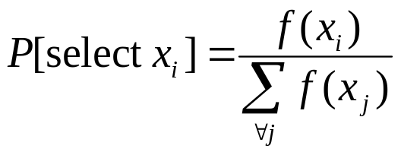
GA Algorithm
Randomly generate an initial population P
Evaluate the fitness f(x_{i}) of each individual in P
Repeat:
  Survival: Probabilistically select (1-r)p individuals from P and add to P_{new}, according to
  Crossover: Probabilistically select rp/2 pairs from P and apply the crossover operator. Add to P_{new}
  Mutation: Uniformly choose m percent of member and invert one randomly selected bit
  Update: P ← P_{new}
  Evaluate: Compute the fitness f(x_{i}) of each individual in P
Return the fittest individual from P

Slide 19
Analysis of GA: Schemas
Does GA converge?
Does GA move towards a good solution? Local optima?
Holland (1975): Analysis based on schemas
Schema: string combination of 0s, 1s, *s
Example: 0*10 represents {0010,0110}

Slide 20
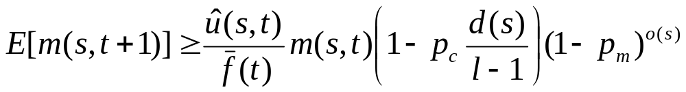
The Schema Theorem
(all the theory on one slide)
Average fitness of
individuals in
schema s at time t
Distance between
defined bits in s
Number of
defined bits
in schema s
Probability
of crossover
Probability
of mutation
Number of instance of
schema s at time t

Slide 21
Interpretation
Fit schemas grow in influence
What is missing
  Crossover?
  Mutation?
How about time t+1 ?
Other approaches:
  Markov chains
  Statistical mechanics

Slide 22
GA for Feature Selection
Feature selection:
  Select a subset of attributes (features)
  Reason: to many, redundant, irrelevant
Set of all subsets of attributes very large
Little structure to search
Random search methods

Slide 23
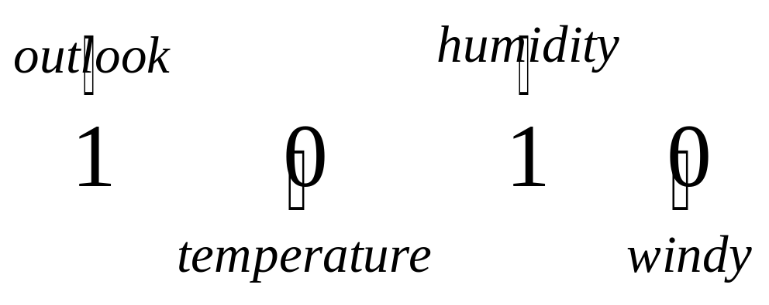
Encoding
Need a bit code representation
Have some n attributes
Each attribute is either in (1) or out (0) of the selected set

Slide 24
Fitness
Wrapper approach
  Apply learning algorithm, say a decision tree, to the individual x ={outlook, humidity}
  Let fitness equal error rate (minimize)
Filter approach
  Let fitness equal the entropy (minimize)
  Other diversity measures can also be used
Simplicity measure?

Slide 25
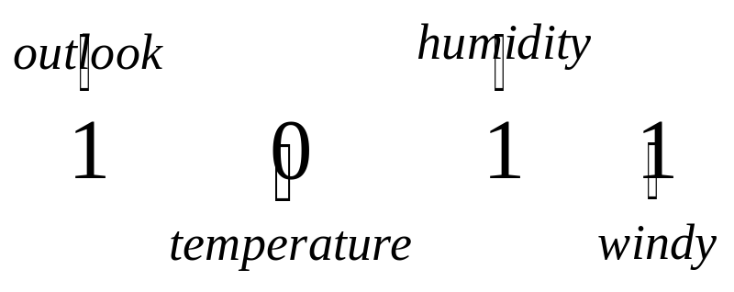
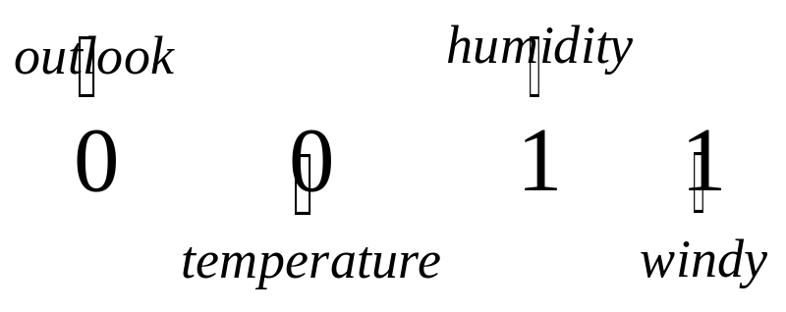
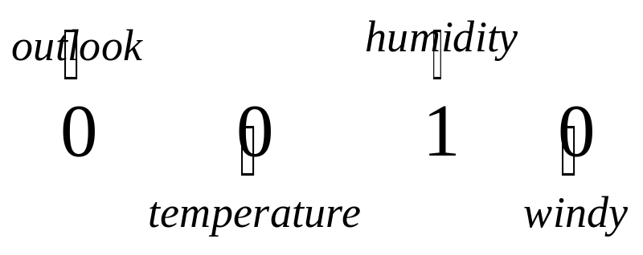
Crossover
Crossover point

Slide 26
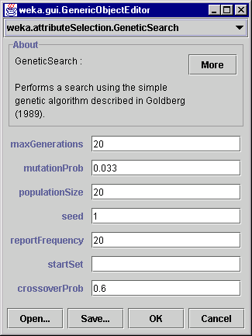
In Weka

Slide 27
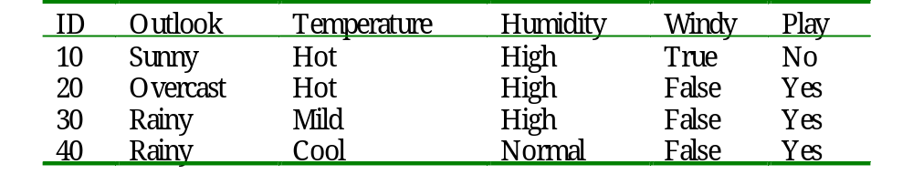
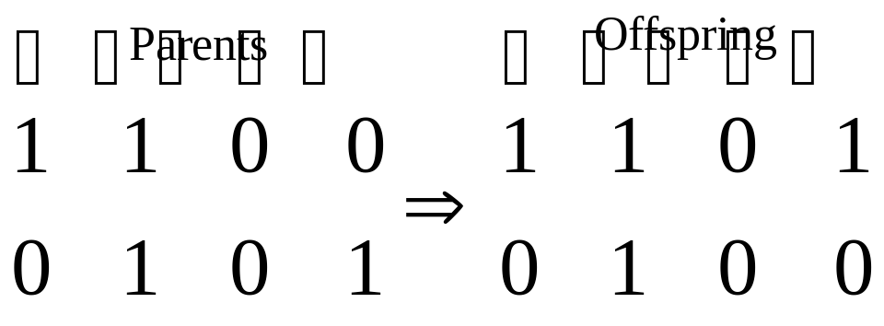
Clustering Example
Create two clusters for:
{10,20}
{30,40}
{10,20,40}
{30}
{20,40}
{10,30}
{20}
{10,30,40}
Crossover

Slide 28
Discussion
GA is a flexible and powerful random search methodology
Efficiency depends on how well you can encode the solutions in a way that will work with the crossover operator
In data mining, attribute selection is the most natural application

Slide 29
Attribute Selection in Unsupervised Learning
Attribute selection typically uses a measure, such as accuracy, that is directly related to the class attribute
How do we apply attribute selection to unsupervised learning such as clustering?
Need a measure
  compactness of cluster
  separation among clusters
Multiple measures

Slide 30
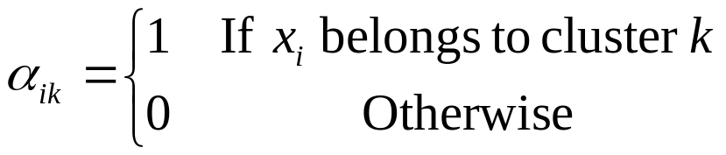
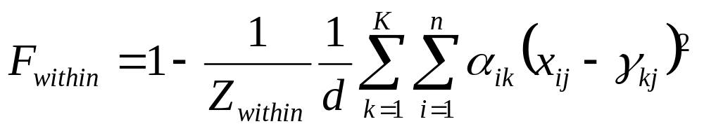
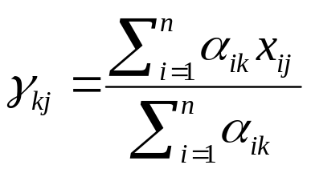

Quality Measures
Compactness
Instances
Clusters
Centroid
Number of
attributes
Normalization
constant to make

Slide 31
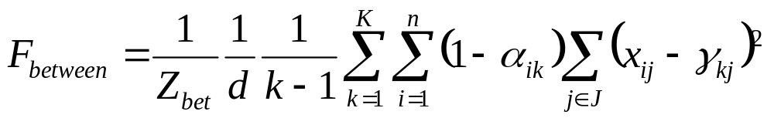
More Quality Measures
Cluster Separation

Slide 32
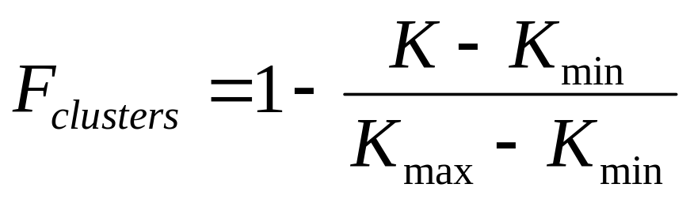
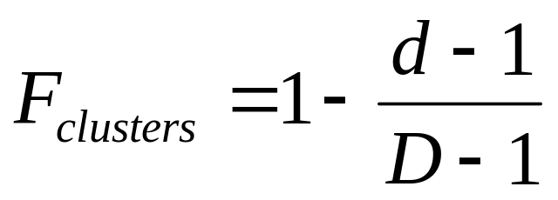
Final Quality Measures
Adjustment for bias
Compexity

Slide 33
Wrapper Framework
Loop:
  Obtain an attribute subset
  Apply k-means algorithm
  Evaluate cluster quality
Until stopping criterion satisfied

Slide 34
Problem
What is the optimal attribute subset?
What is the optimal number of clusters?
Try to find simultaneously

Slide 35
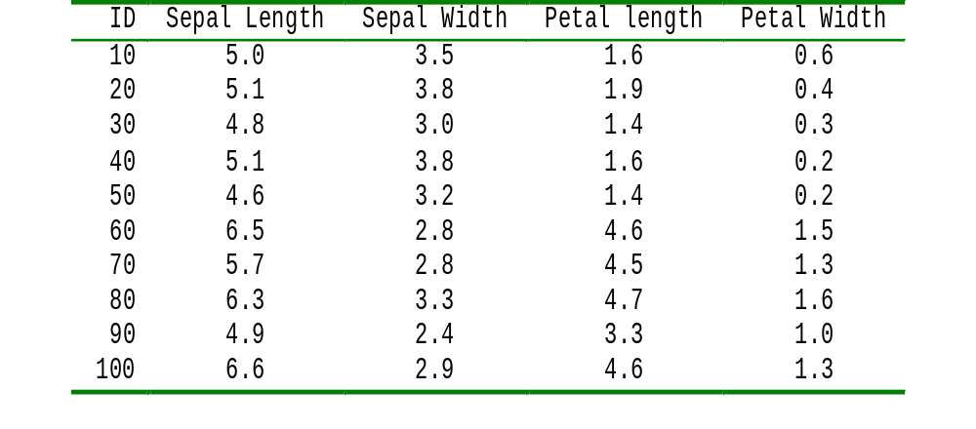
Example
Find an attribute subset and optimal number of clusters (K_{min} = 2, K_{min} = 3) for

Slide 36
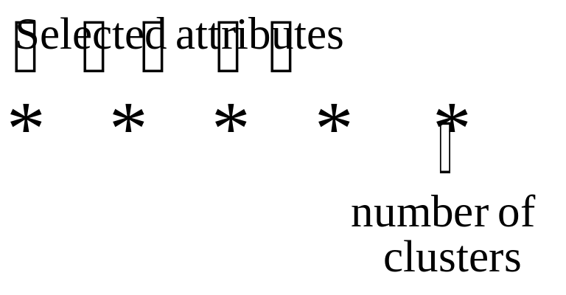
Formulation
Define an individual
Initial Population
0 1 0 1 1
1 0 0 1 0

Slide 37
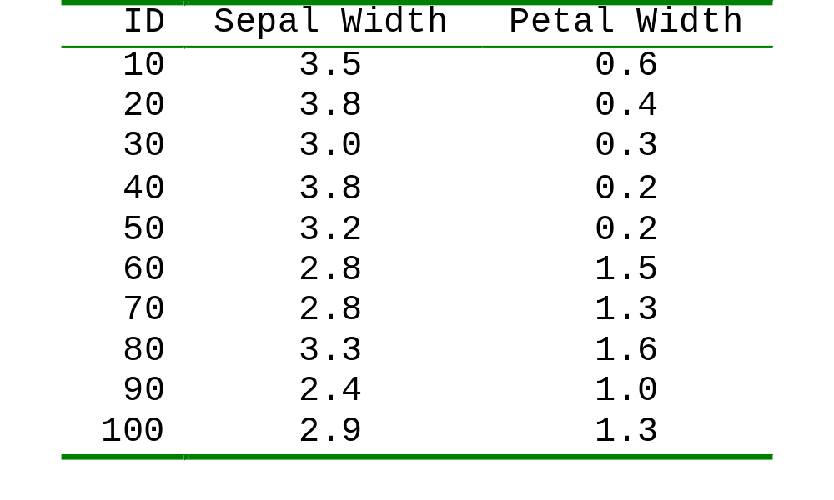
Evaluate Fitness
Start with 0 1 0 1 1
Three clusters and {Sepal Width, Petal Width}
Apply k-means with k=3

Slide 38
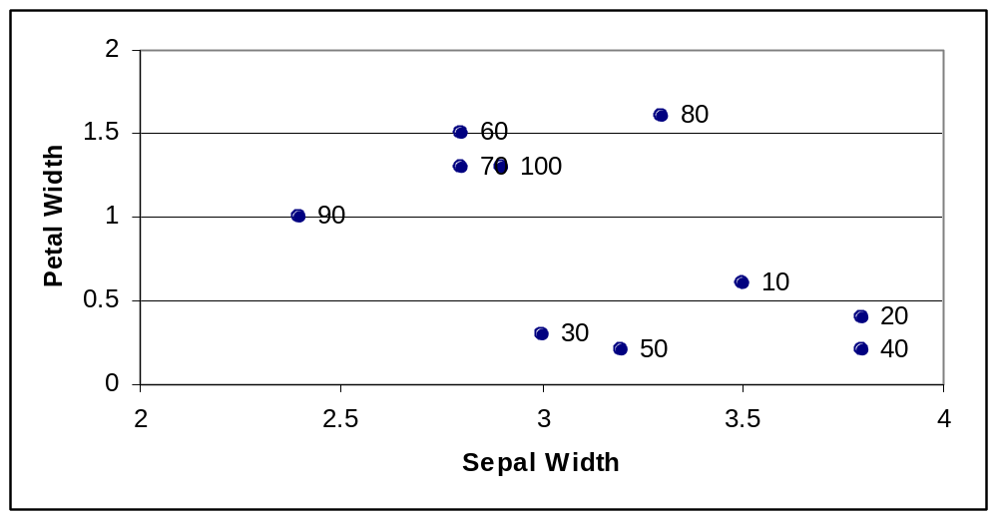
K-Means
Start with random centroids: 10, 70, 80

Slide 39
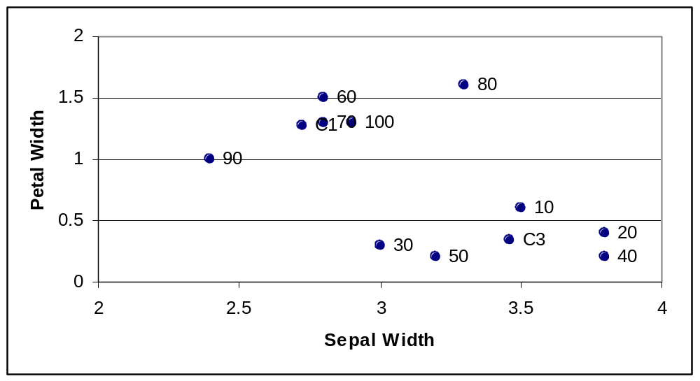
New Centroids
No change in assignment so
terminate k-means algorithm

Slide 40
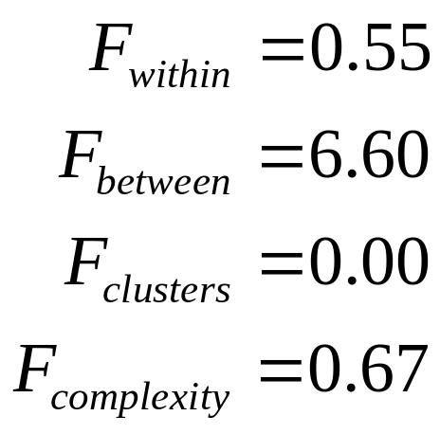
Quality of Clusters
Centers
  Center 1 at (3.46,0.34): {60,70,90,100}
  Center 2 at (3.30,1.60): {80}
  Center 3 at (2.73,1.28): {10,20,30,40,50}
Evaluation

Slide 41
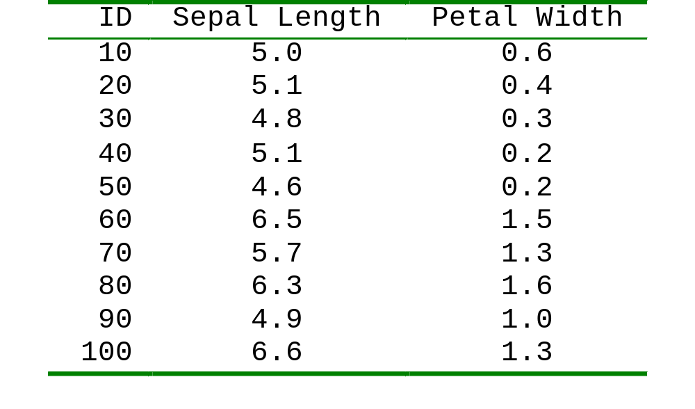
Next Individual
Now look at 1 0 0 1 0
Two clusters and {Sepal Length, Petal Width}
Apply k-means with k=3

Slide 42
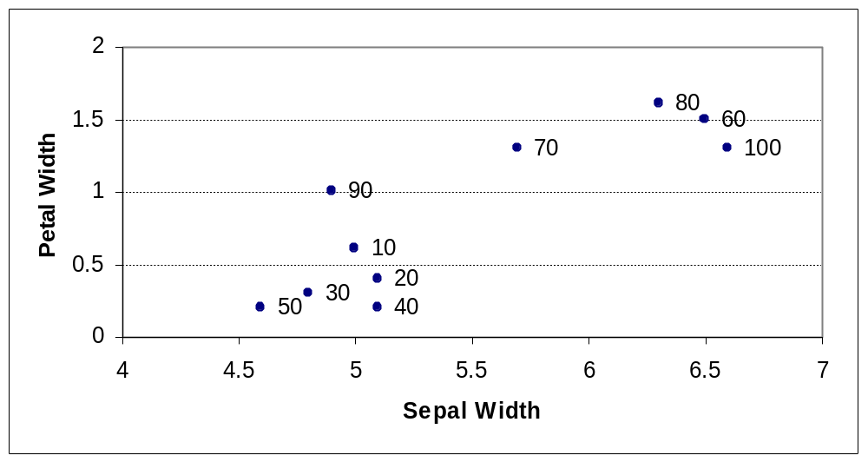
K-Means
Say we select 20 and 90 as initial centroids:

Slide 43
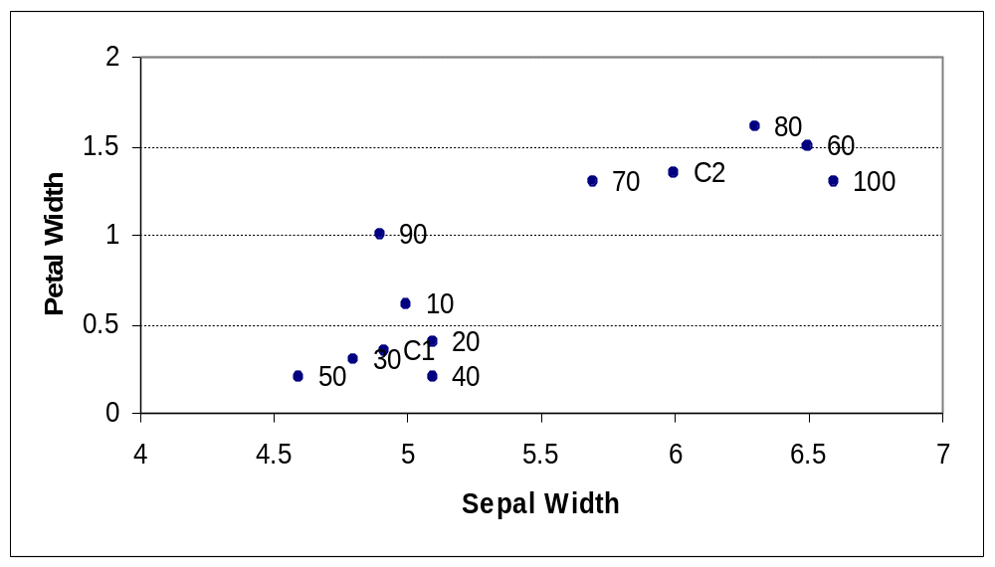
Recalculate Centroids

Slide 44
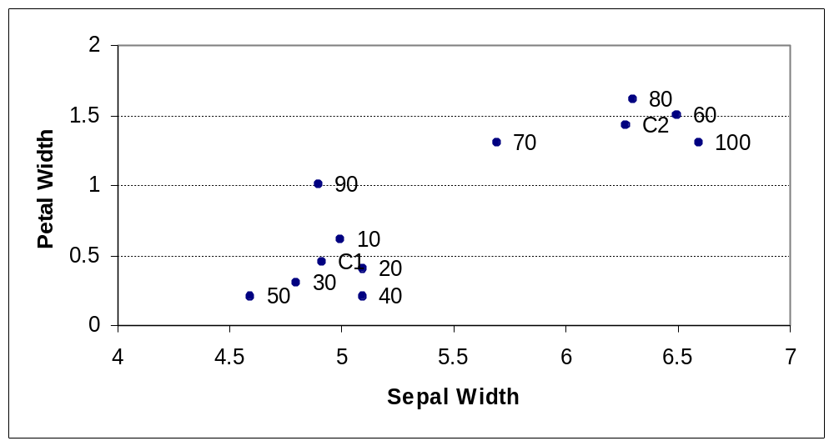
Recalculate Again
No change in assignment so
terminate k-means algorithm

Slide 45
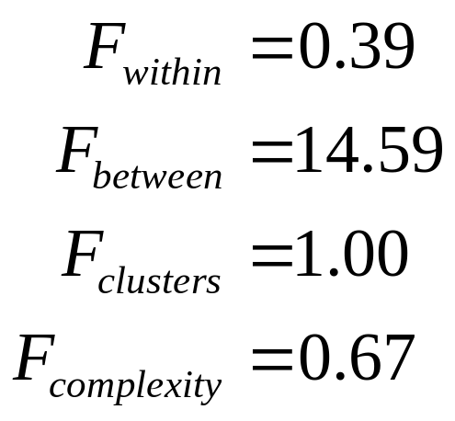
Quality of Clusters
Centers
  Center 1 at (4.92,0.45): {10,20,30,40,50,90}
  Center 3 at (6.28,1.43): {60,70,90,100}
Evaluation

Slide 46
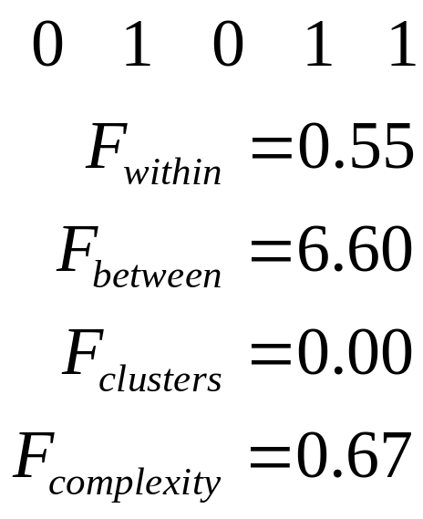
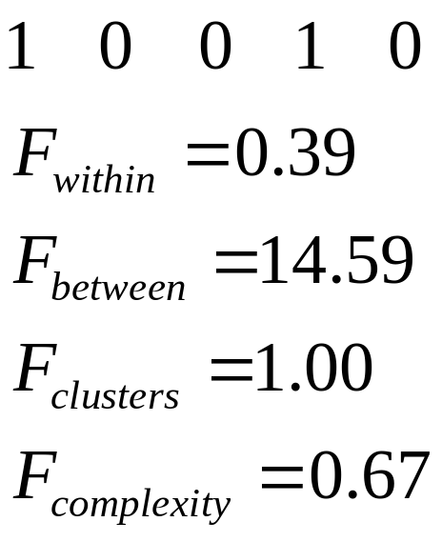

Compare Individuals
Which is fitter?

Slide 47
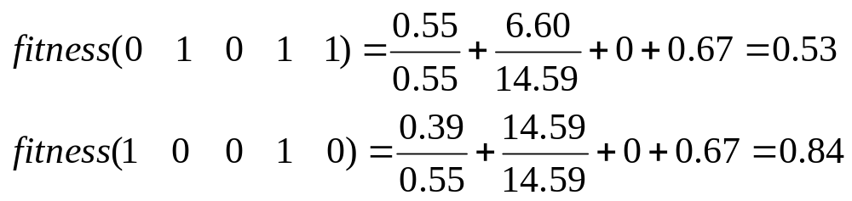
Evaluating Fitness
Can scale (if necessary)
Then weight them together, e.g.,
Alternatively, we can use Pareto optimization

Slide 48
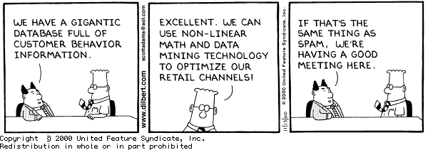

Slide 49
Mathematical Programming
Continuous decision variables
Constrained versus non-constrained
Form of the objective function
  Linear Programming (LP)
  Quadratic Programming (QP)
  General Mathematical Programming (MP)

Slide 50
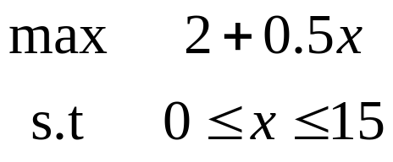




Linear Program
Optimal solution
10

Slide 51


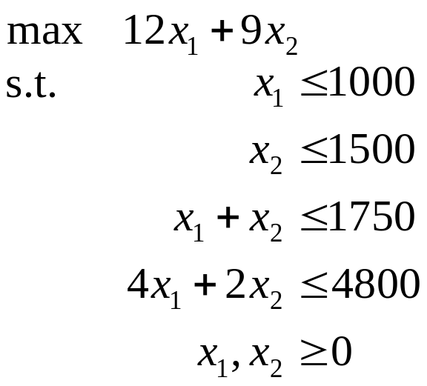








Two Dimensional Problem
2000
1500
1000
500
Feasible
Region
Optimal Solution
500 1000 1500 2000
Optimum is
always at an
extreme point

Slide 52
Simplex Method
2000
1500
1000
500
500 1000 1500 2000

Slide 53
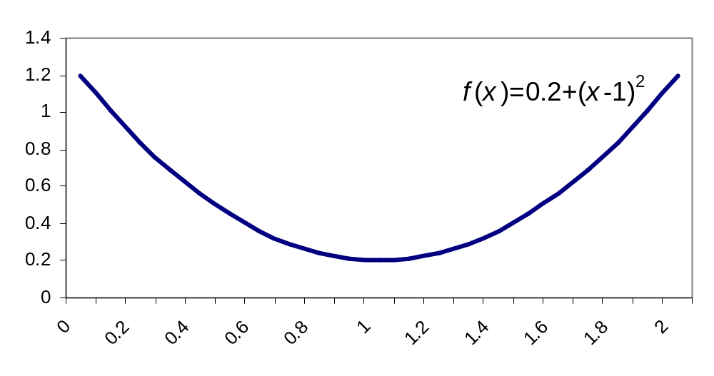
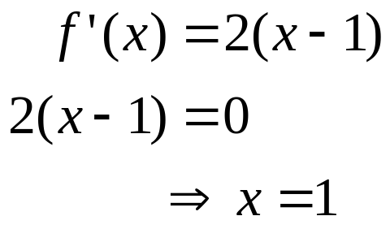
Quadratic Programming

Slide 54

General MP
Derivative being
zero is a necessary
but not sufficient
condition

Slide 55

Constrained Problem?

Slide 56
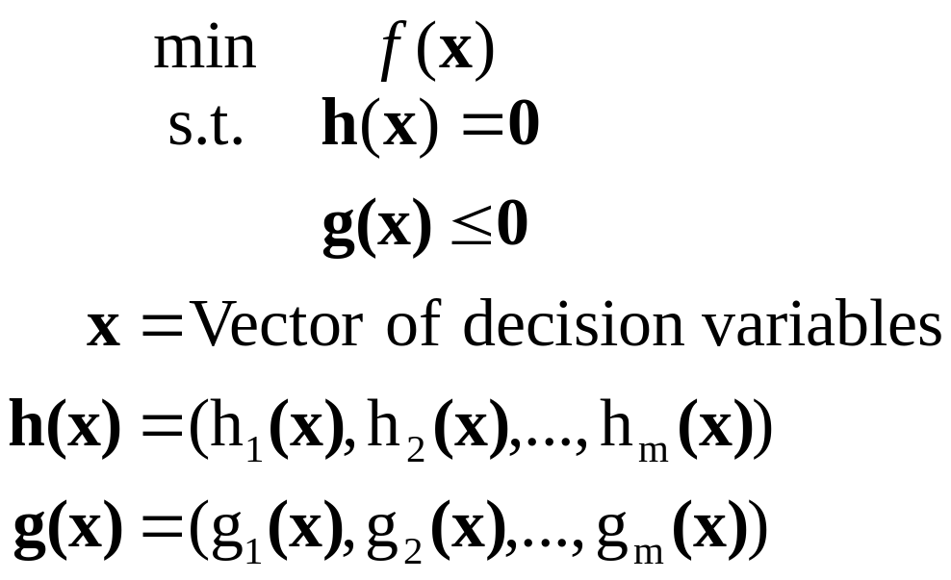
General MP
We write a general mathematical program in
matrix notation as:

Slide 57
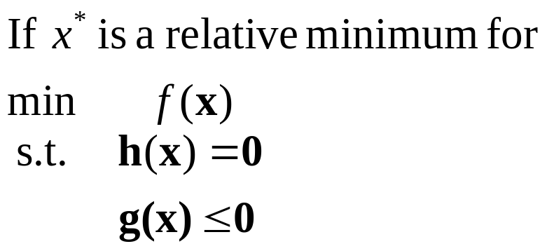


Karush-Kuhn-Tucker (KKT) Conditions

Slide 58
Convex Sets
A set C is convex if any line connecting two points in the
set lies completely within the set, that is,
Convex
Not Convex

Slide 59
Convex Hull
The convex hull co(S) of a set S is the intersection of all convex sets containing S
A set V ∈ R^{n} is a linear variety if

Slide 60
Hyperplane
A hyperplane in R^{n} is a (n-1)-dimensional variety
Hyperplane in R²
Hyperplane in R³

Slide 61
Convex Hull Example
Closets points in
convex hulls
Play
No Play
Humidity
d
c
Separating hyperplane
bisects closest points
Temperature

Slide 62

Finding the Closest Points
Formulate as QP:

Slide 63
Support Vector Machines
Support Vectors
Play
No Play
Humidity
Separating
Hyperplane
Temperature

Slide 64

Example

Slide 65

Separating Hyperplane

Slide 66


Assume Separating Planes
Constraints:
Distance to each plane:

Slide 67

Optimization Problem

Slide 68

How Do We Solve MPs?

Slide 69

Improving Search
Direction-step approach
Search direction
Current Solution
New Solution
Step size

Slide 70


Steepest Descent
Search direction equal to negative gradient
Finding λ is a one-dimensional optimization problem of minimizing

Slide 71


Newton’s Method
Taylor series expansion
The right hand side is minimized at

Slide 72

Discussion
Computing the inverse Hessian is difficult
  Quasi-Newton
  Conjugate gradient methods
Does not account for constraints
  Penalty methods
  Lagrangian methods, etc.

Slide 73

Non-separable
Add an error term to the constraints:

Slide 74

Wolfe Dual
Only place
data appears
Simple
constraints

Slide 75


Extension to Non-Linear
Kernel functions
Mapping
Takes place of
dot product in
Wolfe dual
High dimensional
Hilbert space

Slide 76

Some Possible Kernels

Slide 77
In Weka
Weka.classifiers.smo
Support vector machine for nominal data only
Does both linear and non-linear models

Slide 78
Optimization in DM
Optimization
Mathematical
Programming
Combinatorial
Optimization
Support
Vector
Machines
Steepest
Descent
Search
Genetic
Algorithm
Classification,
Clustering,
etc
Neural Nets,
Bayesian Networks
(optimize parameters)
Feature selection
Classification
Clustering

Slide 79
Bayesian Classification
Naïve Bayes assumes independence between attributes
  Simple computations
  Best classifier if assumption is true
Bayesian Belief Networks
  Joint probability distributions
  Directed acyclic graphs
    Nodes are random variables (attributes)
    Arcs represent the dependencies

Slide 80

Example: Bayesian Network
Lung Cancer depends on Family History and Smoker
Family History
Smoker
Lung Cancer
Emphysema
Positive X-Ray
Dyspnea
Lung Cancer is conditionally independent of
emphysema. given Family History and Smoker

Slide 81

Conditional Probabilities
Random
variable
Outcome of the
random variable
The node representing
the class attribute is
called the output node

Slide 82
How Do we Learn?
Network structure
  Given/known
  Inferred or learned from the data
Variables
  Observable
  Hidden (missing values / incomplete data)

Slide 83
Case 1: Known Structure and Observable Variables
Straightforward
Similar to Naïve Bayes
Compute the entries of the conditional probability table (CPT) of each variable

Slide 84

Case 2: Known Structure and Some Hidden Variables
Still need to learn the CPT entries
Let S be a set of s training instances
Let w_{ijk} be the CPT entry for variable Y_{i}=y_{ij} having parents U_{i}=u_{ik}.

Slide 85



CPT Example

Slide 86

Objective
Must find the value of
The objective is to maximize the likelihood of the data, that is,
How do we do this?

Slide 87


Non-Linear MP
From training data
Compute gradients:
Move in the direction of the gradient
Learning rate

Slide 88
Case 3: Unknown Network Structure
Need to find/learn the optimal network structure for the data
What type of optimization problem is this?
Combinatorial optimization (GA etc.)

