Slide 1
House Price Prediction
Group 8
Venkata Reddy Attala 700770541
VinayDeep Reddy Ambati
Rajesh
Prathusha

Slide 2
Overview
The "House Price Prediction" project aims to develop a model that can accurately predict housing prices based on various features.
This prediction task is of great significance in real estate and finance, enabling informed decision-making for buyers, sellers, and investors.
By employing machine learning algorithms and a curated dataset, this project provides a powerful tool for estimating house prices.

Slide 3
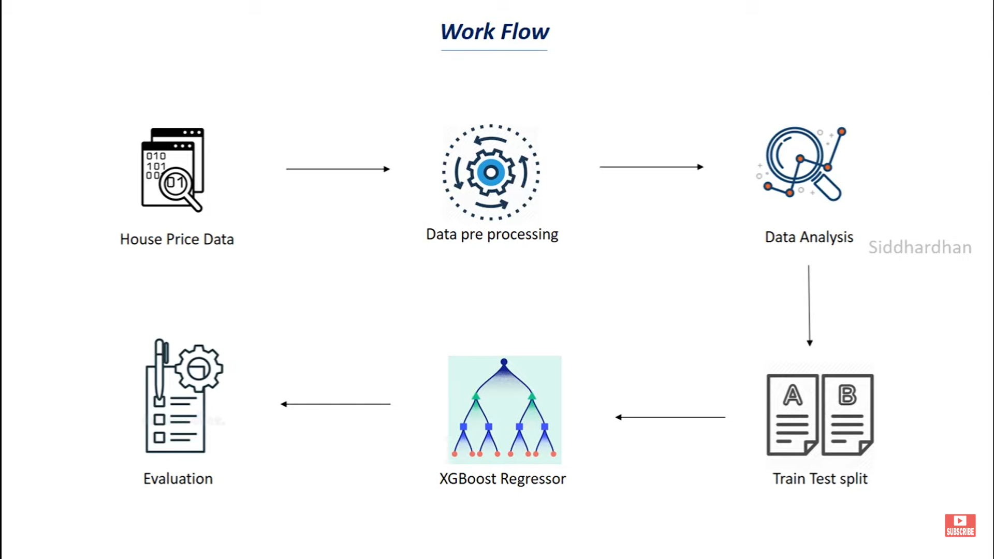
Flow

Slide 4
House Price Data
The project utilizes the "California Housing" dataset
The dataset contains features such as house age, number of rooms, population, and median income.
Using Pandas, the data is processed and transformed to ensure it is suitable for analysis.

Slide 5
Data Processing
The project employs data visualization techniques to gain insights into the dataset.
Matplotlib and Seaborn are utilized to create visualizations such as histograms, scatter plots, and correlation matrices.
These visualizations provide a deeper understanding of the relationships between features and help identify trends and patterns.

Slide 6
Data Analysis
To evaluate the performance of the regression model, the project employs the train-test split technique.
The dataset is split into training and testing subsets, ensuring that the model is trained on a portion of the data and evaluated on unseen data.
This allows for an accurate assessment of the model's predictive capabilities.

Slide 7
Train Test Split
To evaluate the performance of the regression model, the project employs the train-test split technique.
The dataset is split into training and testing subsets, ensuring that the model is trained on a portion of the data and evaluated on unseen data.
This allows for an accurate assessment of the model's predictive capabilities.

Slide 8
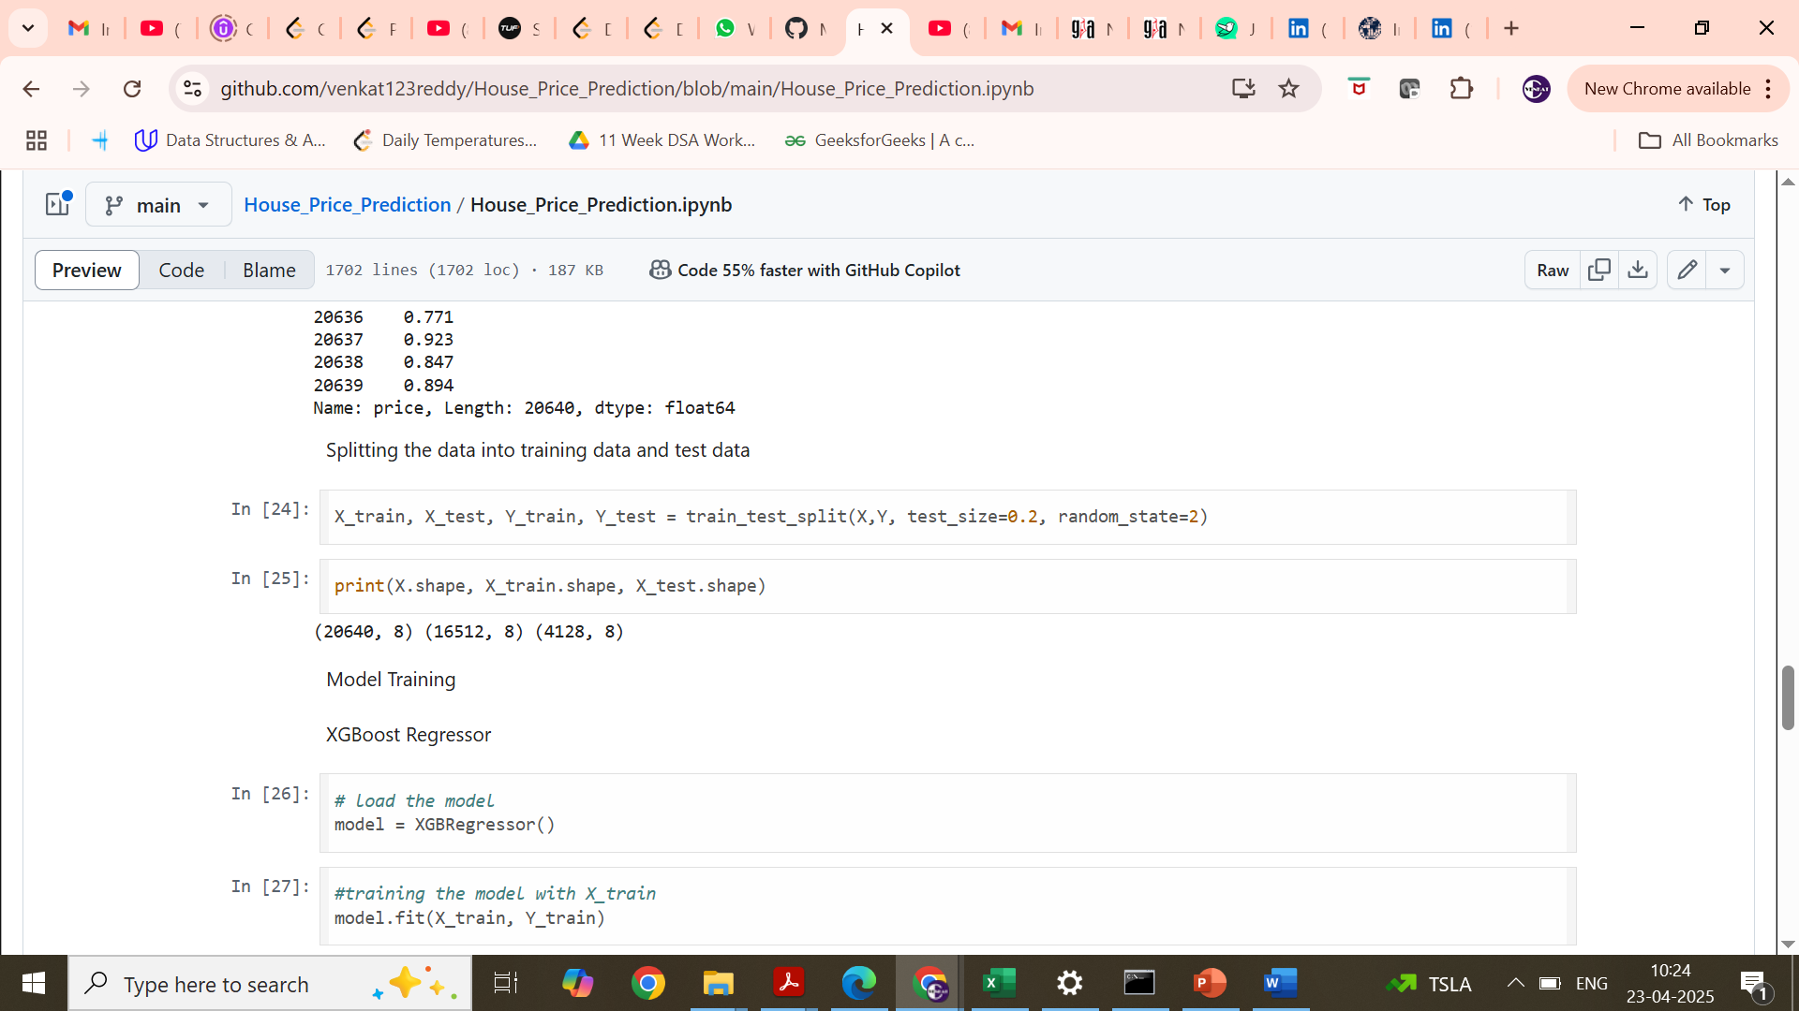
Train Test Split

Slide 9
XG Boost Regressor
The project utilizes the XGBoost algorithm, a popular gradient boosting framework, to build the regression model.
XGBoost is known for its ability to handle complex relationships between features and achieve high predictive accuracy.
The Scikit-learn library provides an implementation of XGBoost that is utilized in this project.

Slide 10
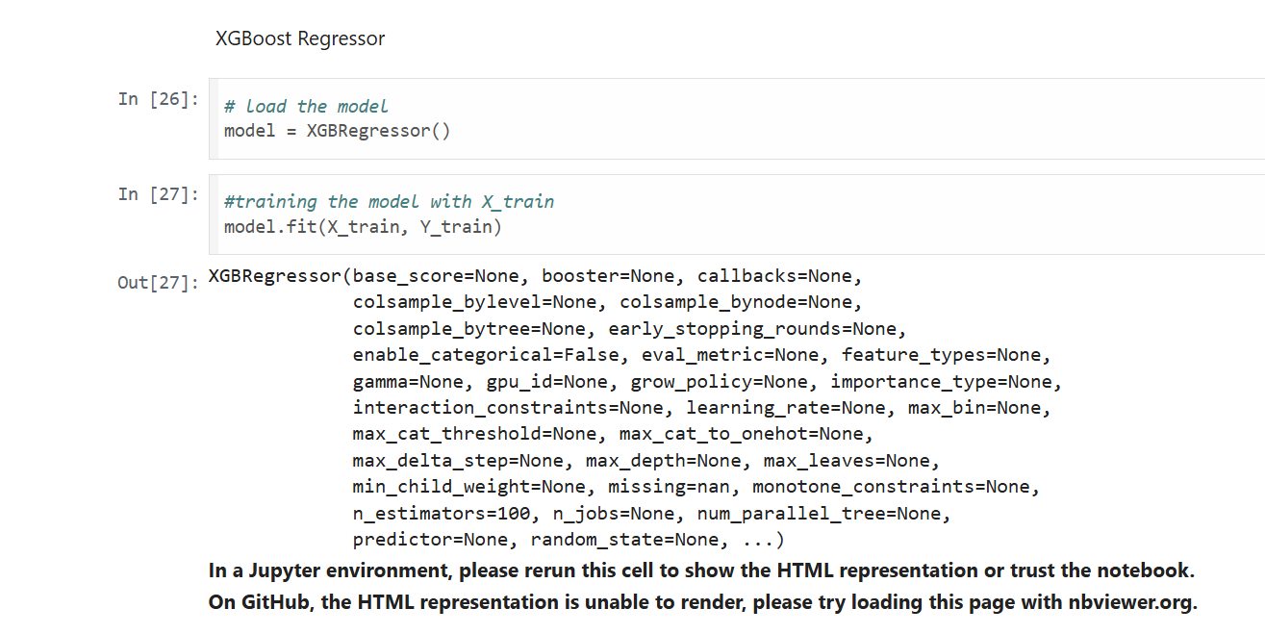
XG Boost Regressor

Slide 11
Evalaution
The project assesses the performance of the regression model using evaluation metrics such as R-squared error and mean absolute error. R-squared error measures the proportion of the variance in the target variable that can be explained by the model, while mean absolute error quantifies the average difference between the predicted and actual house prices.
These metrics provide insights into the model's accuracy and precision. Additionally, a scatter plot is created to visualize the predicted prices against the actual prices.

Slide 12
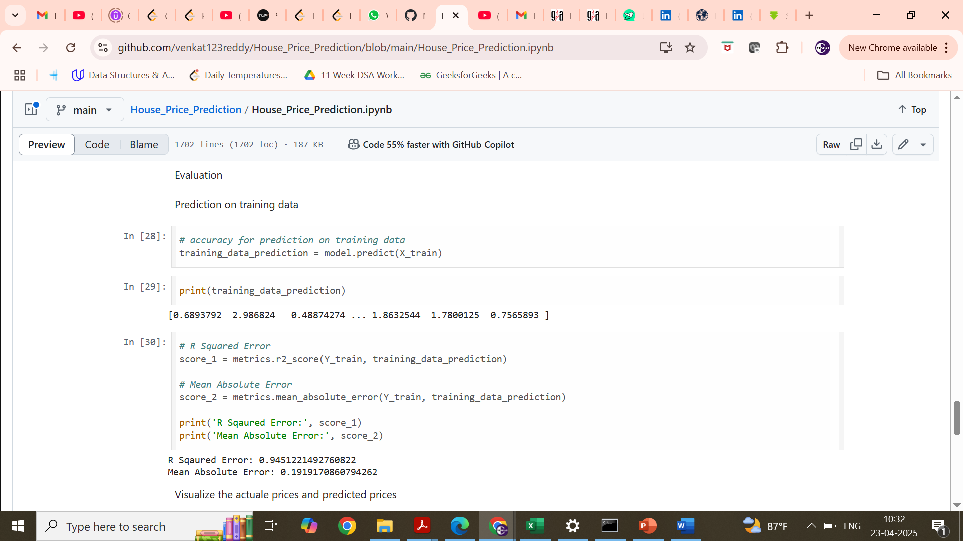
Evalaution

Slide 13
Conclusion
The "House Price Prediction" project provides a practical solution for estimating housing prices based on various features.
By leveraging data collection, preprocessing, visualization, XGBoost regression modeling, and model evaluation, this project offers a comprehensive approach to addressing the price prediction task.
The project utilizes the "California Housing" dataset from Scikit-learn, ensuring a reliable and widely accessible data source.

