Slide 1
Mini Project
Deep Learning Anti-Fraud Model for Internet Loan
Name: Venkata Sai Prasad Nakka
Student ID: 700755524
Link: Reasearch paper
GitHub Link:
Deep Learning Anti-Fraud Model for Internet Loan

Slide 2
Motivation
Financial fraud, especially in internet loans, is a growing concern.
Traditional fraud detection methods are often ineffective against evolving threats.
Deep learning provides a promising solution for detecting fraudulent activities.
This study explores the advancements and challenges in AI-driven fraud detection.

Slide 3
Problem Statement
Internet loan fraud is increasing, causing significant financial losses.
Traditional rule-based fraud detection systems are inadequate.
There is a need for scalable and efficient AI-driven fraud detection methods.
Understanding deep learning's role in combating fraud is crucial.

Slide 4
Objectives
Analyze the effectiveness of deep learning in fraud detection.
Evaluate various AI models used for internet loan fraud detection.
Identify key datasets and performance metrics used in research.
Discuss the challenges and future directions in deep learning-based fraud detection.

Slide 5
Methodology Applied/Main Idea
Deep Learning Techniques: Supervised and unsupervised learning for fraud detection.
Use of neural networks, including CNNs, RNNs, and hybrid models.
Feature engineering and data preprocessing to improve model accuracy.
Comparison of deep learning models with traditional fraud detection methods.

Slide 6
Results/Findings
Deep learning models demonstrate superior fraud detection capabilities.
AI techniques provide higher accuracy in identifying fraudulent activities.
Hybrid models combining deep learning and traditional methods yield better results.
Challenges include data privacy, adversarial attacks, and computational costs.

Slide 7
References
Fang, W., Li, X., Zhou, P., Yan, J., Jiang, D., & Zhou, T. (2021).
Deep Learning Anti-Fraud Model for Internet Loan: Where We Are Going.
Published in IEEE Access.
Supported by the National Natural Science Foundation of China and other institutions.

Slide 8
Summary Report
The rapid growth of internet-based lending platforms has led to an increase in financial fraud, posing significant risks to financial institutions and consumers. Traditional fraud detection methods, which rely on rule-based systems and conventional machine learning models, struggle to keep up with the sophisticated tactics employed by fraudsters. This paper explores how deep learning techniques can enhance fraud detection in internet loan transactions by leveraging advanced pattern recognition and anomaly detection capabilities.
The authors review various deep learning models applied to fraud detection, including Convolutional Neural Networks (CNNs), Recurrent Neural Networks (RNNs), and hybrid architectures. These models analyze vast amounts of transactional data to identify suspicious behaviors that traditional methods might overlook. The study also highlights the importance of feature engineering, data preprocessing, and the integration of explainable AI techniques to improve model interpretability and regulatory compliance.
Key findings from the paper indicate that deep learning-based fraud detection systems outperform conventional approaches in accuracy and adaptability. However, challenges such as data privacy concerns, adversarial attacks, and high computational costs must be addressed to ensure widespread adoption. The study emphasizes the need for continuous innovation and collaboration between financial institutions and AI researchers to develop robust, scalable, and explainable fraud detection frameworks.
Conclusion:
In conclusion, the paper provides a critical assessment of the current state and future directions of deep learning in combating internet loan fraud. By incorporating cutting-edge AI methodologies, financial institutions can significantly enhance their fraud detection capabilities, ensuring greater security and trust in online lending platforms.

Slide 9
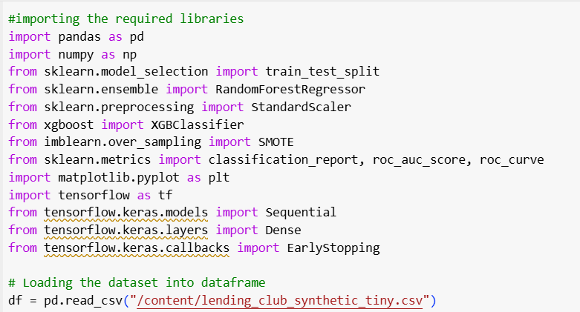
Reproduction of the experiment
Importing the data sets and data for the experiment

Slide 10
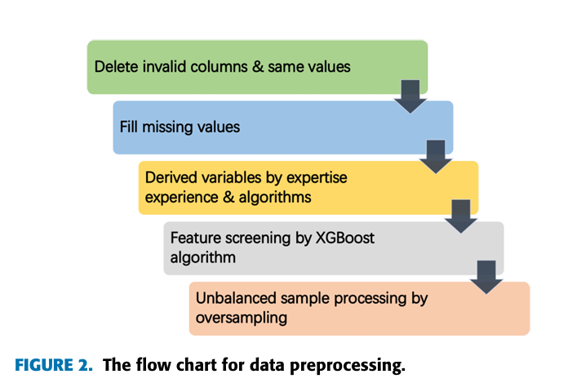
Data Processing procedure

Slide 11
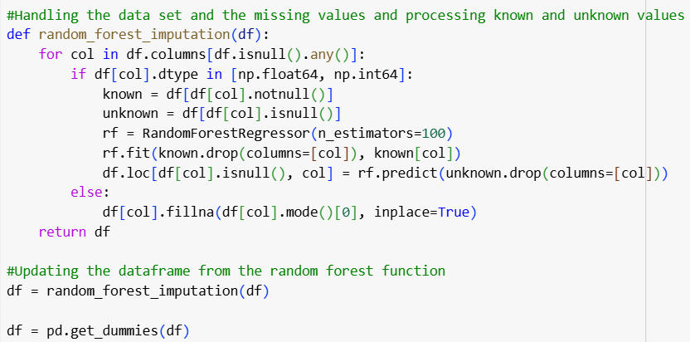
Reproduction of the experiment
Handling the data set and processing the data

Slide 12
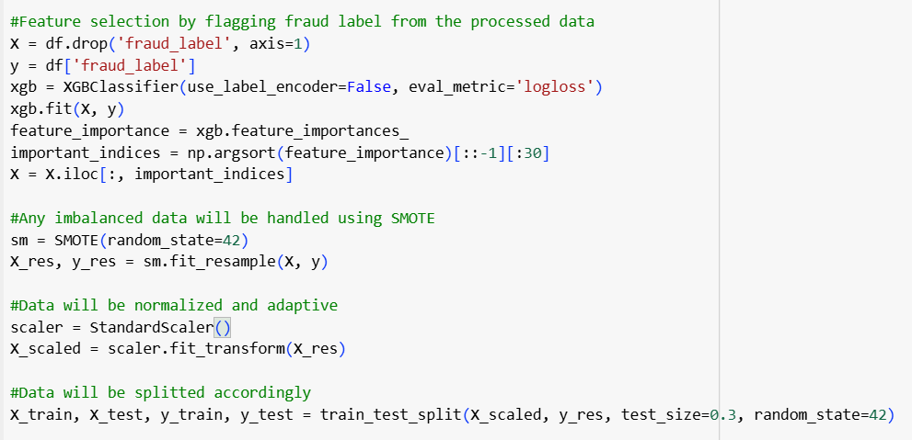
Reproduction of the experiment
Feature selection and data handling such as flagging and scaling the data

Slide 13
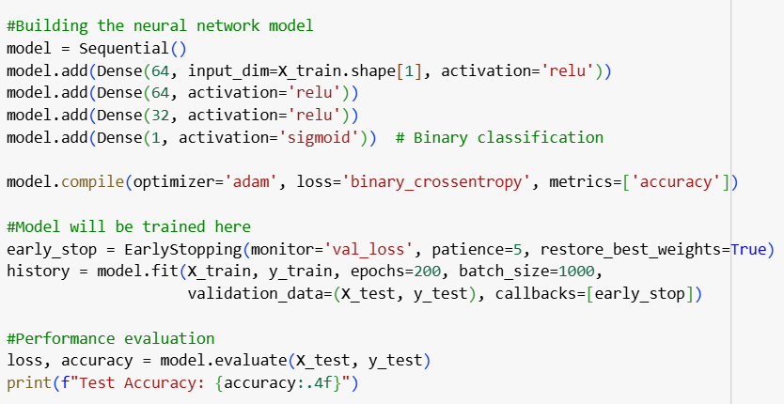
Reproduction of the experiment
Building the neural network and adding the performance evaluation

Slide 14
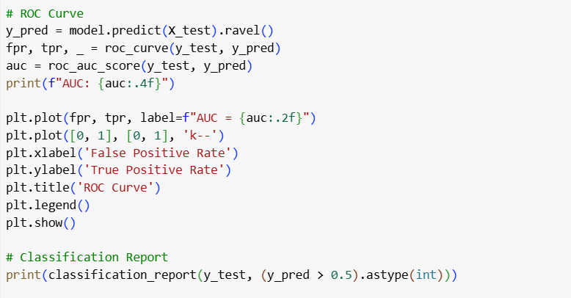
Reproduction of the experiment
ROC curve and report classification

Slide 15
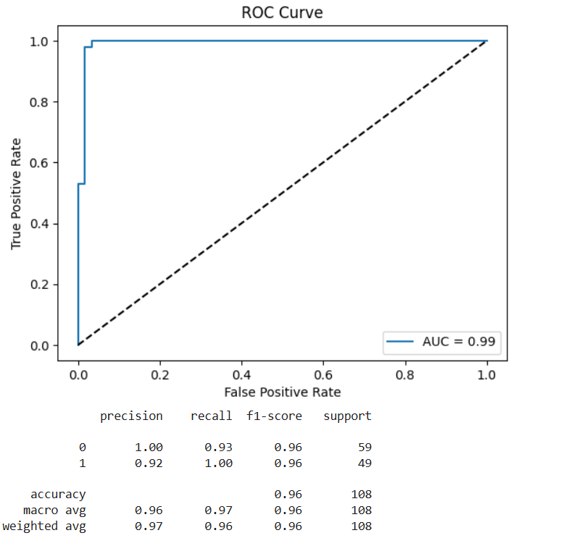
ROC curves for datasets
ROC curve for dataset 1

Slide 16
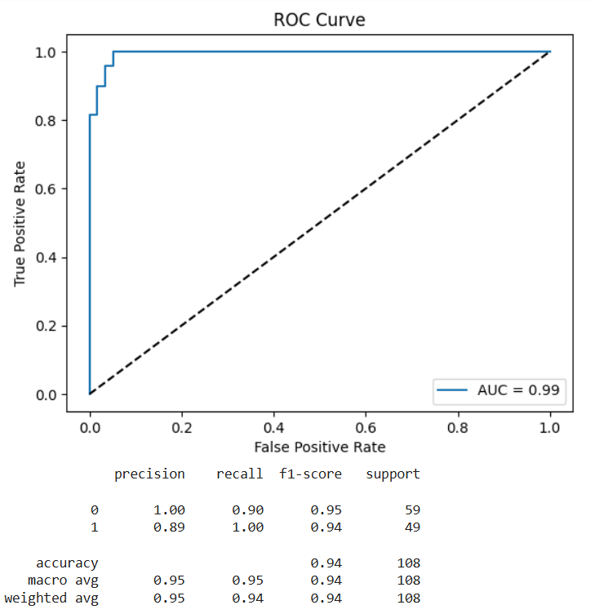
ROC curves for datasets
ROC curve for dataset 2

