Slide 1

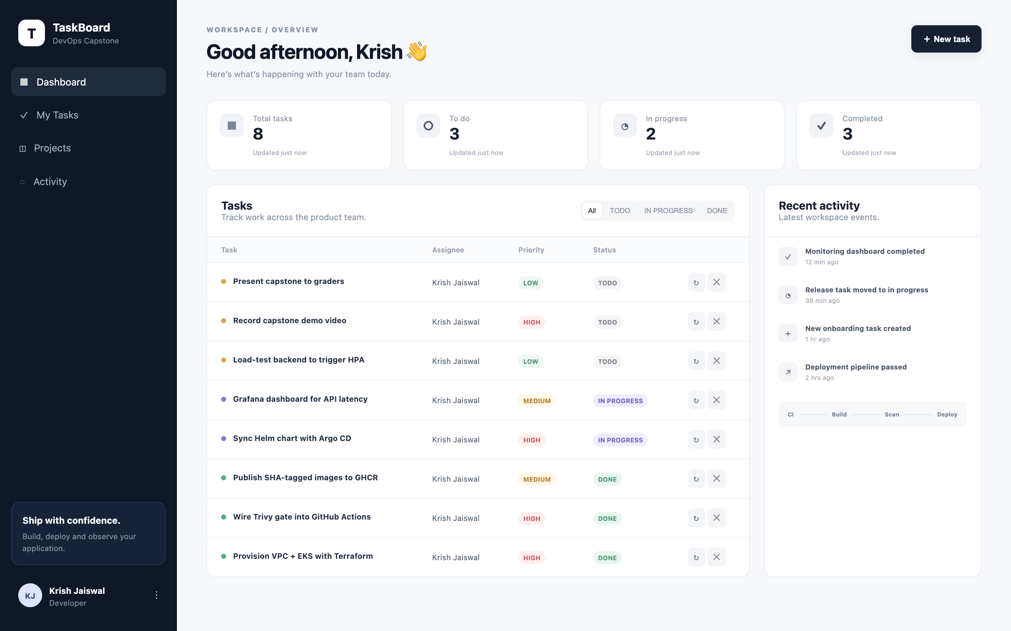
TaskBoard
DEVSECOPS CAPSTONE
Shipping a full-stack app from a laptop to a secured, monitored, autoscaled Kubernetes cluster on AWS
React · FastAPI · PostgreSQL · Docker · GitHub Actions · Trivy · Terraform · EKS · Helm · Argo CD · Prometheus · Grafana
Krish Jaiswal · October 2026
Notes:
Introduce yourself and the goal: not a tool tour, but one real application carried through every DevOps layer — tests, containers, CI/CD, security scanning, infrastructure as code, Kubernetes, GitOps and monitoring. Everything you will see in the demo is automated end to end.

Slide 2
One app, every layer automated
TaskBoard is a SaaS-style task manager: a React dashboard, a FastAPI REST API and PostgreSQL.
The point is the journey: every commit is tested, built into a non-root image, scanned for CVEs, published with its commit SHA, deployed by Helm, synced by Argo CD and observed in Grafana.
16
0
pytest tests passing on an isolated in-memory DB
fixable HIGH / CRITICAL CVEs in both images (Trivy)
61
2 → 4
AWS resources in the Terraform plan (VPC + EKS)
backend pods, autoscaled by the HPA under load
Notes:
Four numbers summarise the project. 16 automated tests gate every build. Both images are free of fixable high and critical vulnerabilities. Terraform plans 61 AWS resources. And under a load test the autoscaler really did scale the API from 2 to 4 pods.

Slide 3
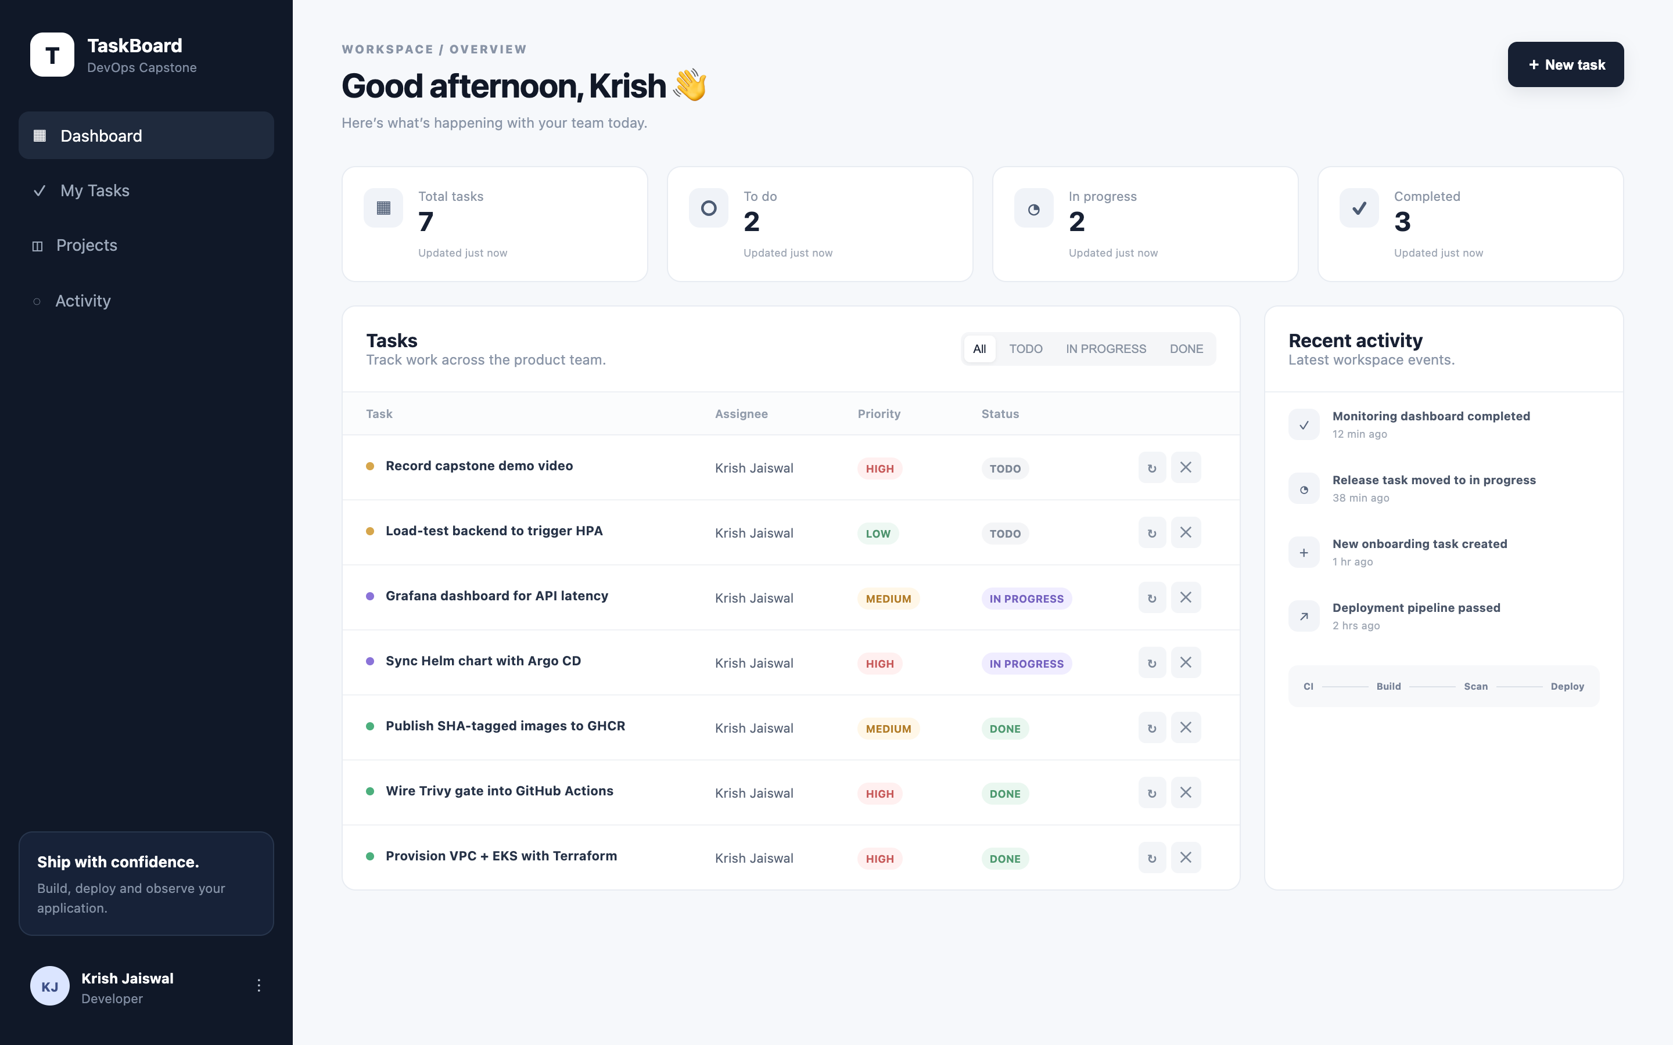
The application: React + FastAPI + PostgreSQL
GET
/api/tasks
list, newest first
GET
/api/tasks/{id}
one task (404 if missing)
POST
/api/tasks
create, validated
PUT
/api/tasks/{id}
partial update
DELETE
/api/tasks/{id}
remove (204)
GET
/api/tasks/stats
KPI card counts
GET
/health · /ready · /metrics
probes + Prometheus
Schema owned by Alembic · migrations advisory-locked so replicas can't race
Notes:
Show the dashboard: KPI cards from the stats endpoint, the filterable task table, advancing status with PUT, deleting with DELETE, creating with the modal. On the right are the REST endpoints — more than the four required. The table is created by an Alembic migration; because every pod runs migrations at start-up, I added a Postgres advisory lock so two pods starting together queue instead of racing.

Slide 4








Tech stack
Application
Quality
Containers
CI/CD
React 19 · Vite 8
FastAPI · SQLAlchemy 2.1
PostgreSQL 16 · Alembic
pytest 9 · TestClient
in-memory SQLite
16 tests, 7 endpoints
multi-stage Dockerfiles
non-root (uid 10001 / 101)
Docker Compose
GitHub Actions
GHCR, SHA-tagged images
kind smoke deploy
Security
Infrastructure
Delivery
Observability
Trivy 0.75 image gate
Pod Security Admission
dropped capabilities
Terraform · AWS VPC
EKS 1.35 · node group
EBS CSI · Pod Identity
Helm chart · Traefik Ingress
HPA · metrics-server
Argo CD (GitOps)
Prometheus Operator
ServiceMonitor
Grafana dashboard
Notes:
The stack, grouped by job. Everything is pinned: Python and npm dependencies, base images, Terraform providers via the lock file, and the Trivy version.

Slide 5



Architecture
Developer
AWS ap-south-1 · VPC 10.20.0.0/16 · EKS 1.35 (Terraform)
git push
Argo CD
syncs chart from Git
GitHub
frontend × 2
main branch
/
Nginx + React
Traefik Ingress
AWS load balancer
GitHub Actions
test · build · scan
backend × 2–6
PostgreSQL
/api
FastAPI · HPA
PVC on EBS gp3
Private subnets run the nodes; public subnets hold the NAT gateway and load balancer.
GHCR
scrapes /metrics
image:<git-sha>
Prometheus
Grafana
Notes:
Left: the delivery chain from a git push to an image in GHCR tagged with the commit SHA. Right: what Terraform builds in AWS — a VPC with public and private subnets and an EKS cluster. Inside, Traefik routes slash to the React frontend and slash-api to FastAPI; FastAPI talks to PostgreSQL on an EBS volume. Prometheus scrapes the API's metrics and Grafana visualises them. Argo CD keeps the cluster in sync with Git.

Slide 6

CI/CD: four gated stages on every push to main
1 Test
2 Image
3 Deploy test
4 GitOps
pytest -v (16 tests)
npm ci && vite build
build per component
Trivy HIGH/CRITICAL gate
push to GHCR :<sha>
ephemeral kind cluster
helm upgrade --install
full CRUD smoke test
write <sha> into
values-prod.yaml
[skip ci] commit
Fails when any test fails
Fails when a fixable CVE is found
Fails when pods aren't Ready or an API call fails
→ Argo CD syncs EKS
Image tag = commit SHA, never latest ghcr.io/venkat1701/taskboard-backend:<sha> → git show <sha>
Notes:
Walk the pipeline. Stage one is the quality gate. Stage two builds each image once, scans it with Trivy and only then pushes to GHCR — pull requests run this without pushing. Stage three proves the Helm chart actually deploys: a throwaway kind cluster pulls the new images and a smoke test exercises create, read, update and delete. Stage four records the new tag in Git so Argo CD rolls it out. Tags are the commit SHA, so every running pod is traceable to source.

Slide 7

DevSecOps: Trivy blocked our first build, and was right
Fixable HIGH/CRITICAL findings
The CVE we explained
urllib3 CVE-2026-97687 (HTTPS-proxy traffic interception) plus msgpack and setuptools findings — none were our dependencies. They were vendored inside pip, which the API never runs in production.
backend image
4
0
Backend: multi-stage build, venv copied into a clean image with pip removed
frontend image
44
Frontend: apk upgrade on the unprivileged Nginx base cleared 44 fixed Alpine CVEs
0
--ignore-unfixed keeps the gate actionable: fail only when a fix exists
First scan
After fixes
Notes:
This is the CVE explanation the rubric asks for. The first scan failed: four high findings in the backend and forty-four in the frontend. The backend ones were urllib3, msgpack and setuptools — but they live inside pip's own vendored copy, not in our application. Since the API never installs anything at runtime, the right fix was to remove pip from the runtime image. The frontend findings were Alpine packages that already had fixes, so upgrading packages in the runtime stage cleared them. Both images now pass with zero fixable high or critical vulnerabilities. Also: an older Trivy reported a phantom pcre2 issue that wasn't in the image — keep scanners current.

Slide 8


Containers: small, non-root, health-gated
docker compose up --build
backend image
frontend image
351 MB
112 MB
postgres
pg_isready → healthy
python:3.12-slim → deps into /opt/venv
clean runtime stage: apt upgrade, no pip
runs as appuser (uid 10001)
HEALTHCHECK on /health
alembic upgrade head → uvicorn
node:22-alpine → npm ci && vite build
nginx-unprivileged:1.29-alpine runtime
runs as nginx (uid 101) on :8080
BACKEND_URL rendered by envsubst
SPA fallback + /api reverse proxy
backend
migrations + /health → healthy
frontend
Nginx :8080 → healthy
depends_on: condition: service_healthy — no start-up races
Notes:
Both Dockerfiles are multi-stage, so build tooling never ships. Both run as non-root users; the frontend uses the unprivileged Nginx image listening on 8080 so it doesn't need root to bind a port. Compose starts services in order using health checks, so the backend never runs migrations against a database that isn't accepting connections yet.

Slide 9
Terraform: VPC + EKS as code
VPC 10.20.0.0/16 · ap-south-1
61
resources to add
0 to change, 0 to destroy
(terraform plan)
ap-south-1a
ap-south-1b
public 10.20.101.0/24
NAT gateway · load balancer
public 10.20.102.0/24
load balancer
Why these choices
EKS 1.31 is no longer offered; 1.35 is in standard support
AL2 AMIs don't exist for ≥ 1.33 → AL2023 nodes
EBS CSI driver, or the Postgres PVC never binds
metrics-server, or the HPA has no CPU data
Single NAT gateway ≈ $0.27/h total: apply, demo, destroy
private 10.20.1.0/24
EKS worker node (t3.medium, AL2023)
private 10.20.2.0/24
EKS worker node (t3.medium, AL2023)
EKS 1.35 control plane · add-ons: vpc-cni, coredns, kube-proxy, pod-identity, metrics-server, EBS CSI
Notes:
Terraform creates the VPC with two public and two private subnets across two availability zones, a NAT gateway, and an EKS cluster with a managed node group. The original code would not have worked: the HCL was not even parseable, and EKS 1.31 is no longer offered. I also added the EBS CSI driver — without it the database volume never binds — and metrics-server for the autoscaler. terraform plan shows 61 resources. Credentials come from the AWS CLI, never from files, and terraform destroy tears it all down.

Slide 10



Kubernetes + Helm: one chart, every environment
Deployments
$ kubectl get pods -n taskboard
NAME READY STATUS
taskboard-…-backend-7b8c…-k26s6 1/1 Running
taskboard-…-backend-7b8c…-x2vst 1/1 Running
taskboard-…-frontend-759b…-hgsvz 1/1 Running
taskboard-…-frontend-759b…-zcdhz 1/1 Running
taskboard-…-postgres-66ff…-w6rh7 1/1 Running
$ kubectl get ingress -n taskboard
CLASS HOSTS PATHS
traefik taskboard.localhost /api → backend, / → frontend
$ helm list -n taskboard
taskboard rev 3 deployed taskboard-1.1.0
backend 2–6 (HPA) · frontend 2 · probes: startup, /ready, /health
Hardened pods
runAsNonRoot, seccomp RuntimeDefault, no privilege escalation, caps dropped
PostgreSQL
Recreate strategy for RWO volume, PGDATA subdir, PVC kept on uninstall
Ingress + HPA
Traefik routes / and /api; HPA on 60 % CPU, Deployment omits replicas
Notes:
The Helm chart deploys backend, frontend and Postgres with ClusterIP services, an Ingress that routes slash to the frontend and slash-api to the backend, and an autoscaler. Values files switch between local k3d, dev and production. Pods run hardened under Pod Security Admission. Two subtle fixes: Postgres uses the Recreate strategy because a ReadWriteOnce volume can't be attached to two pods during a rolling update, and the backend Deployment omits replicas while the HPA is on, so Helm and Argo CD don't fight the autoscaler. I used Traefik because the community ingress-nginx project was retired in March 2026.

Slide 11

GitOps with Argo CD: Git is the source of truth
git push
CI passes
tag commit
Argo CD sync
EKS rolls out
developer commits to main
tests, Trivy gate, image :<sha> in GHCR
CI writes <sha> into values-prod.yaml
detects the commit, renders the chart
new pods; old ones drain
selfHeal
prune
rollback
a manual kubectl edit is reverted to what Git says
resources deleted from Git are deleted from the cluster
git revert the tag commit; Argo CD does the rest
argocd/application.yaml · argocd/install.sh
Notes:
CI never runs kubectl against production. It records the new image tag in Git, and Argo CD, running inside the cluster, pulls that change and applies it. Self-heal reverts manual drift, prune removes deleted resources, and rollback is just a git revert. Show the Argo CD UI: the application is Synced and Healthy.

Slide 12
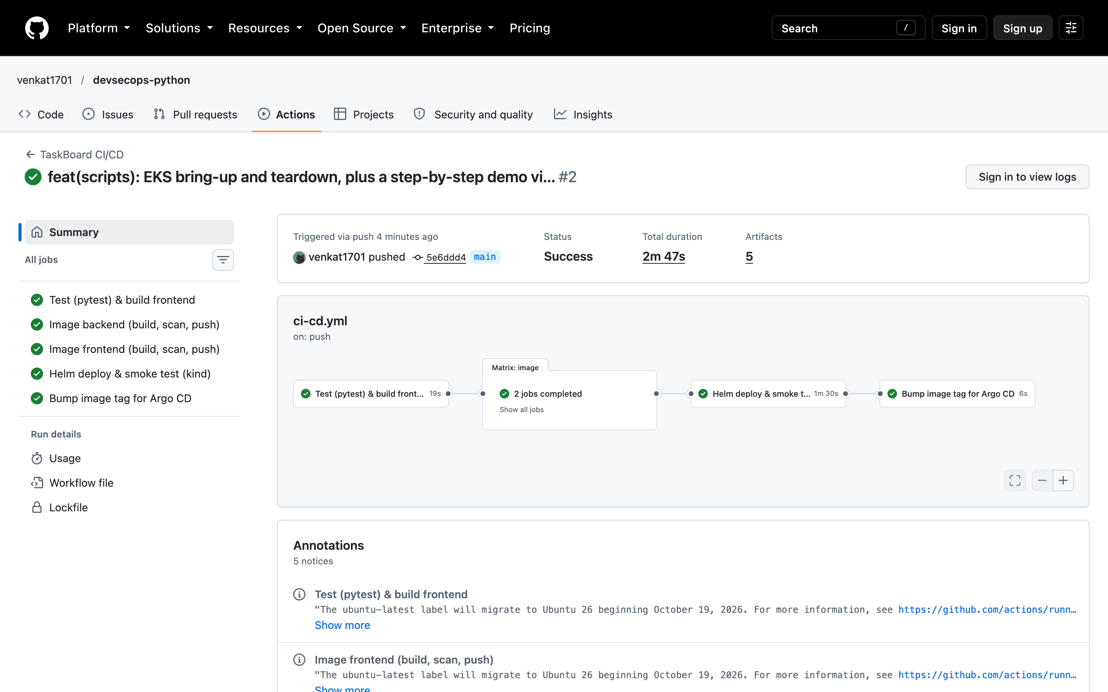
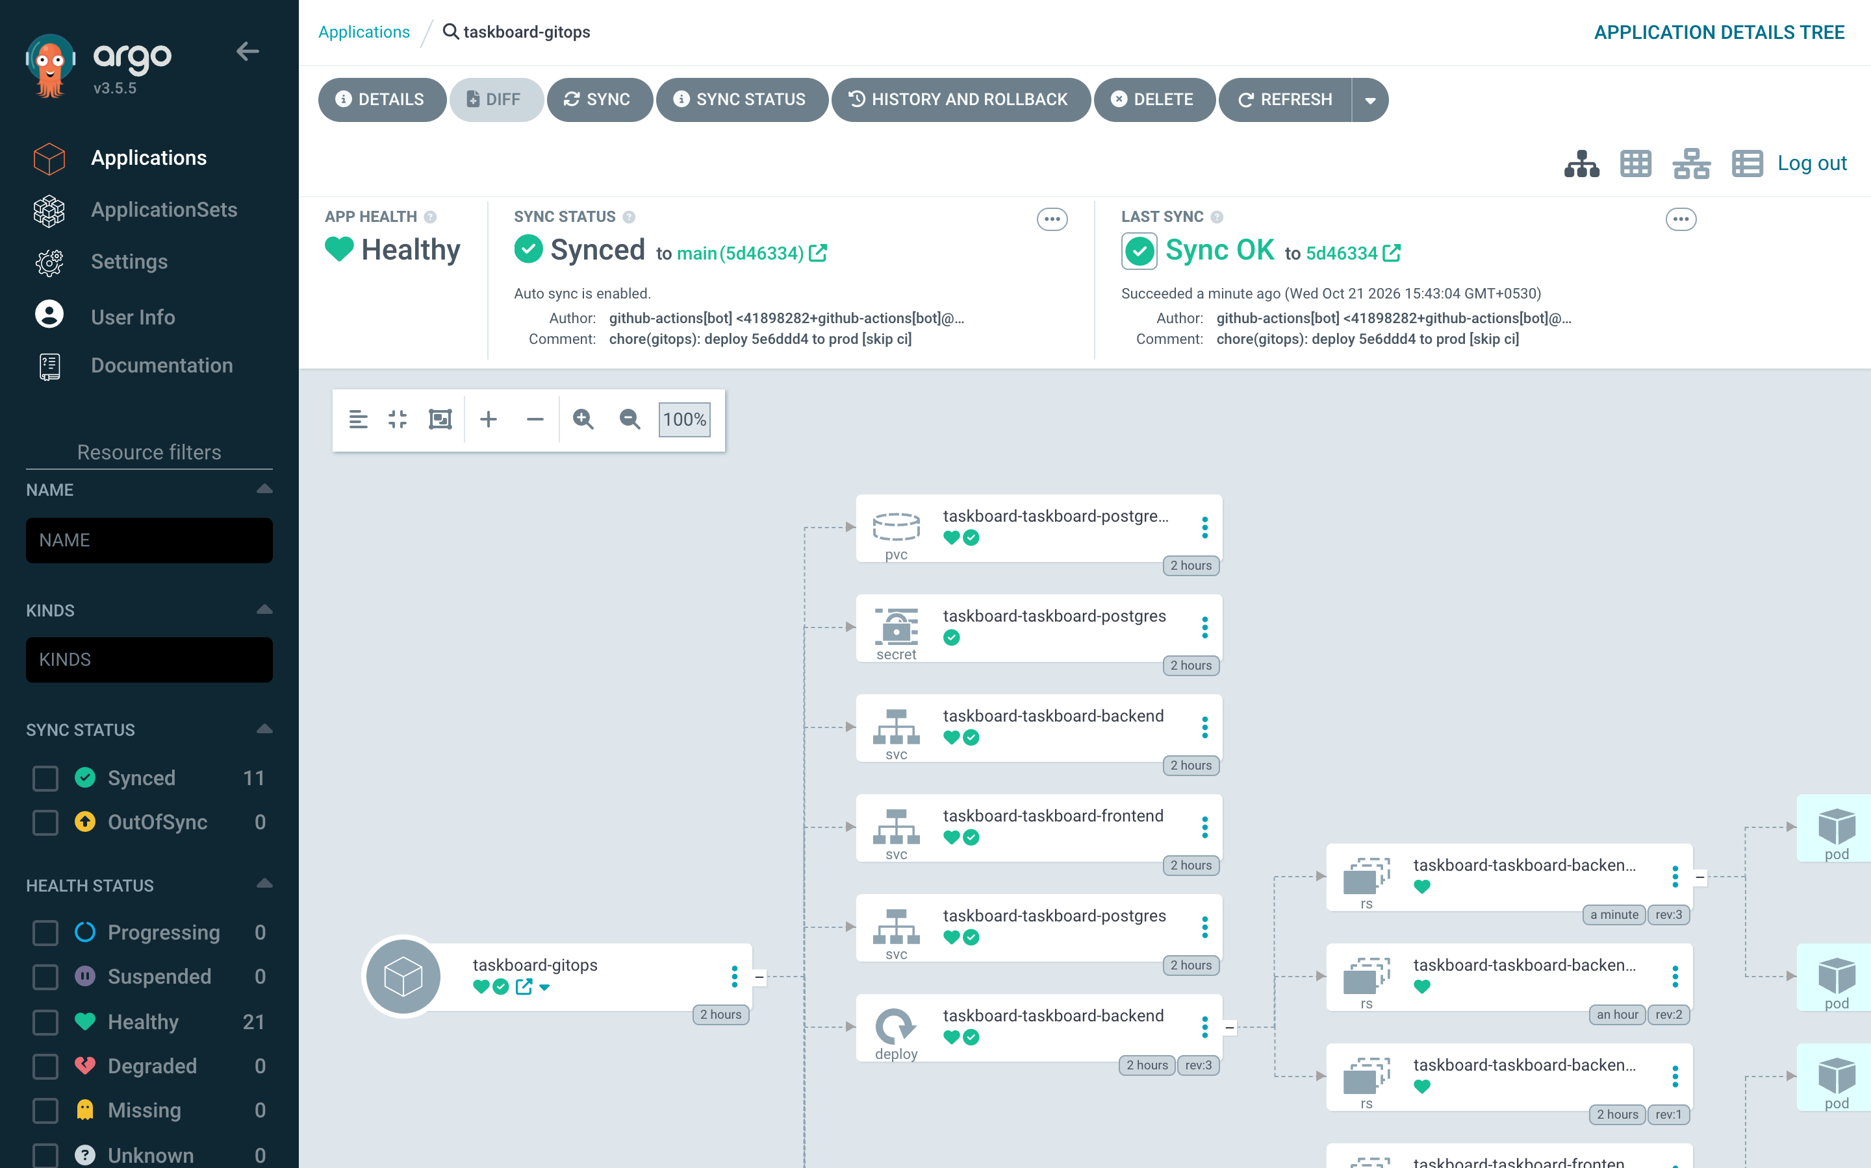
Proof: green pipeline, Argo CD in sync
GitHub Actions: all 5 jobs green; images pushed to GHCR tagged with the commit SHA
Argo CD: Synced + Healthy at the bot's chore(gitops) commit; manual scale-down reverted in ~6 s
Notes:
Real evidence from the public repo: the first pipeline run with every stage green, and Argo CD synced to the commit the pipeline wrote. The image tag in GHCR is the commit SHA. Self-heal was tested by scaling a deployment by hand; Argo CD put it back.

Slide 13
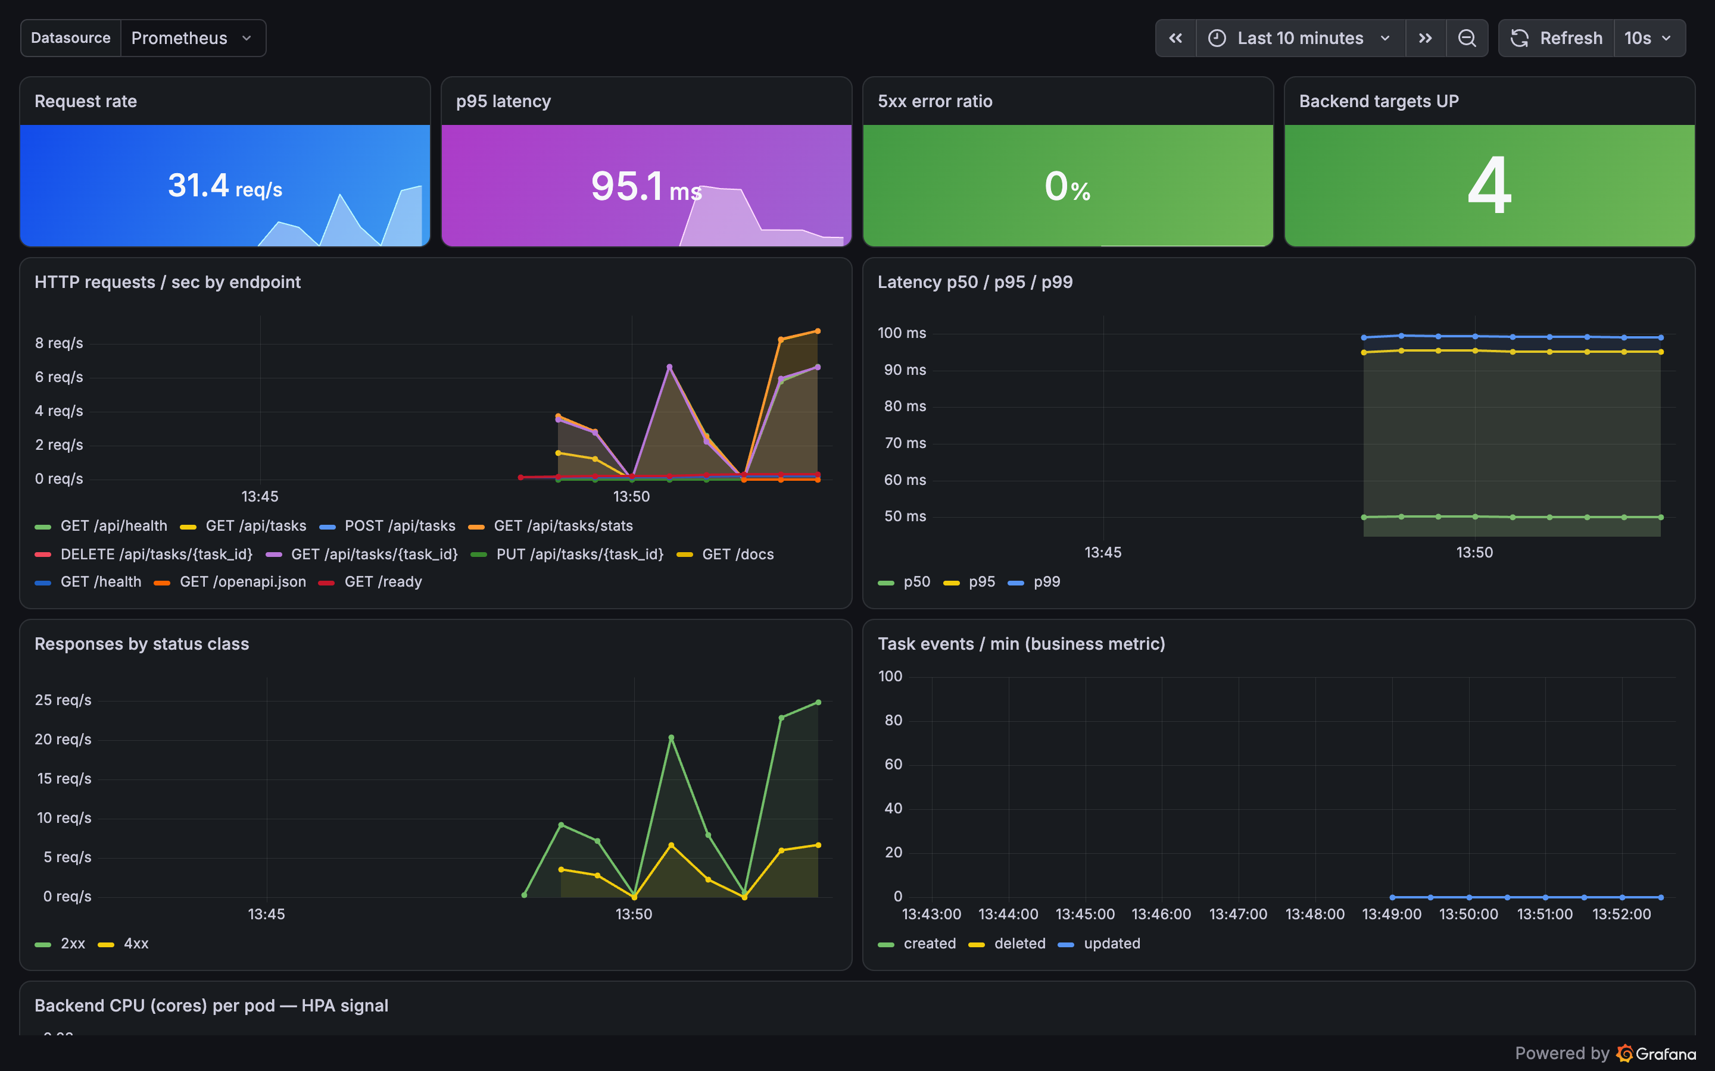
Observability: Prometheus + Grafana
/metrics
request count + latency histograms, and a business counter taskboard_task_events_total
ServiceMonitor
Prometheus Operator discovers every backend pod automatically — 4/4 targets UP after scaling
Dashboard as code
Grafana JSON ships in the Helm chart; the sidecar loads it, no clicking
Live panels: request rate, p95 latency, 5xx ratio, targets UP, per-endpoint traffic, status classes, CPU per pod
Notes:
The backend exposes Prometheus metrics. A ServiceMonitor in the Helm chart tells the Prometheus Operator to scrape every backend pod — when the autoscaler added pods, they appeared as targets automatically. The Grafana dashboard is code inside the chart, loaded by Grafana's sidecar. During the demo, run the load test and watch request rate and latency move live.

Slide 14
Autoscaling in action: 2 → 4 pods under load
2
baseline
New size: 2; replicas below Spec.MinReplicas
How it works
metrics-server reports pod CPU against the 100m request
HPA targets 60 % average utilisation, min 2, max 6
scripts/load-test.sh drives /api traffic through the Ingress
Prometheus picked up each new pod as a target with no config change
Scale-down waits 5 minutes (stabilisation window)
3
+4m45s
New size: 3; cpu utilization above target
4
+6m31s
New size: 4; cpu utilization above target
kubectl get events -n taskboard --field-selector reason=SuccessfulRescale
Notes:
These are the real HPA events from the local cluster. Under the load test, CPU crossed the 60 percent target and the autoscaler added a third and then a fourth backend pod. Show kubectl get hpa during the demo.

Slide 15
Making it work: 12 defects found and fixed
Terraform HCL did not parse
EKS 1.31 no longer offered
Ingress → wrong Service and port
multi-attribute one-line blocks
moved to 1.35 + AL2023 nodes
taskboard-backend:8080 didn't exist
Nginx proxied to host 'backend'
Pipeline never pushed to GHCR
Trivy could never fail the build
templated BACKEND_URL per environment
Docker Hub, :latest tags, 3 rebuilds
added --exit-code 1
Frontend ran Nginx as root
Init container waited forever
Create-task modal never closed
unprivileged image on :8080
pg_isready as uid 10001: pass -U/-d
React currentTarget is null after await
Postgres initdb fails on EBS
Compose start-up races
ingress-nginx retired (2026)
lost+found → PGDATA subdirectory
health-gated depends_on
switched to Traefik
Notes:
The starting repository looked complete but would not have run end to end. These are twelve concrete defects I found by actually running every layer, each with its fix. Pick two or three to tell as stories — for example the init container that waited forever because the container user had no passwd entry, or the React modal that never closed because the event's currentTarget is cleared after an await.

Slide 16


Key learnings and next steps
Learnings
Next steps
Run every layer for real; reading YAML hides broken wiring
Gates must be able to fail: a scanner without --exit-code is decoration
Liveness ≠ readiness: a DB outage should drain pods, not restart them
Pin versions and keep them current: EKS, AMIs and Ingress controllers retire
Git as the deployment API makes rollback a git revert
Amazon RDS instead of in-cluster Postgres
External Secrets + AWS Secrets Manager
cert-manager TLS on the Ingress
S3 remote state with locking for Terraform
App authentication; alerting rules in Alertmanager
Notes:
Close with what I'd take to a real team, and what I'd do next to make this production-grade.

Slide 17
Live demo
git push → GitHub Actions green
terraform plan / AWS console
Argo CD: Synced + Healthy
Pipeline run · Terraform plan · Argo CD sync · kubectl · Prometheus targets · Grafana
kubectl get pods,svc,ingress,hpa
Prometheus /targets: UP
Grafana: live panels under load
Thank you · Krish Jaiswal
Notes:
Switch to the live walkthrough in this order: push a commit and show the Actions run, then terraform plan and the AWS console, Argo CD, kubectl, Prometheus targets and Grafana with the load test running.

