Slide 1
SecurityHub Design & Implementation for AWS
Jigar Kapasi
Venkat Reddy

Slide 2
Requirements

Slide 3
Requirements for Security Hub (AWS)
Enable Multi-Account, Multi-Region deployment architecture for Security Hub
Enable CIS benchmarks in Security Hub
Integrate with Netcool-ServiceNow and post findings into ServiceNow as tickets
Define a uniform design/architecture across AWS, Azure
Cover Delta between IBM tech specs & CIS implementation of AWS
Provide for remediation of tickets
Note: More requirements to follow.

Slide 4
Reference Architecture & Proposed Changes

Slide 5



Multi-Account structure
There is an exclusive deep dive session recording available on Security Hub service
Member Account
Master Account
Member Account
Master Account
If your invitations are accepted by a member account , your account is designated as the Security Hub master account
Member Account
Added accounts are member accounts. With the master account, you can view findings in member accounts

Slide 6
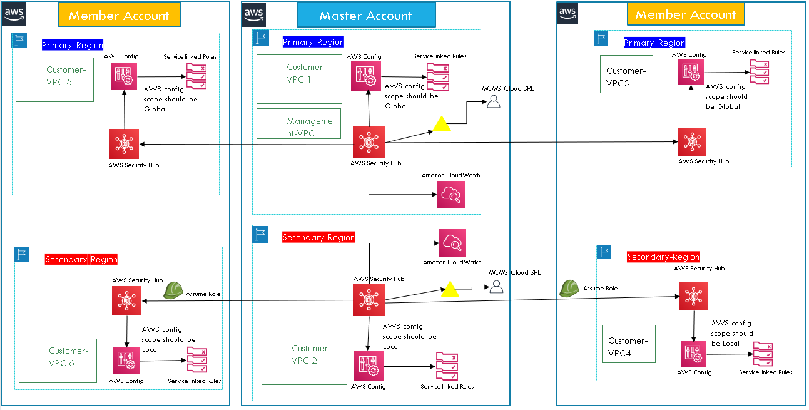
Multi-Account, Multi-Region deployment – Earlier Design

Slide 7
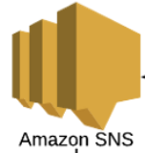
Proposed Design – AWS side Implementation Done
Region1
Member Account1
Master Account
MCMS ServiceNow/Ticketing
Assume Role
Findings
Member AccountN
MCMS Netcool (Softlayer DC)
MCMS Netcool (with Message Bus Probe):
NAT Public IP mapped
URL: https://<netcoolmsgprobe-domainname>:XX
Webhook integration
Master Account
Member Accounts
Region2
Findings
Region3 …..
..... RegionN
Enable Multi-Account, Multi-Region deployment architecture. Enable as many regions as needed and where Customer services are running.
No concept of Secondary Region. Multiple regions enabled wherever Account Region specific services are running and compliance needs to be reported.
Enable CIS benchmarks in Security Hub. All controls are enabled in all regions. (Duplicate findings across regions for Global Resources like IAM.)
Primary key for Netcool integration could be Region, AccountId, CIS_control_id . This will uniquely identify an Event, ticket.

Slide 8
Proposed Design
Enable Multi-Account, Multi-Region deployment architecture. Enable as many regions as needed and where Customer services are running.
No concept of Secondary Region. Multiple regions enabled wherever Account Region specific services are running and compliance needs to be reported.
Enable CIS benchmarks in Security Hub. All controls are enabled in all required regions. (Duplicate findings across regions for Global Resources like IAM.)
Gather findings per CIS control, per account, per region and send them to SNS topic. There is a subscription on the SNS topic to send events to Netcool through webhook integration.
Primary key for Netcool integration could be StandardsControlArn which is a combination of Region, AccountId, CIS_control_id . This will uniquely identify an Event, ticket.
Refer below URL for a dump of sample Events to Netcool from SecurityHub
https://github.ibm.com/venkatre/aws_security_hub_automation/tree/master/EventDump_forNetcoolTeam/cis_findings

Slide 9
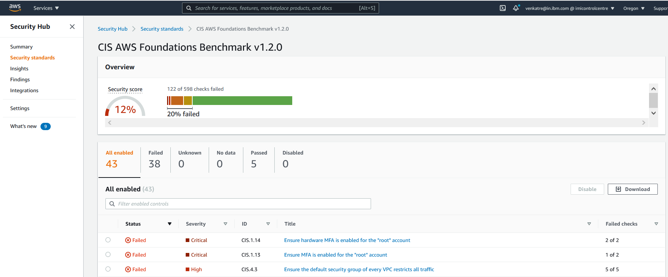
Proposed Design
One ServiceNow ticket
per CIS control
Above is a sample view in AWS Security Hub for "CIS AWS Foundations Benchmark v1.2.0”
Our goal is to replicate a similar view in ServiceNow. One ServiceNow ticket per CIS control, per account, per region.

Slide 10
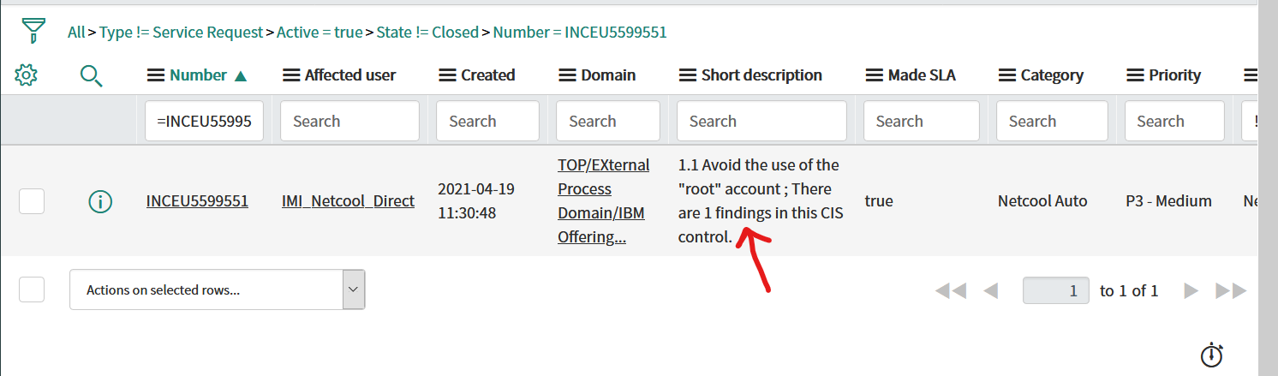
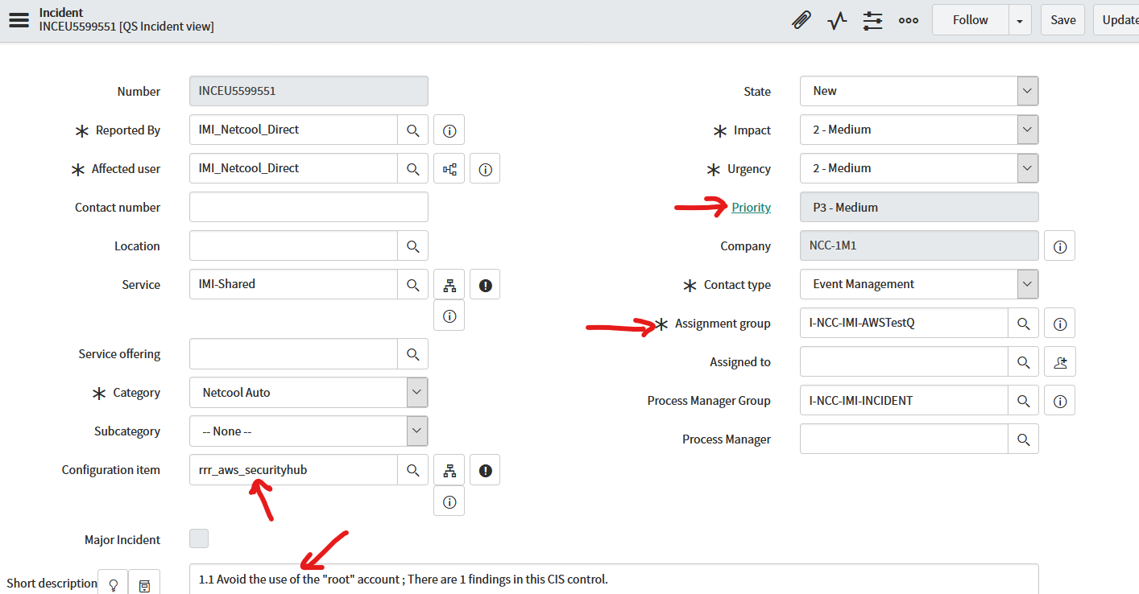
ServiceNow Ticket Screen shots

Slide 11
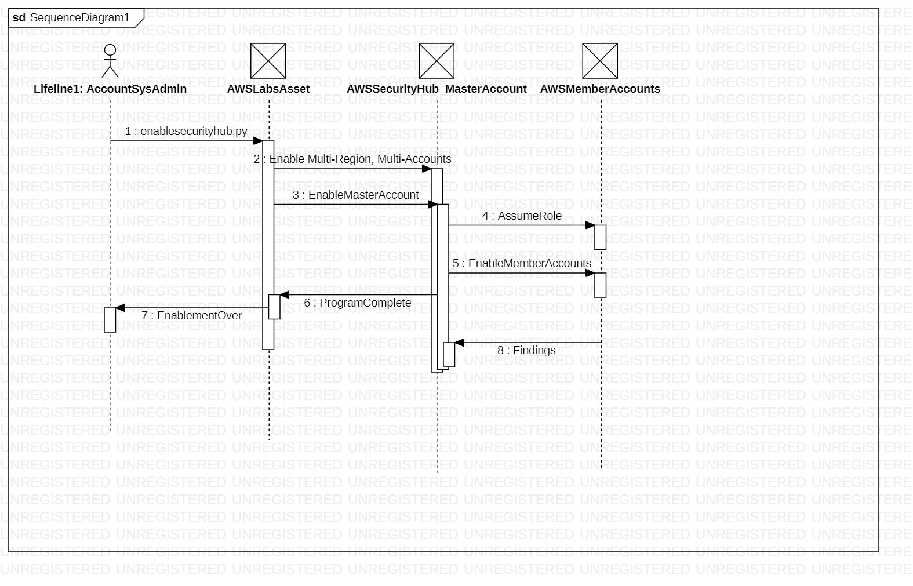
Sequence Diagram – Enable SecurityHub

Slide 12
Demo – Enable SecurityHub
Walkthrough PPT, the deployment topology.
Enable multi-account security hub. Multi-account is the norm in AWS.
SecurityHub is a region wise service. So we have Multi-account, multi-region as the reference architecture.
Enable security hub: https://github.com/awslabs/aws-securityhub-multiaccount-scripts
cd C:\GTS\MCMS\SecurityHub\Design\awslabs_code\aws-securityhub-multiaccount-scripts
enablesecurityhub.py --master_account 802878444238 --assume_role ManageSecurityHub1 --enabled_regions us-west-2 --enable_standards arn:aws:securityhub:::ruleset/cis-aws-foundations-benchmark/v/1.2.0 accounts.csv
2. Disable security hub
cd C:\GTS\MCMS\SecurityHub\Design\awslabs_code\aws-securityhub-multiaccount-scripts
disablesecurityhub.py --master_account 802878444238 --assume_role ManageSecurityHub1 --enabled_regions us-west-2 accounts.csv
disablesecurityhub.py --master_account 802878444238 --delete_master --assume_role ManageSecurityHub1 --enabled_regions us-west-2 accounts.csv

Slide 13
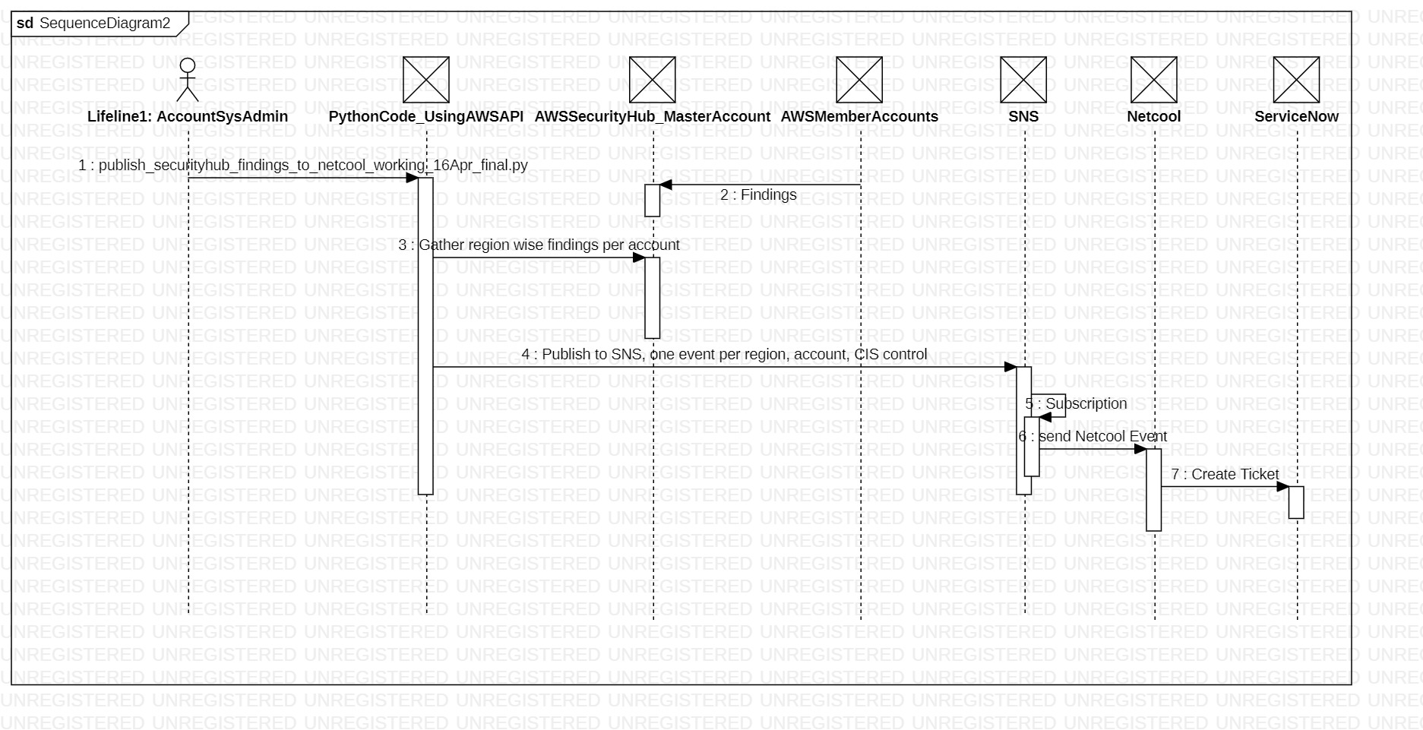
Sequence Diagram– Gather SecurityHub Findings and send to Netcool/Snow

Slide 14
Demo – Gather CIS findings & send to Netcool
Fetch CIS control findings and send them to Netcool: https://github.ibm.com/venkatre/aws_security_hub_automation/tree/master/final_code
cd C:\GTS\MCMS\code\serious_code
publish_securityhub_findings_to_netcool_working_16Apr_final.py --account_3letter_code RRR --enabled_regions us-west-2

Slide 15
Status, Queries, Next Steps

Slide 16
Status - what has been done so far
Design review & proposed design changes
Enable Multi-Account, Multi-Region deployment architecture using automation, code. Reused existing automation asset from AWS Labs
https://github.com/awslabs/aws-securityhub-multiaccount-scripts
Enable CIS benchmarks in Security Hub using above automation
Gather region wise CIS findings and send them to Netcool. Custom code by us
https://github.ibm.com/venkatre/aws_security_hub_automation/blob/master/final_code/
Automation to disable SecurityHub on master, member accounts.

Slide 17
Implementation - Pre-requisites from Customer Account
Using CloudFormation, for Master and each Member Account, setup of cross account role permissions to enable Assume Role. Cloud formation template for same at below URL
https://github.com/awslabs/aws-securityhub-multiaccount-scripts/blob/master/EnableSecurityHub.yaml
Download, execute below github repo locally to enable SecurityHub
https://github.com/awslabs/aws-securityhub-multiaccount-scripts
Create region wise SNS topic to integrate with Netcool
Download and execute below code to get findings per cis control and send them to Netcool
https://github.ibm.com/venkatre/aws_security_hub_automation/tree/master/final_code

Slide 18
Queries, Issues
Using AWS labs asset. Do we need any licensing to reuse ?
Minor risk: Using AWS labs asset for enabling Multi-Account architecture. We will need to understand, support the code for enhancements, support ?
Our python code using AWS API. COO for same ?
Code runs as standalone. Should we schedule it to run on regular interval in AWS environment ?
Currently raising one Snow ticket per account, region, CIS control. Should this be one Snow ticket per account, region (instead of per CIS control) ?
Need to sort out logic in Netcool to close Events once Remediated in Snow.
Raised issue on awslab code. While using the AWS labs asset, along with CIS controls, AWS Foundational Security Best Practices v1.0.0 also getting enabled by default.
https://github.com/awslabs/aws-securityhub-multiaccount-scripts/issues/61

Slide 19
Next Steps
Integrate with Netcool-ServiceNow. Integration done. Under review.
IBM tech specs minus CIS. Delta enablement, automation
Remediation
Solution packaging using Quickstart?
Documentation, COO for code written by us

Slide 20
References
AWS Labs asset: https://github.com/awslabs/aws-securityhub-multiaccount-scripts
Our github repo: https://github.ibm.com/venkatre/aws_security_hub_automation

Slide 21
Design Details

Slide 22
Proposed Design – Netcool/Snow Integration
One Event/Json payload will have multiple Findings within it. Simplified JSON payload now. Do we need any further modification to playload ? (Customer 3 letter code is sent in json payload to Netcool.)
We need to create one ServiceNow ticket for one cis control, event/json payload.
StandardsControlArn within json payload will be unique identifier for a ticket. This is a combination of accountID, region & CIS benchmark ID.
"StandardsControlArn":"arn:aws:securityhub:us-west-2:628937587111:control/cis-aws-foundations-benchmark/v/1.2.0/1.2"
When we send an Event to Netcool, please check if an event already exists for this StandardsControlArn. If Event does no exist for this StandardsControlArn, then create a new ticket in Snow. If it already exists, suppress event.
All SecurityHub findings can have a standard ServiceNow severity attached to them.
These tickets once created will be manually resolved in Snow. Once resolved in Snow, Event will be closed in Netcool.

Slide 23
Proposed Design – Netcool/Snow Integration Mapping- TBD
SecurityHub Event Key in Netcool | Netcool mapping | ServiceNow mapping
"Account3LetterCode” | RRR_AWS_SecurityHub will be Node | RRR_AWS_SecurityHub will be CI name
"Region":"us-west-2", "AwsAccountId":"802878444238", "RuleId":"CIS.2.9" | region:accountid:rule-id will be Alert group
"Title" |  | Short Description
"Description" |  | Ignored
"StandardsControlArn" | AlertKey of Netcool
"ProductArn" |  | Ignored
"GeneratorId" |  | Ignored
"RemediationUrl" |  | Ignored
"Severity" |  | Severity of ticket
"NumberOfFindings" |  | Short Description

Slide 24
Proposed Design for Netcool Integration– Sample JSON payload, Netcool event
{
"Account3LetterCode":"RRR",
"Provider":"aws",
"AwsAccountId":"628937587111",
"Region":"us-west-2",
"RuleId":"CIS.1.1",
"Title":"1.1 Avoid the use of the \"root\" account",
"Description":"The \"root\" account has unrestricted access to all resources in the AWS account. It is highly recommended that the use of this account be avoided.",
"StandardsControlArn":"arn:aws:securityhub:us-west-2:628937587111:control/cis-aws-foundations-benchmark/v/1.2.0/1.1",
"ProductArn":"arn:aws:securityhub:us-west-2::product/aws/securityhub",
"GeneratorId":"arn:aws:securityhub:::ruleset/cis-aws-foundations-benchmark/v/1.2.0/rule/1.1",
"RemediationUrl":"https://docs.aws.amazon.com/console/securityhub/standards-cis-1.1/remediation",
"Severity":"Medium",
"NumberOfFindings":"There are 1 findings in this CIS control."
}
RRR_AWS_SecurityHub will be Node, CI
Alert Group
Summary, Short description
Alert Key
Ticket Severity

Slide 25
Sample ServiceNow Ticket

Slide 26
Architecture Decisions - TBD

Slide 27
Architectural Decisions – Decision 1
Severity of all Events/tickets going to ServiceNow will have the same severity of Medium.
Options
SecurityHub defines/reports different severity levels for the different CIS controls. We could capture and send this severity to the tickets created within ServiceNow.
Define a constant severity for all cis controls in ServiceNow.
Recommendation
Define a constant severity for all cis controls in ServiceNow.
27
Notes:
27

Slide 28
Backup slides

