Slide 1
Cloud Security Posture Management AWS Security Hub Design & Implementation
Jigar Kapasi
Venkat Reddy

Slide 2
Agenda
Background
Reference Architecture
Demo
Pre-reqs, Next Steps

Slide 3
Background

Slide 4
Scope – Cloud Platform Security within AWS using Security Hub
Cloud Platform Security
OS and Middleware Security
*Cloud IAM (MFA, pwd expiry), *Object / Block Storage , *VPC , *Security Groups, *VMs, *Logging (CloudTrail, Config), *Monitoring (unauthorized APIs), *PaaS services etc.
*Security of OS platforms such as Windows/Linux OS/AIX
*Security of Middleware platforms hosted on OS *No different from Hybrid Environment.
Current solution scope includes AWS cloud platform security CIS benchmark implementation & integration using AWS cloud native tooling Security Hub
Manual remediation in scope for current solution

Slide 5
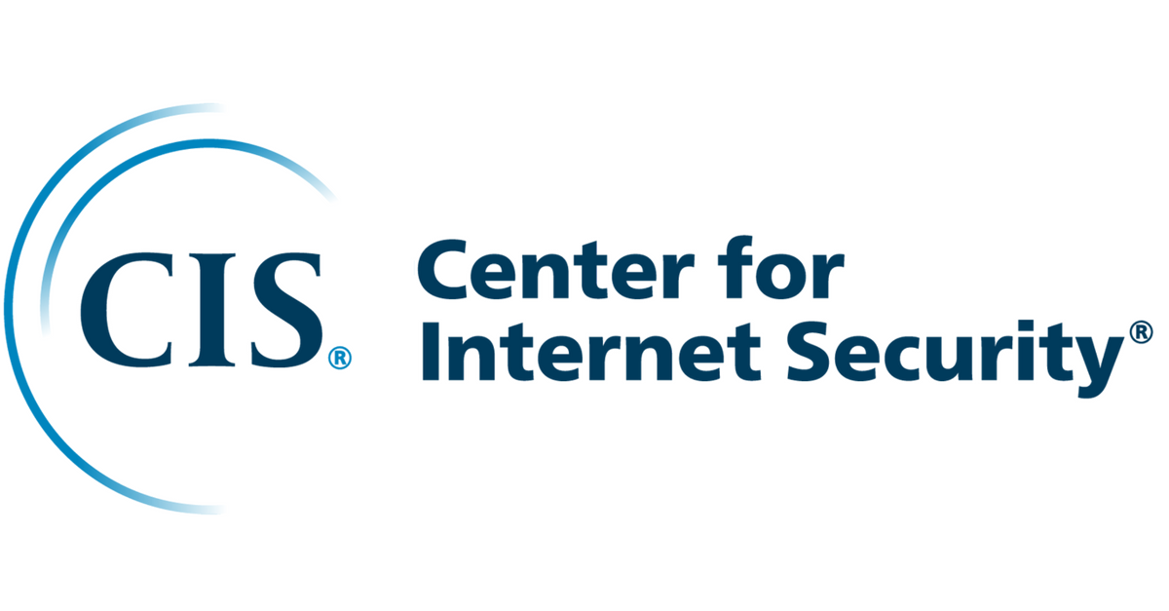
CIS Controls and Benchmarks
CIS (Center for Internet Security) is a community-driven nonprofit org, responsible for the CIS Controls and CIS Benchmarks, globally recognized best practices for securing IT systems and data.
The CIS Controls are a general set of recommended practices for securing a wide range of systems and devices, whereas CIS Benchmarks are guidelines for hardening specific operating systems, middleware, software applications, and network devices.
CIS Benchmarks are developed through the consensus based generous volunteer efforts of subject matter experts, technology vendors, public and private community members, Secure Suite members and the CIS Benchmark Development team. Eg. IBM Cloud CIS benchmarks are being developed in similar method
AWS Security Hub implements CIS benchmarks for cloud platform security. In current scope, for CIS benchmarks, we have integrated the findings from Security Hub into Netcool, ServiceNow for alerting, ticketing. Remediation is manual for now.

Slide 6
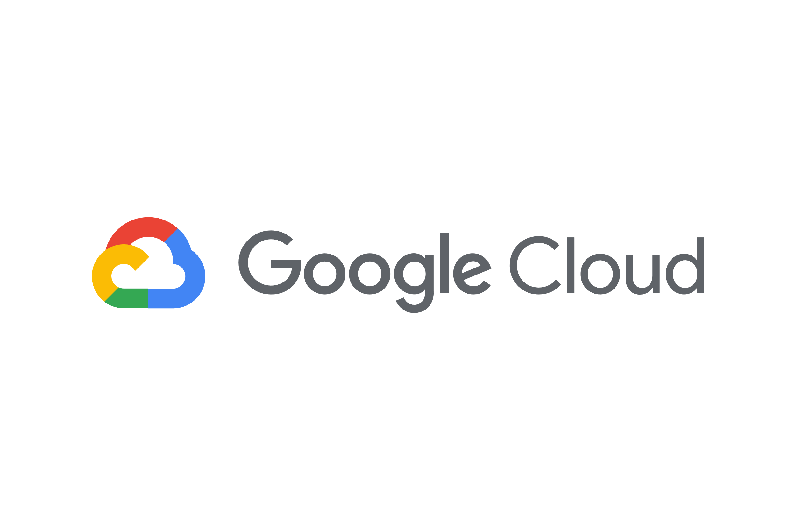


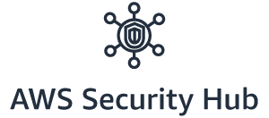


CIS Benchmark comparison - Overview
Benchmark Latest version : 1.2.0 (1.3.0 draft)
MCMS supported: 1.2.0
No. Sections : 4
No of Recommendations : 49
Supported Native Tool :
Tool Coverage of Benchmark : 88%* (43/49)
Benchmark Latest version : 1.1.0 (1.2.0 draft)
MCMS supported: 1.1.0
No. Sections : 9
No of Recommendations : 111
Supported Native Tool: Azure Security Center Tool Coverage of Benchmark : 55% (61/111)
Benchmark Latest version : 1.1.0 (1.2.0 draft)
MCMS supported: 1.0.0
No. Sections : 7
No of Recommendations : 64
Supported Native Tool: GCP Security Command Center Tool Coverage of Benchmark : 92% (59/64)
* 88% coverage due to not scored benchmark items. Not scored benchmark items cannot be programmatically implemented.

Slide 7
CIS Benchmark comparison - Detailed
49 recommendations
111 recommendations
64 recommendations
Section 1 : IAM Recommendations : 22
Level1 : 20 ( 4 not scored) | Level2 : 2 (1 not scored*)
Section 1 : IAM Recommendations : 23
Level1 : 8 ( 7 not scored) | Level2 : 15 (14 not scored)
Section 1 : IAM Recommendations : 13
Level1 : 10 ( 3 not scored) | Level2 : 3 (2 not scored)
Section 2 : Logging Recommendations : 9
Level1 : 5 | Level2 : 4
Section 2 : Security Center Recommendations : 19
Level1 : 17 | Level2 : 2
Section 2 : Logging & Monitoring Recommendations : 11
Level1 : 11 | Level2 : 0
Section 3 : Monitoring Recommendations : 14
Level1 : 9 | Level2 : 5
Section 3 : Storage accounts Recommendations : 8
Level1 : 5 ( 3 not scored) | Level2 : 3 (2 not scored)
Section 3 : Networking Recommendations : 9
Level1 : 6 (3 not scored) | Level2 : 3
Section 4 : Database Services Recommendations : 19
Level1 : 14 | Level2 : 5
Section 4 : Virtual Machines Recommendations : 6
Level1 : 5 (1 not scored) | Level2 : 1
Section 4 : Networking Recommendations : 4
Level1 : 2 | Level2 : 2 (1 not scored*)
Section 5 : Monitoring & Logging Recommendations : 16
Level1 : 15 | Level2 : 1
Section 5 : Storage Recommendations : 3
Level1 : 3 (1 not scored) | Level2 : 0
* Level 1 are practical/minimum; Level 2 are advanced
* Not scored benchmark items cannot be programmatically implemented and are not covered by Security Hub.
Section 6 : Networking Recommendations : 5
Level1 : 4 | Level2 : 1
Section 6 : Cloud SQL Databases Recommendations : 4
Level1 : 4 | Level2 : 0
Section 7 : Virtual Machines Recommendations : 6
Level1 : 6 (3 not scored) | Level 2: 0
Section 7 : Kubernetes Engine Recommendations : 18
Level1 : 16 (2 not scored) | Level2 : 2 (1 not scored)
Section 8 : Others Recommendations : 5
Level1 : 4 | Level2: 1 ( 1 not scored)
Section 9 : App Service Recommendations : 10
Level1 : 10 (5 not scored) | Level2: 0

Slide 8
Reference Architecture – AWS Security Hub Implementation

Slide 9

AWS Security Hub Overview
AWS Security Hub is an AWS native tooling that gives you a comprehensive view of your security alerts and security posture across your AWS accounts
Generally available since June 2019
AWS Security Hub is a regional service
Available in 19 regions
There is a free trial of 30 days for Security Hub
Security Hub is SOC, ISO, PCI, and HIPAA certified
Security Hub is integrated with cloudTrail and cloudwatch
When we enable security hub for a region, it automatically starts reading the findings from the AWS services and optionally we can enable industry standards like CIS and PCI DSS
Security Hub is a multi-tenant service offering. To ensure data protection, Security Hub encrypts data at rest and data in transit between component services

Slide 10
Core Features
Receive the security findings input from various security services of AWS account(s)
Receive and/or send security findings from third party providers like Qradar
Check for compliance of industry standard controls like CIS benchmark and PCI DSS and generate security findings if required
Tight Integration with CloudWatch and CloudTrail native services for Alerting and Logging

Slide 11
Security Hub Implementation – Requirements
Enable Multi-Account, Multi-Region deployment architecture for Security Hub
Enable CIS benchmarks in Security Hub (Expand to other offering like foundational best practices later)
Integrate with Netcool-ServiceNow and post findings into ServiceNow as ServiceRequests. One ServiceRequest created per CIS control, per AWS account, per region
Define a uniform design/architecture across AWS, Azure – cloud-native approach
Cover delta between IBM tech specs & CIS implementation of AWS (Not in current scope – IBM Security moving towards pure CIS)
Provide for remediation of tickets (Manual remediation for now)
* In discussion with Adan Rosler (SRRM team), Milton Hernandez & team for further feedback and requirements.

Slide 12


Security Hub - Multi-Account structure
Member Account
Master Account
Member Account
Master Account
If your invitations are accepted by a member account , your account is designated as the Security Hub master account
Member Account
Added accounts are member accounts. With the master account, you can view findings in member accounts

Slide 13
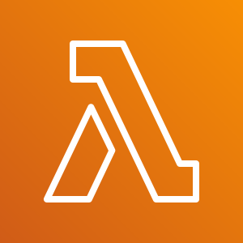
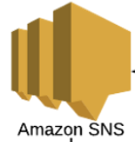
Design – Multi Account, Multi Region
Region1 - Primary
Member Account1
Master Account
MCMS ServiceNow/Ticketing
Assume Role
Pull
Findings
Findings
Lambda Schedule
Member AccountN
MCMS Netcool (Softlayer DC)
MCMS Netcool (with Message Bus Probe):
NAT Public IP mapped
URL: https://<netcoolmsgprobe-domainname>:XX
Webhook integration
Master Account
Security Hub
Pull
Findings
Member Account
Security Hub
Region2
Master Account Member Account
Security Hub Security Hub
Findings
Region3 ...
... RegionN
Master Account Member Account
Security Hub Security Hub
Findings
Enable Multi-Account, Multi-Region deployment architecture. Automation available for same. (Identify master account, primary region as a pre-req.)
Multiple regions enabled wherever Account Region specific services are running and compliance needs to be reported.
Enable CIS benchmarks in Security Hub. All controls are enabled in all regions. (Duplicate findings across regions for Global Resources like IAM.)
In Master Account, Primary Region, enable Lambda, SNS topic.
Security Hub CIS Events reported into Netcool. Primary key for Netcool integration would be Region, AccountId, CIS_control_id .

Slide 14
Solution features
Automation of architecture, solution deployment: Security Hub is a multi-account, regional service. Through our solution, reusing awslabs asset, we have automated the multi-account, multi-region deployment architecture. Enable as many regions as needed and where Customer services are running.
Single ServiceNow dashboard: Security Hub dashboard is a regional dashboard. Our solution provides for a single ServiceNow dashboard for multi-account, multiple regions.
xxx Account 3 letter code and linking with AWS accounts, regions: xxx customer Account can have multi-account, multi-region AWS setup. Through our solution, we are able to collect all Security Hub findings related to a xxx Account into a single ServiceNow dashboard. “xxx: AWS account id: Region: CIS control name” is displayed in ticket summary and treated as primary/unique key in solution.
Integration into Service Management (ITSM) processes: Since ServiceNow is a Service Management solution, through our integration into ServiceNow we integrate into IBM/customers Service Management processes.
Integration Touchpoints: Through event management solutions like Netcool, integration touchpoints like SNS, we have complete control over Security Hub service and integration touchpoints. Can integrate with AIOps, other future requirements etc.
Customizable Solution: Example, one service request created per CIS control. Example, suppression of CIS controls can be done (in future solution). Customizable ticket severity. We cannot customize the CIS recommended values implemented by AWS.
Currently enabled CIS benchmarks in Security Hub. We can enhance to cover other benchmarks provided by AWS and enhance to meet IBM related specs (CIS++ not covered by AWS).
Remediation is manual currently. Is in scope for future releases.

Slide 15
Design Details
Security Hub is a regional service. Identify master account, primary region as a starting point.
Enable Multi-Account, Multi-Region deployment architecture. Automation available to enable, disable Security Hub for this architecture. Can also be done manually.
Multiple regions enabled wherever Account’s region-specific services are running and compliance needs to be reported. Automation available.
Enable CIS benchmarks in Security Hub. All controls are enabled in all required regions. (Duplicate findings across regions for Global Resources like IAM.)
The result will be a master account that contains all security findings for all member accounts. Since Security Hub is regionally isolated, findings for each member account will roll up to the corresponding region in the master account.
Using Lambda(details in next slide), gather “failed” findings from Security Hub. Gather findings per CIS control, per account, per region and send them to SNS topic (created in master account, primary region).
Through webhook integration, SNS subscription posts Security Hub CIS Events/findings to Netcool.
Netcool creates Service Requests in ServiceNow. Service Requests have sufficient details to identify the Security Hub finding in AWS console.
SAs can act upon Service Requests, fix findings in AWS and close Service Requests. Once resolved manually by SAs, Security Hub will identify fixed findings and stop reporting on them as “failed”.

Slide 16
Design Details – Lambda & Scheduler setup
In primary region, in master account, create SNS topic (say “test_topic”). Create SNS subscription with integration to Netcool.
In primary region, in master account, setup the Cloudwatch Scheduler rule, Lambda function. Note that this is not needed to be setup in every region within the master account.
Lambda function setup:
Copy, paste the code at below github URL into a lambda function. The below code fetches CIS findings and posts them to Netcool.
https://github.ibm.com/venkatre/aws_security_hub_automation/blob/master/final_code/lambda_publish_securityhub_findings_to_netcool_servicenow.py
Lambda function needs to have read access to Security Hub and full access to SNS.
Cloudwatch Scheduler setup:
Create a cloudwatch scheduler rule to invoke above lambda function. It can be scheduled periodically like 24 hours. Below input parameters need to be sent from Scheduler to the Lambda function.
{"account_3letter_code": "rrr", "enabled_regions": "us-west-2, us-east-2", "sns_topic": "test_topic"}
* “account_3letter_code” configuration has to be account specific
Detailed screen shots for the above setup are under pre-reqs section of this PPT.

Slide 17
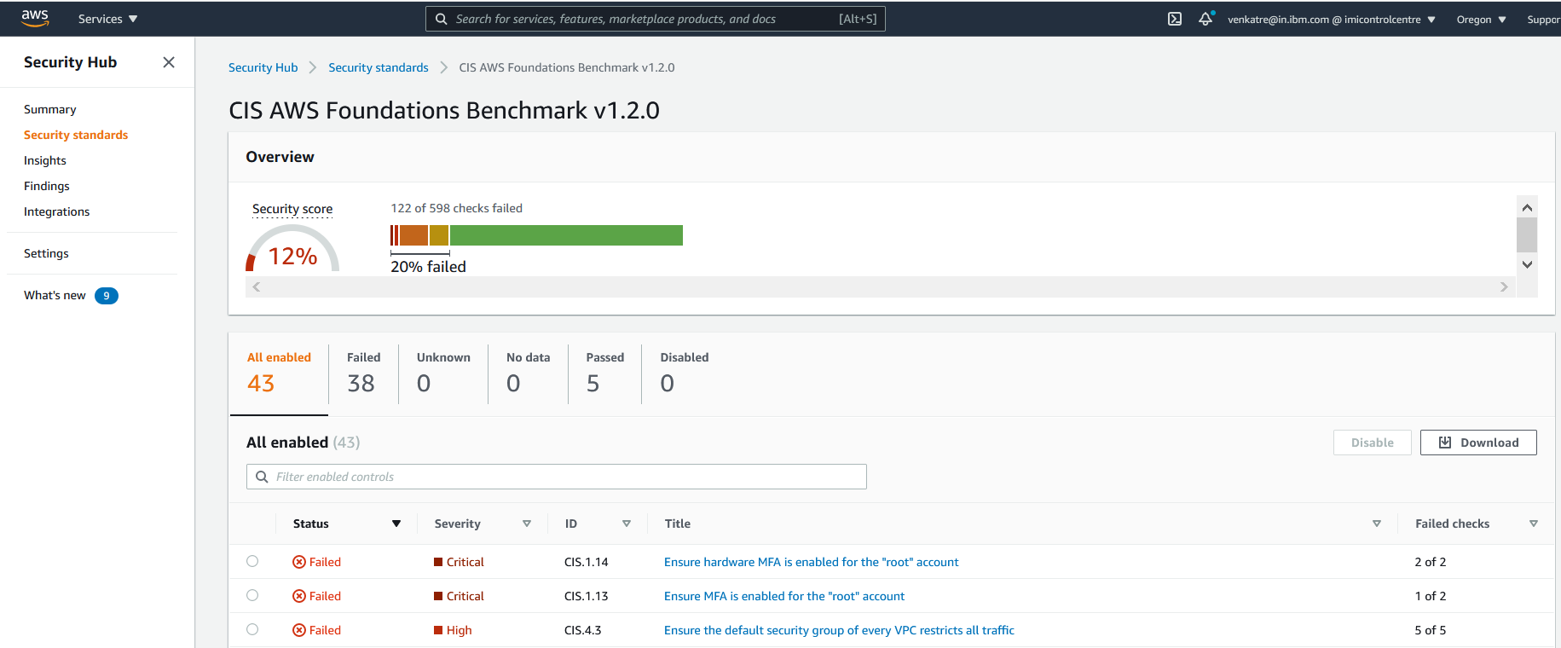
Design
One ServiceNow ticket
per CIS control
Above is a sample view in AWS Security Hub for "CIS AWS Foundations Benchmark v1.2.0”
Our goal is to replicate a similar view in ServiceNow. One ServiceNow ticket per CIS control, per account, per region.

Slide 18
Demo Setup, Reporting, AWS Console, ServiceNow

Slide 19
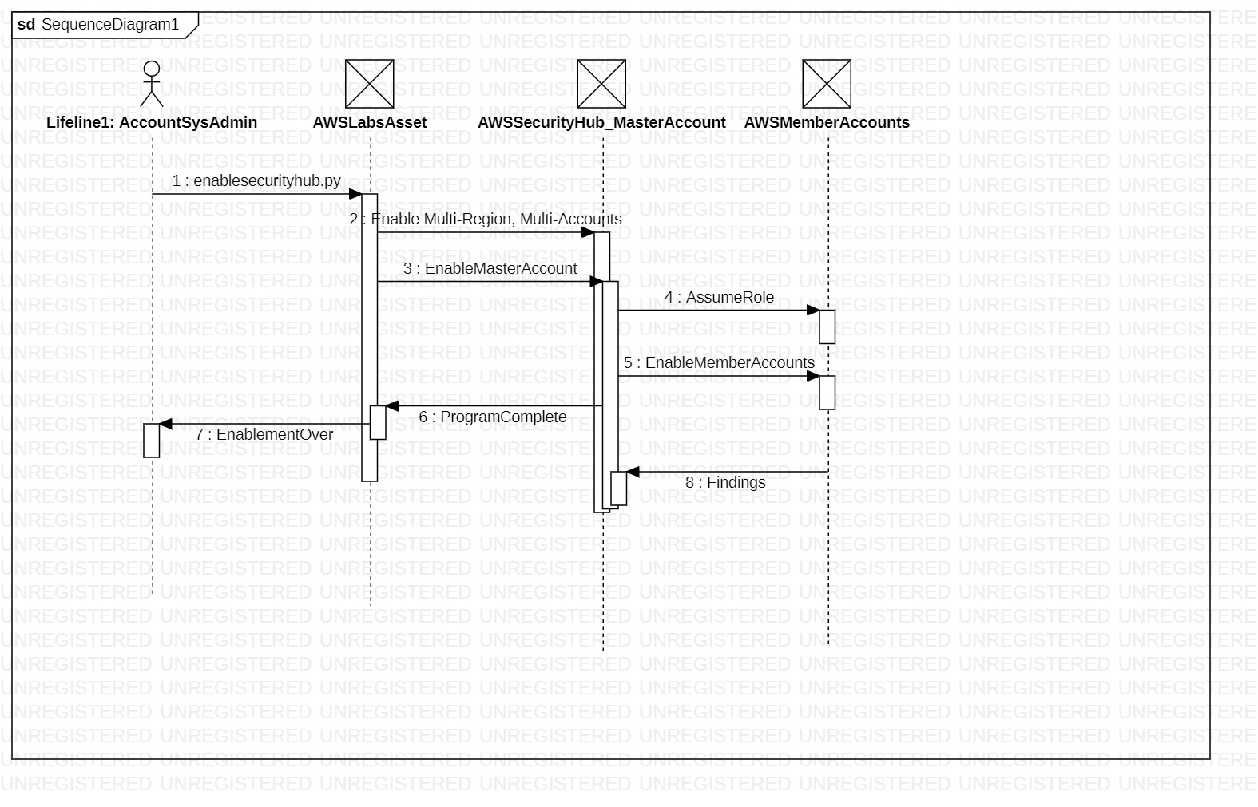
Sequence Diagram – Enable Security Hub

Slide 20
Demo – Enable Security Hub
Walkthrough PPT, the deployment topology.
Enable multi-account security hub. Multi-account is the norm in AWS.
Security Hub is a region wise service. So we have multi-account, multi-region as the reference architecture.
Enable security hub: https://github.com/awslabs/aws-securityhub-multiaccount-scripts
cd C:\Kyndryl\MCMS\SecurityHub\Design\awslabs_code\aws-securityhub-multiaccount-scripts
enablesecurityhub.py --master_account 802878444238 --assume_role ManageSecurityHub1 --enabled_regions us-west-2,us-east-1 --enable_standards arn:aws:securityhub:::ruleset/cis-aws-foundations-benchmark/v/1.2.0 accounts.csv
2. Disable security hub
cd C:\Kyndryl\MCMS\SecurityHub\Design\awslabs_code\aws-securityhub-multiaccount-scripts
disablesecurityhub.py --master_account 802878444238 --assume_role ManageSecurityHub1 --enabled_regions us-west-2 accounts.csv
disablesecurityhub.py --master_account 802878444238 --delete_master --assume_role ManageSecurityHub1 --enabled_regions us-west-2 accounts.csv

Slide 21
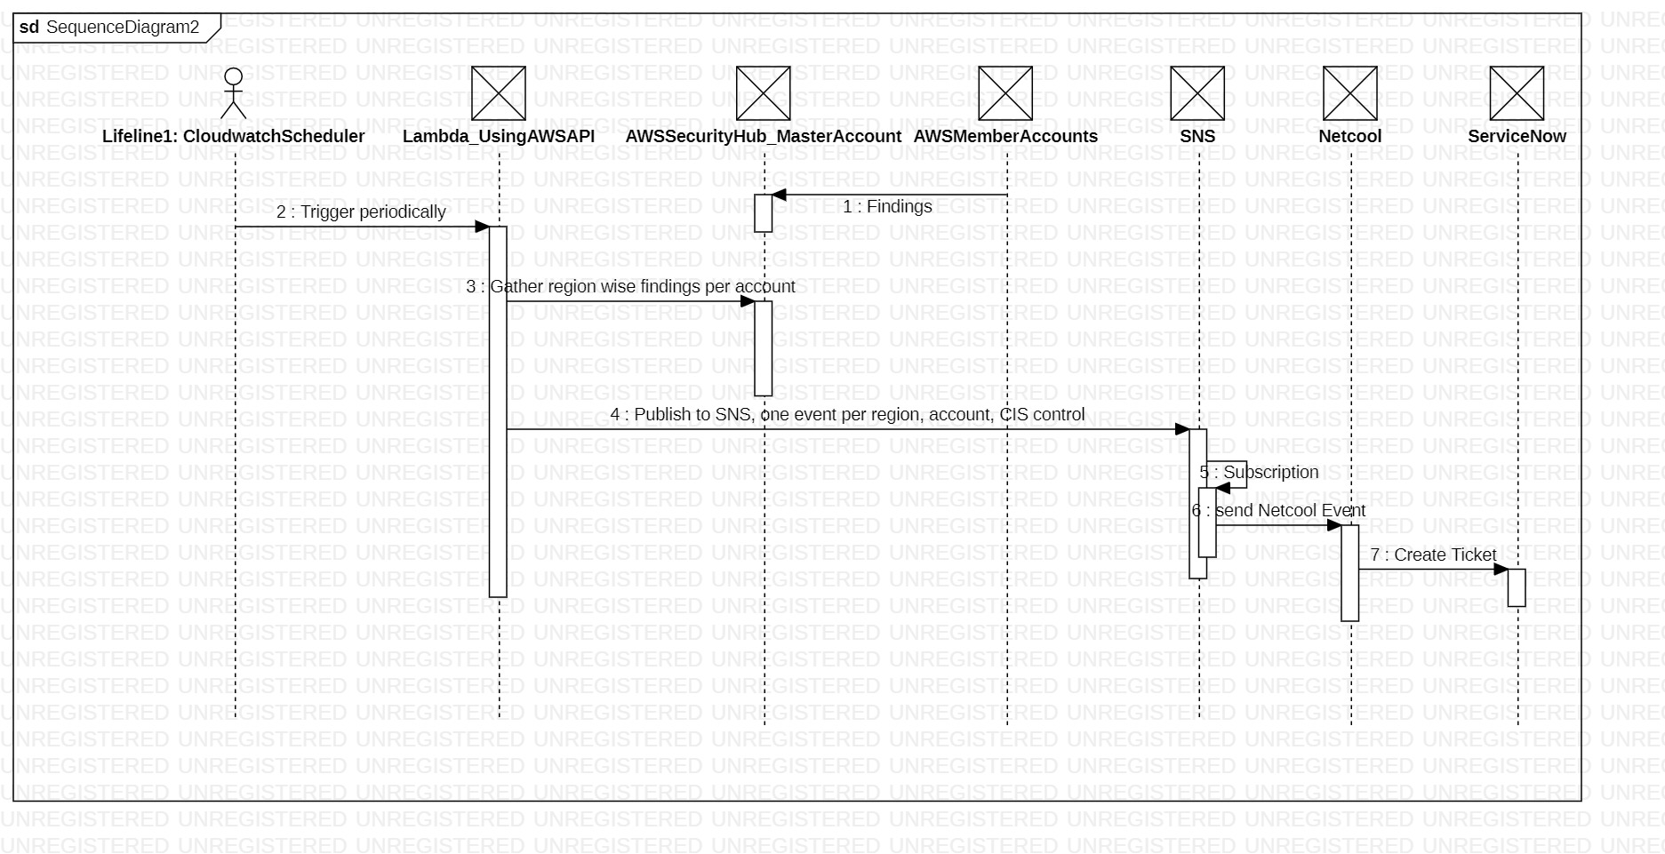
Sequence Diagram – Using Lambda, pull Security Hub Findings and send to Netcool/ServiceNow

Slide 22
Demo – Using Lambda, pull Security Hub Findings and send to Netcool/ServiceNow
In primary region, in master account, create SNS topic (say “test_topic”), subscription with integration to Netcool.
In primary region, in master account, setup the Cloudwatch Scheduler rule, Lambda function.
Lambda function setup:
Copy, paste the code at below github URL into a lambda function. The below code fetches CIS findings and posts them to Netcool.
https://github.ibm.com/venkatre/aws_security_hub_automation/blob/master/final_code/lambda_publish_securityhub_findings_to_netcool_servicenow.py
Lambda function needs to have read access to Security Hub and full access to SNS.
Cloudwatch Scheduler setup:
Create a cloudwatch scheduler rule to invoke above lambda function. It can be scheduled periodically like 24 hours. Below input parameters need to be sent from Scheduler to the Lambda function.
{"account_3letter_code": "rrr", "enabled_regions": "us-west-2, us-east-2", "sns_topic": "test_topic"}
* “account_3letter_code” configuration has to be account specific
Detailed screen shots for the above setup are under pre-reqs section of this PPT.

Slide 23
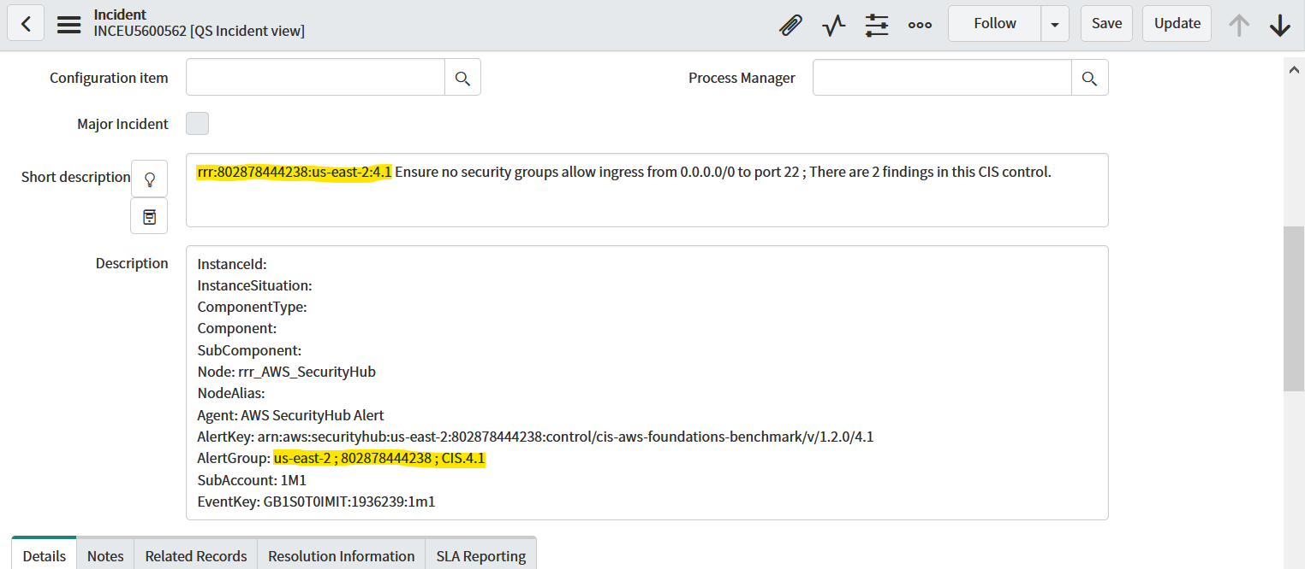
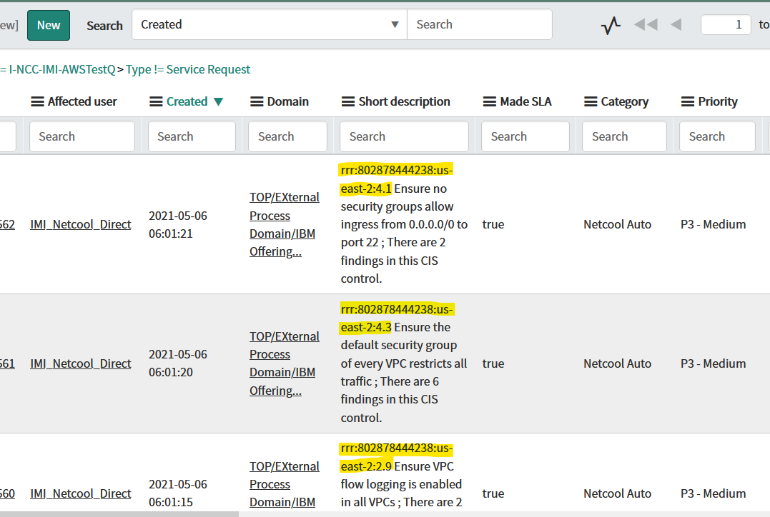
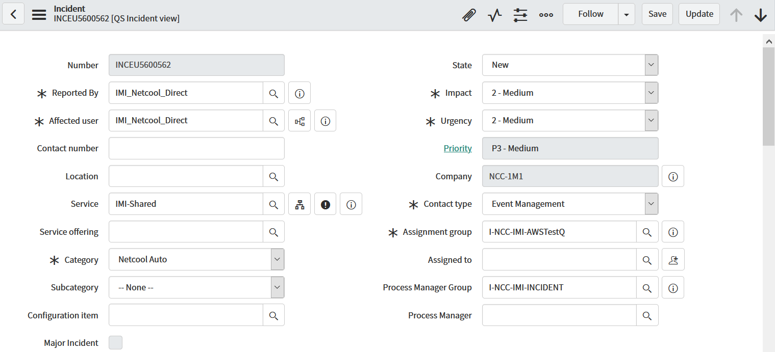
ServiceNow Ticket Screen shots

Slide 24
Pre-reqs, Next Steps

Slide 25
Status - what has been done so far
Multi-Account, Multi-Region deployment architecture. Design proposal and implementation
Enable Multi-Account, Multi-Region deployment architecture using automation, code. Reused existing automation asset from AWS Labs
https://github.com/awslabs/aws-securityhub-multiaccount-scripts
Enable CIS benchmarks in Security Hub using above automation
Gather region wise, account wise CIS findings and send them to Netcool, ServiceNow. Custom code by us
https://github.ibm.com/venkatre/aws_security_hub_automation/blob/master/final_code/
Automation to disable Security Hub on master, member accounts.

Slide 26
Pre-requisites
Enable Security Hub:
Run below cloud formation template on Master and each Member Account to setup cross account role permissions.
https://github.com/awslabs/aws-securityhub-multiaccount-scripts/blob/master/EnableSecurityHub.yaml
Download, execute below github repo code to enable Security Hub. (If there are regions where AWS Config is not already enabled, the script will enable it.)
https://github.com/awslabs/aws-securityhub-multiaccount-scripts
Netcool Integration:
In Primary region, for Netcool integration, create SNS topic (say “test_topic”). Create a subscription to post events on the SNS topic to Netcool webhook URL.
Ensure Netcool integration in place. AWS SNS IPs to be whitelisted on Netcool end and connectivity done.
Using Lambda, gather CIS findings and post to Netcool/ServiceNow:
Screen shots in next slides for Lambda and Scheduler setup

Slide 27
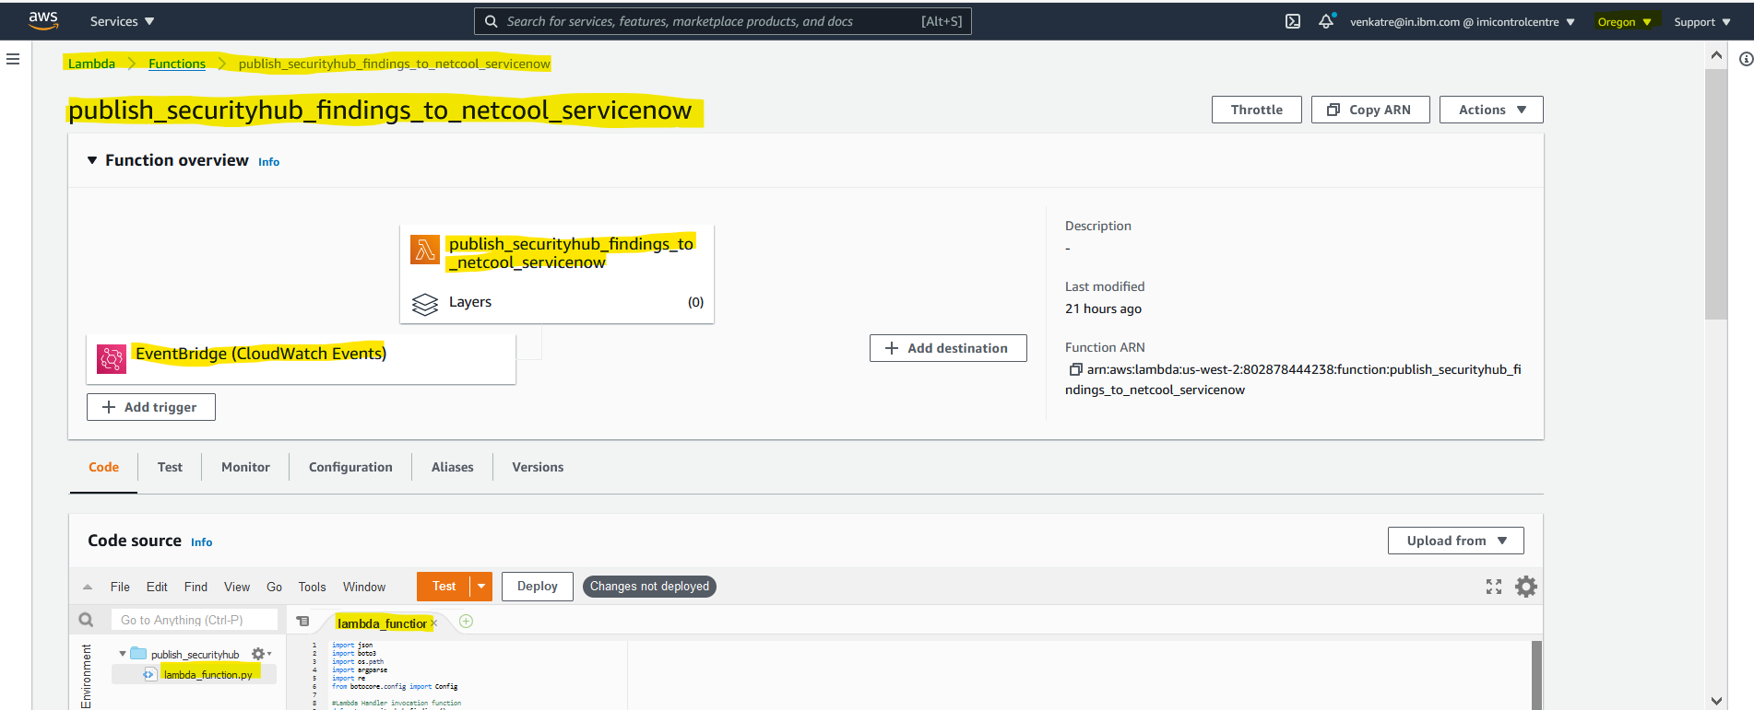
Pre-requisites: Creating Lambda fn as scheduled job
Gather CIS findings and post to Netcool/ServiceNow:
Configure the below github code as a scheduled job (lambda function) in AWS
https://github.ibm.com/venkatre/aws_security_hub_automation/blob/master/final_code/lambda_publish_securityhub_findings_to_netcool_servicenow.py
Sample screen shot below
Paste above github code here

Slide 28
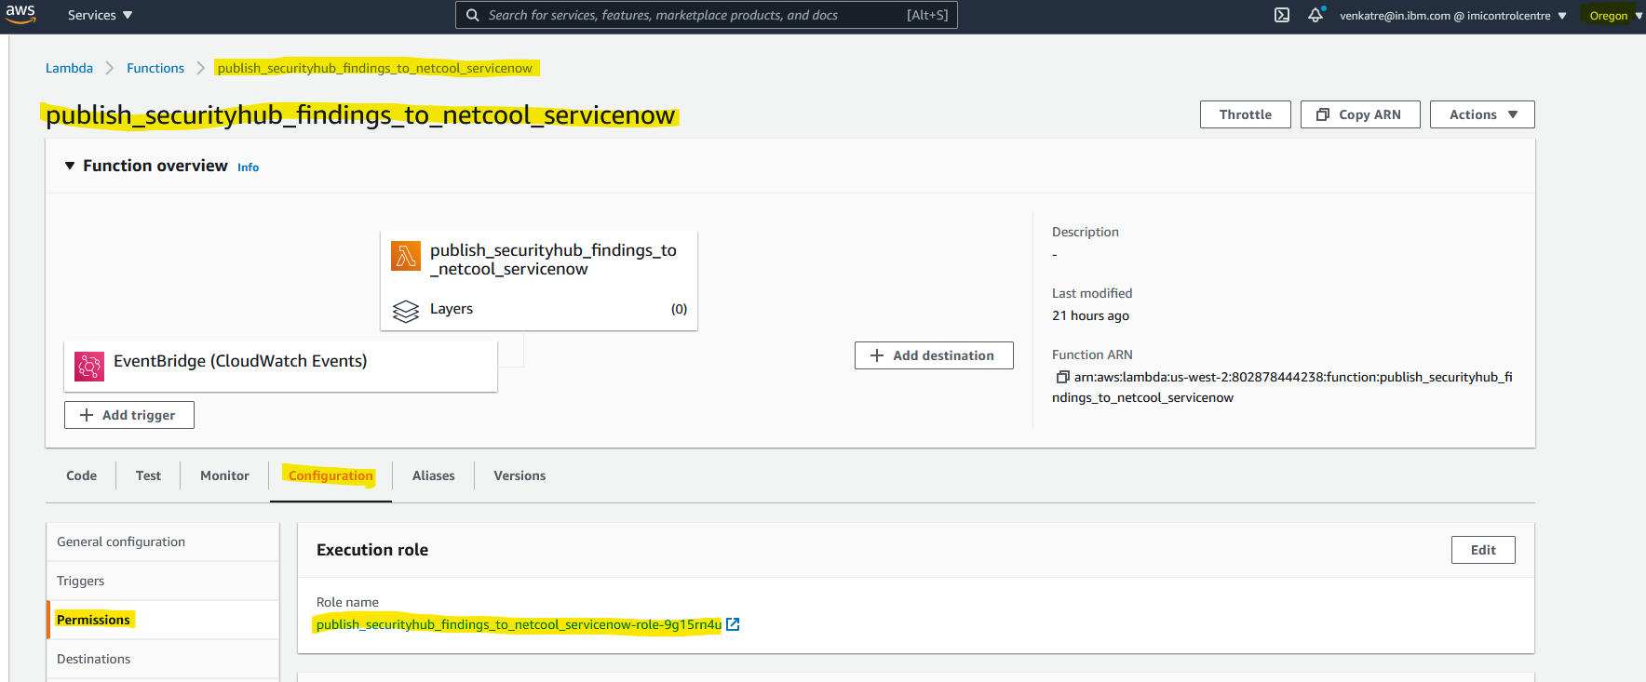
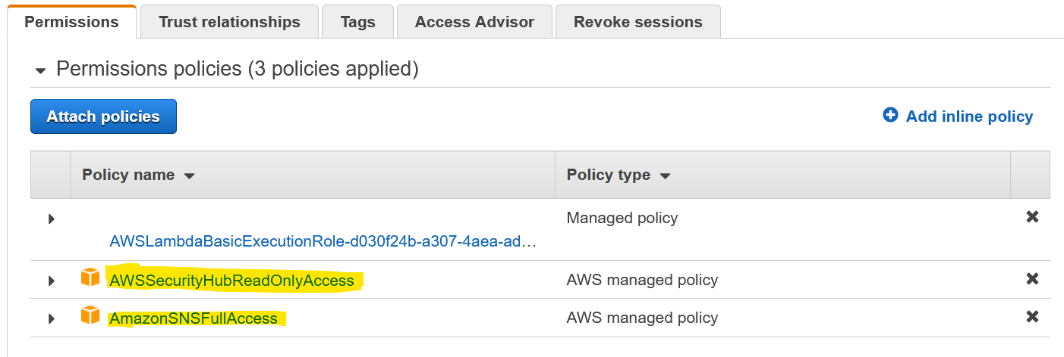
Pre-requisites: Creating Lambda fn as scheduled job
Gather CIS findings and post to Netcool/ServiceNow:
Sample permissions for Lambda function to gather Security Hub findings and post them to SNS.
Sample screen shot below
Lambda function needs read access to Security Hub (to read findings) and full access (to post events) to SNS. Sample screen shot above.

Slide 29
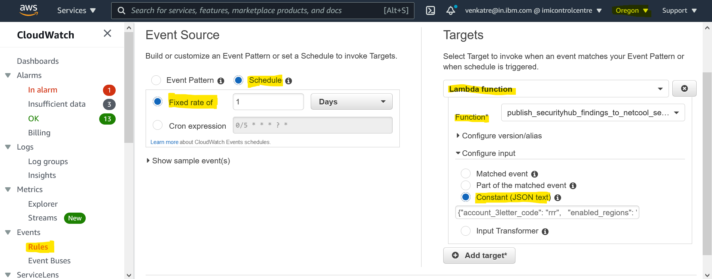
Pre-requisites: Creating Lambda fn as scheduled job
Gather CIS findings and post to Netcool/ServiceNow:
Configure scheduler in CloudWatch rules
Sample screen shot below
Configure in primary
region
Configure schedule to
gather Security Hub events
Point to Lambda fn
Configure variable input
{"account_3letter_code": "rrr", "enabled_regions": "us-west-2, us-east-2", "sns_topic": "test_topic"}

Slide 30
Next Steps
Integrate with Netcool-ServiceNow. Integration done.
IBM tech specs minus CIS. Delta enablement, automation
Remediation
Harvesting of assets
Documentation, COO for code written by us

Slide 31
References
IBM CIS techspecs for cloud. Refer “Amazon Web Services (AWS) Cloud” below:
https://w3.ibm.com/w3publisher/gts-technical-specifications/technical-specifications/sponsored
AWS Labs asset: https://github.com/awslabs/aws-securityhub-multiaccount-scripts
Our github repo: https://github.ibm.com/venkatre/aws_security_hub_automation

Slide 32
Thank you

