Slide 1
SecurityHub Design & Implementation for AWS
Jigar Kapasi
Venkat Reddy

Slide 2
Requirements, Status

Slide 3
Security Hub related Requirements (AWS)
Enable Multi-Account, Multi-Region deployment architecture for Security Hub
Enable CIS benchmarks in Security Hub
Integrate with Netcool-ServiceNow and post findings into ServiceNow as tickets
Define a uniform design/architecture across AWS, Azure
Cover Delta between IBM tech specs & CIS implementation of AWS
Provide for remediation of tickets

Slide 4
What has been Done so far
Design review & proposed design changes
Enable Multi-Account, Multi-Region deployment architecture using automation, code. Reused existing automation asset from AWS Labs
https://github.com/awslabs/aws-securityhub-multiaccount-scripts
Enable CIS benchmarks in Security Hub using above automation
Gather region wise CIS findings and send them to Netcool. Custom code by us
https://github.ibm.com/venkatre/aws_security_hub_automation/blob/master/final_code/publish_securityhub_findings_to_netcool_working_10Apr_final.py
Automation to disable SecurityHub on master, member accounts.

Slide 5
Customer Account Pre-requisites
Using CloudFormation, for Master and each Member Account, setup of cross account role permissions to enable Assume Role. Cloud formation template for same at below URL
https://github.com/awslabs/aws-securityhub-multiaccount-scripts/blob/master/EnableSecurityHub.yaml
Download, execute below github repo locally to enable SecurityHub
https://github.com/awslabs/aws-securityhub-multiaccount-scripts
Create region wise SNS topic to integrate with Netcool
Download and execute below code to get findings per cis control and send them to Netcool
https://github.ibm.com/venkatre/aws_security_hub_automation/tree/master/final_code

Slide 6
Reference Architecture & Proposed Changes

Slide 7



Multi-Account structure
There is an exclusive deep dive session recording available on Security Hub service
Member Account
Master Account
Member Account
Master Account
If your invitations are accepted by a member account , your account is designated as the Security Hub master account
Member Account
Added accounts are member accounts. With the master account, you can view findings in member accounts

Slide 8
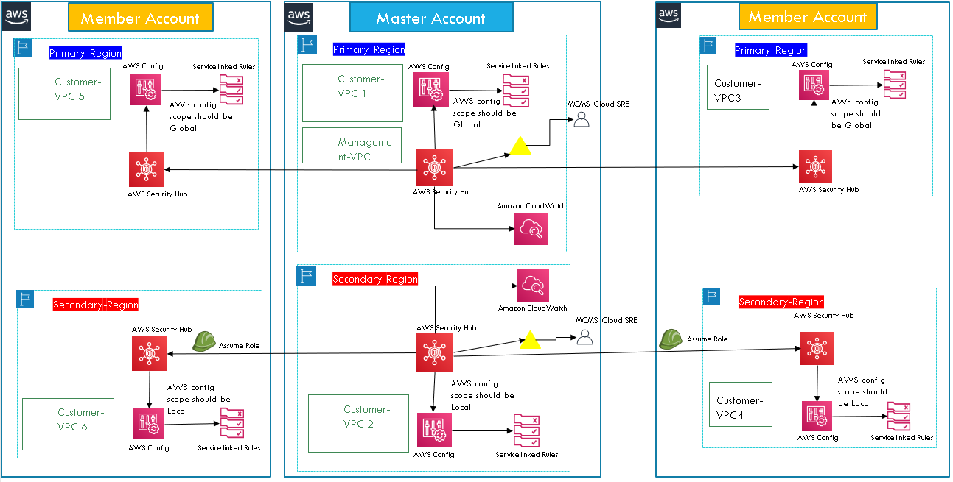
Multi-Account, Multi-Region deployment – Earlier Design

Slide 9
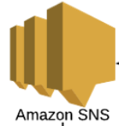
Proposed Design – AWS side Implementation Done
Region1
Member Account1
Master Account
IMI ServiceNow/Ticketing
Assume Role
Findings
Member AccountN
IMI Netcool (Softlayer DC)
IMI Netcool (with Message Bus Probe):
NAT Public IP mapped
URL: https://<netcoolmsgprobe-domainname>:XX
Webhook integration
Master Account
Member Accounts
Region2
Findings
Region3 …..
..... RegionN
Enable Multi-Account, Multi-Region deployment architecture. Enable as many regions as needed and where Customer services are running.
No concept of Secondary Region. Multiple regions enabled wherever Account Region specific services are running and compliance needs to be reported.
Enable CIS benchmarks in Security Hub. All controls are enabled in all regions. (Duplicate findings across regions for Global Resources like IAM.)
Primary key for Netcool integration could be Region, AccountId, CIS_control_id . This will uniquely identify an Event, ticket.

Slide 10
Proposed Design
Enable Multi-Account, Multi-Region deployment architecture. Enable as many regions as needed and where Customer services are running.
No concept of Secondary Region. Multiple regions enabled wherever Account Region specific services are running and compliance needs to be reported.
Enable CIS benchmarks in Security Hub. All controls are enabled in all regions. (Duplicate findings across regions for Global Resources like IAM.)
Primary key for Netcool integration could be Region, AccountId, CIS_control_id . This will uniquely identify an Event, ticket.
Refer below URL for a dump of sample Events to Netcool from SecurityHub
https://github.ibm.com/venkatre/aws_security_hub_automation/tree/master/EventDump_forNetcoolTeam/cis_findings

Slide 11
Demo

Slide 12
Next Steps
Integrate with Netcool-ServiceNow and post findings into ServiceNow as tickets. Netcool event dump for CIS findings below. One CIS control sends one Netcool request. One CIS control can have findings related to multiple resources. Sample json Event dump below
https://github.ibm.com/venkatre/aws_security_hub_automation/tree/master/EventDump_forNetcoolTeam/cis_findings
IBM tech specs – CIS delta enablement, automation
Remediation
Solution packaging using Quickstart?
Documentation, COO for code written by us

Slide 13
Queries, Issues
Raised issue on awslab code. While using the AWS labs asset, along with CIS controls, AWS Foundational Security Best Practices v1.0.0 also getting enabled by default.
https://github.com/awslabs/aws-securityhub-multiaccount-scripts/issues/61
Minor risk: Using AWS labs asset for enabling Multi-Account architecture. We will need to understand, support the code for enhancements ?
Architecture Decisions, design queries in coming slides.

Slide 14
Architecture Decisions - TBD

Slide 15
Backup slides

Slide 16
Public Cloud Onboarding Automation Options
Github repo URL
https://github.ibm.com/venkatre/aws_security_hub_automation
Lambda function to filter, send security hub findings/events to SNS -> Netcool
https://github.ibm.com/venkatre/aws_security_hub_automation/blob/master/code/route_securityhub_events_to_netcool.py
Lambda function for IBM tech specs not covered by CIS, SecurityHub. Custom config rule invokes below lambda function:
https://github.ibm.com/venkatre/aws_security_hub_automation/blob/master/code/remediate_security_group_ports_lambda_function.py

