Slide 1

MATCHING OF A DC MOTOR TO A PHOTOVOLTAIC GENERATOR USING A STEP-UP CONVERTER WITH A CURRENT-LOCKED LOOP
S. M. Alghuwainem EB. Department, King Saud University Riyadh, Saudi Arabia 11421
EE-580 Journal presentation
P.Venkatadri
Power Engineering
234102111

Slide 2
Abstract
Challenge: PV generator has insolation-dependent characteristics, making constant optimization difficult.
Proposed Solution: Maintain direct proportionality between generator current and insolation for insolation- independent optimum matching.
System Components:
Shunt DC motor drives a water pump.
PV generator connected via a step-up converter.
Duty ratio of converter controlled using a current-locked feedback loop.

Slide 3
Objective’s:
Adjust duty ratio to ensure the system operates at the maximum power
Optimize matching of PV generator with shunt DC motor and water pump.point under varying insolation levels.
The problem of poor utilization efficiency of a dc motor operating from a PV generator is solved by a feedback current-locked loop which controls the duty ratio of a step-up converte

Slide 4

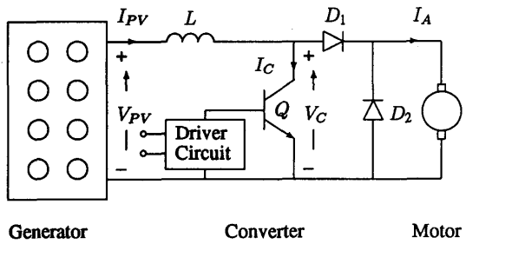
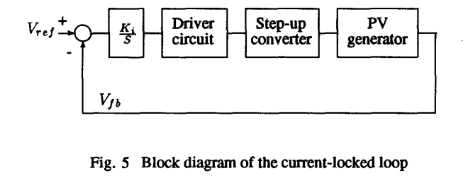
SYSTEM DIAGRAM:

Slide 5
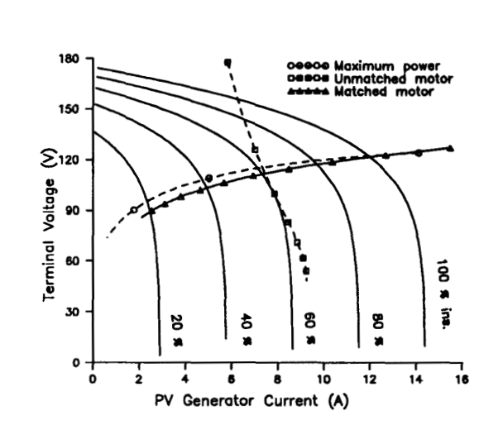
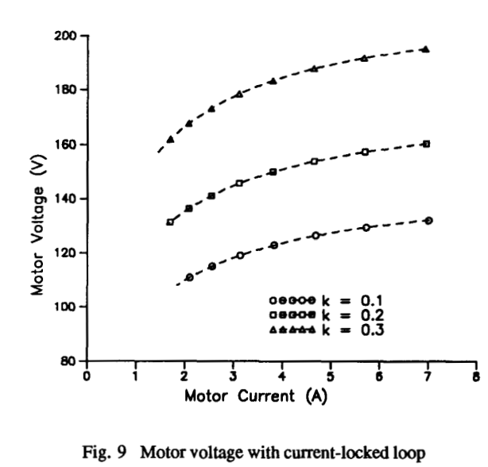
SIMULATION AND RESULT’S:

Slide 6
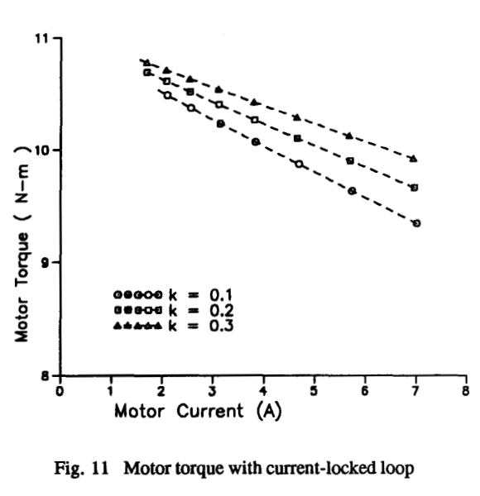
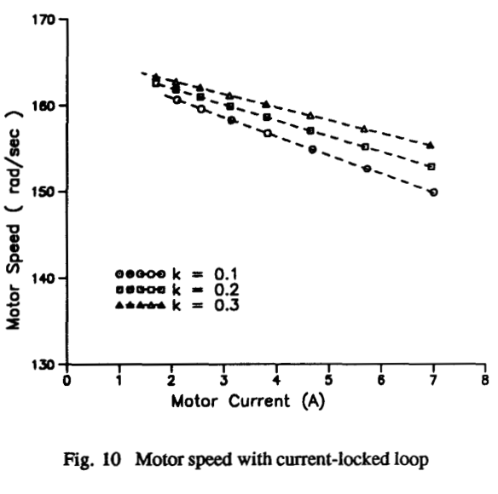
SIMULATION AND RESULT’S:

Slide 7
THANK YOU

