Slide 1
Terraform on AWS with IaC DevOps & SRE

Slide 3
AWS EKS Kubernetes
DevOps on AWS
EC2, ECS, EKS, Lambda, VPC
STACKSIMPLIFY
Azure AKS Kubernetes
DevOps &
SRE
Roadmap
DevOps on Azure
VMs, ACI, AKS, Functions, App Services
AWS ECS
Docker on AWS
SRE with Terraform on AWS
EC2, ECS, EKS, Lambda, VPC
AWS
CloudFormation
HashiCorp Certified
Terraform Associate
SRE with Terraform on Azure
VMs, ACI, AKS, Functions, App Services
Google GKE Kubernetes
HashiCorp Certified
Vault & Consul
CKAD Certified Kubernetes Application Developer
AWS
Lambda & Serverless
CKA Certified Kubernetes Administrator
CKS Certified Kubernetes Security
LIVE

Slide 4
Terraform Fundamentals (Commands, Language, Settings, Providers, Resources, Variables, Datasources, Meta-Arguments)
AWS VPC 3-Tier Architecture
Terraform
On
AWS
AWS Autoscaling with Launch Configuration
AWS EC2 Instances & Security Groups
AWS Autoscaling with Launch Templates
AWS Classic Load Balancer
Real-World
Approach
AWS Network Load Balancer with TCP & TLS
AWS Application Load Balancer ALB
AWS CloudWatch Alarms for ALB, ASG and CIS
ALB Context-Path based Routing
Step by Step Documentation
On GitHub
Terraform Local Modules – Leverage Public Registry
ALB Host-Header based Routing
Terraform Local Modules – Build from scratch
ALB Custom HTTP Header & Query String Redirects
Incremental way to Build Complex Infra
Terraform Remote State Storage
AWS DNS to DB Implementation
Terraform Remote State Datasource
IaC DevOps with AWS CodePipeline for Terraform Project

Slide 5
Terraform Workflow
1
2
3
4
5
init
validate
plan
apply
destroy
terraform init
terraform validate
terraform plan
terraform apply
terraform destroy

Slide 6
Terraform language uses a limited number of top-level block types, which are blocks that can appear outside of any other block in a TF configuration file.
Terraform
Top-Level
Blocks
Most of Terraform's features are implemented as top-level blocks.
Terraform Block
Input Variables Block
Data Sources Block
Providers Block
Output Values Block
Modules Block
Resources Block
Local Values Block
Fundamental Blocks
Variable Blocks
Calling / Referencing Blocks

Slide 7
Section-1
Section-2
Section-3
Meta-Argument: count
Meta-Argument: for_each
Datasource:
aws_ec2_instance_type_offerings
Variables: Lists & Maps
Function: toset
Datasource:
aws_availability_zones
For Loop with Lists
Function: tomap
For Loop with Maps
For Loop with Maps
Datasource: aws_availability_zones
For Loop with if
For Loops with Advanced Maps
Function: keys
Section-4
Legacy Splat Operator (.*.)
Fix issues in Section-2 with section-3
Utility Project with
Datasources
Latest Splat Operator [*]
Final Output

Slide 8
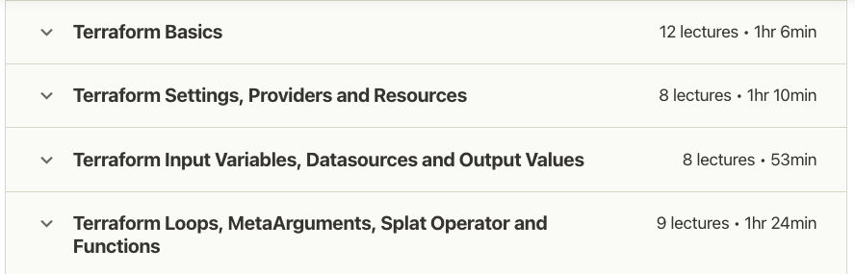
Terraform Fundamentals

Slide 9








AWS VPC 3-Tier Architecture
AWS Cloud
Availability Zone 1
Availability Zone 2
VPC
Build manually using AWS Mgmt Console
Internet gateway
Public subnet
Public subnet
Outbound Communication
Build same using Terraform
Elastic IP
address
NAT gateway
Elastic IP
address
NAT gateway
Terraform Modules
Private subnet
Private subnet
Terraform Local Values
For
EC2 Instances
For
EC2 Instances
Terraform Variables – terraform.tfvars
Terraform Variables – vpc.auto.tfvars
Private subnet
Private subnet
For
Databases
For
Databases
Terraform Version Constraints
Terraform Code Organizing – Production Grade style

Slide 10


AWS VPC + EC2 Instance + Security Groups
Admin
AWS Cloud
SSH Port 22
Availability Zone 1
Availability Zone 2
Terraform & AWS Concepts
VPC
Terraform Module: VPC
Internet gateway
Security group port 22
Public subnet
Destination: 0.0.0.0/0
Public subnet
Terraform Module: Security Group
Outbound Communication
NAT gateway
Elastic IP
address
Bastion EC2 Instance
Terraform Module: AWS EC2 Instance
Meta-Argument: depends_on
Security group port 22 & 80
Private subnet
Private subnet
Destination: 10.0.0.0/16
Terraform null_resource
Private EC2 Instance
Private EC2 Instance
Terraform File Provisioner
Terraform Remote-exec Provisioner
Private subnet
Private subnet
For
Databases
For
Databases
Terraform Local-exec Provisioner

Slide 11
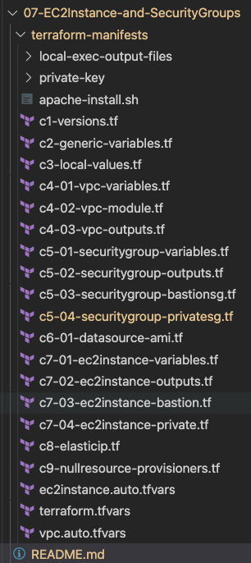
What are we going to learn ?
Create AWS VPC using Terraform Modules
Create AWS Security Groups using Terraform Modules
Create AWS AMI Datasource to get latest AMI ID dynamically
Create AWS EC2 Instance using Terraform Modules
File Provisioner
Null Resource
Remote-exec Provisioner
Variables
Local-exec
Provisioner

Slide 12

AWS VPC + EC2 Instance + Security Groups + AWS ELB Classic Load Balancer
http://hr-stag-myelb-557211422.us-east-1.elb.amazonaws.com
AWS Cloud
http://hr-stag-myelb-557211422.us-east-1.elb.amazonaws.com:81
Availability Zone 1
Availability Zone 2
VPC
Terraform & AWS Concepts
Public subnet
Classic Load Balancer
Public subnet
Terraform Module: ELB Classic LB
Terraform Module: Security Group
NAT gateway
Bastion EC2 Instance
Add Custom SG Rule for Inbound Port 81
Private subnet
Private subnet
Private EC2 Instance
Private EC2 Instance
Private subnet
Private subnet
For
Databases
For
Databases
Internet gateway

Slide 13

AWS VPC + EC2 Instance + Security Groups + AWS ALB Application Load Balancer
http://hr-stag-alb-1575108738.us-east-1.elb.amazonaws.com
AWS Cloud
Availability Zone 1
Availability Zone 2
VPC
Terraform & AWS Concepts
Public subnet
Public subnet
Terraform Module: AWS ALB
NAT gateway
Application Load Balancer
Bastion EC2 Instance
Private subnet
Private subnet
A1
A1
Private EC2 Instance
Private EC2 Instance
Private subnet
Private subnet
For
Databases
For
Databases
Internet gateway

Slide 14






AWS ALB Context Path Based Routing
http://apps.devopsincloud.com/app1
http://apps.devopsincloud.com
http://apps.devopsincloud.com/app2
AWS Cloud
Availability Zone 1
Availability Zone 2
VPC
Public subnet
Public subnet
Application Load Balancer
HTTPS
Internet gateway
NAT gateway
/app1*
/*
/app2*
Bastion EC2 Instance
Private subnet
Fixed Response
Private subnet
A1
A1
AWS Certificate Manager (ACM)
A2
A2
Amazon Route 53
Private EC2 Instance
Private EC2 Instance
Private subnet
Private subnet
For
Databases
For
Databases

Slide 15

AWS ALB Host Header Based Routing
http://app1.devopsincloud.com
http://myapps.devopsincloud.com
http://app2.devopsincloud.com
AWS Cloud
Availability Zone 1
Internet gateway
Availability Zone 2
Amazon Route 53
VPC
Public subnet
Public subnet
Application Load Balancer
HTTPS
AWS Certificate Manager (ACM)
NAT gateway
app1.devopsincloud.com
Any other domain
app2.devopsincloud.com
Bastion EC2 Instance
Private subnet
Fixed Response
Private subnet
A1
A1
A2
A2
Private EC2 Instance
Private EC2 Instance
Private subnet
Private subnet
For
Databases
For
Databases

Slide 16



AWS ALB Custom Header Based Routing & Redirects with Query String and Host Header
Host Header External Redirect 302
HTTP Header Routing
Query String External Redirect 302
http://myapps.devopsincloud.com
http://myapps.devopsincloud.com/?website=aws-eks
http://azure-aks.devopsincloud.com
Internet gateway
AWS Cloud
Availability Zone 1
Availability Zone 2
Amazon Route 53
VPC
Public subnet
Public subnet
HTTPS
Application Load Balancer
AWS Certificate Manager (ACM)
NAT gateway
cheader=my-app-1
default
cheader=my-app-2
Bastion EC2 Instance
Private subnet
Fixed Response
Private subnet
A1
A1
A2
A2
Private EC2 Instance
Private EC2 Instance
Private subnet
Private subnet
External Website-1
For
Databases
For
Databases
External Website-2

Slide 17

AWS DNS to DB using Terraform
http://dns-to-db.devopsincloud.com/app1
http://dns-to-db.devopsincloud.com/app2
http://dns-to-db.devopsincloud.com
Internet gateway
AWS Cloud
Availability Zone 1
Amazon Route 53
Availability Zone 2
VPC
Public subnet
Public subnet
HTTPS
Application Load Balancer
NAT gateway
/app1*
/*
/app2*
Bastion EC2 Instance
Private subnet
Private subnet
A1
A1
A2
A2
AWS Certificate Manager (ACM)
A3
A3
Private EC2 Instance
Private EC2 Instance
Private subnet
Private subnet
Amazon RDS DB
Amazon RDS DB

Slide 18
Upgrade Terraform Modules
Module Type
Previous Version
New Version
Impact Analysis
VPC Terraform Module
v2.78.0
v3.0.0
No Impact
Security Group Terraform Module
v3.18.0
v4.0.0
High Impact
Application Load Balancer Terraform Module
v5.16.0
v6.0.0
High Impact
ACM Certificate Manager Terraform Module
v2.14.0
v3.0.0
High Impact
There is a major change in all the modules (except vpc) related to output names of these modules which impacts all these module references wherever you use.
Actual Change: `this_` for all outputs was removed for these modules.

Slide 19





AWS Autoscaling with Launch Configuration using Terraform
http://asg-lc1.devopsincloud.com
Internet gateway
AWS Cloud
Terraform ASG Module
Availability Zone 1
Amazon Route 53
Availability Zone 2
VPC
ASG with Launch Configuration
Public subnet
Public subnet
HTTPS
Application Load Balancer
ASG Instance Refresh
NAT gateway
/*
Bastion EC2 Instance
AWS Certificate Manager (ACM)
Private subnet
Private subnet
ASG Lifecycle Hooks
Auto Scaling group
A1
A1
ASG TTSP
AWS IAM
ASG Scheduled Actions
Role
Private EC2 Instance
Private EC2 Instance
ASG Notifications
Private subnet
Private subnet
Amazon SNS
For Databases
For Databases
ASG Autoscaling Tests
Email
notification

Slide 20
AWS Autoscaling with Launch Templates using Terraform
http://asg-lt1.devopsincloud.com
Internet gateway
AWS Cloud
Terraform ASG Resource
Availability Zone 1
Amazon Route 53
Availability Zone 2
VPC
ASG with Launch Templates
Public subnet
Public subnet
HTTPS
Application Load Balancer
ASG Instance Refresh
NAT gateway
/*
Bastion EC2 Instance
AWS Certificate Manager (ACM)
Private subnet
Private subnet
ASG Lifecycle Hooks
Auto Scaling group
A1
A1
ASG TTSP
AWS IAM
ASG Scheduled Actions
Role
Private EC2 Instance
Private EC2 Instance
ASG Notifications
Private subnet
Private subnet
Amazon SNS
For Databases
For Databases
ASG Autoscaling Tests
Email
notification

Slide 21


AWS Network Load Balancer
with
TCP & TLS Listeners
using Terraform
SSL
NON-SSL
https://nlb.devopsincloud.com
http://nlb.devopsincloud.com
Internet gateway
AWS Cloud
Availability Zone 1
Amazon Route 53
Availability Zone 2
VPC
SSL-Termination
Public subnet
Public subnet
Terraform NLB Module
NAT gateway
Network Load Balancer
Bastion EC2 Instance
AWS Certificate Manager (ACM)
Private subnet
Private subnet
Terraform NLB TCP Listeners
Auto Scaling group
A1
A1
Terraform NLB TLS Listeners
AWS IAM
Terraform NLB Target Groups
Role
Private EC2 Instance
Private EC2 Instance
Terraform NLB with EC2 Autoscaling Groups
Private subnet
Private subnet
Amazon SNS
For Databases
For Databases
Email
notification

Slide 22

AWS CloudWatch using Terraform
http://cloudwatch1.devopsincloud.com
Internet gateway
AWS Cloud
Availability Zone 1
Amazon Route 53
Availability Zone 2
VPC
AWS CloudWatch
Public subnet
Public subnet
HTTPS
AWS CloudWatch
Application Load Balancer
ASG Alarms
NAT gateway
/*
Bastion EC2 Instance
AWS Certificate Manager (ACM)
Private subnet
Private subnet
ALB Alarms
Auto Scaling group
A1
A1
CIS Alarms
AWS IAM
CloudWatch Synthetics
Role
Private EC2 Instance
Private EC2 Instance
Private subnet
Private subnet
Amazon SNS
For Databases
For Databases
Email
notification

Slide 23
Build Terraform Modules Locally
Build from Scratch
Leverage existing Terraform Modules and change the code as per your need
If already not available, then use this approach
If already available, use the code and modify as per your need
Review existing modules in Terraform Public Registry (Minimum 3 modules to get complete idea)
Less effort and you can start using them in your private infrastructure spaces without public internet access

Slide 24
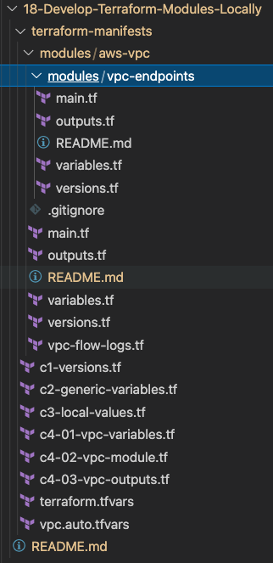
What are we going to learn ?
AWS VPC Module
AWS VPC Modules - VPC Endpoints Sub Module
Root Module calling the VPC Local Module

Slide 25
Terraform State
Terraform
Local
State
Storage
Terraform
Remote
State
Storage

Slide 26


What is Terraform Backend ?
Backends are responsible for storing state and providing an API for state locking.
Terraform State Storage
Terraform State Locking
AWS S3 Bucket
AWS DynamoDB

Slide 27









Local State File
Remote State File
Admin1
Admin2
Admin3
Multiple Team members
cannot update the infrastructure as they don’t have access to State File
Using Terraform Backend concept we can use AWS S3 as the shared storage for State Files
Admin1
Admin2
Admin3
Admin1
Desktop
Admin2
Desktop
Admin3
Desktop
This means we need store the state file in a shared location.
If two team members are running Terraform at the same time, you may run into race conditions as multiple Terraform processes make concurrent updates to the state files, leading to conflicts, data loss, and state file corruption.
Admin1
Desktop
terraform.tfstate
AWS S3 Bucket
terraform.tfstate
EC2
Instance
EC2
Instance
AWS Cloud
Implement State Locking
AWS Cloud

Slide 28
Terraform Remote State File with State Locking
Admin1
Admin2
Admin3
Not all backends support State Locking. AWS S3 supports State Locking
State locking happens automatically on all operations that could write state.
Admin1
Desktop
Admin2
Desktop
Admin3
Desktop
If state locking fails, Terraform will not continue.
You can disable state locking for most commands with the -lock flag but it is not recommended.
If acquiring the lock is taking longer than expected, Terraform will output a status message.
AWS S3 Bucket
terraform.tfstate
AWS DynamoDB
If Terraform doesn't output a message, state locking is still occurring if your backend supports it.
EC2
Instance
Terraform has a force-unlock command to manually unlock the state if unlocking failed.
AWS Cloud

Slide 29
Terraform Remote State Datasource
The terraform_remote_state data source retrieves the root module output values from some other Terraform configuration, using the latest state snapshot from the remote backend.
Project-1
Project-2
AWS VPC
AWS ASG, ALB, Route53
terraform_remote_state data source
project-1/terraform.tfstate
project-2/terraform.tfstate

Slide 30
Terraform Remote State Datasource
http://tfremoteds.devopsincloud.com
Internet gateway
Project-1
AWS Cloud
Availability Zone 1
Amazon Route 53
Availability Zone 2
VPC Resources
VPC
Public subnet
Public subnet
HTTPS
Application Load Balancer
Project-2
NAT gateway
/*
Bastion EC2 Instance
AWS Certificate Manager (ACM)
Private subnet
Private subnet
Autoscaling Groups
Auto Scaling group
Application Load Balancers
A1
A1
AWS IAM
AWS Route53
Role
Private EC2 Instance
Private EC2 Instance
AWS Certificate Manager
Private subnet
Private subnet
AWS SNS
Amazon SNS
For Databases
For Databases
AWS IAM
Email
notification

Slide 31




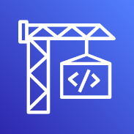







IaC DevOps
On
AWS
AWS CodePipeline
Manager
Dev Deploy
Stage
Manual Approval Stage
Stag Deploy
Stage
Developer
GitHub
AWS CodeBuild
Email
AWS CodeBuild
Email notification
Route 53
Application Load Balancer
Certificate
Manager
EC2 Auto Scaling
NAT
Gateway
Route 53
Application Load Balancer
Certificate
Manager
EC2 Auto Scaling
NAT
Gateway
Dev
Stage
SNS
Bastion
EC2 Instance
AWS IAM
VPC
SNS
Bastion
EC2 Instance
AWS IAM
VPC

Slide 32
http://devdemo1.devopsincloud.com
Internet gateway
AWS Cloud
Dev
Environment
Availability Zone 1
Amazon Route 53
Availability Zone 2
VPC
Public subnet
Public subnet
HTTPS
Application Load Balancer
NAT gateway
/*
Bastion EC2 Instance
AWS Certificate Manager (ACM)
Private subnet
Private subnet
Staging
Environment
Auto Scaling group
A1
A1
AWS IAM
Role
Private EC2 Instance
Private EC2 Instance
Private subnet
Private subnet
Amazon SNS
For Databases
For Databases
Email
notification

Slide 33

Terraform
Infrastructure as Code
IaC

Slide 34
What is Infrastructure as Code ?

Slide 35
Traditional Way of Managing Infrastructure
Admin-1
Admin-1
Admin-2
Admin-2
Admin-2
Documentation
Dev
QA
Staging
Production
Disaster
Recovery
5 Days
5 Days
5 Days
5 Days
5 Days
Total Time: 25 Days

Slide 36
Traditional Way of Managing Infrastructure
Admin-1
Admin-1
Admin-2
Admin-2
Admin-2
Documentation
(Steps Missing)
Dev
QA
Staging
Production
Disaster
Recovery
No CI
Delays
Issues
Outages
Not-in-Sync
Many Problems at many places in manual process

Slide 37

Traditional Way of Managing Infrastructure
Admin-1
Admin-1
Admin-2
Admin-2
Admin-2
Documentation
Dev
QA
Staging
Production
Disaster
Recovery
Dev
QA
Staging
Production
Disaster
Recovery
Admin-3
Admin-3
Admin-4
Admin-4
Admin-4
Documentation
Infrastructure scalability – Workforce need to be increased to meet the timelines

Slide 38
Traditional Way of Managing Infrastructure
Prod-1
Prod-2
Prod-3
Prod-4
Scale Up
Prod-1
Prod-2
Scale Down
On-Demand Scale-Up and Scale-Down is not an option

Slide 39


Manage using IaC with Terraform
5 Days
Admin-1
Github
DevOps / CI CD for IaC
Check-In TF Code
Triggers
TF Runs
Terraform
Cloud
Scale-Up and Scale-Down On-Demand
Creates Infra
Dev
QA
Staging
Production
Disaster
Recovery
One-Time
Work
Re-Use
Templates
Quick & Fast
Reliable
Tracked for Audit
Total Time: 25 Days reduced to 5 days, Provisioning environments will be in minutes or seconds

Slide 40
Manage using IaC with Terraform
Visibility
IaC serves as a very clear reference of what resources we created, and what their settings are. We don’t have to navigate to the web console to check the parameters.
Stability
If you accidentally change the wrong setting or delete the wrong resource in the web console you can break things. IaC helps solve this, especially when it is combined with version control, such as Git.
Scalability
With IaC we can write it once and then reuse it many times. This means that one well written template can be used as the basis for multiple services, in multiple regions around the world, making it much easier to horizontally scale.
Security
Once again IaC gives you a unified template for how to deploy our architecture. If we create one well secured architecture we can reuse it multiple times, and know that each deployed version is following the same settings.
Audit
Terraform not only creates resources it also maintains the record of what is created in real world cloud environments using its State files.

Slide 41
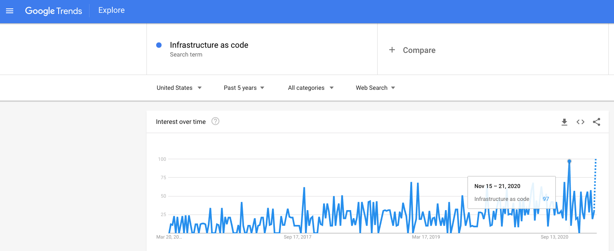
Google Trends – Past 5 Years

Slide 42
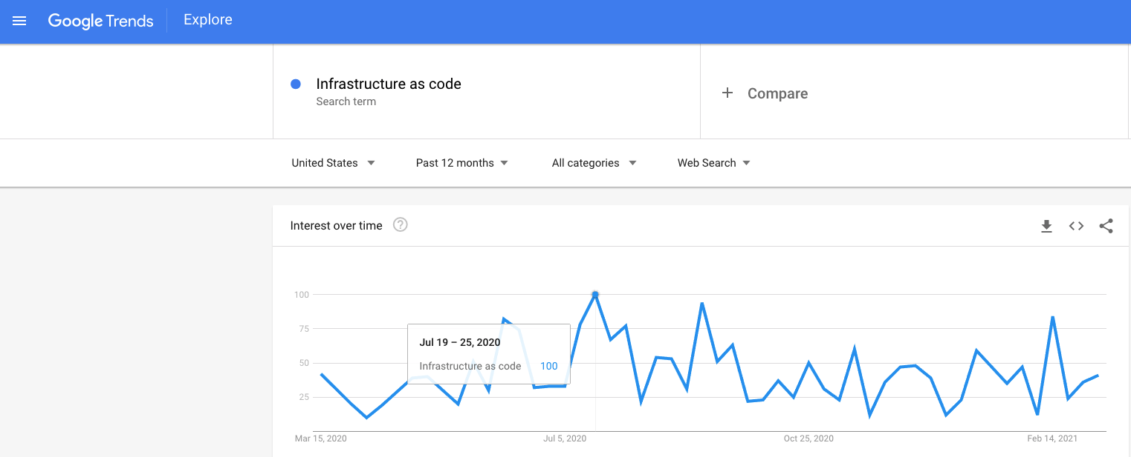
Google Trends – Past 1 Year

Slide 43
Terraform
Installation

Slide 44
Terraform Installation
Terraform CLI
AWS CLI
VS Code Editor
Terraform plugin for VS Code
Mac OS
Windows OS
Linux OS

Slide 45
Terraform
Command Basics

Slide 46
Terraform Workflow
1
2
3
4
5
init
validate
plan
apply
destroy
terraform init
terraform validate
terraform plan
terraform apply
terraform destroy

Slide 47
Terraform Workflow
1
2
3
4
5
init
validate
plan
apply
destroy
Used to Initialize a working directory containing terraform config files
This is the first command that should be run after writing a new Terraform configuration
Downloads Providers
Validates the terraform configurations files in that respective directory to ensure they are syntactically valid and internally consistent.
Creates an execution plan
Terraform performs a refresh and determines what actions are necessary to achieve the desired state specified in configuration files
Used to apply the changes required to reach the desired state of the configuration.
By default, apply scans the current directory for the configuration and applies the changes appropriately.
Used to destroy the Terraform-managed infrastructure
This will ask for confirmation before destroying.

Slide 48
Terraform
Language Basics

Slide 49
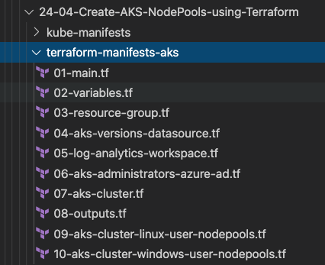
Terraform Language Basics – Files
Terraform Working Directory
Code in the Terraform language is stored in plain text files with the .tf file extension.
There is also a JSON-based variant of the language that is named with the .tf.json file extension.
We can call the files containing terraform code as Terraform Configuration Files or Terraform Manifests
Terraform Configuration Files ending with .tf as extension

Slide 50
Terraform Language Basics – Configuration Syntax
Blocks
Arguments
HCL – HashiCorp Language
Terraform
Identifiers
Comments

Slide 51
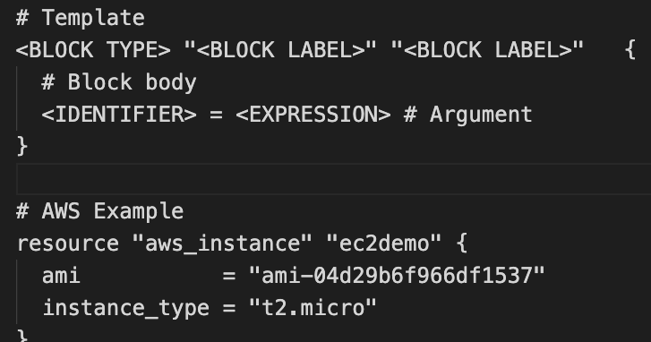
Terraform Language Basics – Configuration Syntax
Block Labels
Block Type
Based on Block Type block labels will be 1 or 2
Example: Resource – 2 labels
Variables – 1 label
Top Level & Block inside Blocks
Top Level Blocks: resource, provider
Arguments
Block Inside Block: provisioners, resource specific blocks like tags

Slide 52
Terraform Language Basics – Configuration Syntax
Argument Name
[or]
Identifier
Argument Value
[or]
Expression

Slide 53
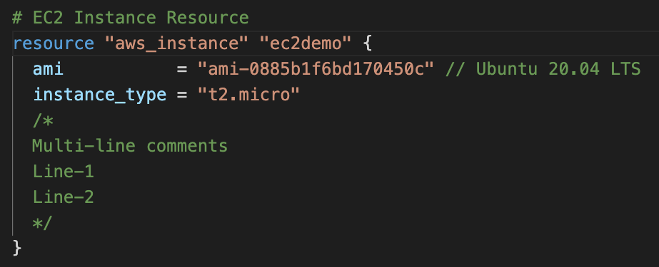
Terraform Language Basics – Configuration Syntax
Single Line Comments with # or //
Multi-line comment

Slide 54
Terraform language uses a limited number of top-level block types, which are blocks that can appear outside of any other block in a TF configuration file.
Terraform
Top-Level
Blocks
Most of Terraform's features are implemented as top-level blocks.
Terraform Block
Input Variables Block
Data Sources Block
Providers Block
Output Values Block
Modules Block
Resources Block
Local Values Block
Fundamental Blocks
Variable Blocks
Calling / Referencing Blocks

Slide 55
Terraform
Fundamental Blocks

Slide 56
Terraform Basic Blocks
Terraform
Block
Provider
Block
Resource
Block
Special block used to configure some behaviors
HEART of Terraform
Each Resource Block describes one or more Infrastructure Objects
Required Terraform Version
Terraform relies on providers to interact with Remote Systems
Resource Syntax:
How to declare Resources?
List Required Providers
Declare providers for Terraform to install providers & use them
Resource Behavior: How Terraform handles resource declarations?
Terraform Backend
Provider configurations belong to Root Module
Provisioners: We can configure Resource post-creation actions
c1-versions.tf
c2-resource-name.tf

Slide 57
Terraform
Block

Slide 58
Terraform Block
This block can be called in 3 ways. All means the same.
Terraform Block
Terraform Settings Block
Terraform Configuration Block
Each terraform block can contain a number of settings related to Terraform's behavior.
VERY VERY IMPORTANT TO MEMORIZE
Within a terraform block, only constant values can be used; arguments may not refer to named objects such as resources, input variables, etc, and may not use any of the Terraform language built-in functions.

Slide 59
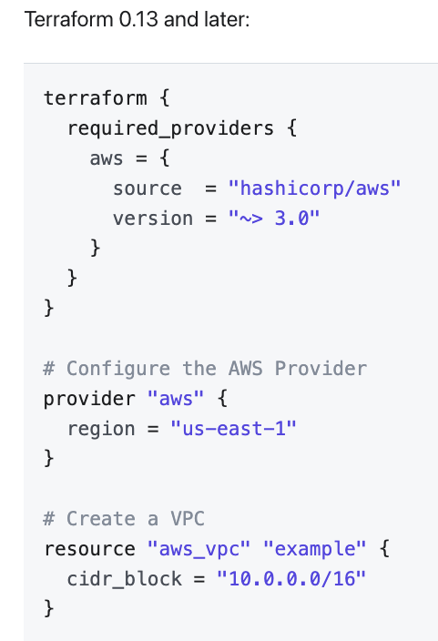
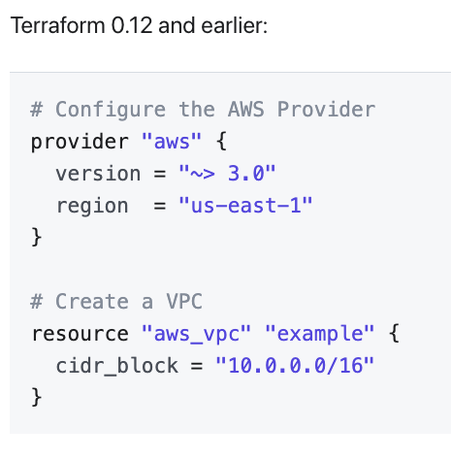
Terraform Block from 0.13 onwards

Slide 60
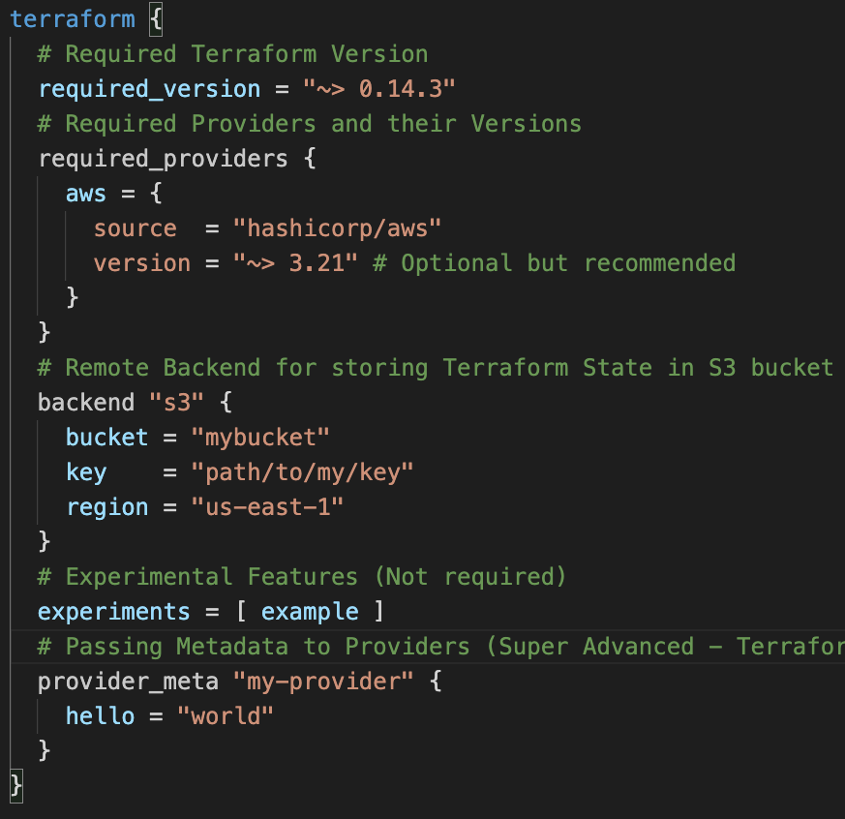
Terraform Block
Required Terraform Version
Provider Requirements
Terraform Block
Terraform Backend
Experimental Language Features
Passing Metadata to
Providers

Slide 61
Terraform
Providers

Slide 62







Terraform Providers
Providers are HEART of Terraform
Every Resource Type (example: EC2 Instance), is implemented by a Provider
Without Providers Terraform cannot manage any infrastructure.
Terraform Admin
Providers are distributed separately from Terraform and each provider has its own release cycles and Version Numbers
Terraform Registry is publicly available which contains many Terraform Providers for most major Infra Platforms
Local Desktop
1
AWS Cloud
terraform init
Terraform CLI
VPC
Download Provider
Terraform Registry
Public subnet
Terraform AWS
Provider
4
terraform apply
AWS
APIs
5
terraform destroy
EC2 Instance
2
terraform validate
3
terraform plan

Slide 63
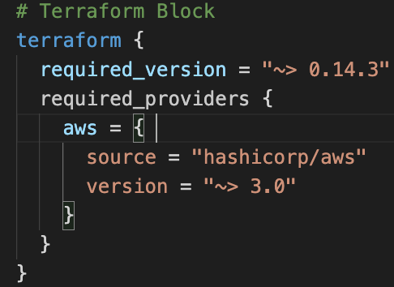
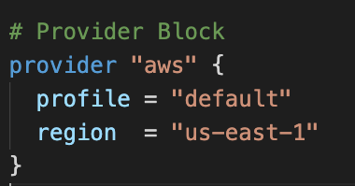
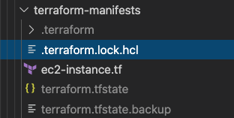
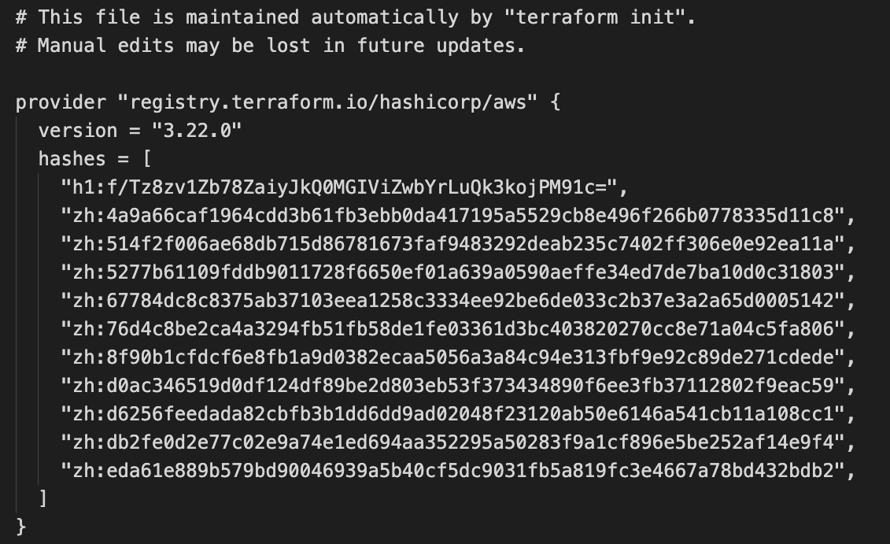
Terraform
Providers
Provider Requirements
Provider Configuration
Dependency Lock File

Slide 64
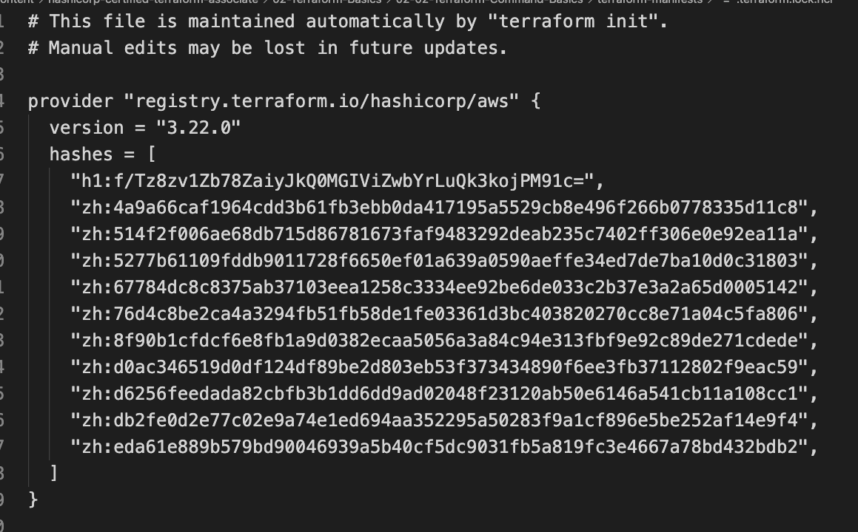
Dependency Lock File

Slide 65
Required Providers
Local Names
Local Names are Module specific and should be unique per-module
Terraform configurations always refer to local name of provider outside required_provider block
Users of a provider can choose any local name for it (myaws, aws1, aws2).
Recommended way of choosing local name is to use preferred local name of that provider (For AWS Provider: hashicorp/aws, preferred local name is aws)
Source
It is the primary location where we can download the Terraform Provider
Source addresses consist of three parts delimited by slashes (/)
[<HOSTNAME>/]<NAMESPACE>/<TYPE>
registry.terraform.io/hashicorp/aws
Registry Name is optional as default is going to be Terraform Public Registry

Slide 66




Terraform Registry
Terraform Provider Registry
Providers
registry.terraform.io
Modules
Provider Badges
These are owned and maintained by HashiCorp
Provider Documentation
These are owned and maintained by third-party technology partners. HashiCorp has verified the authenticity of the Provider’s publisher
Community providers are published to the Terraform Registry by individual maintainers, groups of maintainers, or other members of the Terraform community.
Archived Providers are Official or Verified Providers that are no longer maintained by HashiCorp or the community.

Slide 67
Terraform
Resources
Introduction

Slide 68
Terraform Language Basics – Configuration Syntax
Block Labels
Block Type
Based on Block Type block labels will be 1 or 2
Example: Resource – 2 labels
Variables – 1 label
Top Level & Block inside Blocks
Top Level Blocks: resource, provider
Arguments
Block Inside Block: provisioners, resource specific blocks like tags

Slide 69
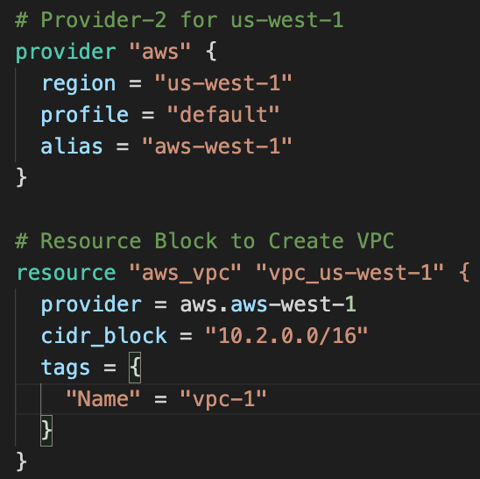
Resource Syntax
Resource Type: It determines the kind of infrastructure object it manages and what arguments and other attributes the resource supports.
Resource Local Name: It is used to refer to this resource from elsewhere in the same Terraform module, but has no significance outside that module's scope.
The resource type and name together serve as an identifier for a given resource and so must be unique within a module
Meta-Arguments: Can be used with any resource to change the behavior of resources
Resource Arguments: Will be specific to resource type. Argument Values can make use of Expressions or other Terraform Dynamic Language Features

Slide 70
Terraform
State

Slide 71
Resource Behavior
Create Resource
Create resources that exist in the configuration but are not associated with a real infrastructure object in the state.
Destroy Resource
Destroy resources that exist in the state but no longer exist in the configuration.
Terraform Resource
Update in-place Resources
Update in-place resources whose arguments have changed.
Destroy and re-create
Destroy and re-create resources whose arguments have changed but which cannot be updated in-place due to remote API limitations.
Terraform State

Slide 72

Terraform State
Terraform must store state about your managed infrastructure and configuration
Terraform
Admin
This state is used by Terraform to map real world resources to your configuration (.tf files), keep track of metadata, and to improve performance for large infrastructures.
Local Desktop
This state is stored by default in a local file named "terraform.tfstate", but it can also be stored remotely, which works better in a team environment.
1
terraform init
AWS Cloud
Terraform CLI
VPC
Download Provider
Terraform Registry
Public subnet
Terraform AWS
Provider
4
terraform apply
AWS
APIs
5
terraform destroy
EC2 Instance
2
terraform validate
3
terraform plan
The primary purpose of Terraform state is to store bindings between objects in a remote system and resource instances declared in your configuration.
Terraform State
File
terraform.tfstate
When Terraform creates a remote object in response to a change of configuration, it will record the identity of that remote object against a particular resource instance, and then potentially update or delete that object in response to future configuration changes.

Slide 73
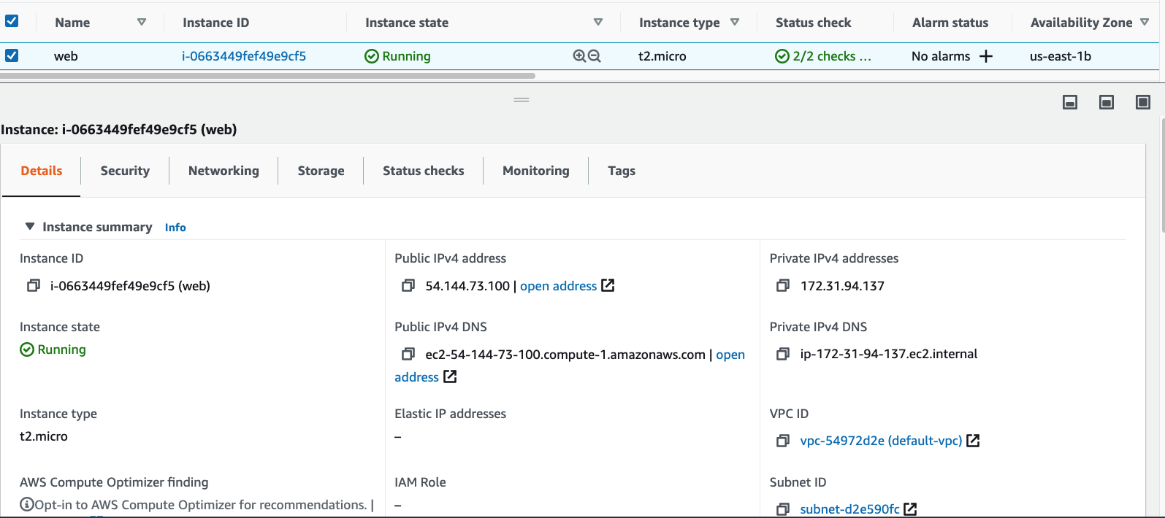

Desired & Current Terraform States
Terraform Configuration Files
Real World Resource – EC2 Instance
terraform.tfstate
Desired State
Current State

Slide 74
Terraform
Input Variables
Datasources
Outputs

Slide 75



What are we going to learn ?
Terraform
Concepts
AWS Services
Terraform Input Variables
AWS Cloud
Default VPC
Terraform Output Values
Public subnet
Security group
EC2 Instance
VPC-SSH
Security group
EC2 Key Pair
VPC-Web
Terraform Datasources
Dynamically get latest AMI ID

Slide 76
Terraform Variables
Terraform
Input
Variables
Terraform
Output
Values
Terraform
Local
Values

Slide 77
Terraform Input Variables
Input variables serve as parameters for a Terraform module, allowing aspects of the module to be customized without altering the module's own source code, and allowing modules to be shared between different configurations.
Input Variables - Basics
1
6
Provide Input Variables using <any-name>.tfvars file with CLI
argument -var-file
Provide Input Variables when prompted during terraform plan or apply
2
7
Provide Input Variables using auto.tfvars files
Terraform Input Variables
Override default variable values using CLI argument -var
3
8
Implement complex type constructors like List & Map in Input Variables
Override default variable values using Environment Variables (TF_var_aa)
9
Implement Custom Validation Rules in Variables
4
Provide Input Variables using terraform.tfvars files
5
10
Protect Sensitive Input Variables

Slide 78
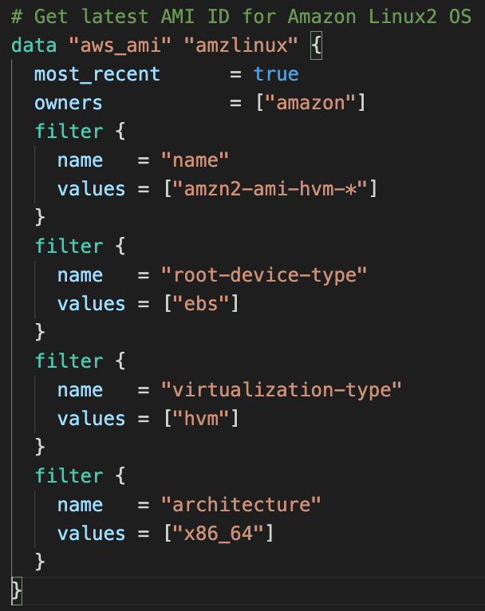
Terraform Datasources
Data sources allow data to be fetched or computed for use elsewhere in Terraform configuration.
Use of data sources allows a Terraform configuration to make use of information defined outside of Terraform, or defined by another separate Terraform configuration.
A data source is accessed via a special kind of resource known as a data resource, declared using a data block
Each data resource is associated with a single data source, which determines the kind of object (or objects) it reads and what query constraint arguments are available
Data resources have the same dependency resolution behavior as defined for managed resources. Setting the depends_on meta-argument within data blocks defers reading of the data source until after all changes to the dependencies have been applied.

Slide 79
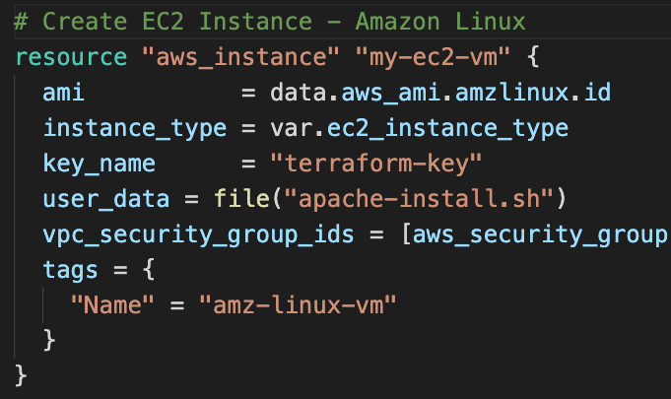
Terraform Datasources
We can refer the data resource in a resource as depicted
Meta-Arguments for Datasources
Data resources support the provider meta-argument as defined for managed resources, with the same syntax and behavior.
Data resources do not currently have any customization settings available for their lifecycle, but the lifecycle nested block is reserved in case any are added in future versions.
Data resources support count and for_each meta-arguments as defined for managed resources, with the same syntax and behavior.
Each instance will separately read from its data source with its own variant of the constraint arguments, producing an indexed result.

Slide 80
Terraform Variables – Output Values
Output values are like the return values of a Terraform module and have several uses
A root module can use outputs to print certain values in the CLI output after running terraform apply.
A child module can use outputs to expose a subset of its resource attributes to a parent module.
1
Terraform Variables
Outputs
2
When using remote state, root module outputs can be accessed by other configurations via a terraform_remote_state data source.
Advanced
3

Slide 81
Terraform
For Loops
Lists & Maps
Meta-Argument Count & for_each

Slide 82
Section-1
Section-2
Section-3
Meta-Argument: count
Meta-Argument: for_each
Datasource:
aws_ec2_instance_type_offerings
Variables: Lists & Maps
Function: toset
Datasource:
aws_availability_zones
For Loop with Lists
Function: tomap
For Loop with Maps
For Loop with Maps
Datasource: aws_availability_zones
For Loop with if
For Loops with Advanced Maps
Function: keys
Section-4
Legacy Splat Operator (.*.)
Fix issues in Section-2 with section-3
Utility Project with
Datasources
Latest Splat Operator [*]
Final Output

Slide 83




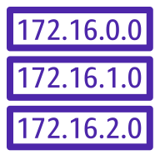


Amazon Virtual Private Cloud (Amazon VPC)
Internet gateway
NAT gateway
Elastic IP
address
Route table
Public Subnet
Private Subnet
AWS VPC
3-Tier
Web, App and DB

Slide 84
AWS VPC 3-Tier Architecture
AWS Cloud
Availability Zone 1
Availability Zone 2
VPC
Build manually using AWS Mgmt Console
Internet gateway
Public subnet
Public subnet
Outbound Communication
Build same using Terraform
Elastic IP
address
NAT gateway
Elastic IP
address
NAT gateway
Terraform Modules
Private subnet
Private subnet
Terraform Local Values
For
EC2 Instances
For
EC2 Instances
Terraform Variables – terraform.tfvars
Terraform Variables – vpc.auto.tfvars
Private subnet
Private subnet
For
Databases
For
Databases
Terraform Version Constraints
Terraform Code Organizing – Production Grade style

Slide 85
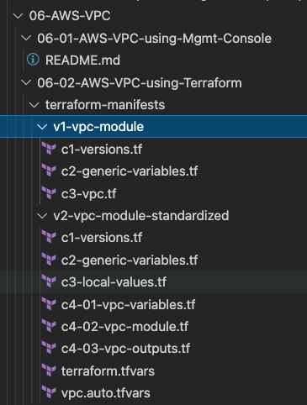
What are we going to Learn ?
Build VPC manually using AWS Management Console
Build VPC using Terraform Modules
Standardize the Terraform Code at Production Grade

Slide 86
Terraform Modules
Modules are containers for multiple resources that are used together. A module consists of a collection of .tf files kept together in a directory.
Modules are the main way to package and reuse resource configurations with Terraform.
A module that has been called by another module is often referred to as a child module.
Every Terraform configuration has at least one module, known as its root module, which consists of the resources defined in the .tf files in the main working directory
Child modules can be called multiple times within the same configuration, and multiple configurations can use the same child module.
A Terraform module (usually the root module of a configuration) can call other modules to include their resources into the configuration.
In addition to modules from the local filesystem, Terraform can load modules from a public or private registry.
This makes it possible to publish modules for others to use, and to use modules that others have published.

Slide 87

Amazon Virtual Private Cloud (Amazon VPC)
Internet gateway
NAT gateway
Elastic IP
address
Route table
Public Subnet
Private Subnet
AWS
VPC with Web, App and DB Tiers
EC2 Instances, Bastion Host and
Security Groups
Security group
EC2 Instance

Slide 88
AWS VPC + EC2 Instance + Security Groups
Admin
AWS Cloud
SSH Port 22
Availability Zone 1
Availability Zone 2
Terraform & AWS Concepts
VPC
Terraform Module: VPC
Internet gateway
Security group port 22
Public subnet
Destination: 0.0.0.0/0
Public subnet
Terraform Module: Security Group
Outbound Communication
NAT gateway
Elastic IP
address
Bastion EC2 Instance
Terraform Module: AWS EC2 Instance
Meta-Argument: depends_on
Security group port 22 & 80
Private subnet
Private subnet
Destination: 10.0.0.0/16
Terraform null_resource
Private EC2 Instance
Private EC2 Instance
Terraform File Provisioner
Terraform Remote-exec Provisioner
Private subnet
Private subnet
For
Databases
For
Databases
Terraform Local-exec Provisioner

Slide 89
What are we going to learn ?
Create AWS VPC using Terraform Modules
Create AWS Security Groups using Terraform Modules
Create AWS AMI Datasource to get latest AMI ID dynamically
Create AWS EC2 Instance using Terraform Modules
File Provisioner
Null Resource
Remote-exec Provisioner
Variables
Local-exec
Provisioner

Slide 90

Amazon Virtual Private Cloud (Amazon VPC)
Internet gateway
NAT gateway
Elastic IP
address
Route table
Public Subnet
Private Subnet
AWS
VPC with Web, App and DB Tiers
EC2 Instances, Bastion Host and Security Groups
Classic Load Balancer
Security group
EC2 Instance
Security Groups
Classic Load Balancer

Slide 91
AWS VPC + EC2 Instance + Security Groups + AWS ELB Classic Load Balancer
http://hr-stag-myelb-557211422.us-east-1.elb.amazonaws.com
AWS Cloud
http://hr-stag-myelb-557211422.us-east-1.elb.amazonaws.com:81
Availability Zone 1
Availability Zone 2
VPC
Terraform & AWS Concepts
Public subnet
Classic Load Balancer
Public subnet
Terraform Module: ELB Classic LB
Terraform Module: Security Group
NAT gateway
Bastion EC2 Instance
Add Custom SG Rule for Inbound Port 81
Private subnet
Private subnet
Private EC2 Instance
Private EC2 Instance
Private subnet
Private subnet
For
Databases
For
Databases
Internet gateway

Slide 92
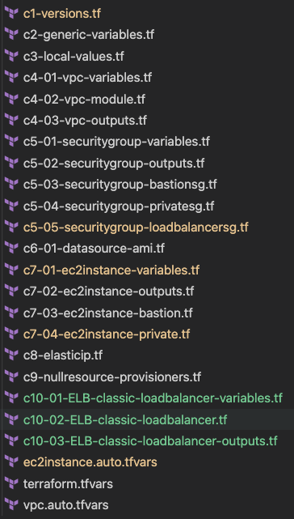
What are we going to learn ?
Create Security Group to allow access from Internet to Load Balancer using AWS Security Group Terraform Module
Create AWS ELB Classic Load Balancer using Terraform Modules

Slide 93

Amazon Virtual Private Cloud (Amazon VPC)
Internet gateway
NAT gateway
Elastic IP
address
Route table
Public Subnet
Private Subnet
AWS
VPC with Web, App and DB Tiers
EC2 Instances, Bastion Host and Security Groups
Application Load Balancer - Basic
Security group
EC2 Instance
Security Groups
Classic Load Balancer
Application Load Balancer

Slide 94
AWS VPC + EC2 Instance + Security Groups + AWS ALB Application Load Balancer
http://hr-stag-alb-1575108738.us-east-1.elb.amazonaws.com
AWS Cloud
Availability Zone 1
Availability Zone 2
VPC
Terraform & AWS Concepts
Public subnet
Public subnet
Terraform Module: AWS ALB
NAT gateway
Application Load Balancer
Bastion EC2 Instance
Private subnet
Private subnet
A1
A1
Private EC2 Instance
Private EC2 Instance
Private subnet
Private subnet
For
Databases
For
Databases
Internet gateway

Slide 95
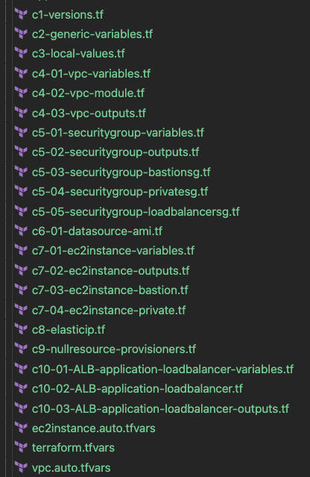
What are we going to learn ?
Create Security Group to allow access from Internet to Load Balancer using AWS Security Group Terraform Module
Create AWS ALB Application Load Balancer using Terraform Modules

Slide 96
Amazon Virtual Private Cloud (Amazon VPC)
Internet gateway
NAT gateway
Elastic IP
address
Route table
Public Subnet
Private Subnet
AWS
VPC with Web, App and DB Tiers
EC2 Instances, Bastion Host and Security Groups
Application Load Balancer
Context Path Based Routing
Security group
EC2 Instance
Classic Load Balancer
Application Load Balancer
AWS Certificate Manager (ACM)
Amazon Route 53
Security Groups

Slide 97
AWS ALB Context Path Based Routing
http://apps.devopsincloud.com/app1
http://apps.devopsincloud.com
http://apps.devopsincloud.com/app2
AWS Cloud
Availability Zone 1
Availability Zone 2
VPC
Public subnet
Public subnet
Application Load Balancer
HTTPS
Internet gateway
NAT gateway
/app1*
/*
/app2*
Bastion EC2 Instance
Private subnet
Fixed Response
Private subnet
A1
A1
AWS Certificate Manager (ACM)
A2
A2
Amazon Route 53
Private EC2 Instance
Private EC2 Instance
Private subnet
Private subnet
For
Databases
For
Databases

Slide 98
Load Balancer SG
Add Port 443
Other TF Configs
ALB TF Configs
Listeners HTTP:80 and HTTPS:443
EC2 Private Instances
App1
Target Groups for App1 and App2
AWS
ALB
Context Path Based Routing
EC2 Private Instances
App2
HTTP Listener Redirect to HTTPS
AWS Certificate Manager
for SSL (HTTPS)
HTTPS Listener Return Fixed Response for /*
AWS Route53 DNS
Registration
HTTPS Listener Rules for /app1* and /app2*

Slide 99
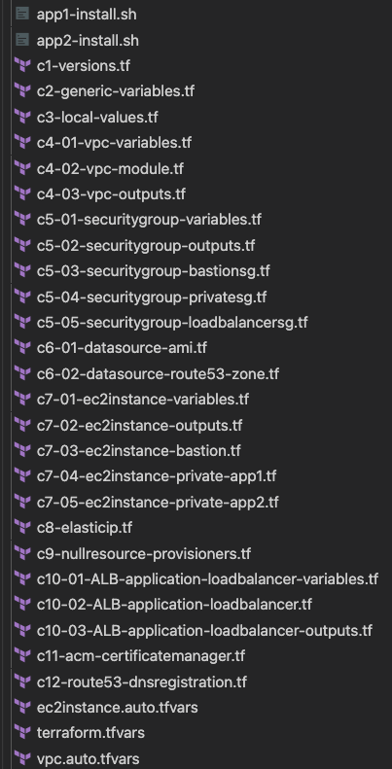
What are we going to learn ?
App1 and App2 Userdata
Allow HTTPS 443 in Load Balancer SG
Route53 Hosted Zone Datasource
Define App1 and App2 EC2 Instances and also configure their equivalent Outputs
Define ALB HTTP and HTTPS Listeners, App1 and 2 Target Groups, Listener Rules, Redirects etc
Define SSL Certificate using AWS Certificate Manager Service
Create Route53 DNS Record

Slide 100
Amazon Virtual Private Cloud (Amazon VPC)
Internet gateway
NAT gateway
Elastic IP
address
Route table
Public Subnet
Private Subnet
AWS
VPC with Web, App and DB Tiers
EC2 Instances, Bastion Host and Security Groups
Application Load Balancer
Host Header Based Routing
Security group
EC2 Instance
Classic Load Balancer
Application Load Balancer
AWS Certificate Manager (ACM)
Amazon Route 53
Security Groups

Slide 101
AWS ALB Host Header Based Routing
http://app1.devopsincloud.com
http://myapps.devopsincloud.com
http://app2.devopsincloud.com
AWS Cloud
Availability Zone 1
Internet gateway
Availability Zone 2
Amazon Route 53
VPC
Public subnet
Public subnet
Application Load Balancer
HTTPS
AWS Certificate Manager (ACM)
NAT gateway
app1.devopsincloud.com
Any other domain
app2.devopsincloud.com
Bastion EC2 Instance
Private subnet
Fixed Response
Private subnet
A1
A1
A2
A2
Private EC2 Instance
Private EC2 Instance
Private subnet
Private subnet
For
Databases
For
Databases

Slide 102
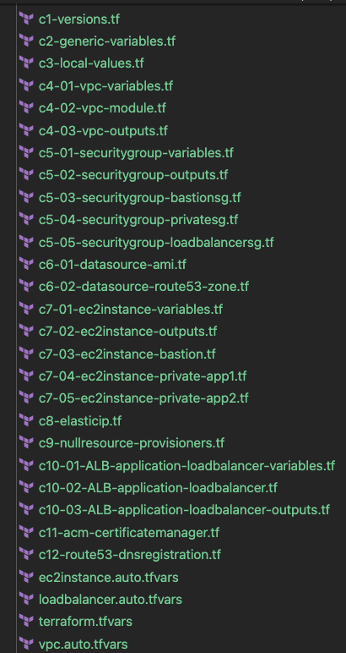
What are we going to learn ?
Changes related to ALB Variables and ALB Host Header settings
Changes related to Multiple DNS Names in Route53
Multiple DNS Names reference in ALB and Route53 DNS – So created variables for DNS Names

Slide 103
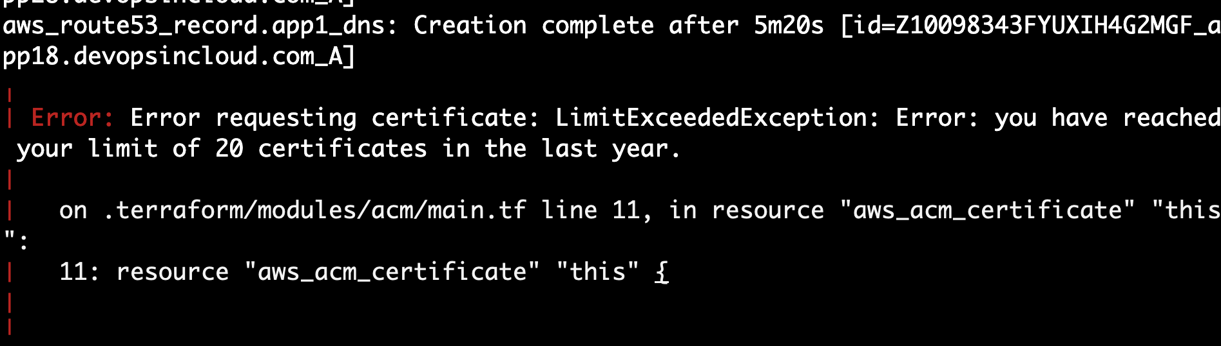
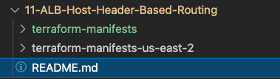
AWS ACM Certificate Limit Issue

Slide 104
Amazon Virtual Private Cloud (Amazon VPC)
Internet gateway
NAT gateway
Elastic IP
address
Route table
Public Subnet
Private Subnet
AWS
VPC with Web, App and DB Tiers
EC2 Instances, Bastion Host and Security Groups
Application Load Balancer
AWS Certificate Manager (ACM)
Rule-1: Custom HTTP Header Routing to App1 TG
Rule-2: Custom HTTP Header Routing to App2 TG
Rule-3: Query String with 302 Redirect
Rule-4: Host Header with 302 Redirect
Amazon Route 53
Security group
EC2 Instance
Security Groups
Classic Load Balancer
Application Load Balancer

Slide 105
AWS ALB Custom Header Based Routing & Redirects with Query String and Host Header
Host Header External Redirect 302
HTTP Header Routing
Query String External Redirect 302
http://myapps.devopsincloud.com
http://myapps.devopsincloud.com/?website=aws-eks
http://azure-aks.devopsincloud.com
Internet gateway
AWS Cloud
Availability Zone 1
Availability Zone 2
Amazon Route 53
VPC
Public subnet
Public subnet
HTTPS
Application Load Balancer
AWS Certificate Manager (ACM)
NAT gateway
cheader=my-app-1
default
cheader=my-app-2
Bastion EC2 Instance
Private subnet
Fixed Response
Private subnet
A1
A1
A2
A2
Private EC2 Instance
Private EC2 Instance
Private subnet
Private subnet
External Website-1
For
Databases
For
Databases
External Website-2

Slide 106
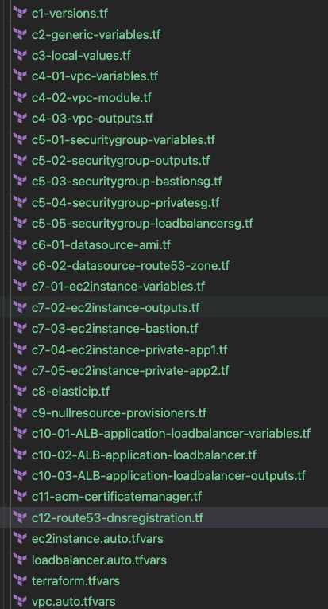
What are we going to learn ?
Added new Rules 1 to 4 outlining Custom HTTP Header and Redirects with Query String and Host Header
Added DNS Records as per need for this usecase

Slide 107

Amazon Virtual Private Cloud (Amazon VPC)
Internet gateway
NAT gateway
Elastic IP
address
Route table
Public Subnet
Private Subnet
AWS
VPC with Web, App and DB Tiers
EC2 Instances, Bastion Host and Security Groups
Application Load Balancer
DNS to DB
Security group
EC2 Instance
Classic Load Balancer
Application Load Balancer
AWS Certificate Manager (ACM)
Amazon Route 53
Amazon RDS DB
Security Groups

Slide 108
AWS DNS to DB using Terraform
http://dns-to-db.devopsincloud.com/app1
http://dns-to-db.devopsincloud.com/app2
http://dns-to-db.devopsincloud.com
Internet gateway
AWS Cloud
Availability Zone 1
Amazon Route 53
Availability Zone 2
VPC
Public subnet
Public subnet
HTTPS
Application Load Balancer
NAT gateway
/app1*
/*
/app2*
Bastion EC2 Instance
Private subnet
Private subnet
A1
A1
A2
A2
AWS Certificate Manager (ACM)
A3
A3
Private EC2 Instance
Private EC2 Instance
Private subnet
Private subnet
Amazon RDS DB
Amazon RDS DB

Slide 109
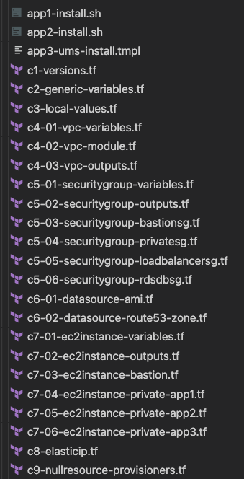
What are we going to learn ?
App3 User Management Application (UMS) which needs Database Userdata for App3 EC2 Instances
Add HTTP 8080 for Private Instances Security Group which is an UMS App Listen Port
RDS Database Security Group
Define Outputs for App3 EC2 Instances
Update Bastion EC2 Instance to have Userdata containing automatic install of MySQL Client to check RDS DB Connection
Create Private EC2 Instances for App3

Slide 110
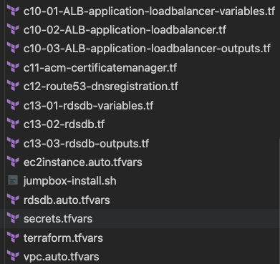
What are we going to learn ?
Create App3 Target Groups and Listener Rules
Create dns-to-db Route53 Record
Create RDS Database Variables, RDS Module and RDS Outputs
Create Userdata for Bastion Host to install MYSQL Client during creation of EC2 Instance using userdata
Define RDS Database Variables
Create RDS DB related password as secure variable in secret.tfvars

Slide 111
Upgrade Terraform Modules
Module Type
Previous Version
New Version
Impact Analysis
VPC Terraform Module
v2.78.0
v3.0.0
No Impact
Security Group Terraform Module
v3.18.0
v4.0.0
High Impact
Application Load Balancer Terraform Module
v5.16.0
v6.0.0
High Impact
ACM Certificate Manager Terraform Module
v2.14.0
v3.0.0
High Impact
There is a major change in all the modules (except vpc) related to output names of these modules which impacts all these module references wherever you use.
Actual Change: `this_` for all outputs was removed for these modules.

Slide 112

Amazon Virtual Private Cloud (Amazon VPC)
Internet gateway
NAT gateway
Elastic IP
address
Route table
Public Subnet
Private Subnet
AWS
VPC with Web, App and DB Tiers
EC2 Instances, Bastion Host and Security Groups
Application Load Balancer
Autoscaling with Launch Configurations
Security group
EC2 Instance
Classic Load Balancer
Application Load Balancer
AWS Certificate Manager (ACM)
Amazon Route 53
Amazon RDS DB
Autoscaling
AWS IAM
Amazon SNS
Security Groups

Slide 113
AWS Autoscaling with Launch Configuration using Terraform
http://asg-lc1.devopsincloud.com
Internet gateway
AWS Cloud
Terraform ASG Module
Availability Zone 1
Amazon Route 53
Availability Zone 2
VPC
ASG with Launch Configuration
Public subnet
Public subnet
HTTPS
Application Load Balancer
ASG Instance Refresh
NAT gateway
/*
Bastion EC2 Instance
AWS Certificate Manager (ACM)
Private subnet
Private subnet
ASG Lifecycle Hooks
Auto Scaling group
A1
A1
ASG TTSP
AWS IAM
ASG Scheduled Actions
Role
Private EC2 Instance
Private EC2 Instance
ASG Notifications
Private subnet
Private subnet
Amazon SNS
For Databases
For Databases
ASG Autoscaling Tests
Email
notification

Slide 114
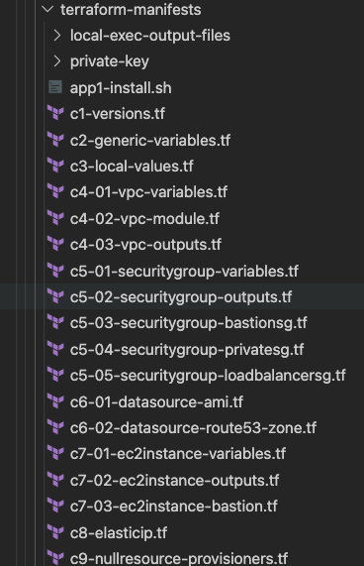
What are we going to learn ?
Added Autoscaling related tags
Removed all private EC2 Instances (App1, App2) related configurations as we are going to create EC2 Instances using Autoscaling

Slide 115
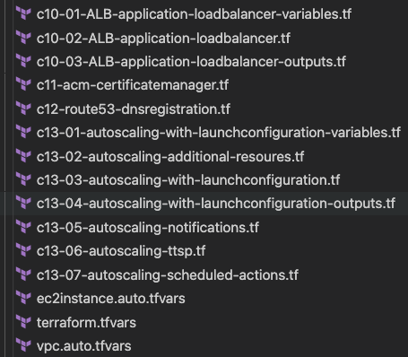
What are we going to learn ?
ALB Load Balancer – Remove App1 Targets as we are going to link ALB with Autoscaling Group
Update ASG Demo related DNS Name
Terraform Autoscaling Module
Autoscaling Service Linked Role
Autoscaling Group with Launch Configuration
Autoscaling Group Terraform Outputs
Autoscaling Group Notifications
Autoscaling Group TTSP and Scheduled Actions

Slide 116
Amazon Virtual Private Cloud (Amazon VPC)
Internet gateway
NAT gateway
Elastic IP
address
Route table
Public Subnet
Private Subnet
AWS
VPC with Web, App and DB Tiers
EC2 Instances, Bastion Host and Security Groups
Application Load Balancer
Autoscaling with Launch Templates
Security group
EC2 Instance
Classic Load Balancer
Application Load Balancer
AWS Certificate Manager (ACM)
Amazon Route 53
Amazon RDS DB
Autoscaling
AWS IAM
Amazon SNS
Security Groups

Slide 117
AWS Autoscaling Launch Templates
A launch template is similar to a launch configuration with latest and advanced features
Template Versioning
We can create multiple versions of same template and use it. Tracking changes to LT by versioning them
Template Re-Usability
Create base template with important features (Standardization of Templates)
Create app specific template by loading base template features and adding additional features to it.
Going forward, start using Launch Templates for all your Autoscaling groups. This is latest and greatest available on AWS from ASG perspective.

Slide 118
AWS Autoscaling with Launch Templates using Terraform
http://asg-lt1.devopsincloud.com
Internet gateway
AWS Cloud
Terraform ASG Resource
Availability Zone 1
Amazon Route 53
Availability Zone 2
VPC
ASG with Launch Templates
Public subnet
Public subnet
HTTPS
Application Load Balancer
ASG Instance Refresh
NAT gateway
/*
Bastion EC2 Instance
AWS Certificate Manager (ACM)
Private subnet
Private subnet
ASG Lifecycle Hooks
Auto Scaling group
A1
A1
ASG TTSP
AWS IAM
ASG Scheduled Actions
Role
Private EC2 Instance
Private EC2 Instance
ASG Notifications
Private subnet
Private subnet
Amazon SNS
For Databases
For Databases
ASG Autoscaling Tests
Email
notification

Slide 119
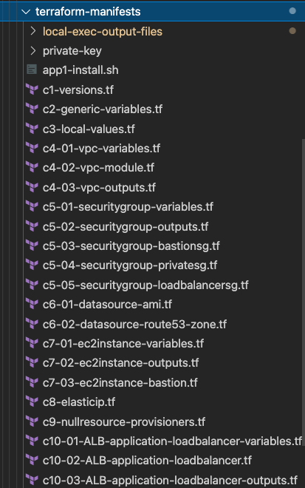
What are we going to learn ?
No changes from previous section as these templates are copied from
Autoscaling with Launch Configurations

Slide 120
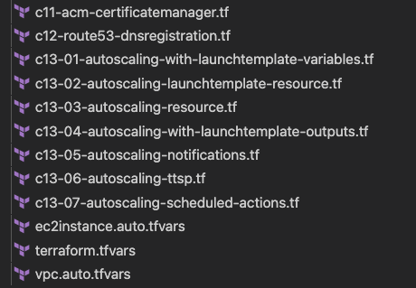
What are we going to learn ?
DNS name changes relevant to demo
Launch Template using Terraform Resource
Autoscaling Group using Terraform Resource
Launch Template and Autoscaling Group Terraform Outputs
Autoscaling Notifications
Autoscaling TTSP
Autoscaling Scheduled Actions

Slide 121

Amazon Virtual Private Cloud (Amazon VPC)
Internet gateway
NAT gateway
Elastic IP
address
Route table
Public Subnet
Private Subnet
AWS
VPC with Web, App and DB Tiers
EC2 Instances, Bastion Host and Security Groups
Autoscaling with Launch Templates
Network Load Balancer
TCP & TLS Listeners
Security group
EC2 Instance
Classic Load Balancer
Application Load Balancer
AWS Certificate Manager (ACM)
Amazon Route 53
Amazon RDS DB
Autoscaling
AWS IAM
Amazon SNS
Network Load Balancer
Security Groups

Slide 122
AWS Network Load Balancer
with
TCP & TLS Listeners
using Terraform
SSL
NON-SSL
https://nlb.devopsincloud.com
http://nlb.devopsincloud.com
Internet gateway
AWS Cloud
Availability Zone 1
Amazon Route 53
Availability Zone 2
VPC
SSL-Termination
Public subnet
Public subnet
Terraform NLB Module
NAT gateway
Network Load Balancer
Bastion EC2 Instance
AWS Certificate Manager (ACM)
Private subnet
Private subnet
Terraform NLB TCP Listeners
Auto Scaling group
A1
A1
Terraform NLB TLS Listeners
AWS IAM
Terraform NLB Target Groups
Role
Private EC2 Instance
Private EC2 Instance
Terraform NLB with EC2 Autoscaling Groups
Private subnet
Private subnet
Amazon SNS
For Databases
For Databases
Email
notification

Slide 123
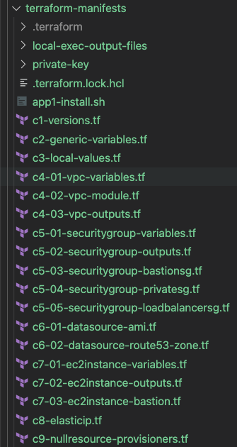
What are we going to learn ?
Changes related to NLB for Ingress CIDR Block to be 0.0.0.0/0
No changes from c1 to c9 except c5-04

Slide 124
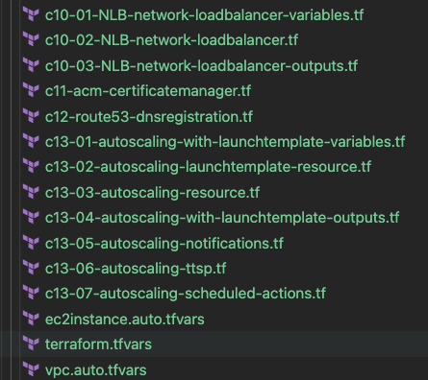
What are we going to learn ?
Network Load Balancer using Terraform Module with TCP and TLS Listeners
Update Route53 related DNS Name and NLB References
Integrate Autoscaling Group and NLB to attach Autoscaling Group EC2 Instances to NLB Target Group
Comment TTSP ALB Policy which is not applicable for NLB usecase

Slide 125
Amazon Virtual Private Cloud (Amazon VPC)
Internet gateway
NAT gateway
Elastic IP
address
Route table
Public Subnet
Private Subnet
AWS
VPC with Web, App and DB Tiers
EC2 Instances, Bastion Host and Security Groups
Application Load Balancer
Autoscaling with Launch Templates
CloudWatch Alarms
Security group
EC2 Instance
Classic Load Balancer
Application Load Balancer
AWS Certificate Manager (ACM)
Amazon Route 53
Amazon RDS DB
Autoscaling
AWS IAM
Amazon SNS
CloudWatch
Security Groups

Slide 126
AWS CloudWatch using Terraform
http://cloudwatch1.devopsincloud.com
Internet gateway
AWS Cloud
Availability Zone 1
Amazon Route 53
Availability Zone 2
VPC
AWS CloudWatch
Public subnet
Public subnet
HTTPS
AWS CloudWatch
Application Load Balancer
ASG Alarms
NAT gateway
/*
Bastion EC2 Instance
AWS Certificate Manager (ACM)
Private subnet
Private subnet
ALB Alarms
Auto Scaling group
A1
A1
CIS Alarms
AWS IAM
CloudWatch Synthetics
Role
Private EC2 Instance
Private EC2 Instance
Private subnet
Private subnet
Amazon SNS
For Databases
For Databases
Email
notification

Slide 127
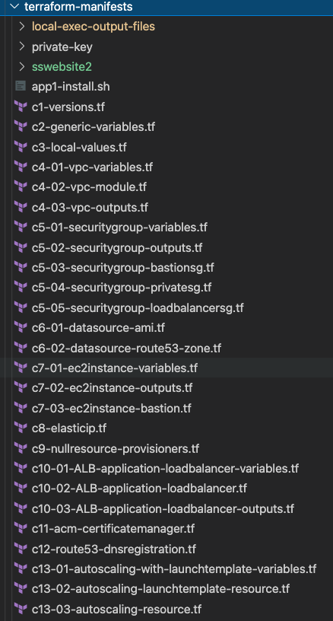
What are we going to learn ?
AWS CloudWatch Synthetics related Node JS Files for Heart Beat Monitor
No changes from c1 to c13

Slide 128
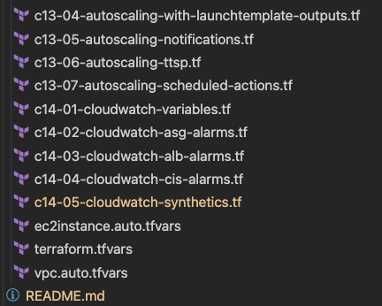
What are we going to learn ?
AWS CloudWatch Autoscaling Alarms
AWS CloudWatch Application Load Balancer Alarms
AWS CloudWatch CIS Alarms
AWS CloudWatch Synthetics

Slide 129


Amazon Virtual Private Cloud (Amazon VPC)
Internet gateway
NAT gateway
Elastic IP
address
Route table
Public Subnet
Private Subnet
AWS
VPC with Web, App and DB Tiers
Build Terraform Modules Locally
Amazon Simple Storage Service (Amazon S3)
Amazon DynamoDB
Security group
EC2 Instance
Classic Load Balancer
Application Load Balancer
AWS Certificate Manager (ACM)
Amazon Route 53
Amazon RDS DB
Autoscaling
AWS IAM
Amazon SNS
CloudWatch
Security Groups

Slide 130
Build Terraform Modules Locally
Build from Scratch
Leverage existing Terraform Modules and change the code as per your need
If already not available, then use this approach
If already available, use the code and modify as per your need
Review existing modules in Terraform Public Registry (Minimum 3 modules to get complete idea)
Less effort and you can start using them in your private infrastructure spaces without public internet access

Slide 131
What are we going to learn ?
AWS VPC Module
AWS VPC Modules - VPC Endpoints Sub Module
Root Module calling the VPC Local Module

Slide 132
Amazon Virtual Private Cloud (Amazon VPC)
Internet gateway
NAT gateway
Elastic IP
address
Route table
Public Subnet
Private Subnet
AWS
VPC with Web, App and DB Tiers
Remote State Storage with
AWS S3 & AWS DynamoDB
Amazon Simple Storage Service (Amazon S3)
Amazon DynamoDB
Security group
EC2 Instance
Classic Load Balancer
Application Load Balancer
AWS Certificate Manager (ACM)
Amazon Route 53
Amazon RDS DB
Autoscaling
AWS IAM
Amazon SNS
CloudWatch
Security Groups

Slide 133
Desired & Current Terraform States
Terraform Configuration Files
Real World Resource – EC2 Instance
terraform.tfstate
Desired State
Current State

Slide 134
Terraform State
Terraform
Local
State
Storage
Terraform
Remote
State
Storage

Slide 135
What is Terraform Backend ?
Backends are responsible for storing state and providing an API for state locking.
Terraform State Storage
Terraform State Locking
AWS S3 Bucket
AWS DynamoDB

Slide 136
Local State File
Remote State File
Admin1
Admin2
Admin3
Multiple Team members
cannot update the infrastructure as they don’t have access to State File
Using Terraform Backend concept we can use AWS S3 as the shared storage for State Files
Admin1
Admin2
Admin3
Admin1
Desktop
Admin2
Desktop
Admin3
Desktop
This means we need store the state file in a shared location.
If two team members are running Terraform at the same time, you may run into race conditions as multiple Terraform processes make concurrent updates to the state files, leading to conflicts, data loss, and state file corruption.
Admin1
Desktop
terraform.tfstate
AWS S3 Bucket
terraform.tfstate
EC2
Instance
EC2
Instance
AWS Cloud
Implement State Locking
AWS Cloud

Slide 137
Terraform Remote State File with State Locking
Admin1
Admin2
Admin3
Not all backends support State Locking. AWS S3 supports State Locking
State locking happens automatically on all operations that could write state.
Admin1
Desktop
Admin2
Desktop
Admin3
Desktop
If state locking fails, Terraform will not continue.
You can disable state locking for most commands with the -lock flag but it is not recommended.
If acquiring the lock is taking longer than expected, Terraform will output a status message.
AWS S3 Bucket
terraform.tfstate
AWS DynamoDB
If Terraform doesn't output a message, state locking is still occurring if your backend supports it.
EC2
Instance
Terraform has a force-unlock command to manually unlock the state if unlocking failed.
AWS Cloud

Slide 138
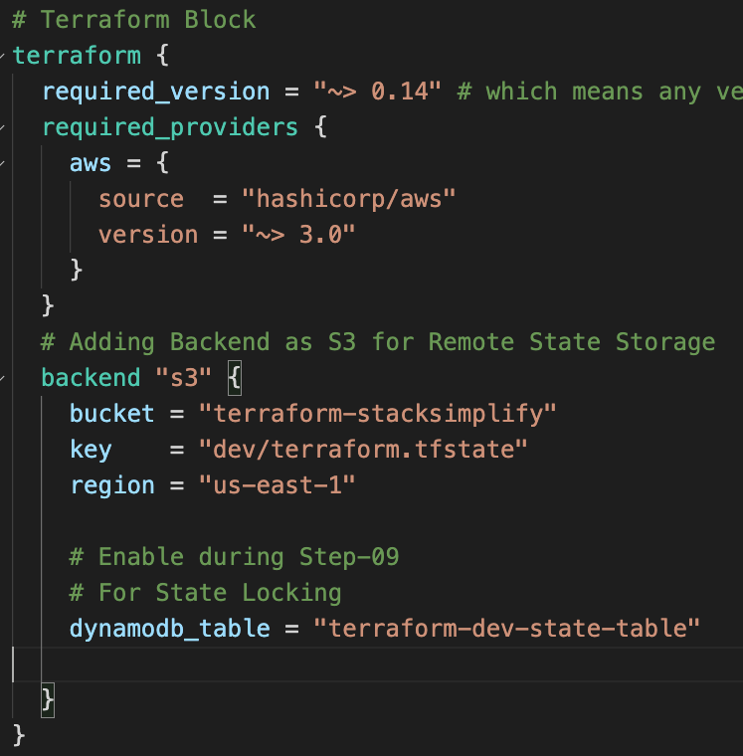
Terraform Remote State File with State Locking
Terraform State Storage to Remote Backend
Terraform State Locking

Slide 139
Terraform
Backends

Slide 140
Terraform Backends
Each Terraform configuration can specify a backend, which defines where and how operations are performed, where state snapshots are stored, etc.
Where Backends are Used
Backend configuration is only used by Terraform CLI.
Terraform Cloud and Terraform Enterprise always use their own state storage when performing Terraform runs, so they ignore any backend block in the configuration.
For Terraform Cloud users also it is always recommended to use backend block in Terraform configuration for commands like terraform taint which can be executed only using Terraform CLI

Slide 141
Terraform Backends
What Backends Do
There are two things backends will be used for
Where state is stored
Where operations are performed.
Store State
State Locking
Operations
Terraform uses persistent state data to keep track of the resources it manages.
State Locking is to prevent conflicts and inconsistencies when the operations are being performed
"Operations" refers to performing API requests against infrastructure services in order to create, read, update, or destroy resources.
Everyone working with a given collection of infrastructure resources must be able to access the same state data (shared state storage).
Not every terraform subcommand performs API operations; many of them only operate on state data.
What are Operations ?
terraform apply
terraform destroy
Only two backends actually perform operations: local and remote.
The remote backend can perform API operations remotely, using Terraform Cloud or Terraform Enterprise.

Slide 142
Terraform Backends
Backend Types
Enhanced Backends
Standard Backends
Enhanced backends can both store state and perform operations. There are only two enhanced backends: local and remote
Standard backends only store state, and rely on the local backend for performing operations.
Example for Remote Backend Performing Operations : Terraform Cloud, Terraform Enterprise
Example: AWS S3, Azure RM, Consul, etcd, gcs http and many more

Slide 143
Terraform
State Commands

Slide 144
Terraform Commands – State Perspective
terraform show
terraform
force-unlock
terraform refresh
Terraform
Commands
terraform taint
terraform plan
terraform untaint
terraform state
terraform
apply target

Slide 145
Amazon Virtual Private Cloud (Amazon VPC)
Internet gateway
NAT gateway
Elastic IP
address
Route table
Public Subnet
Private Subnet
AWS
VPC with Web, App and DB Tiers
EC2 Instances, Bastion Host and Security Groups
Application Load Balancer
Autoscaling with Launch Templates
Terraform Remote State Datasource
Security group
EC2 Instance
Classic Load Balancer
Application Load Balancer
AWS Certificate Manager (ACM)
Amazon Route 53
Amazon RDS DB
Autoscaling
AWS IAM
Amazon SNS
Security Groups

Slide 146
Terraform Remote State Datasource
The terraform_remote_state data source retrieves the root module output values from some other Terraform configuration, using the latest state snapshot from the remote backend.
Project-1
Project-2
AWS VPC
AWS ASG, ALB, Route53
terraform_remote_state data source
project-1/terraform.tfstate
project-2/terraform.tfstate

Slide 147
Terraform Remote State Datasource
http://tfremoteds.devopsincloud.com
Internet gateway
Project-1
AWS Cloud
Availability Zone 1
Amazon Route 53
Availability Zone 2
VPC Resources
VPC
Public subnet
Public subnet
HTTPS
Application Load Balancer
Project-2
NAT gateway
/*
Bastion EC2 Instance
AWS Certificate Manager (ACM)
Private subnet
Private subnet
Autoscaling Groups
Auto Scaling group
Application Load Balancers
A1
A1
AWS IAM
AWS Route53
Role
Private EC2 Instance
Private EC2 Instance
AWS Certificate Manager
Private subnet
Private subnet
AWS SNS
Amazon SNS
For Databases
For Databases
AWS IAM
Email
notification

Slide 148
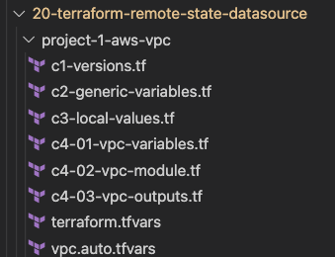
What are we going to learn ?
Project-1
Create VPC Resources with Terraform Backend as S3

Slide 149
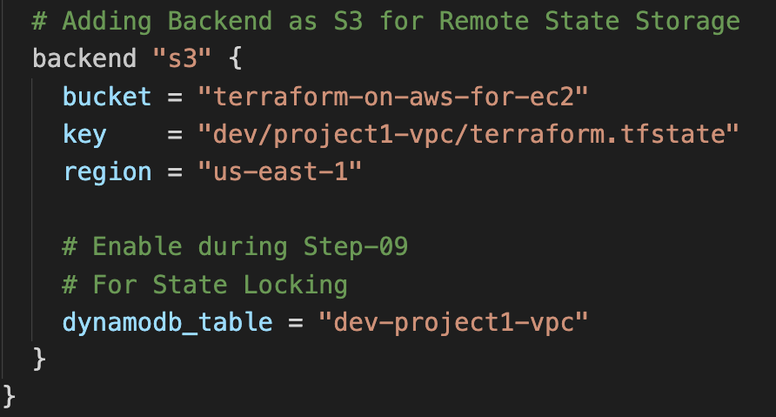
Project-1: Terraform Backend

Slide 150
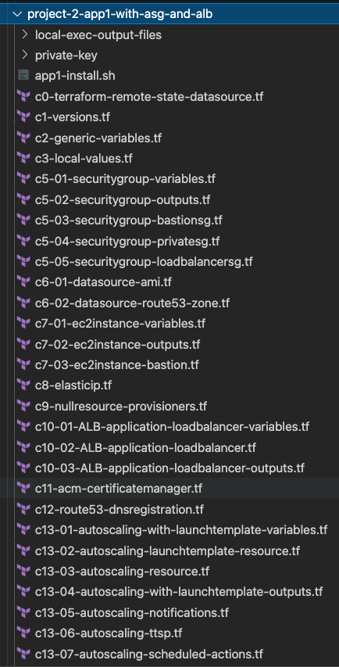

What are we going to learn ?
Terraform Remote State Datasource Definition which will reference the Project-1 state file
Project-2
In this project, we will create Autoscaling Groups, Application Load Balancers in VPC created using Project-1 using Terraform Remote State Datasource.

Slide 151
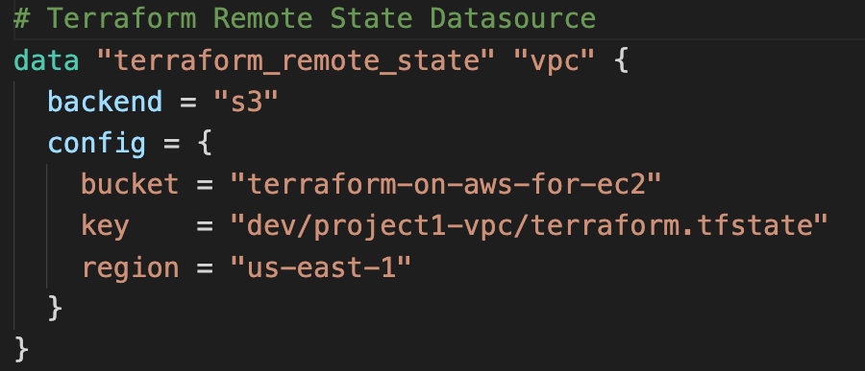
Project-2: Terraform Remote State Datasource

Slide 152
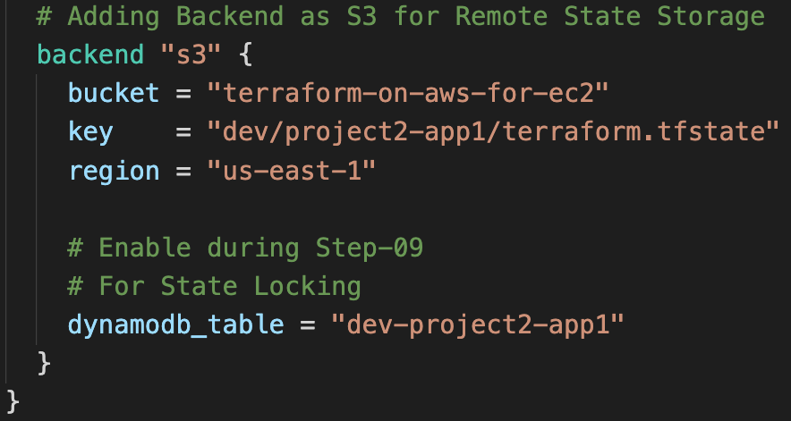
Project-2: Terraform Backend

Slide 153
Amazon Virtual Private Cloud (Amazon VPC)
Internet gateway
NAT gateway
Elastic IP
address
Route table
Public Subnet
Private Subnet
AWS
VPC with Web, App and DB Tiers
EC2 Instances, Bastion Host and Security Groups
Application Load Balancer
Autoscaling with Launch Templates
IaC DevOps with AWS CodePipeline
AWS CodePipeline
AWS CodeBuild
GitHub
Amazon Simple Storage Service (Amazon S3)
Security group
EC2 Instance
Classic Load Balancer
Application Load Balancer
AWS Certificate Manager (ACM)
Amazon Route 53
Amazon RDS DB
Autoscaling
AWS IAM
Amazon SNS
Amazon DynamoDB
Security Groups

Slide 154
IaC DevOps
On
AWS
AWS CodePipeline
Manager
Dev Deploy
Stage
Manual Approval Stage
Stag Deploy
Stage
Developer
GitHub
AWS CodeBuild
Email
AWS CodeBuild
Email notification
Route 53
Application Load Balancer
Certificate
Manager
EC2 Auto Scaling
NAT
Gateway
Route 53
Application Load Balancer
Certificate
Manager
EC2 Auto Scaling
NAT
Gateway
Dev
Stage
SNS
Bastion
EC2 Instance
AWS IAM
VPC
SNS
Bastion
EC2 Instance
AWS IAM
VPC

Slide 155
http://devdemo1.devopsincloud.com
Internet gateway
AWS Cloud
Availability Zone 1
Amazon Route 53
Availability Zone 2
VPC
Public subnet
Public subnet
HTTPS
Application Load Balancer
Dev
Environment
NAT gateway
/*
Bastion EC2 Instance
AWS Certificate Manager (ACM)
Private subnet
Private subnet
Auto Scaling group
A1
A1
AWS IAM
Role
Private EC2 Instance
Private EC2 Instance
Private subnet
Private subnet
Amazon SNS
For Databases
For Databases
Email
notification

Slide 156
http://stagedemo1.devopsincloud.com
Internet gateway
AWS Cloud
Availability Zone 1
Amazon Route 53
Availability Zone 2
VPC
Public subnet
Public subnet
HTTPS
Application Load Balancer
Staging
Environment
NAT gateway
/*
Bastion EC2 Instance
AWS Certificate Manager (ACM)
Private subnet
Private subnet
Auto Scaling group
A1
A1
AWS IAM
Role
Private EC2 Instance
Private EC2 Instance
Private subnet
Private subnet
Amazon SNS
For Databases
For Databases
Email
notification

Slide 157
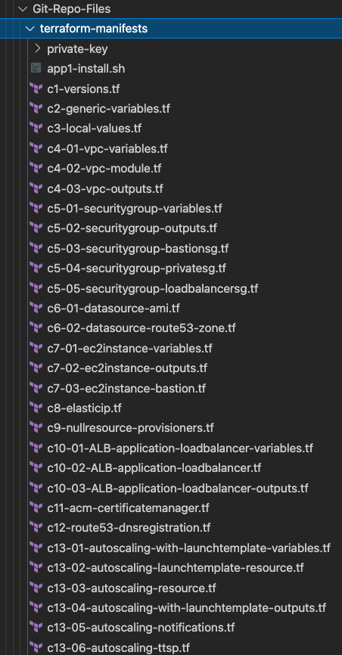
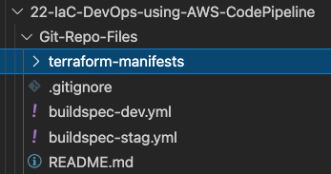
What are we going to learn ?
We are going to use the TF Configs from Section-15 Autoscaling with Launch Templates.
We are going to make many changes to all these TF Configs to support multiple environments like Dev and Staging
Dev and Staging CodePipeline
Build Specification Files

Slide 158
Thank You

