Slide 1

Review - 2
Number System Toolkit
Department of Data Science
Presented By
K. Veera Venkat Satyanarayana – 25B11DS260
K. Dinesh – 25B11DS278
U. Prasanth Kumar – 25B11DS371
E. Sandeep – 25B11DS130
Under the Guidance of
Ch. Bhanu Prakash, Assistant Professor

Slide 2


CONTENTS
Abstract
Problem Statement
Objectives
Existing and Proposed System
Related OOP’s concepts
List of Modules & Explanation
Implementation
Algorithm
Flowchart
Input & Outputs Screenshots

Slide 3
ABSTRACT
The Number System Toolkit is a menu-driven C++ console application that brings together three commonly needed utilities in one program: multi-base number conversion (Decimal, Binary, Octal and Hexadecimal), prime number verification, and palindrome detection for both numbers and words or phrases. A do-while driven main menu leads to dedicated Conversion and Checking sub-menus, and every input is validated before it is processed, so invalid digits or empty entries never crash the program. Internally, the toolkit is implemented as an object-oriented NumberSystemToolkit class that encapsulates all conversion, validation and checking logic behind a single public run() method, so the project demonstrates core C++ concepts - loops, functions and modular design - together with OOP principles such as encapsulation and abstraction, alongside robust input validation and error handling.

Slide 4
PROBLEM STATEMENT
Manual conversion between decimal, binary, octal and hexadecimal is slow and error-prone when done by hand or with separate calculators.
Checking whether a number is prime, or whether a number or word is a palindrome, becomes tedious to verify manually for larger inputs.
Existing tools handle these operations separately, with no single interface and little or no validation of user input.
There is a need for one reliable, menu-driven program that performs all these checks, validates input, and reports results clearly.

Slide 5
OBJECTIVES
Design and implement a menu-driven C++ console application for number base conversion and numeric-property checking.
Provide accurate multi-base conversion between Decimal, Binary, Octal and Hexadecimal in both directions.
Implement reliable prime number and palindrome detection, for both numbers and words or phrases.
Enforce robust input validation and graceful error handling for every menu and user entry.
Reinforce core programming concepts - loops, functions and object-oriented design - through a clean, modular, reusable class structure.

Slide 6
EXISTING & PROPOSED SYSTEM
EXISTING SYSTEM
PROPOSED SYSTEM
Conversions done manually or with separate calculators/websites for each number base.
No integrated way to check primality or palindromes alongside conversions.
Little to no input validation - invalid entries can crash or silently mislead the user.
Scattered, procedural code with no clear structure or reusability.
Single menu-driven C++ application that performs conversion, prime and palindrome checks together.
A do-while driven menu lets the user repeat any operation without restarting the program.
Strong input validation rejects invalid digits/characters before further processing.
Implemented as an object-oriented NumberSystemToolkit class (encapsulation & abstraction) for cleaner, modular, reusable code.

Slide 7
RELATED OOP’S CONCEPTS
Though compact, the toolkit is built around real OOP fundamentals:
Class & Object - All toolkit functionality is wrapped inside a single NumberSystemToolkit class; main() creates one object and calls its run() method to start the program.
Encapsulation - Every conversion, validation and checking function (decimalToBinaryValue, isPrime, isPalindromeString, etc.) is declared private, so internal data and logic are hidden from outside code.
Abstraction - The class exposes only one public method, run(). The caller does not need to know how conversions or checks are implemented internally - it only needs to call run().

Slide 8
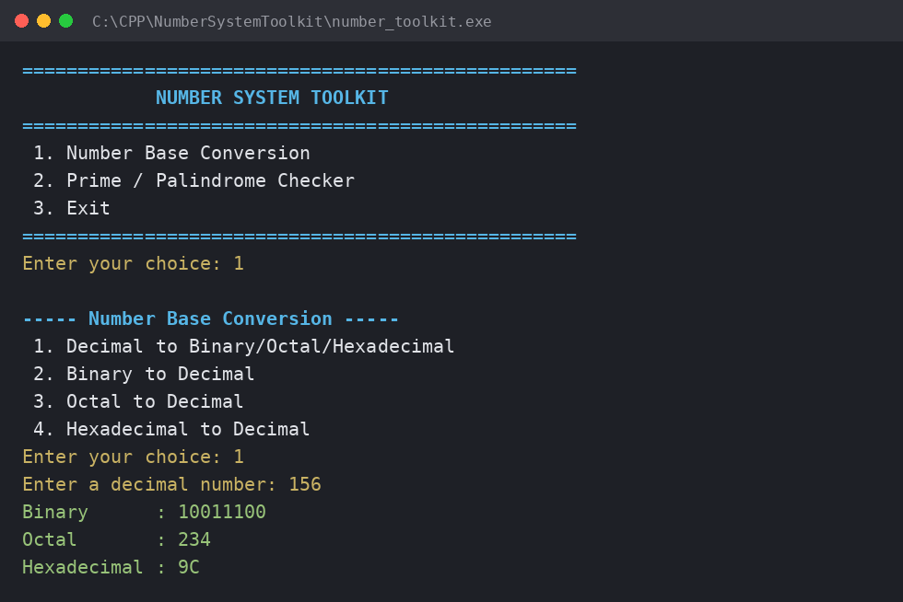
LIST OF MODULES with Explanation
Four cooperating modules, each built from small, reusable functions:
Menu Module - run(), showMenu(). Drives the do-while main loop and dispatches to the right sub-menu.
Conversion Module - conversionMenu() plus decimalToBinaryValue/Octal/Hex and binaryToDecimal/octalToDecimal/hexToDecimal.
Checking Module - checkingMenu() plus isPrime(), isPalindrome() and isPalindromeString().
Validation Module - getValidInt(), isValidBinary(), isValidOctal(), isValidHex() guard every input.

Slide 9
IMPLEMENTATION
Core menu dispatch and checking functions from the NumberSystemToolkit class:
void NumberSystemToolkit::run() {
int choice;
do {
showMenu();
choice = getValidInt(
"Enter your choice: ");
switch (choice) {
case 1: conversionMenu();
break;
case 2: checkingMenu();
break;
case 3: cout << "Thank you!";
}
} while (choice != 3);
}
bool NumberSystemToolkit::isPrime(
long long n) {
if (n < 2) return false;
for (long long i = 2;
i <= sqrt(n); i++)
if (n % i == 0) return false;
return true;
}
bool NumberSystemToolkit::
isPalindromeString(string s) {
string clean;
for (char c : s)
if (isalnum((unsigned char)c))
clean += tolower(c);
int l = 0, r = clean.size()-1;
while (l < r)
if (clean[l++] != clean[r--])
return false;
return true;
}

Slide 10
ALGORITHM
Step-by-step logic behind the two core operations:
Number Base Conversion
Prime & Palindrome Checking
1. Repeatedly divide the number by the target base (2, 8 or 16).
2. Record the remainder produced at each division step.
3. Continue dividing until the quotient becomes 0.
4. Arrange the collected remainders in reverse order to form the result.
5. For the reverse direction, validate each digit, then multiply by the base raised to its position and sum the values.
1. Prime: if n < 2, it is not prime.
2. Test divisibility of n for every i from 2 up to √n.
3. If any i divides n evenly, n is not prime; otherwise it is prime.
4. Palindrome (number): reverse the digits and compare to the original n.
5. Palindrome (phrase): strip non-alphanumeric characters, lowercase the rest, then compare it to its own reverse.

Slide 11
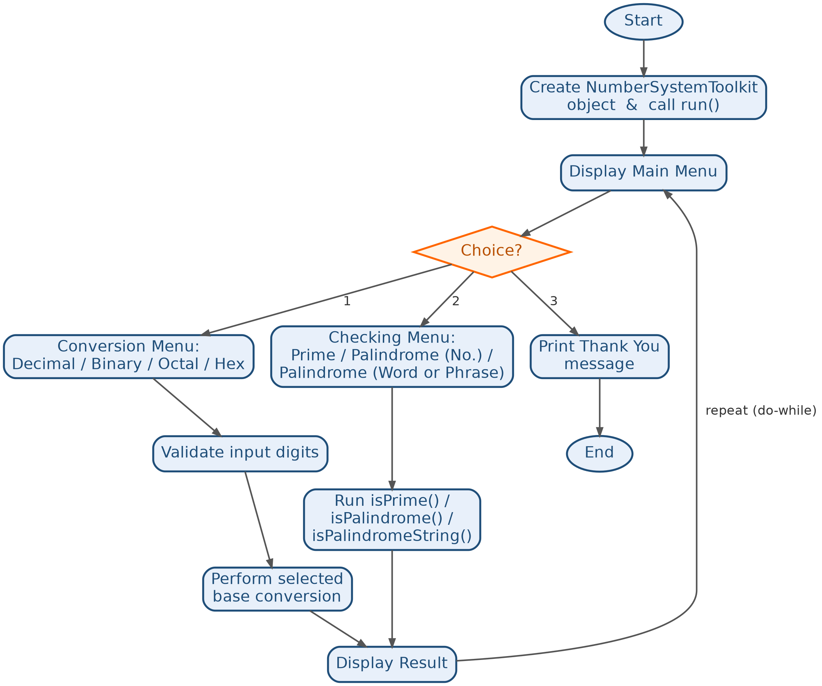
FLOWCHART

Slide 12
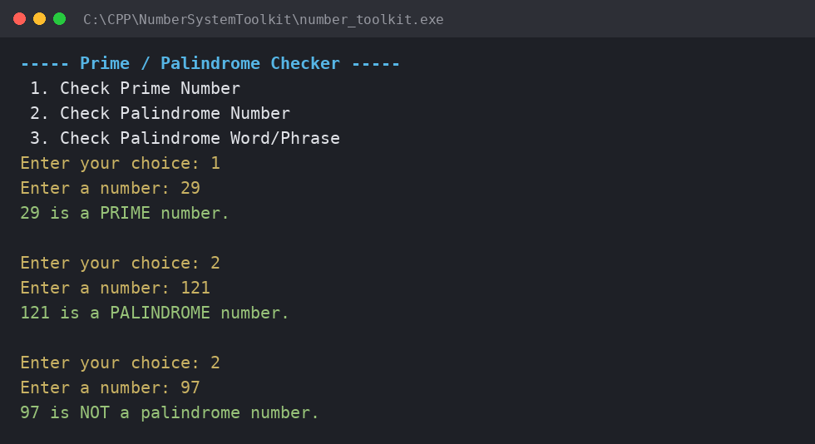
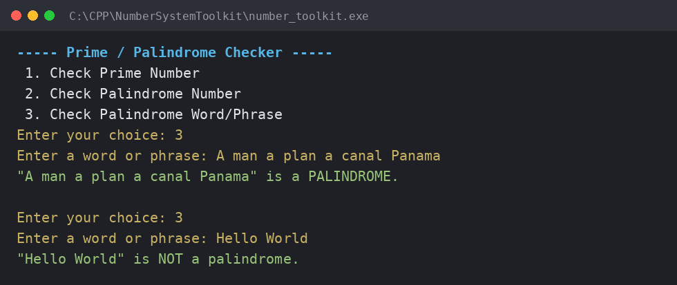
INPUT & OUTPUT SCREENSHOTS
Palindrome word/phrase check (new feature)
Prime & palindrome number checks

Slide 13
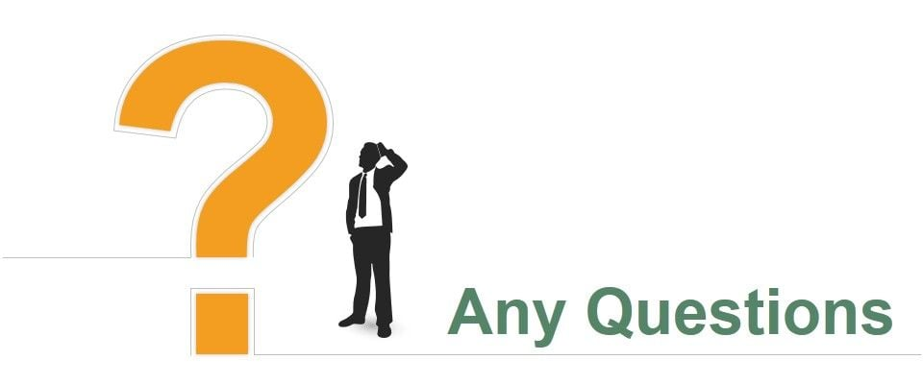

Slide 14

Thank You

