Slide 1

Performance Evaluation of 802.11 Networks Using OPNET
Venkat Raman, University of California, Santa Barbara

Slide 2
MOTIVATION
Wireless networks have become a norm with the growing technology and play a very important role in our lives.
Different wireless standards have their own advantages and disadvantages. Hence it becomes important to compare and evaluate them to determine the standard suitable for the network environment.
Each network is simulated using OPNET with varying 802.11 network standards b/n, number of nodes and traffic sources. The study is focused towards parameters like end-to-end delay, throughput, retransmission attempts, packet loss.

Slide 3
INTRODUCTION
Competent alternative to wired networks.
Easier and less expensive to install.
The 802.11 wireless standards can differ in terms of speed, transmission ranges, and frequency used. The most widely used protocols are the 802.11b, 802.11g and 802.11n for 2.4GHz networks and the 802.11a, 802.11n and 802.11ac for 5GHz networks.
With a whopping 71% of mobile communications flowing over wireless internet, Wi-Fi is now the biggest transmitter of communications around the world.

Slide 4
RELATED WORK
Evaluation of standalone and hybrid networks.
Study on voice over wifi performance for 802.11b, a, g, n releases based on throughput, delay and packet drop key performance indicators.
Simulation study of an IEEE802.11b WLANs used to model a WLAN sub network deployed within an enterprise WAN framework
Study simulation to estimate the number of web user clients and other network applications that could be supported by the Wireless LAN 802.11n to provide certain network load.

Slide 5
METHODOLOGY
Wireless network with 8 nodes (workstation) is created in OPNET project editor. Two routers are used to provide wireless network to the 8 nodes with 4 of the assigned to each router.
Create a test profile in the profile config with HTTP heavy browsing as the application.
Configure all the nodes for to use the created profile. Now set the server to provide the same traffic source as used by the profile config.
Set the network to either 802.11 g/n protocol
Parameters for simulation statistics is chosen for all the nodes and the network is simulated for a duration of 2 hours to obtain the results.

Slide 6
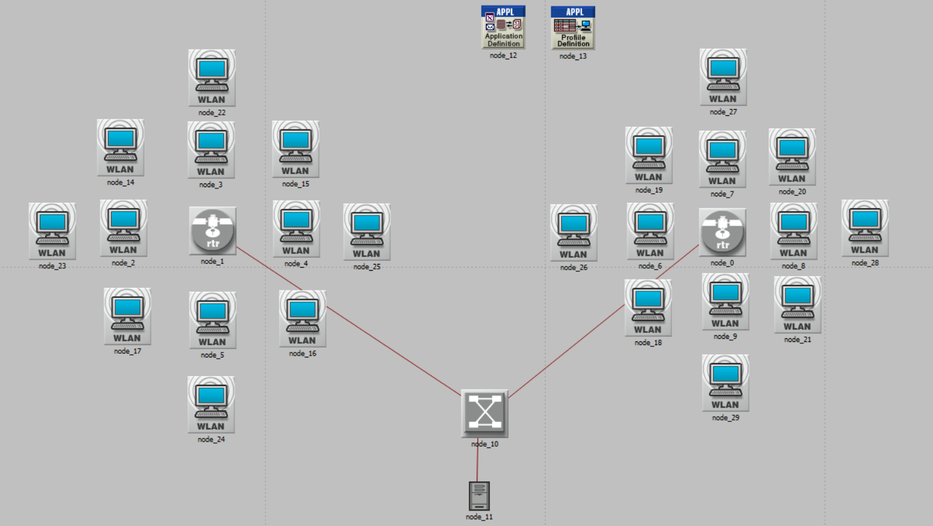
24 NODE NETWORK
Network is built using work stations, routers, switch and a server.

Slide 7
PERFORMANCE METRICS
Network Delay
Wireless LAN Data dropped
Throughput
Retransmission attempts

Slide 8
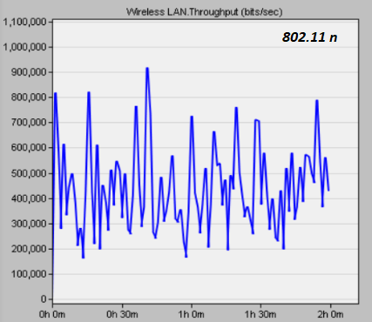
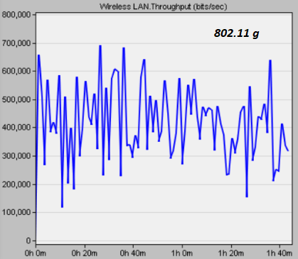
THROUGHPUT ANALYSIS
802.11 n has a higher throughput due to frame aggregation

Slide 9
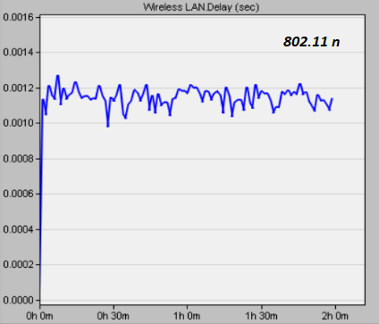
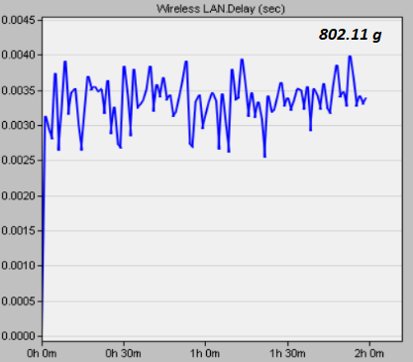
DELAY ANALYSIS
802.11 n having lower latency compared to 802.11 g.

Slide 10
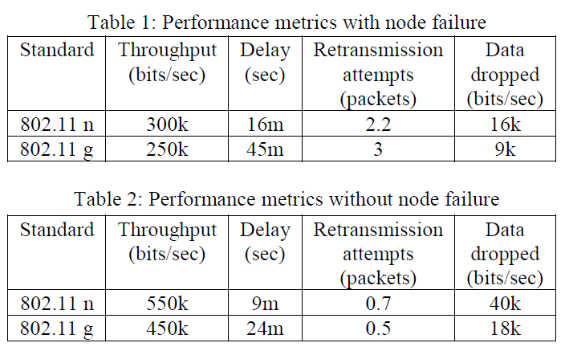
NODE FAILURE ANALYSIS

Slide 11
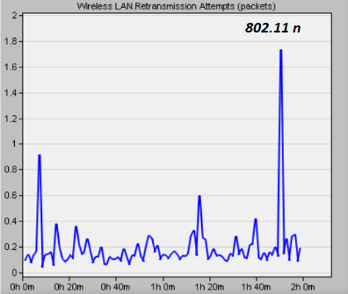
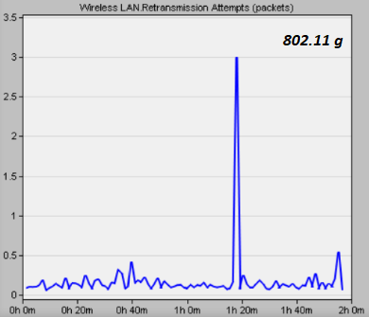
TRAFFIC CONGESTION
802.11 n performs better than g considering the packet loss and retransmission attempts.

Slide 12
THANK YOU

