Slide 1

MADVENTURE
Rediscover the world
Venkat 10th Sep 2020

Slide 2
Overview
Madventure is quest game app which contains different types of quests and variety of tasks like finding secret keys in specific places, completing 1000 steps by walking etc. Users can get badges by reaching different levels and completing quests. User can perform certain tasks in both Smart watch and Smart Tv
Modules
Profile
Quests
Tasks
Compass
Favourites
Rating
Achievements
Login
Signup

Slide 3
Libraries used
Glide : Image loading
Transferwise sequence-layout : task completion view
Smart-fun:XmlToJson : for converting xml data from server to json
Facebook-android-sdk: for Facebook login
Retrofit2 : for network connection to consume REST Api
Barcodescanner:zxing : for scanning and generating Qr code

Slide 4
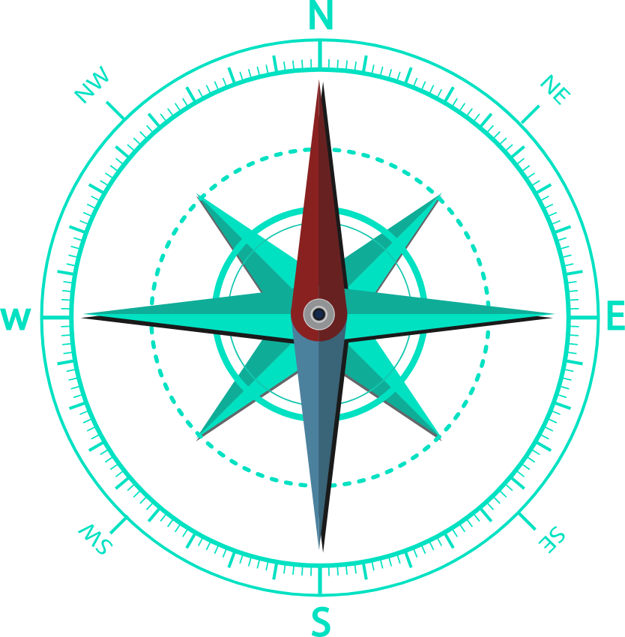
Compass
For compass module used accelerometer and Magnetometer sensors of mobile to get rotation and gravity and thereby calculating direction

Slide 5
Profile
For profile module used Camera Api to capture profile picture for the user
For showing city of user used location services
For showing user achievements, solved quests used Recycler view

Slide 6
Steps
For calculating steps used sensors API and Step counter sensor of mobile device

Slide 7
Any Questions ???

Slide 8
Thank You

