Slide 1

Movie Box Office Gross Prediction Using Machine Learning
Name of the Student: Mr. P.Venkata Lohith Kumar
Register Number: 39111135
Project Guide: Mrs.Vanathi .M

Slide 2
Presentation Outline
Course Certificate
Introduction
Objectives
System Architecture / Ideation Map
Software Requirements
Hardware Requirements
Project Implementation
Methodology
Application Snapshots
Results and Discussions
Conclusion & Future work
References

Slide 3
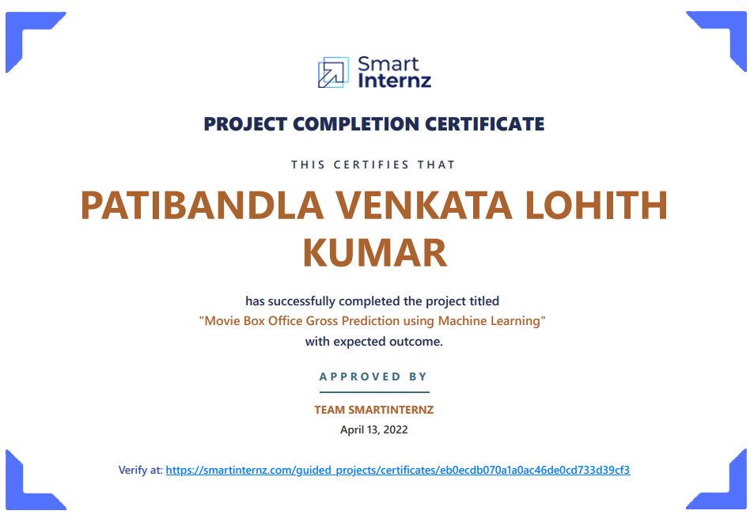
Course Certificate

Slide 4
Introduction
Predicting society's reaction to a new product in the sense of popularity and adoption rate has become an emerging field of data analysis, and such kind of analysis can help the movie industry to take appropriate decisions.
Film studios and its related stakeholders use a forecasting method for the prediction of revenue that a new movie can generate based on a few given input attributes like budget, runtime, released year, popularity, and so on.
Movie box office gross type Classification is one of the many problems that can be solved by Machine learning Algorithms.

Slide 5
Introduction(cont.)
The primary goal of the project is to train an ML model with a given Algorithm, that can predict the gross for movies, based on the input features given to it.
The main challenge of this project is to understand the dataset, deal with missing values, use the right performance metrics for the algorithm and train the model with good accuracy for classification.
Using python and python integrated modules helps to face the challenges of a dataset and make an efficient model for predicting things.

Slide 6
Objectives
Train a Machine Learning model that can predict the movie gross, based on the input features, with reasonable accuracy.
This project helps classify the movie tittles types with machines more efficiently and reduces the time consumed for separating different movie gross.
This study marks as a decision support system for the movie investment sector using machine learning techniques. This project helps investors associated with this business for avoiding investment risks. The system predicts an approximate success rate of a movie based on its profitability by analyzing historical data from different sources like Online rating, Director, Budget, Pre Release business, Genre, etc.. .

Slide 7
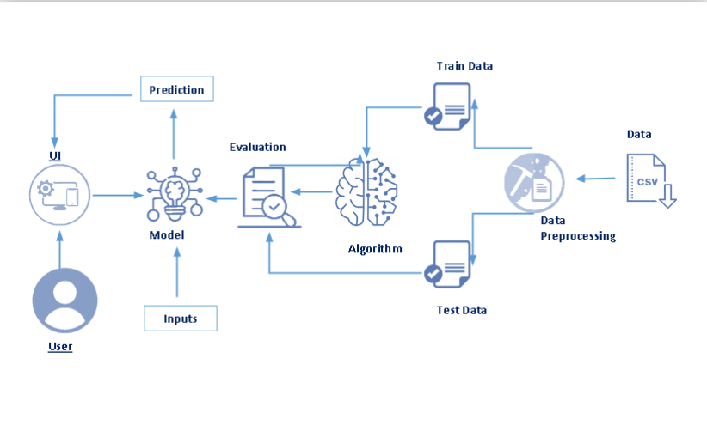
System Architecture Map

Slide 8
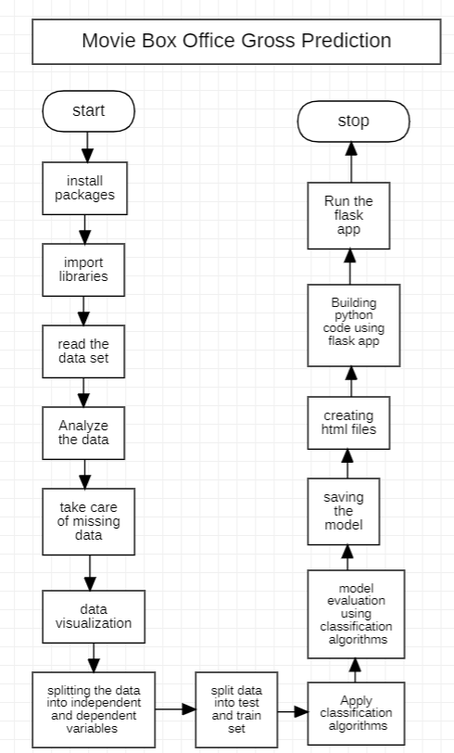
System Architecture Map

Slide 9
Software Requirements:
Selection of dataset with large data and proper labelled values
Software Requirements:
  The following are the software s required for the project:
  ● Jupyter Notebook
  ● Spyder
  ● Microsoft Excel 2013

Slide 10
Hardware Requirements:
Hardware Requirements:
  The following is the Hardware required to complete this project:
  ● Internet connection to download and activate
  ● Administration access to install and run Anaconda Navigator
  ● Minimum 10GB free disk space
  ● Windows 8.1 or 10 (64-bit or 32-bit version) OR Cloud: Get started free, *Cloud account required.
  Minimum System Requirements To run Office Excel 2013, your computer needs to meet the following minimum hardware requirements:
  ● 500 megahertz (MHz) ● 256 megabytes (MB) RAM ● 1.5 gigabytes (GB) available space ● 1024x768 or higher resolution monitor

Slide 11
Project Implementation(cont.)
Importing The Libraries
Pandas: It is a python library mainly used for data manipulation.
NumPy: This python library is used for numerical analysis.
Counter: Python Counter is a container that will hold the count of each of the elements present in the container.
Matplotlib and Seaborn: Both are the data visualization library used for plotting graphs which will help us for understanding the data.
Accuracy score: used in classification type problem and for finding accuracy it is used.
R2 Score: Coefficient of Determination or R² is another metric used for evaluating the performance of a regression model. The metric helps us to compare our current model with a constant baseline and tells us how much our model is better.
Literal_eval: we can use ast.literal_eval() to evaluate the string as a python expression.
Pickle: to serialize your machine learning algorithms and save the serialized format to a file.
Word cloud: to create visualizations with text data

Slide 12
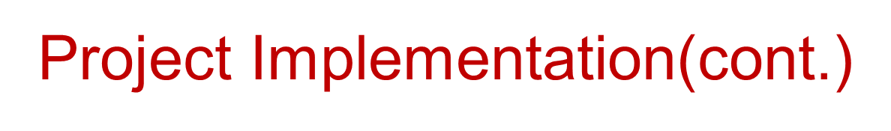
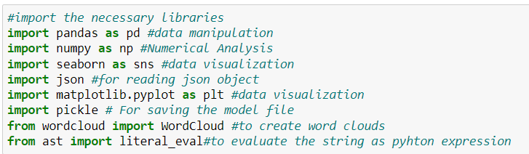
Import pickle

Slide 13
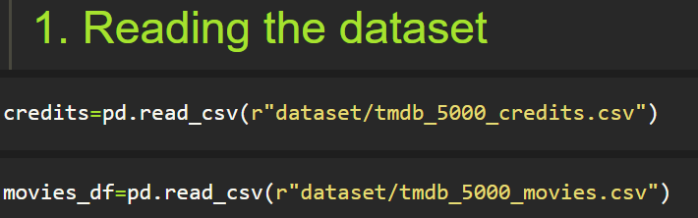
Project Implementation(cont.)
Reading The Dataset
You might have your data in .csv files, .excel files or .tsv files or something else. But the goal is the same in all cases. If you want to analyse that data using pandas, the first step will be to read it into a data structure that’s compatible with pandas.
Let’s load a .csv data file into pandas. There is a function for it, called read_csv().We will need to locate the directory of the CSV file at first (it’s more efficient to keep the dataset in the same directory as your program).

Slide 14
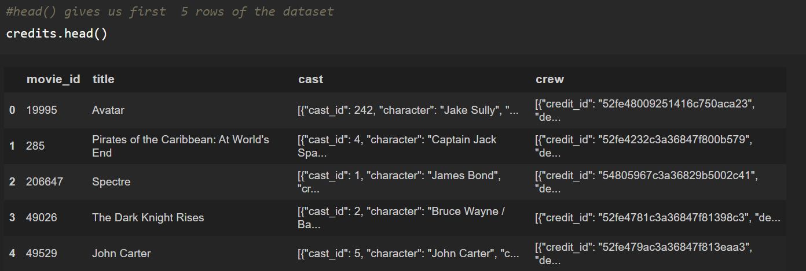
Project Implementation (cont.)
Exploratory Data Analysis
Now that we read the dataset lets analyze the data using Exploratory Data Analysis (EDA)
Exploratory data analysis is an approach to analyzing data sets to summarize their main characteristics, often with visual methods and used for determining how best to manipulate data sources to get the answers you need, making it easier for data scientists to discover patterns, spot anomalies, test a hypothesis or check assumptions.
head() :To check first five rows of dataset, we have a function call head( ).

Slide 15
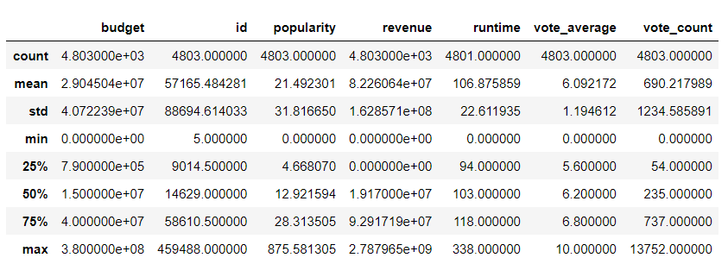
Project Implementation(cont.)
Description of dataset.

Slide 16
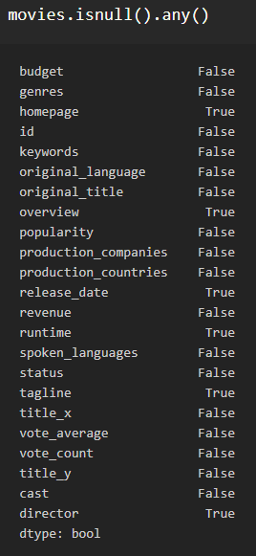
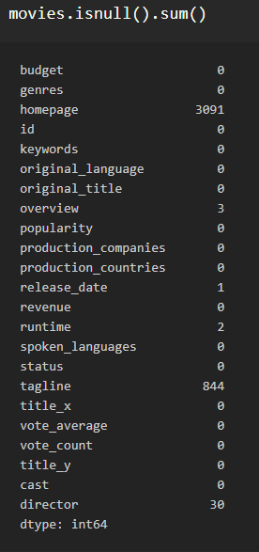
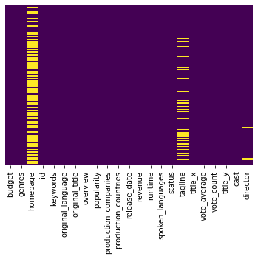

Project Implementation(cont.)
Checking For Null Values
After loading it is important to check the complete information of data as it can indicate many of the hidden information such as null values in a column or a row

Slide 17
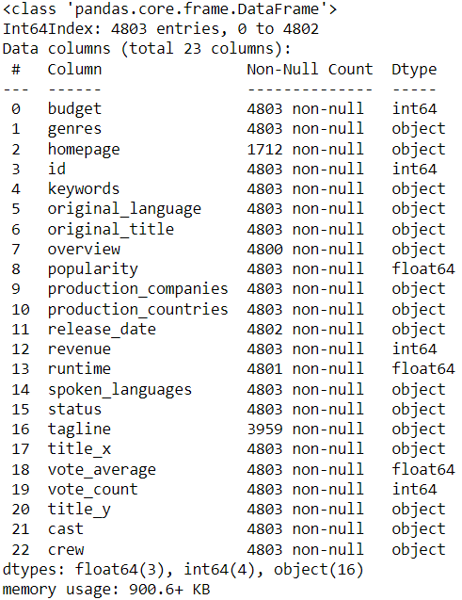
Project Implementation(cont.)
Datatypes in dataset and missing values count

Slide 18
Project Implementation(cont.)
Data Visualization
Data visualization is where a given data set is presented in a graphical format. It helps the detection of patterns, trends, correlations that might go undetected in text-based data.
Understanding your data and the relationship presents within it is just as important as any algorithm used to train your ml model. In fact, even the most sophisticated ml models will perform poorly on data that wasn’t visualized and understood properly.
To visualize the dataset we need libraries called Matplotlib and Seaborn.
The Matplotlib library is a Python 2D plotting library that allows you to generate plots, scatter plots, histograms, bar charts etc.
Let’s visualize our data using Matplotlib and seaborn library.
Before diving into the code, let's look at some of the basic properties we will be using when plotting.
xlabel: Set the label for the x-axis.
ylabel: Set the label for the y-axis.
title: Set a title for the axes.
Legend: Place a legend on the axes.

Slide 19
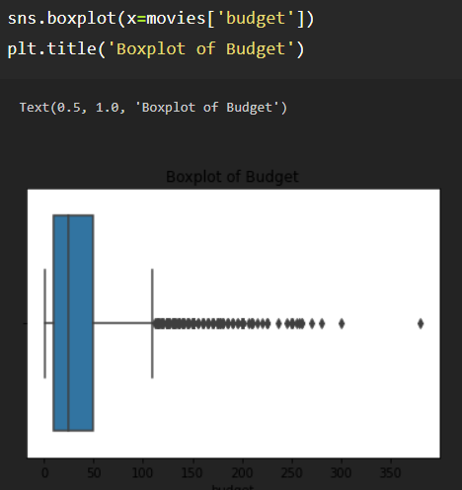
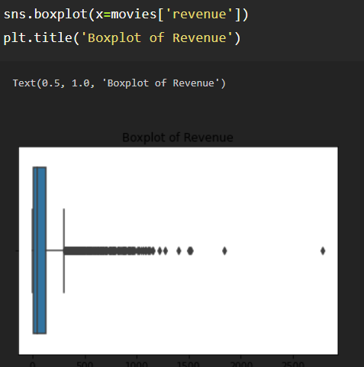
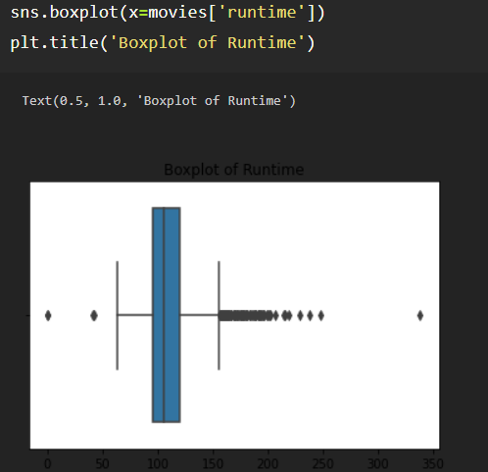
Project Implementation(cont.)
So with the help of boxplot we can visualize and check whether the data contains any outliers or not.
Box plot for budget column
Box plot for revenue column
Box plot for runtime column

Slide 20
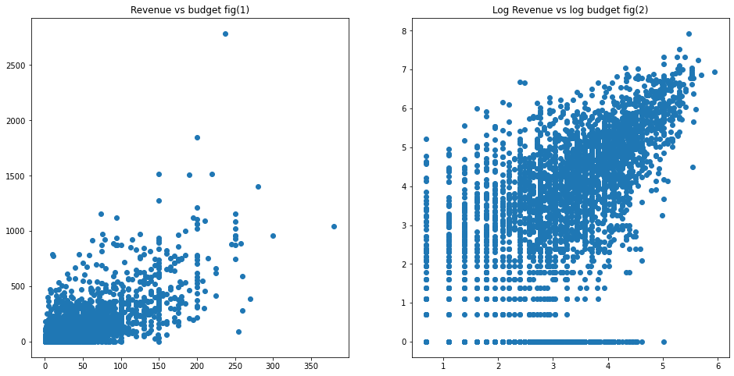
Project Implementation(cont.)
Relationship between Film Revenue and Budget.

Slide 21
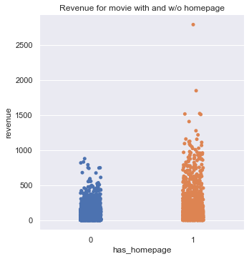
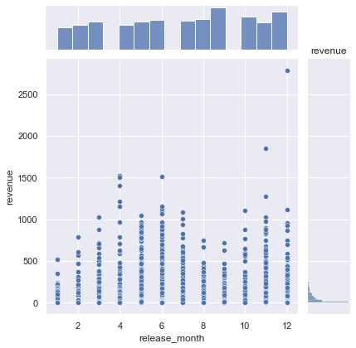
Project Implementation(cont.)
Relationship between the home page and Revenue
Relationship between release_month and revenue

Slide 22
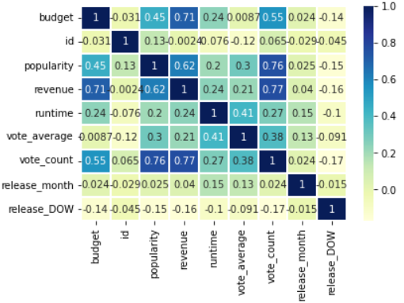
Project Implementation(cont.)
Correlation among features

Slide 23
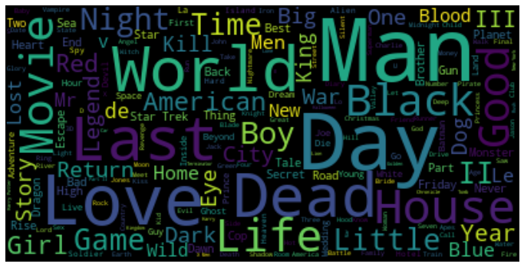
Project Implementation(cont.)
What are the frequent Words in Film Titles:
Word cloud is a data visualization technique used for the representation of text data in which the size of each word indicates its frequency or importance.

Slide 24
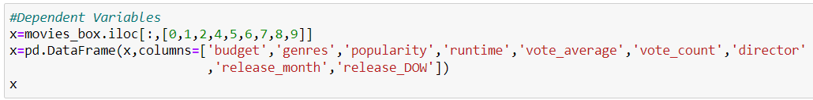
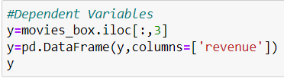
Methodology
Splitting The Dataset Into Dependent And Independent Variable.
Let’s split our dataset into independent and dependent variables.The independent variable in the dataset would be considered as 'x' and the 'budget','genres','popularity','runtime','vote_average','vote_count','director','release_month','release_DOW' columns would be considered as independent variable.
The dependent variable in the dataset would be considered as 'y' and the 'revenue' column is considered as dependent variable.
Independent_variables:
Dependent_variables:

Slide 25

Methodology
Split The Dataset Into Train Set And Test Set
When you are working on a model and you want to train it, you obviously have a dataset. But after training, we have to test the model on some test dataset. For this, you will a dataset which is different from the training set you used earlier. But it might not always be possible to have so much data during the development phase. In such cases, the solution is to split the dataset into two sets, one for training and the other for testing.
The train-test split is a technique for evaluating the performance of a machine learning algorithm.
Train Dataset: Used to fit the machine learning model.
Test Dataset: Used to evaluate the fit machine learning model.
test_size — this parameter decides the size of the data that has to be split as the test dataset. This is given as a fraction. For example, if you pass 0.5 as the value, the dataset will be split 50% as the test dataset.
train_size — you have to specify this parameter only if you’re not specifying the test_size. This is the same as test_size, but instead you tell the class what percent of the dataset you want to split as the training set.
random_state — here you pass an integer, which will act as the seed for the random number generator during the split. Or, you can also pass an instance of the Random_state class, which will become the number generator. If you don’t pass anything, the Random_state instance used by np.random will be used instead.
Now split our dataset into train set and test using train_test_split class from scikit learn library.

Slide 26
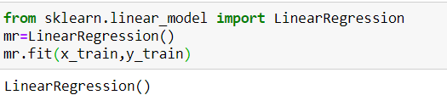
Methodology (cont.)
Train And Test The Model Using Linear Regression.
Build the model
We’re going to use x_train and y_train obtained above in train_test_split section to train our regression model. We’re using the fit method and passing the parameters as shown below.
Generally, ML Algorithms are trained with 80% of the total dataset and the remaining 20% of data is used to test the model's performance. Here we are selecting the same 80%-20% formula followed by professionals.

Slide 27
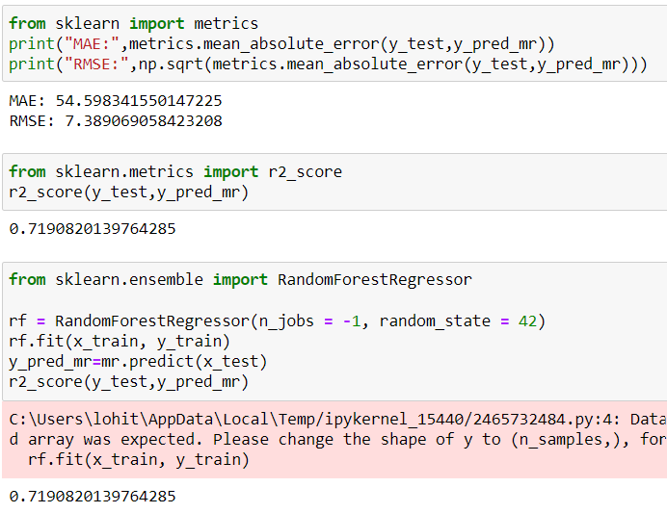
Application Snapshots

Slide 28
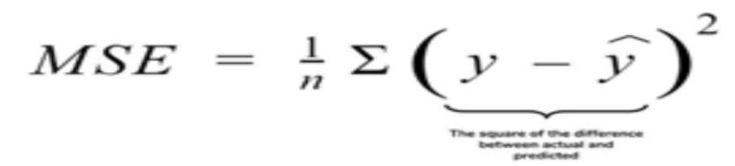
Results and Discussion
Model Evaluation
Finally, we need to check to see how well our model is performing on the test data.
Regression Evaluation Metrics:
Mean Squared Error (MSE):
MSE or Mean Squared Error is one of the most preferred metrics for regression problems. It is simply the average of the squared difference between the target value and the value predicted by the regression model.
As it squares the differences, it penalizes even a small error which leads to over-estimation of how bad the model is. It is preferred more than other metrics because it is differentiable and hence can be optimized better.

Slide 29
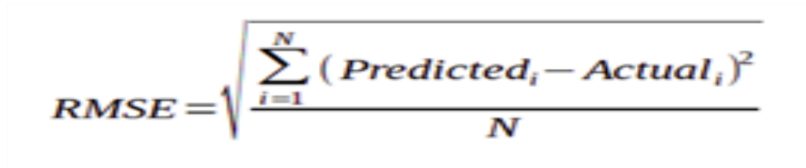
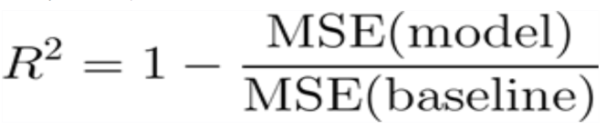
Results and Discussion(cont.)
2.RMSE:Root Mean Square Error:
RMSE is the square root of the averaged squared difference between the target value and the value predicted by the model. It is preferred more in some cases because the errors are first squared before averaging which poses a high penalty on large errors. This implies that RMSE is useful when large errors are undesired.
3.R2 Score:
Coefficient of Determination or R² is another metric used for evaluating the performance of a regression model. The metric helps us to compare our current model with a constant baseline and tells us how much our model is better.
The constant baseline is chosen by taking the mean of the data and drawing a line at the mean. R² is a scale-free score that implies it doesn't matter whether the values are too large or too small, the R² will always be less than or equal to 1.

Slide 30
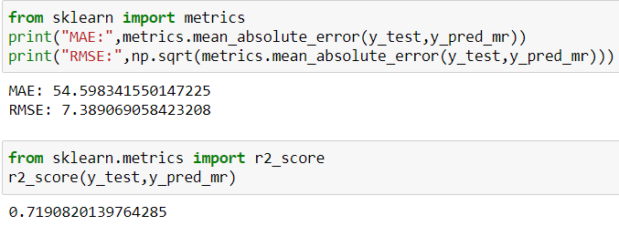
Results and Discussion(cont.)
For testing the model we use the Above methods,

Slide 31

Results and Discussion(cont.)
Save The Model
After building the model we have to save the model.
Pickle is used for serializing and de-serializing Python object structures, also called marshalling or flattening. Serialization refers to the process of converting an object in memory to a byte stream that can be stored on disk or sent over a network. Later on, this character stream can then be retrieved and de-serialized back to a Python object.
This is done by the below code.
Here, mr is our logistic regression class with saving asfitness.pkl file. Wb is the write binary in bytes.

Slide 32
Results and Discussion(cont.)
Application Building:
Create An HTML File
We use HTML to create the front end part of the web page.
Here, we created 2 html pages- Demo2.html, resultnew.html
Demo2.html displays the home page which accepts the values from the user.
resultnew.html displays the prediction.
Build Python Code
Let us build flask file ‘app.py’ which is a web framework written in python for server-side scripting. Let’s see step by step procedure for building the backend application.
App starts running when “__name__” constructor is called in main.
render_template is used to return html file.
“GET” method is used to take input from the user.
“POST” method is used to display the output to the user.

Slide 33



Results and Discussion(cont.)
Importing Libraries:
Creating our flask app and loading the model:
Now after all the libraries are import we will be creating our flask app and the load our model into our flask app.
Routing to the html Page:
@app.route is used to route the application where it should route to.
Rendering the template. This helps to redirect to home page. In this home page ,we give our input and ask the model to predict.

Slide 34
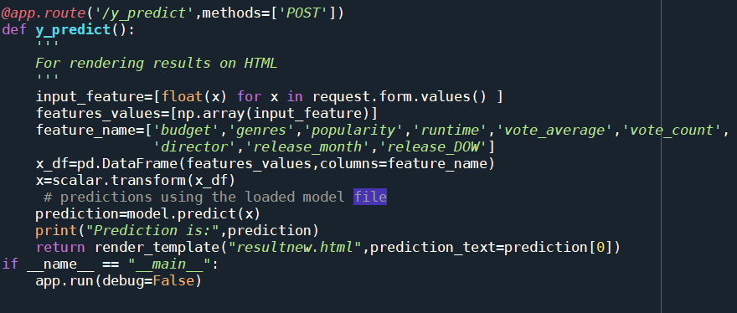
Results and Discussion(cont.)
Firstly, we are rendering the home.html template and from there we are navigating to our prediction page that is resultnew.html.

Slide 35
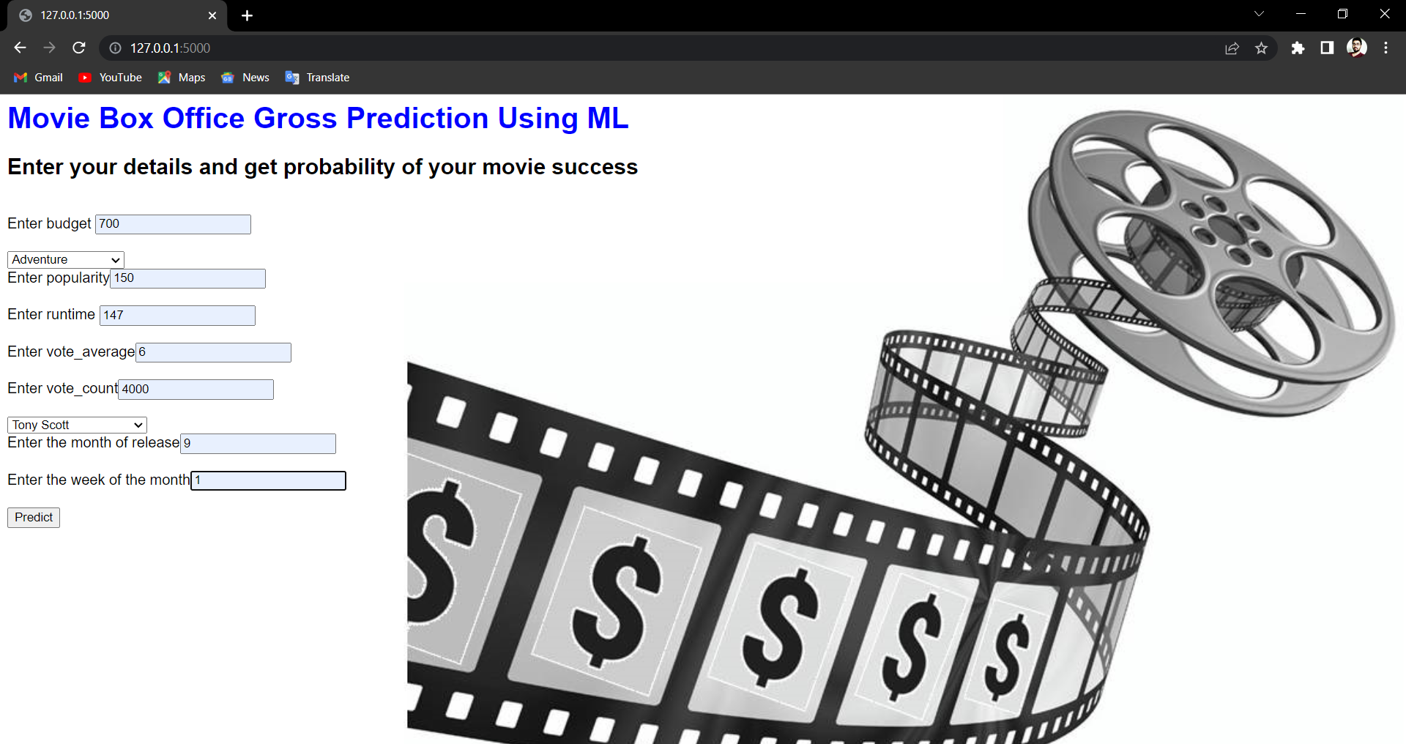
Results and Discussion(cont.)
This is the prediction page where we get to choose the input from our local system and predict the output.

Slide 36
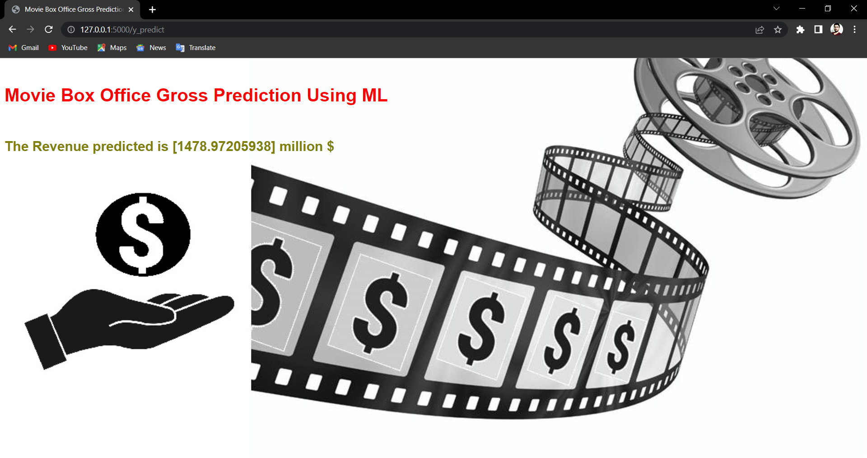
Results and Discussion(cont.)
Finally, the prediction for the given input features is shown.

Slide 37
Conclusion(cont.)
The user interacts with the UI (User Interface) to upload the input features.
Uploaded features/input is analyzed by the model which is integrated.
Once the model analyses the uploaded inputs, the prediction is showcased on the UI.

Slide 38
Conclusion(cont.)
Prompt and timely accurate prediction of Movie box office gross plays a vital role in decreasing for producers and stakeholders.An attempt is made to predict the presence of Movie gross using Support vector machine, Random Forest , K-NN classification Learning,Linear regression methods of Machine.we got 71.90% accuracy by using Linear regression.
I developed a computational model for movie box office gross prediction using a combination of features extracted from movie database metadata, budget-revenue relationship graphs, popularityrevenue relationship graphs, and movie-Revenue relationship graphs. I demonstrated that by using features extracted from these runtime-movies and revenue-movie relationship graphs, we are able to create a more accurate model than using metadata features alone.

Slide 39
References
[1] 1.11. ensemble methods. scikit. (n.d.). Retrieved November 2, 2021, from https://scikit-learn.org/stable/modules/ensemble.html#bagging-meta-estimator.
[2] 5. visualizations. scikit. (n.d.). Retrieved November 2, 2021, from https://scikit-learn.org/stable/visualizations.html.
[3] The absolute basics for beginners. NumPy. (n.d.). Retrieved November 2, 2021, from https://numpy.org/doc/stable/user/absolute_beginners.html.
[4] Matplotlib.pyplot. matplotlib.pyplot - Matplotlib 3.4.3 documentation. (n.d.). Retrieved November 2, 2021, from https://matplotlib.org/stable/api/_as_gen/matplotlib.pyplot.html.
[5] Narkhede, S. (2021, June 15). Understanding confusion matrix. Medium. Retrieved November 2, 2021, from https://towardsdatascience.com/understanding-confusion-matrix-a9ad42dcfd62.
[6] Simonoff, J. S. and Sparrow, I. R. Predicting movie grosses: Winners and losers, blockbusters and sleepers. In Chance, 2000.
[7] Joshi, M., Das, D., Gimpel, K., and Smith, N. A. Movie Reviews and Revenues: An Experiment in Text Regression. In Proceedings of the North American Chapter of the Association for Computational Linguistics Human Language Technologies Conference, 2010.
[8] Sharda, R. and Delen, D. Predicting box-office success of motion pictures with neural networks. In Expert Systems with Applications, 2006.

