Slide 1
Automatic Refinement of 3D Building Models
LOD1.3 to LOD2.2 using Graph-Based Parametric Roof Reconstruction with Machine Learning

Slide 2
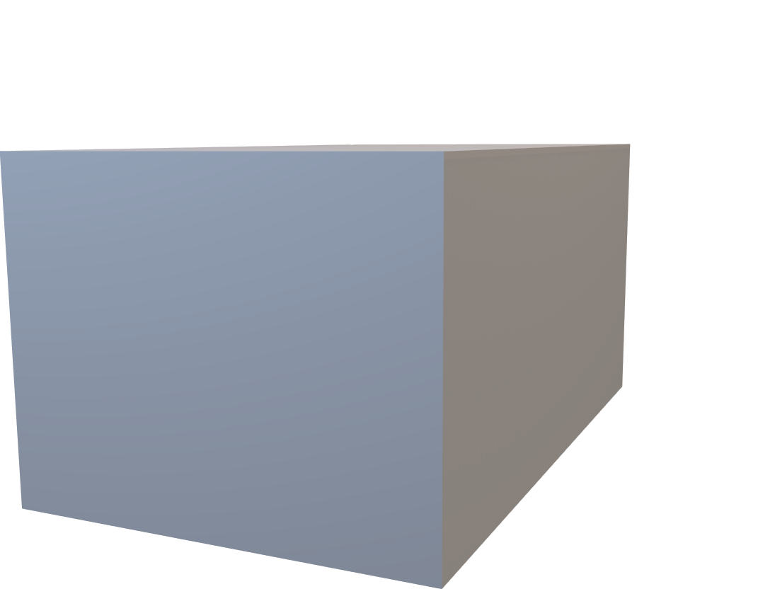
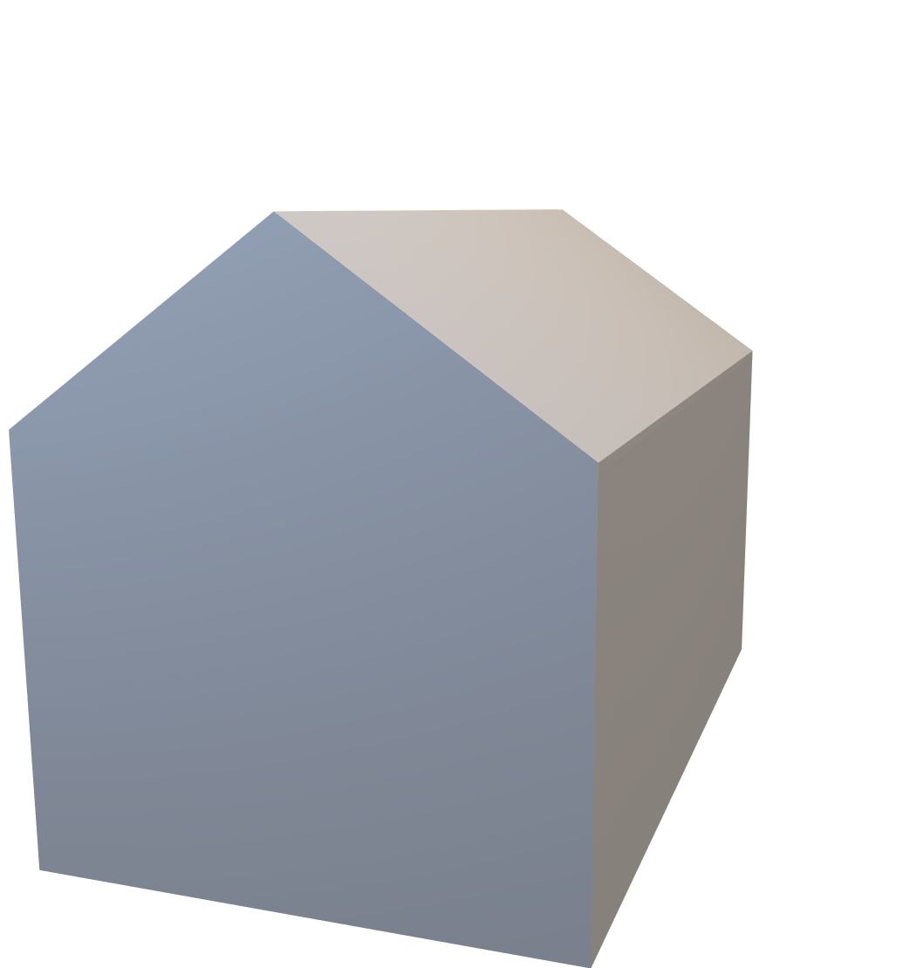
The Problem: Buildings without Roofs
Input
Flat top (No roof shape)
Output
Actual roof geometry
LOD1.3
LOD2.2
Pipeline

Slide 3
Research Questions
RQ1
How accurately can roof types (flat, gabled, hipped) be classified from LOD1.3 building geometry features using Random Forest classifier and which geometric features are most informative for this task?
RQ2
How accurately can roof type-specific geometric parameters (ridge height, ridge position) be predicted from LOD1.3 features using Random Forest regression, and what geometric accuracy does the resulting LOD2.2 reconstruction achieve compared to ground truth?

Slide 4
The Base Unit: What is a building in CityJSON?
CityJSON Structure
Building (parent)
Attributes only (no geometry)
b3_dak_type, b3_h_dak_min/max, volumes, etc
BuildingPart (child)
Contains the actual 3D geometry
LOD1.3 geometry (flat-top box)
LOD2.2 geometry(real roof shape)
Input = LOD1.3
Ground truth = LOD2.2
The LOD1.3 Solid
An extruded 2D footprint:
GroundFace – footprint polygon at ground level
TopFace – identical polygon at building height
WallFaces – Vertical rectangles connecting them
Typical rectangular building:
8 vertices (4 ground + 4 top)
6 faces (1 ground + 1 top + 4 walls)
No roof shape – just a flat top
Coordinates: RD/NAP (EPSG:7415)
Stored as integers x 0.001 + translate

Slide 5

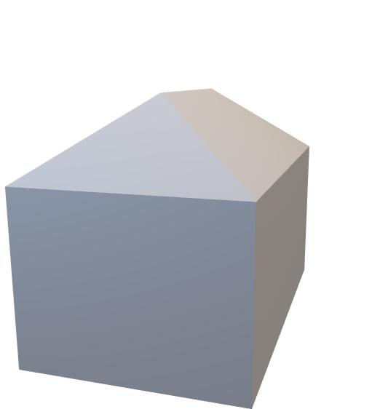

Three Roof Types We Handle
Flat
Gabled
Hipped
1 RoofSurface
0 Ridge Vertices
2 RoofSurface
2 Ridge Vertices
4 RoofSurface
2 Ridge Vertices
Roof type is determined by counting RoofSurface Faces in the LOD2.2 ground truth during training.

Slide 6
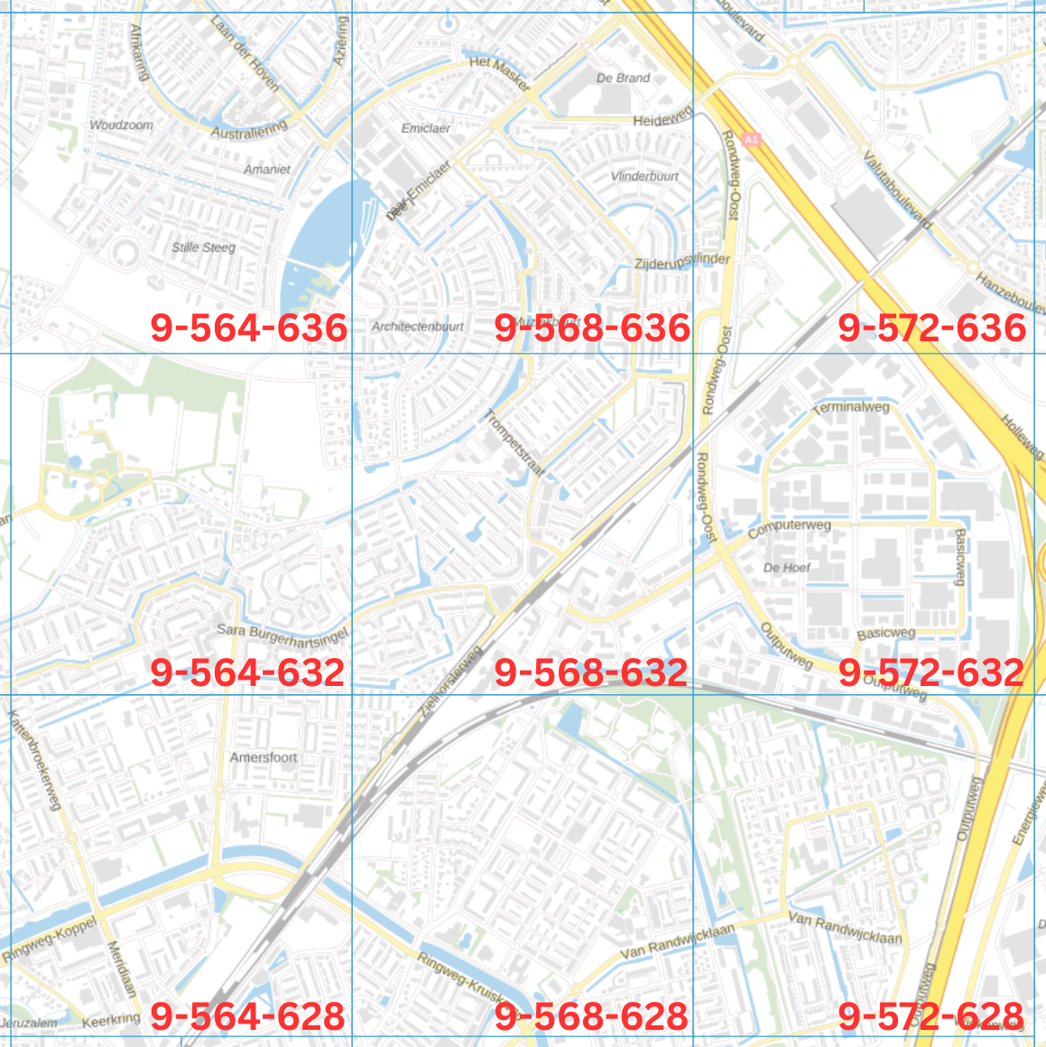
Dataset: 3DBAG
Source
Dutch 3D Building and Address dataset
10M+ buildings in CityJSON format
Both LOD1.3 and LOD2.2 provided
Publicly available at https://3dbag.nl
Coordinate system: EPSG:7415 (RD/NAP)
Subset
9 tiles processed(21,684 buildings)
8,542 buildings after filtering
Flat: 3993 buildings
Gabled: 3624 buildings
Hipped: 925 buildings
Filter:
Max 8 footprint vertices
Area 10-500 m²

Slide 7
Pipeline Overview
CityJSON
Feature Extraction
Stage 1: Classify
7 Features from LOD1.3 Geometry
Stage 2: Predict
Geometric Construction
CityJSON
Random Forest
Flat, Gabled, Hipped
Random Forest
Ridge Vertex Positions
Place ridge vertices
Build roof faces
Add semantic labels
LOD2.2 Building
LOD1.3 Building
The pipeline has two ML stages: (1) classify the roof types, (2) predict the ridge vertex positions. Then deterministic geometric rules construct the final LoD2.2 building.

Slide 8
Feature Extraction and Selection
Started with 13 LOD1.3 features
Used 3 methods to select features:
Random Forest Importance
Permutation Importance
Mutual Importance
Result: 13 → 7 features (accuracy: 88.8% → 88.6%)
Selected (7) – all from LOD1.3 geometry:
building_height, vol_lod13, footprint_area, footprint_perimeter, mbr_length, mbr_width, longest_edge_length
Dropped (6):
n_footprint_vertices, aspect_ratio, compactness, rectangularity, edge_length_ratio, orientation
Also excluded (LIDAR/LOD2.2-derived):
h_dak_min/max, h_dak_50p/70p, height_range, height_std_proxy, vol_lod22, vol ratio, vol difference

Slide 9
Random Forest Feature Importance
During training, each tree splits data using features that best reduce prediction error.
Features that reduce error more often are considered more important.
So importance score reflects:
How much each feature reduces impurity across all trees?
Rank | Feature | Importance
1 | building_height | 0.2174
2 | vol_lod13 | 0.1508
3 | footprint_area | 0.0963
4 | footprint_perimeter | 0.0833
5 | mbr_width | 0.0810
6 | mbr_length | 0.0761
7 | longest_edge_length | 0.0584
8 | aspect_ratio | 0.0527
9 | compactness | 0.0475
10 | edge_length_ratio | 0.0432
11 | rectangularity | 0.0382
12 | n_footprint_vertices | 0.0311
13 | orientation | 0.0241

Slide 10
Permutation Importance
Measures importance after the model is trained.
Procedure:
Train model normally
Shuffle one feature randomly
Measure how much accuracy drops
If accuracy drops a lot → feature is important.
If accuracy barely changes → feature is not useful.
Meaning of Standard Deviation is importance was measured multiple times, and results varied slightly.
Small std = stable importance estimate.
Rank | Feature | Importance | Std
1 | building_height | 0.2606 | 0.0090
2 | longest_edge_length | 0.0276 | 0.0033
3 | vol_lod13 | 0.0218 | 0.0045
4 | mbr_length | 0.0140 | 0.0035
5 | footprint_perimeter | 0.0126 | 0.0036
6 | mbr_width | 0.0101 | 0.0024
7 | rectangularity | 0.0094 | 0.0029
8 | n_footprint_vertices | 0.0085 | 0.0034
9 | aspect_ratio | 0.0073 | 0.0027
10 | footprint_area | 0.0072 | 0.0019
11 | orientation | 0.0071 | 0.0016
12 | edge_length_ratio | 0.0068 | 0.0022
13 | compactness | 0.0061 | 0.0023

Slide 11
Mutual Importance
Mutual Information measures how much information a feature contains about the target variable.
MI(X,Y) = how much knowing X reduces uncertainty about Y
High MI → strong relationship. Low MI → weak relationship.
Rank | Feature | MI Score
1 | building_height | 0.4776
2 | vol_lod13 | 0.3614
3 | mbr_length | 0.3585
4 | footprint_perimeter | 0.3436
5 | longest_edge_length | 0.3384
6 | mbr_width | 0.3367
7 | footprint_area | 0.3311
8 | orientation | 0.2103
9 | edge_length_ratio | 0.1739
10 | compactness | 0.1279
11 | aspect_ratio | 0.1192
12 | rectangularity | 0.0614
13 | n_footprint_vertices | 0.0559

Slide 12
Consensus Feature Selection
Selected features (7):
footprint_area score=3 (RF rank:3, Perm rank:10, MI rank:7)
footprint_perimeter score=6 (RF rank:4, Perm rank:5, MI rank:4)
mbr_length score=6 (RF rank:6, Perm rank:4, MI rank:3)
mbr_width score=6 (RF rank:5, Perm rank:6, MI rank:6)
building_height score=6 (RF rank:1, Perm rank:1, MI rank:1)
longest_edge_length score=5 (RF rank:7, Perm rank:2, MI rank:5)
vol_lod13 score=6 (RF rank:2, Perm rank:3, MI rank:2)
Dropped features (6):
n_footprint_vertices score=2 (RF rank:12, Perm rank:8, MI rank:13)
aspect_ratio score=2 (RF rank:8, Perm rank:9, MI rank:11)
compactness score=2 (RF rank:9, Perm rank:13, MI rank:10)
rectangularity score=2 (RF rank:11, Perm rank:7, MI rank:12)
edge_length_ratio score=2 (RF rank:10, Perm rank:12, MI rank:9)
orientation score=1 (RF rank:13, Perm rank:11, MI rank:8)
Key Findings (RQ1)
Top feature: building_height (21.7%) followed by vol_lod13 (15.1%) and footprint_area (9.6%)
Building size and height alone provide strong classification signal from pure LOD1.3 geometry
7 features sufficient all derivable from LOD 1.3 without LIDAR or LOD2.2 data

Slide 13
Roof Type Classification
Input (7 features from LOD1.3)
footprint_area (m²)
footprint_perimeter (m)
mbr_length (longest side of bounding rect)
mbr_width (shortest side of bounding rect)
longest_edge_length (m)
building_height (max_z – min_z)
vol_lod13 (LOD1.3 volume in m²)
Output (Roof types)
One of three classes:
Flat | Gabled | Hipped
RF Accuracy: 0.8900
RF F1 Score: 0.8920
MLP Accuracy: 0.8619
MLP F1: 0.8597
Predicted → Actual ↓ | flat | gabled | hipped
flat | 560 | 27 | 12
gabled | 32 | 466 | 46
hipped | 1 | 23 | 115
 | precision | recall | f1-score | support
flat | 0.94 | 0.93 | 0.94 | 599
gabled | 0.90 | 0.86 | 0.88 | 544
hipped | 0.66 | 0.83 | 0.74 | 139

Slide 14
Roof Type Classification
But how can roof type be predicted using only footprint geometry?
In architecture, the roof structure is strongly influenced by the footprint geometry.
Reasons include:
structural stability (wall placement, span length, load distribution)
Drainage (helps direct water away from walls)
construction cost
architectural design patterns (warehouse → flat, suburban house → gabled, compact house →hipped)
So certain footprint shapes tend to use certain roof types.

Slide 15
Roof Vertex Prediction
Input
Each building is represented using 26 geometric features derived from the footprint and building properties.
Input dimension: 26
Separate model for gabled and hipped roof.
Output
Output Vector:
[ridge_cx, ridge_cy, ridge_z, ridge_half_len, dim4, dim5]
Instead of predicting the entire roof mesh, the model predicts ridge parameters that allow reconstruction of the roof.
V4: (-0.5, 0.5)
V3: (0.5, 0.5)
V4: (-0.5, 0.5)
V3: (0.5, 0.5)
ridge_center
Origin
V1: (-0.5, -0.5)
V2: (0.5, -0.5)
V1: (-0.5, -0.5)
V2: (0.5, -0.5)

Slide 16
Roof Vertex Prediction
Input Representation
Footprint shape:
Normalised coordinates of up to 8 footprint vertices.
[v1_x, v1_y, v2_x, v2_y, …, v8_x, v8_y]
Footprint is centered at building centroid
Coordinates scaled by max(MBR length, width)
footprints with fewer vertices are zero-padded
Geometric Building Features:
len(footprint_2d), normalized_area, aspect_ratio, compactness, rectangularity, normalized_height, edge_length_ratio, normalized_orientation, normalized_mbr_length, normalized_mbr_width
Models Tested:
Random forest
MLP-small: 64 → 32
MLP-medium: 128 → 64 →32
MLP-large: 256 →128 → 64
Gabled Roof:
Hipped roof:
V4: (-0.5, 0.5)
V3: (0.5, 0.5)
Origin
V1: (-0.5, -0.5)
V2: (0.5, -0.5)
Model | MAE
MLP-small | 0.0518
MLP-medium | 0.0563
MLP-large | 0.0520
Random Forest | 0.0343
Model | MAE
MLP-small | 0.0894
MLP-medium | 0.0899
MLP-large | 0.0730
Random Forest | 0.0427

