Slide 1
Got Scale?
Arvind Jayaprakash
(arvindj@yahoo-inc.com)
4th July 2007

Slide 2
Is scale a problem?
A few billion pages served every day
  1 billion is 1e9
  1 day has ~87e3 seconds
Hundreds of millions of users who think they have infinite mail storage
Revenues per year in US$ in the same order as pages served per day
  Solutions have to be cost efficient

Slide 3
What does it take to scale?
A lot more than running supercomputers
A lot less than inventing a general sorting algorithm with an asymptotic complexity of O(1)

Slide 4
Break the problem into small areas
Storage
Network
Computation
etc etc…

Slide 5
Storage Hardware

Slide 6
Storage Hardware
The size problem

Slide 7
How do I Store everyone’s e-mail?
  Hundreds of millions of accounts
  Each account with a theoretical infinite capacity (previously 1-2G per person)
  Where do I store all of this?
Crawlers
  Save the “internets” so that we can build a search engine on it

Slide 8

Assume you had to start simple…
One server, one hard drive
Got more data?
Get a bigger drive!
HDD
And then comes a point when they don’t make any bigger hard drives!

Slide 9
Now that you own the world’s biggest HDD…
We go buy more of them!
And then you realize there are only so many drives you can attach to one host
HDD
HDD
HDD
HDD
HDD
HDD
HDD
HDD
HDD
HDD
HDD
HDD

Slide 10
Enter the filer
Your application needs lots of storage
You don’t care if the storage medium is housed inside the same unit as the CPU
You do however care about being under the illusion that the storage media is a local

Slide 11


NFS mounts please
Application Server
Storage servers

Slide 12
What is NFS?
Network mount file systems
Mount disks from other hosts
Effectively have access to a very large FS
App Server
Storage Servers
/home/m1 -> /home from machine 1
/home/z3 -> /homes from machine 2
/data/secret -> /FBI from machine 3

Slide 13
Storage Hardware
Speed

Slide 14
Assume we have small amounts (a few GB) of data but need very fast access to it.
Here is how you can spend money
  Buy HDD that spins faster
  Buy HDD with larger buffer
  Buy HDD with greater seek speed
  Buy HDD that connects to a faster bus

Slide 15


Say no to HDD, go for RAM!
X
Lots of RAM

Slide 16
What if…
RAM is too expensive
You have attached maximum RAM possible
You need something that is faster than HDD but not as fast as RAM

Slide 17
Data striping
Have multiple HDDs and use them in parallel
Read/write 16 blocks
RAID Controller
1/9
3/11
5/13
7/15
2/10
4/12
6/14
8/16

Slide 18
RAID
Redundant Array of Inexpensive Disks
Used for both performance and fault tolerance
RAID has many levels

Slide 19
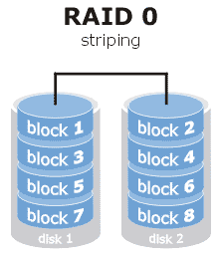
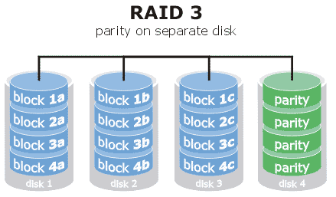
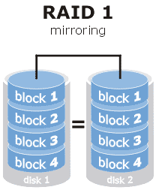
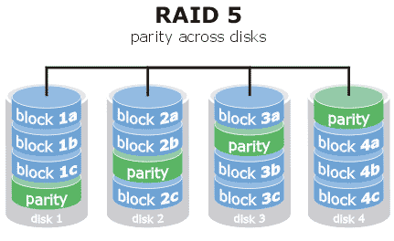
Images from http://www.prepressure.com/techno/raid.htm

Slide 20
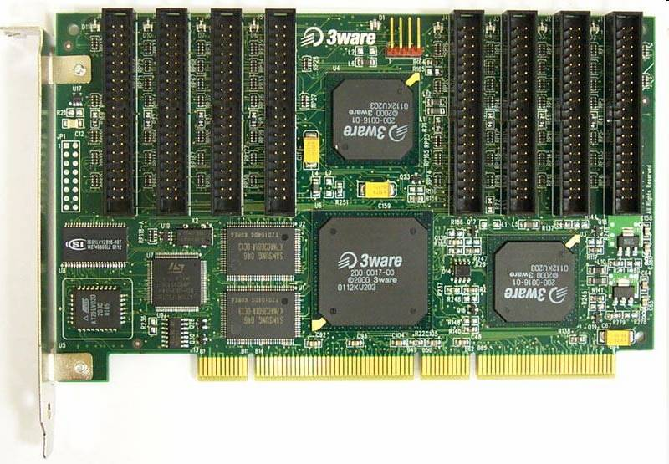

Slide 21
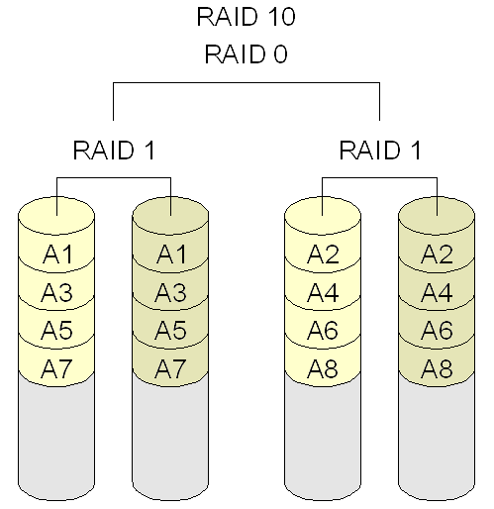
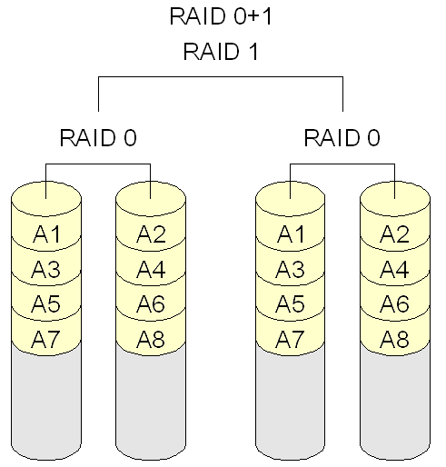
Multi RAID

Slide 22
Going hybrid?
Many combinations possible
  RAID on filers
  Cluster of machines with RAM talking over the network

Slide 23
Application servers

Slide 24
Application servers
Who does my work?

Slide 25
Can we afford to look around for stuff?
There are hundreds of storage servers
There are lots of front end servers
There are servers you don’t know even know exist

Slide 26
Partition your dataset
Create clusters of nodes
Have a deterministic way of associating the dataset to a partition
Decide what needs to be partitioned and what does not have to

Slide 27
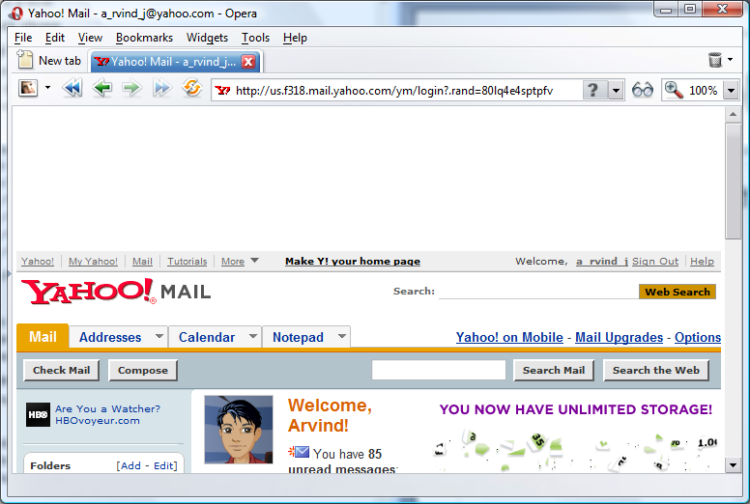
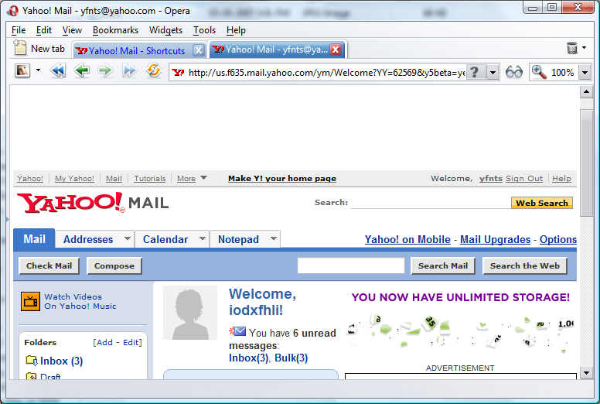
Farms

Slide 28


mail.yahoo.com just needs to know where to send the user
Farm 318 (a_rvind_j)
Farm 635 (yfnts)

Slide 29
How to partition
All entities must have a systemwide unique id
Two approaches possible
  Magic hash
  Lookup tables

Slide 30
Farms are always not possible
All operations do not lend itself to farming
Web search uses partitioning but it is not possible to restrict search operation to one partition
Resort to federation

Slide 31

Federator/Aggregator
Nodeset 1
Nodeset 2
Nodeset 3

Slide 32
Application servers
When does my work get done?

Slide 33
Try not to do a whole lot when the user is at your doorstep
Can we do the work later?
Could we have done it beforehand?
If not, then keep the user waiting and finish the job

Slide 34
What can we do later?
Non real time but mandatory actions
  Things that we have to do
  Things that we can do later
  Acceptable delay time varies
Examples
  Defer all offline communication (send mail, e-card, friendship invite etc)
  Saving ratings, reviews, comments

Slide 35
Store-(forward)-process
WS-1
WS-2
WS-n
Web server s/w
Web server s/w
Web server s/w
Job
queue
Job
queue
Job
queue
Job
queue
Job
queue
Queue processor
Queue processor

Slide 36
What can we do beforehand
Expensive but crude operations
  The user may ask for something in future
  We need not be accurate with the results
  The acceptable level of inaccuracy varies
Examples
  Pull RSS feeds
  Push stock quotes
  Most viewed items

Slide 37
Storage software

Slide 38
Storage software
Databases

Slide 39
Databases
Let us start by naming a few databases…

Slide 40
The list
Oracle
MySQL
PostgreSQL
MS SQL Server
MS Access?
…
(g|n|s)dbm
BerkeleyDB
CSV,TSV files
XML?
mmap’ed files

Slide 41
Database ≠ RDBMS
By definition, a database is any collection of structured query-able records
The query language does not have to be SQL
Even files written using fread() fits the above definition

Slide 42
Some factors influencing choice of DB
Speed (read/write)
Size of data
Concurrency (simultaneous reads/writes)
Replication
Reliability
Hardware and software (licensing+support) costs

Slide 43
Storage software
RDBMS

Slide 44
Different RDBMS have different capabilities
These differences are usually very significant
It is almost impossible to write a generic but highly optimized SQL query or in some cases even define a table

Slide 45
Examples
Oracle is known to make much better use of filers than MySQL
MySQL had “LIMIT x OFFSET y” clause which is very useful for pagination
Postgre can also act as an ORDBMS
Prepared statements in MySQL may be slower as it bypasses query cache
Do not assume all RDBMS are ACID compliant

Slide 46
Non purist design
Maximal normalization may not result in the fastest system
  Denormalized tables may work better
  Storing auxiliary data as a blob in one column might make sense in some cases
Design based on access patterns

Slide 47
Storage software
Other options

Slide 48
Key/Value pair stores
Lots of alternatives available to RDBMS if the data to be stored is just a key value pair
*dbm, BDB etc have a much smaller memory footprint and simpler APIs for such operations
Easier to create on the fly (no create table statements)

Slide 49
Flat files
Flat files (CSV, TSV, et al) make sense for very large amounts of data (Think TB)
Works best if sequential access is involved
*NIX vertical filters can also be used (with small files)

Slide 50
Web Servers

Slide 51
The rules
Whatever you do, do it quickly
…And that’s about it

Slide 52
Disclaimer!
Most of this is not specific to just webservers…

Slide 53
Things to do
Use shared memory to cache frequently accessed data
  Gets shared across processes
  Overhead is minimal
Write extensions/modules
  Load/compute constants when server starts and not on every request
  Coding in C still makes sense for CPU intensive operations

Slide 54
Things to avoid
Sessions tied to a single server
Making system calls
Starting off a new process
Disk access
Heavy computations
Waiting on time consuming network operations

Slide 55
Examples
Avoid cgi scripts.
  Fork (and exec) is expensive
  Prefer mod_perl / mod_php etc
  Creates the intpreter just once for the lifetime of the webserver
Use intermediate compilers like APC(for PHP)
  Parsing happens just once and saves a lot of time

Slide 56
Never use swap space
  A web server that starts swapping for the lack of RAM is a dead webserver
Network operations
  All network operations must have a configurable timeout after which you assume the operation failed
  Limits how long you can get stuck

Slide 57
Networking

Slide 58
Networking
Internal Bandwith

Slide 59
Ethernet
Ethernet uses CSMA-CD protocol when connected to a hub
Real bandwidth at a frame level is significantly lower than the spec when used with a hub
Use switched hubs (not to be confused with router switch) to avoid frame collisions

Slide 60
Networking
TCP/IP

Slide 61
Socket connections
Cost of setting up and tearing down a TCP connection is high
If your application is long running, then try and use persistent connections

Slide 62
Networking
Load Distribution

Slide 63
A web server maybe only able to handle say 100 simultaneous requests
We needs lots of servers to handle all traffic
We publish only one hostname to our users. Eg: news.yahoo.com
How do we get tens of servers to use the same name?s

Slide 64


Proxy servers
Broswer
news.yahoo.com
(proxy server)
news01.y.c
news02.y.c
news03.y.c
news04.y.c

Slide 65
Single hosts accepts all connections; forwards request to real worker and sends the result back
Proxy does no real work, so scales much better than a single scale
Proxy is now the bottleneck
  Bandwidth limitations
  Max number of connections
Caching proxies may be used in some cases

Slide 66
(HTTP) Redirects
Broswer
User now sends request to the suggested server
Response
User requests n.y.c
Rd server randomly returns a name
news.yahoo.com
(redirect server)
news01.y.c
news02.y.c
news03.y.c
news04.y.c

Slide 67
Redirect Servers
Chooses the name of a host and sends it back to user
User makes another request to the specified host
RD servers not involved in actual request serving
Scales much better than proxy
Use a proxy in front of an RD to scale more ☺

Slide 68
May actually work in case of session based closed client apps. Eg: messenger
Used in conjunction with farms (just to resolve a farm; the farm has many machines)

Slide 69
Where it fails (miserably)
Expensive for users (site is slow, it sucks!)
Users can hit real servers directly in future, thus not giving us a chance to balance the load dynamically

Slide 70
Hardware load balancing
VIPs (or virtual IPs), also known as Alteon (Brand name of equipment made by Notrel) are hardware load balancers
Place a vip behind the router and front of the real servers
Almost looks like the proxy setup
So what is the hardware magic?

Slide 71


VIP
Broswer
Public internet
Yahoo! n/w
Router
news01.y.c
news02.y.c
news03.y.c
news04.y.c

Slide 72
When was the last time you saw a triangular TCP story?
Direct Server Response (DSR)
The response did not flow through the VIP

Slide 73
DSR explained
Users are unaware of what happens inside our networks.
They believe they are making connections with the VIP and the hop before that is our BGP router
VIP spoofs the MAC address of the destination_x0013_ when pushing the frame to the real server
The real server innocently sends its replies back to the router

Slide 74
VIP management
How does the VIPs know the names of all hosts?
How does it know if individual hosts are up?
How to pick a host?

Slide 75
Names of hosts is a configuration
VIP periodically checks (10 seconds) by hitting a fixed url (eg: http://servername/status.html)
  If response is HTTP OK (200), assume host is in good shape
  Else assume host is down
Choosing a host for a request can be done in may ways (round robin, weighted avg etc etc)

Slide 76
Multiple datacenters
We cannot have all servers in one single physical location
Being in many places (closer to the user) matters
Being in many places saves for from geo specific problems (earthquakes, power outages, etc etc)

Slide 77
Distributing users across geographies
For a given request, it is fairly obvious which is the nearest/fastest datacenter available
Each datacenter will have VIPs internally
How do we now choose a datacenter?

Slide 78
Akadns
Use CNAMEs for your site that resolve differently in different parts of the world
n.y.c resolves a (V)IP for n.west.y.c for Californian users and as n.east.y.c for New York users
n.(west|east).y.c could be real datacenters in USA
Akamai partners with ISPs around the world to make this magic happen

Slide 79
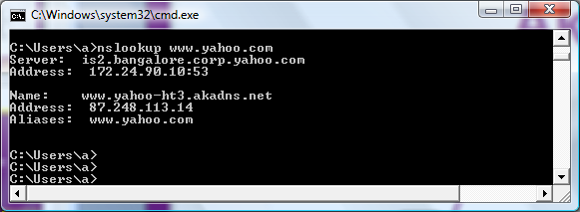

Slide 80
Datacenter failover
VIPs are near real time in polling servers for availability, akadns is not
DNS results have TTLs
If an entire datacenter sinks, then users with DNS cache entries are helpless till the TTL expirers
Moral of the story: Make sure you don’t completely disappear off a datacenter!

Slide 81
Uses a similar technique like VIP for polling health (hits http://vipname/akamai)
  Same rules as vip, i.e. check for 200
Akamai uses roundtrip times of the above url across datacenters to periodically update its CNAMEs from a given location

Slide 82
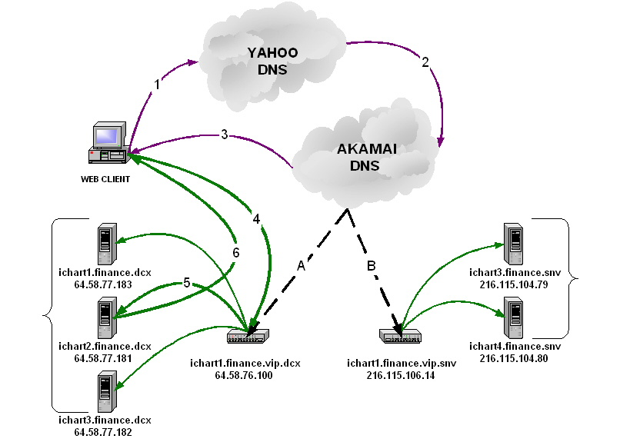

Slide 83
Browsers

Slide 84
Do a lot in the least amount of time
Overall page rendering process should appear fast
Things affecting page load times are size of page, time taken to generate HTML, number of images/CSS files, size of each component files, number of domains needed to complete a request etc etc

Slide 85
Use cache settings when appropriate to avoid reloading
HTTP 1.1 does only 2 requests per domain in parallel; minimize number of images
Frequent domain name lookups are expensive
Use edge caching for static content

Slide 86
Culture

Slide 87
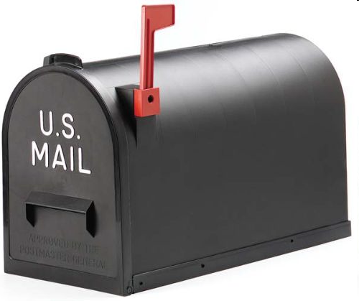
What is this?

Slide 88

What about this?

Slide 89
Mail flag
The status of the flag indicated if you have mail or not
Concept that is alien in many countries
A US designer may not be aware of the issue

Slide 90
Birthday party!
Diya was born on 12/9/1981
When is her birthday coming next?
It is not the 12th of September
It is on the 9th of December

Slide 91
Born on the 4th of July
Assume Tom Cruise was born on the 4th of July
We need to wish him at midnight
It is close to noon, we are late!
How do we make up?
In LA, midnight didn’t happen all that long ago

Slide 92
Moral of the story
Being a global company requires you to be aware the user’s cultural settings
Date formats, colo(u)rs, symbols, spelling, digit separators, even time* is not the same for everyone
The challenge is not a CS problem, it is not knowing what to assume
*Jawaharlal Nehru was wrong in saying “At the stroke of the midnight hour, when the world sleeps, India will awake to life and freedom”. The entire world doesn’t sleep at the same time and most definitely doesn’t have midnight at the same time

Slide 93
Putting it all togther

Slide 94
How mail.yahoo.com could be done
Users grouped into farms
RD to send user to a farm
Inside a farm…
Primary storage is large amounts of filers
Filers may have RAID
Frontend servers behind VIPs
Mail delivery is done using queuing
Frontend localized for each country/language

Slide 95
Questions?

