Slide 1
Job Market Analysis Using Power BI

Slide 2
Project Overview
Analysis of job market trends, salaries, industries, companies, skills, and education requirements using Power BI.

Slide 3
Objectives
Identify top states, analyze salaries, find top industries and companies, analyze job titles and skills, and build a dashboard.

Slide 4
Dataset Description
Dataset contains Job Title, Company Name, Industry, Location, Degree, Salary, and Skills.

Slide 5
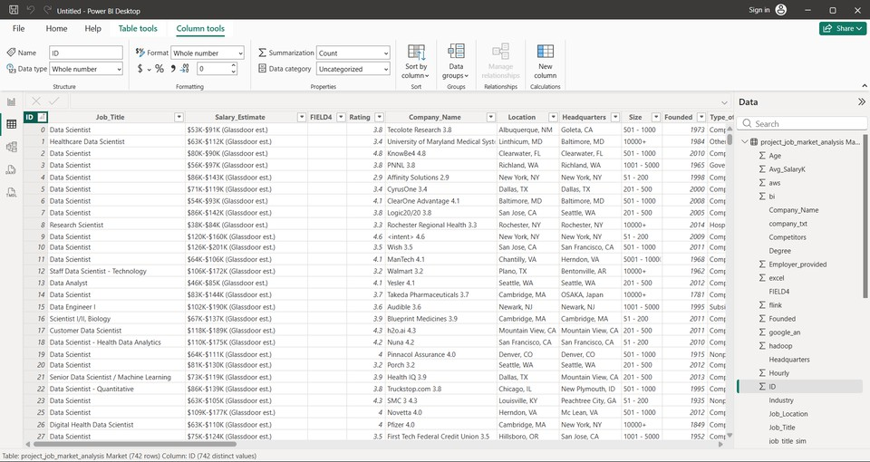
Data Cleaning & Preprocessing
Removed duplicates, handled missing values, corrected data types, and prepared data.

Slide 6
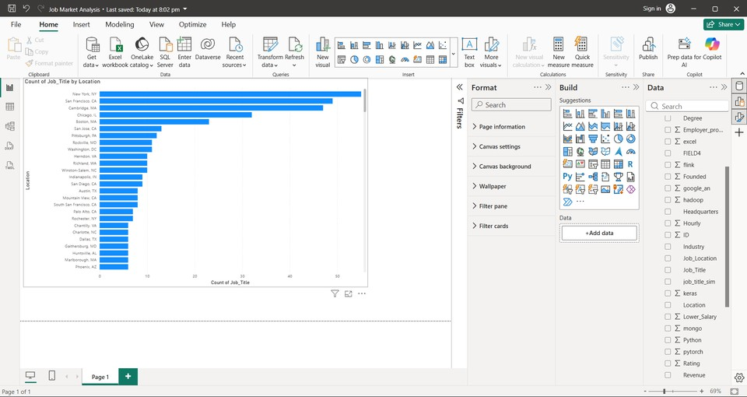
States with Most Jobs

Slide 7
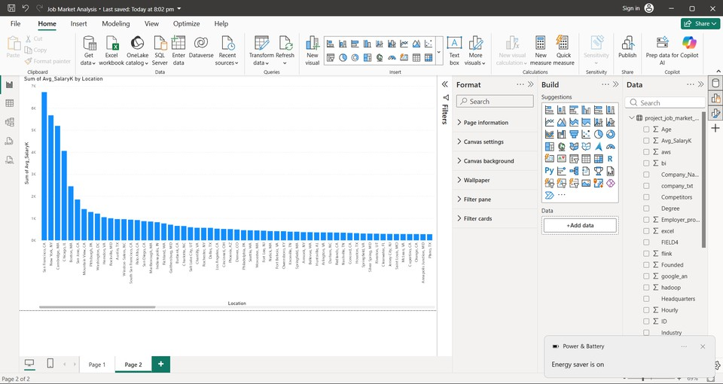
Salary Analysis by State

Slide 8
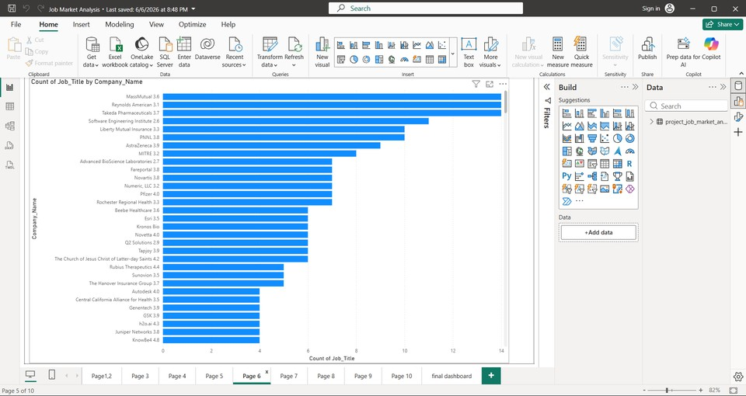
Top Industries & Companies

Slide 9
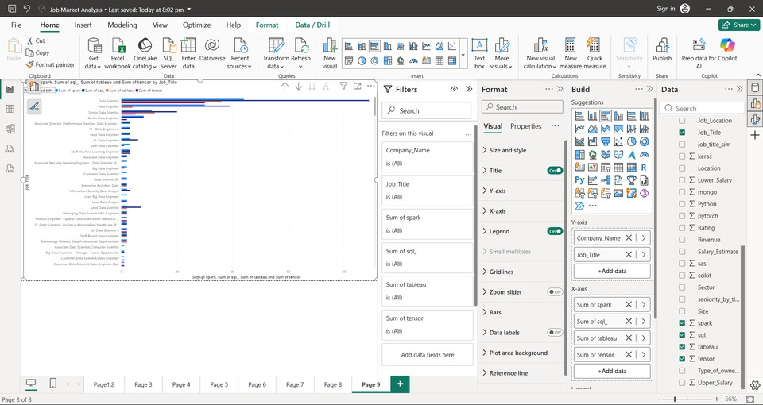
Job Titles & Skills Analysis

Slide 10
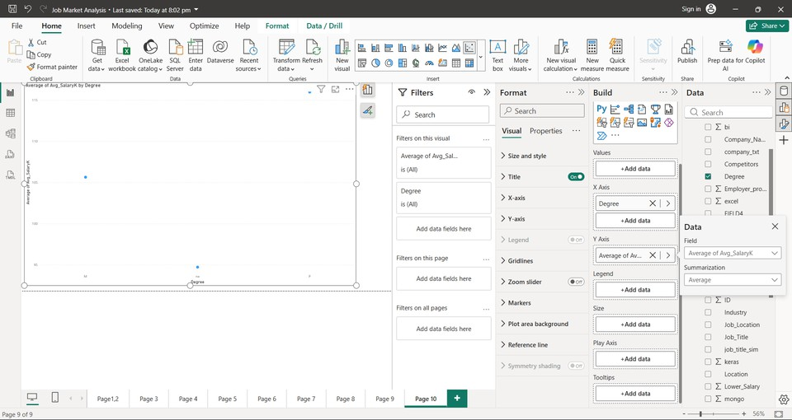
Education vs Salary

Slide 11
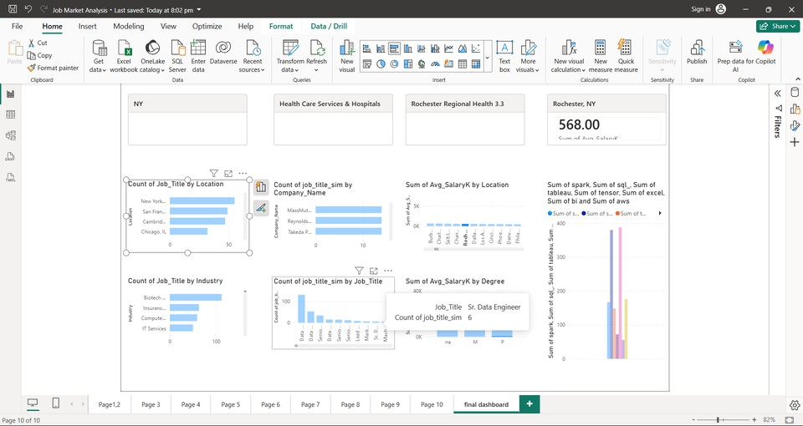
Dashboard Overview

Slide 12
Key Insights
High-demand states dominate hiring. SQL and Python are key skills. Higher education often leads to higher salaries.

Slide 13
Recommendations
Focus on in-demand skills, training, competitive salaries, and analytics-driven hiring.

Slide 14
Conclusion
The project provides actionable insights into job market trends using Power BI.

Slide 15
Thank You
Questions & Answers

