Slide 1
Housing Price Predictions
Group 3: Venkata, Islom, Cheryl

Slide 2
Problem
Predict housing prices given 100+ data points

Slide 3
Getting ready for modeling
Pre-process data
Anomaly detection
Standardize data
Correlation Matrix

Slide 4
Fit and predict
Models used
Random Forest
SVR
Logistic Regression

Slide 5
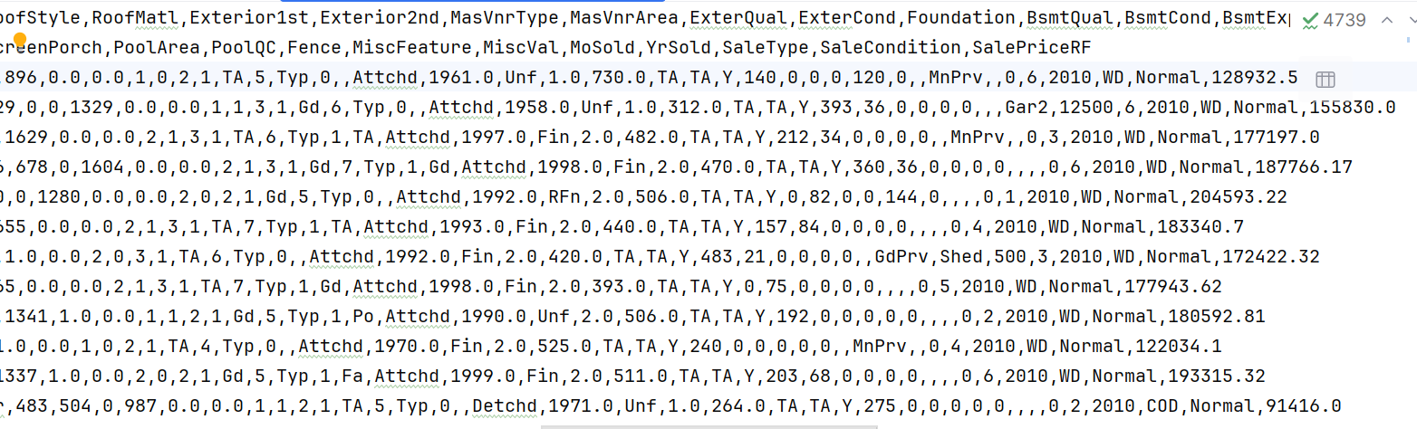
Predictions

Slide 6
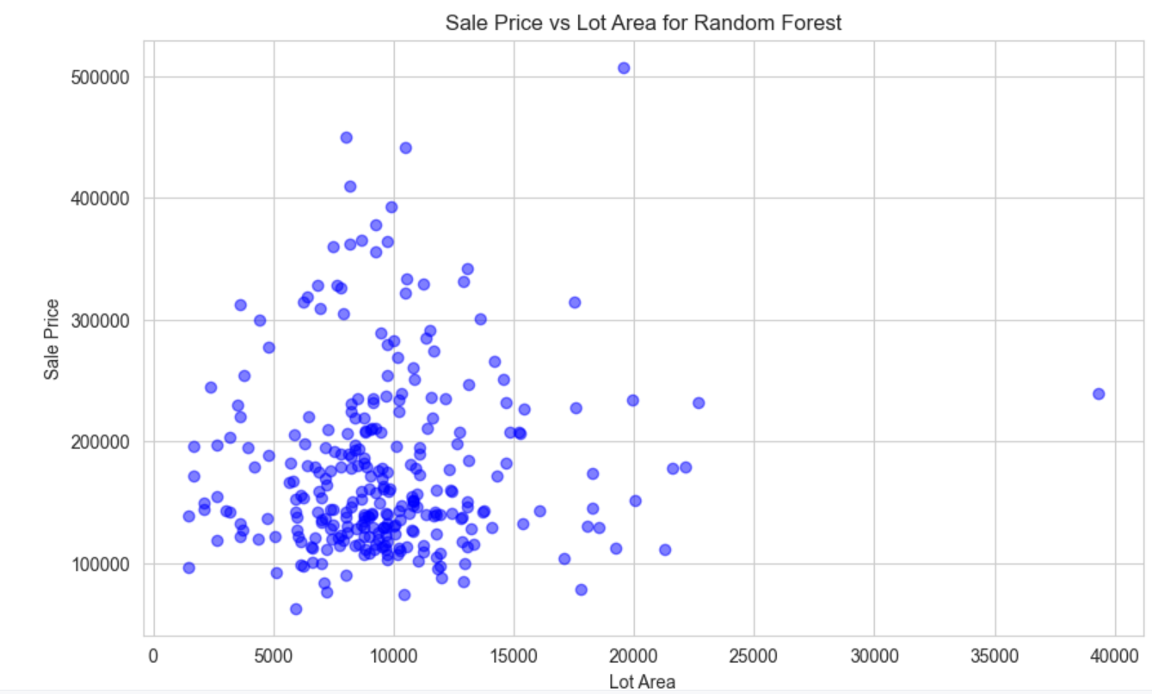
Analysis

