Slide 1

Parallel Implementation of Advanced Matrix Operations for Machine Learning using MPI B11

Slide 2

Team Members
CB.AI.U4AID23125 M SATHVIKA
CB.AI.U4AID23129 P HARIGOPAL
CB.AI.U4AID23130 SAI CHARAN
CB.AI.U4AID23153 MOHIT MADHAV

Slide 3
INTRODUCTION
Matrix operations like multiplication, addition, and inversion are fundamental in machine learning algorithms such as neural networks, principal component analysis, and support vector machines.
With growing data sizes, these operations become computationally intensive, slowing down training and predictions.
Parallel computing distributes the workload across multiple processors to perform matrix computations faster and more efficiently.
MPI (Message Passing Interface) is a standardized, portable communication protocol used to program parallel computers. It enables multiple processes to communicate by sending and receiving messages, making it ideal for distributed memory architectures.

Slide 4
Problem Statement
Large-scale machine learning models require advanced matrix operations on massive datasets, leading to high computational costs and long execution times.
Traditional sequential execution of matrix operations does not scale well and becomes a bottleneck.
There is a need for a parallel implementation that efficiently utilizes computing resources to handle the complexity and scale of matrix computations in machine learning.

Slide 5
Objectives
Develop efficient parallel algorithms for advanced matrix operations such as multiplication and inversion using MPI.
Achieve significant performance improvements over sequential methods.
Ensure scalability of the implementation to handle increasing data sizes and compute nodes.
Minimize communication overhead and balance load among processors for optimal performance.

Slide 6
Overview of the Program
The program multiplies two square matrices of fixed size N×N (here, N=64) in parallel using MPI.
There are multiple MPI processes:
Process with rank 0 acts as the Manager, which distributes data to worker processes and collects computed results
Worker processes (rank > 0) perform matrix multiplication for a subset of rows.

Slide 7

Step 1: Initialization
Initialize the MPI environment to enable communication among distributed processes.
Determine the total number of processes and each process's rank.
Define the size $N×N$ of the matrices to be multiplied.
Step 2: Data Preparation by Manager
The manager (rank 0) creates and initializes two matrices (matrix1 and matrix2) with random integer values.
The total workload is divided by equally partitioning the rows of matrix1 among the worker processes.
Calculate the number of rows each worker will handle: $ rows = N / numberOfWorkers $.
Step 3: Data Distribution to Workers
For each worker process:
Send the starting row index (matrixSubset) for its assigned subset.
Send the number of rows it needs to process.
Send the corresponding block (subset of rows) of matrix1.
Send the full matrix2 since workers require all columns of this matrix to perform multiplication.

Slide 8

Step 4: Parallel Computation by Workers
Each worker receives its assigned subset of rows from matrix1 and the full matrix2.
Workers perform local matrix multiplication on their subset:$\text{productMatrix}[i][k]=\sum_{j=0}^{N−1}{ }\text{matrix}\text{1}[i][j]×\text{matrix}\text{2}[j][k]$
where $i$ iterates over assigned rows and $k$ over columns.
This local computation is done independently across all worker processes in parallel.
Step 5: Collecting Results
Upon completing their computation, workers send back to the manager:
The starting subset row index.
The number of rows computed.
The computed partial result matrix block.
The manager receives and assembles all partial matrices into the final productMatrix.
Step 6: Finalization
Optionally, the manager prints all matrices (matrix1, matrix2, productMatrix) for verification.
The runtime of the entire parallel multiplication is measured and displayed.
Finally, MPI environment is finalized to clean up resources.

Slide 9
Reference & Year | Key Focus | Parallelization Approach | Main Results & Contributions | Notes
Adefemi (2024) | Performance analysis of matrix multiplication on Cirrus supercomputer | MPI + OpenMP hybrid | Demonstrated scalability and efficiency of parallel matmul; MPI scales better for large matrices | Discusses trade-offs between multithreading and MPI for different matrix sizes
Earth Science (2023) | Parallel numerical algorithm for matrix assembly and multiplication | MPI + OpenMP hybrid | Achieved near-linear speedup on up to 100 cores; optimized finite element matrix computations | Optimizes matrix symmetry and reduces workload
ScienceDirect (2023) | Accelerating large dataset preprocessing in ML with MPI | MPI distributed matrix computation | Reduced runtime significantly vs sequential; suitable for real-time large-scale ML data | Focus on preprocessing pipeline acceleration
IIT Goa (2025) | Matrix multiplication implementation using MPI_SEND & MPI_RECV | Manager-Worker MPI paradigm | Analysis of execution time and communication overhead; scalability limited by communication | Highlights communication overhead as limitation for many MPI-based implementations
Arxiv (2020) | Parallel matrix multiplication algorithms & optimization frameworks | Diverse including Cannon's & SUMMA algorithms | Discussed communication minimization strategies; compared traditional and advanced MPI algorithms | Provides mathematical background and practical considerations

Slide 10
Objectives
To implement parallel matrix multiplication using MPI.
To demonstrate how matrix operations for Machine Learning can be accelerated through parallel processing.
analyzing performance gains compared to sequential execution.
Improve performance and scalability for ML workloads
Demonstrate manager-worker paradigm for workload distribution

Slide 11
Manager–Worker Paradigm
Manager (Rank 0):
Initializes matrices
Divides workload into row chunks
Sends data to workers and collects results
Workers (Rank > 0):
Receive assigned rows of matrix1 and entire matrix2
Perform local multiplication
Send partial product back to Manager

Slide 12
MPI Functions Used
MPI_Init() – Initialize MPI environment
MPI_Comm_size() – Get number of processes
MPI_Comm_rank() – Get rank of process
MPI_Send() – Send data between processes
MPI_Recv() – Receive data from processes
MPI_Finalize() – Terminate MPI environment

Slide 13
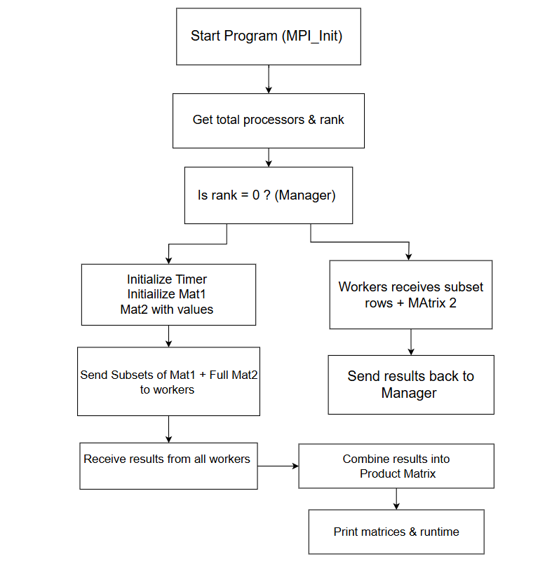

Slide 14
Code Flow
Initialize MPI environment
Manager creates and populates matrices
Manager distributes rows of matrix1 to workers
Workers perform multiplication with matrix2
Workers send results back to Manager
Manager assembles final product matrix
Print results and runtime

Slide 15
Conclusion
MPI enables efficient parallel implementation of matrix operations
Manager–worker paradigm distributes workload effectively
C MPI code demonstrates real performance gains for ML tasks
Future Scope: Extend to advanced ML operations (factorization, inversion, GPU-MPI hybrid)

