Slide 1

CASE STUDY · GOOGLE DATA ANALYTICS CAPSTONE
Two ways to ride Cyclistic
How members and casual riders use the bikes differently, and which casual riders are closest to becoming members
Saran Raj Loganathan
Junior Data Analyst, Marketing Analytics · October 2026
Data: Oct 2025 – Sep 2026 · 6,006,874 rides after cleaning
Notes:
Hi everyone, and thanks for making the time. A few weeks ago the marketing team asked me a simple question: how do our annual members and our casual riders actually use the bikes differently? I spent the last year of trip data on it. I'll walk you through what I found, which casual riders I think we should talk to first, and three things I'd recommend. It should take about 15 minutes, with time for questions at the end.

Slide 2



Members commute. Casual riders explore.
THE SHORT VERSION
MEMBERS
CASUAL RIDERS
A quick, practical way to get around
Something to do on a sunny afternoon
64.9%
8.7 min
Wed
11.1 min
37.2%
~15×
of all rides
median ride
busiest day, Tue–Thu close behind
median ride
of their rides at weekends
more rides in July than January
The opportunity: about 6% of casual rides already look like a commute — rush hour, business district. Those riders are the easiest to win over.
Notes:
If you only remember one slide, make it this one. Members use Cyclistic as transport: short rides, mostly midweek, around work hours. Casual riders use it as a leisure activity: longer rides, weekends, summer. The interesting part is at the bottom. There's a small group of casual riders who already ride exactly like members. They're the people I'd talk to first.

Slide 3

What a typical ride looks like for each group
PUTTING A FACE ON THE DATA
TYPICAL MEMBER RIDE
TYPICAL CASUAL RIDE
The weekday commuter
The Saturday explorer
Picks up a bike near Union Station around 8 AM
About 9 minutes to the office in the Loop
Does the same trip home at 5 PM
Rides most on Tuesday to Thursday, all year
Grabs an e-bike at Navy Pier after lunch
Rolls along the lakefront for longer than a member would
Rides most on Saturday, from late morning to early evening
Mostly rides between June and August
These two are illustrations built from the patterns in the data, not real people. The dataset has no rider IDs, so every number in this deck describes rides, not individual riders.
Notes:
Numbers can feel abstract, so here are two typical rides. On the left, someone who uses the bike to get to work. On the right, someone out on a nice Saturday. To be clear, these aren't real people. We can't track individuals in this data, there's no rider ID. They're just a way to picture what the averages mean.

Slide 4




What the marketing team asked me to find out
ASK
How do annual members and casual riders use Cyclistic bikes differently, and how can we use that to turn more casual riders into members?
Why it matters
The opportunity
Who decides
Annual members bring in more profit, yet about a third of all rides still come from casual riders.
Casual riders already know Cyclistic and use it. Winning them over should cost less than finding brand-new customers.
Lily Moreno, Director of Marketing, shapes the campaign. The executive team signs it off.
Notes:
Here's the brief. Finance found that members are worth more to us than casual riders. Lily's idea is to grow by converting the casual riders we already have, rather than spending on brand-new customers. Before we can design that campaign, we need to understand how the two groups actually ride. That's what this analysis is about.

Slide 5

Turning 12 messy monthly files into one clean dataset
PREPARE AND PROCESS
12
6.17M
164,911
6.0M
monthly files, Oct 2025 – Sep 2026
raw rides, 13 columns, no personal data
rides removed as errors (2.7%)
rides left for analysis (6,006,874)
STEP 1
Combine the 12 files
STEP 2
Drop rides with no end point
STEP 3
Fix dates, add columns
STEP 4
Drop rides <1 min or >24 h
STEP 5
Keep the 12 months only
Done in Python on Google Colab (pandas, NumPy, Matplotlib, Seaborn, scikit-learn). Six million rows is too much for a spreadsheet, and code means anyone can check and re-run every step.
Notes:
The raw data came as twelve monthly files, 6.17 million rides in total. Cleaning was mostly common sense: I removed rides with no end point, and rides shorter than a minute or longer than a day, which are usually false starts or lost bikes. In total I removed about 165,000 rides, 2.7% of the data, which left just over six million. Rides with no station name I kept, because they're mostly e-bikes parked outside a dock, and throwing them away would have skewed the results.

Slide 6
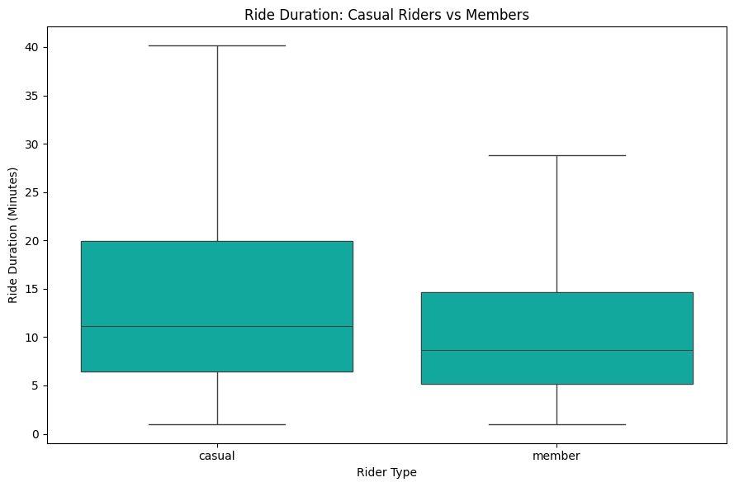
Members ride more often. Casual riders stay on longer.
FINDING 1 · RIDE LENGTH
64.9%
of all rides are taken by members
11.1 vs 8.7
median minutes, casual vs member ride
A member ride is a quick hop from A to B. A casual ride is more of a little outing.
Ride length by rider type (outliers hidden)
Notes:
Members take 64.9% of all rides, about two out of every three. But look at the boxes: casual rides last longer. The median casual ride is 11.1 minutes against 8.7 for members, and the longest casual rides stretch to around 40 minutes. Members are getting somewhere; casual riders are taking their time.

Slide 7
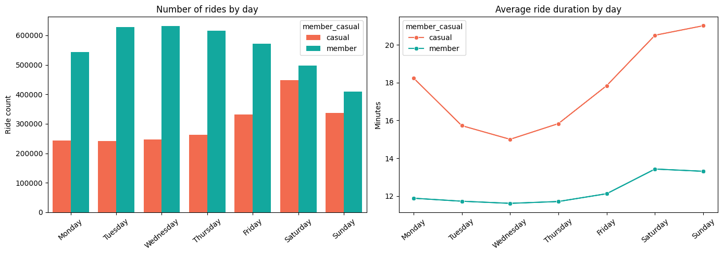
Weekdays belong to members, weekends to casual riders
FINDING 2 · DAY OF THE WEEK
~630K
member rides on a typical Tuesday to Thursday
~450K
casual rides on Saturday, nearly level with members
Casual riders also ride longer at the weekend, up to ~21 minutes on Sunday.
Left: rides per day. Right: average ride length per day
Notes:
Member rides stay high all through the working week and drop off at the weekend. Casual rides do the opposite and peak on Saturday, when the two groups are almost level. Casual riders also stay on longer at the weekend, about 21 minutes on average by Sunday, while members stick to 12 or 13 minutes every day.

Slide 8
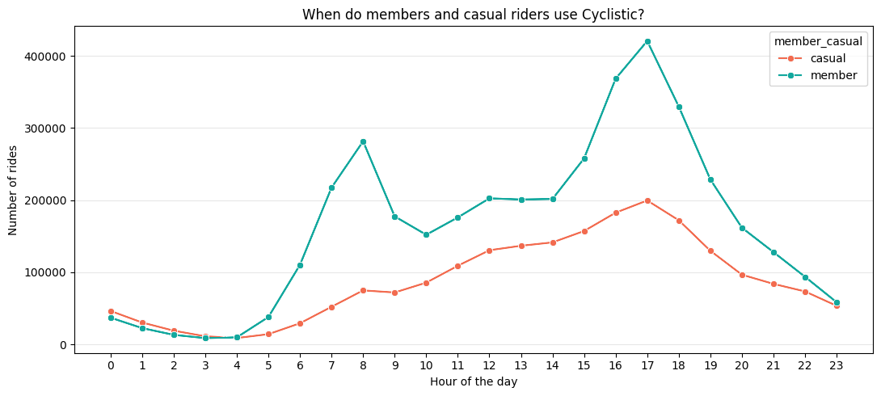
Members follow the commute. Casual riders don't.
FINDING 3 · TIME OF DAY
~4×
more member rides than casual rides at 8 AM
5 PM
busiest hour for both groups
Casual riders have no real morning rush. Late afternoon is when they're most likely to be on a bike.
Rides by hour of the day
Notes:
This is the clearest commuting signal in the data. Members have two peaks, 8 AM and 5 PM: people going to work and coming home. At 8 AM there are about four times as many member rides as casual ones. Casual riding just builds slowly through the day and tops out at 5 PM.

Slide 9
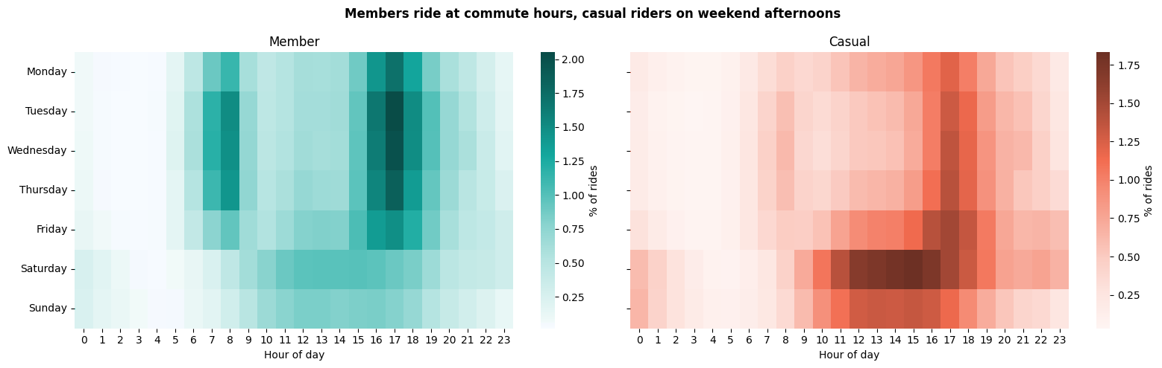
Put together: a work week versus a weekend afternoon
FINDING 3, CONTINUED
Members: Darkest at 7–8 AM and 4–6 PM, Tuesday to Thursday. A work schedule.
Casual riders: Darkest on Saturday from about 11 AM to 5 PM. Free time.
Notes:
This heatmap combines the last two slides. Each cell is the share of that group's rides at a given day and hour. On the left, members light up at commute times midweek. On the right, casual riders light up on weekend afternoons. Two completely different relationships with the same bikes.

Slide 10
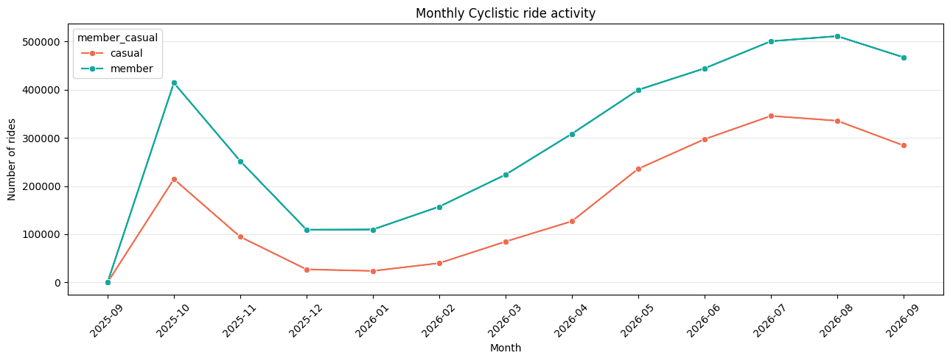
Casual riding is a summer business
FINDING 4 · SEASON
~15×
more casual rides in July than in January
~5×
the same swing for members
46.4% of casual rides happen in June, July and August, against 37.4% of member rides.
Monthly rides. The first point (Sep 2025) is a handful of rides removed in final cleaning
Notes:
Everyone rides more when it's warm, but casual riders swing much harder: around 23 thousand rides in January against 345 thousand in July. Members only swing about five times. In practice this means a campaign aimed at casual riders in February would mostly be talking to an empty room.

Slide 11
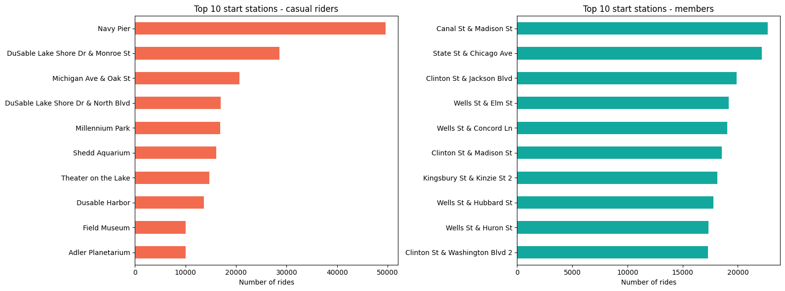
Casual riders head for the lake. Members head for work.
FINDING 5 · LOCATION
~49.5K
casual rides from Navy Pier, twice the next station
The Loop
where members start, close to the big train stations
E-bikes are popular with both: 74.2% of casual and 68.3% of member rides.
Top 10 start stations for casual riders (left) and members (right)
Notes:
Casual riders start at Navy Pier, the lakefront, Millennium Park and the museum campus, the places you'd take visiting friends. Members start in the Loop and River North, near Union Station and Ogilvie. One thing that isn't a big difference: bike type. Both groups mostly ride e-bikes.

Slide 12
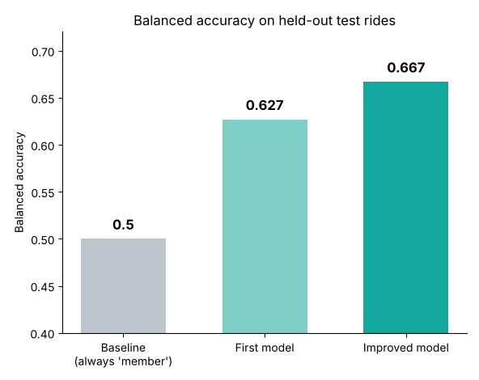
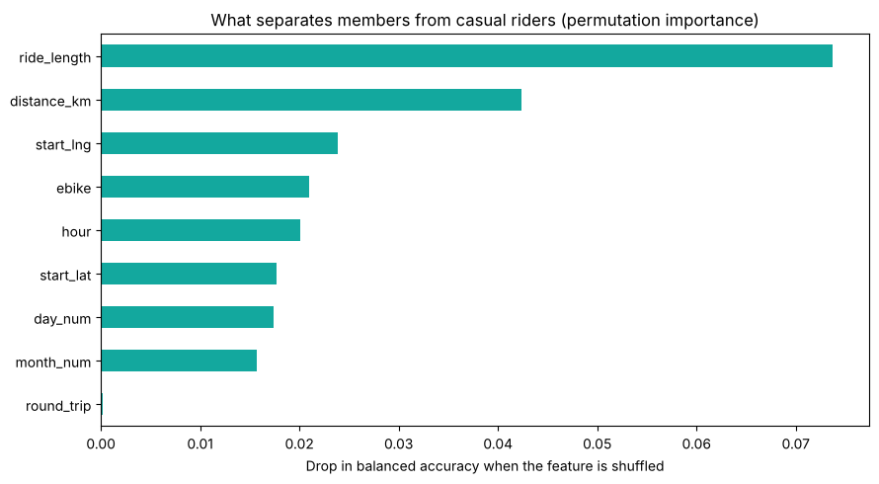
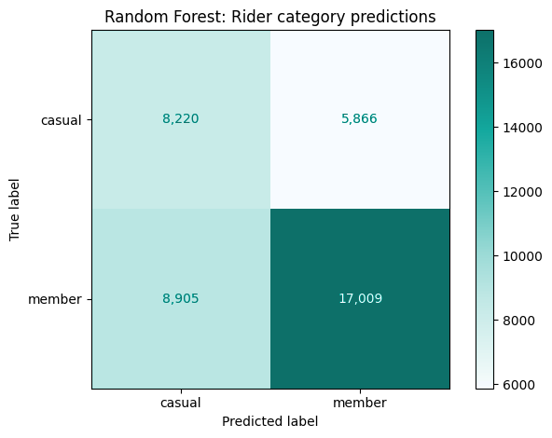
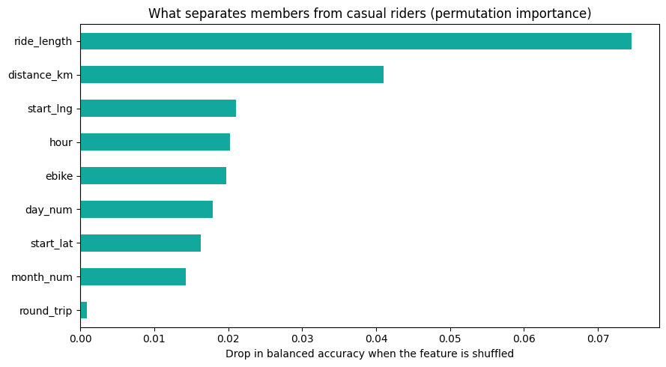
Can a model tell members and casual riders apart?
MACHINE LEARNING
0.667
balanced accuracy of the improved model (first model 0.627, guessing 0.50)
Ride length
is the strongest signal, then distance and start point
Improved model: ROC-AUC 0.736. It gets 60% of casual and 74% of member rides right.
Left: balanced accuracy of each model. Right: what the improved model relies on
Notes:
I wanted to go one step further than averages, so I trained a Random Forest to guess whether a ride was by a member or a casual rider. Honestly, the first version was only okay: 0.63 balanced accuracy, where pure guessing gets 0.50. Adding where the ride started and how far it went raised it to 0.67, with a ROC-AUC of 0.74. That's a moderate result, but it's good enough to rank casual rides by how member-like they are. The model leans most on ride length, which matches everything we've just seen. I use balanced accuracy because members are almost two-thirds of rides, so a model that always says 'member' would look good on plain accuracy without being useful.

Slide 13
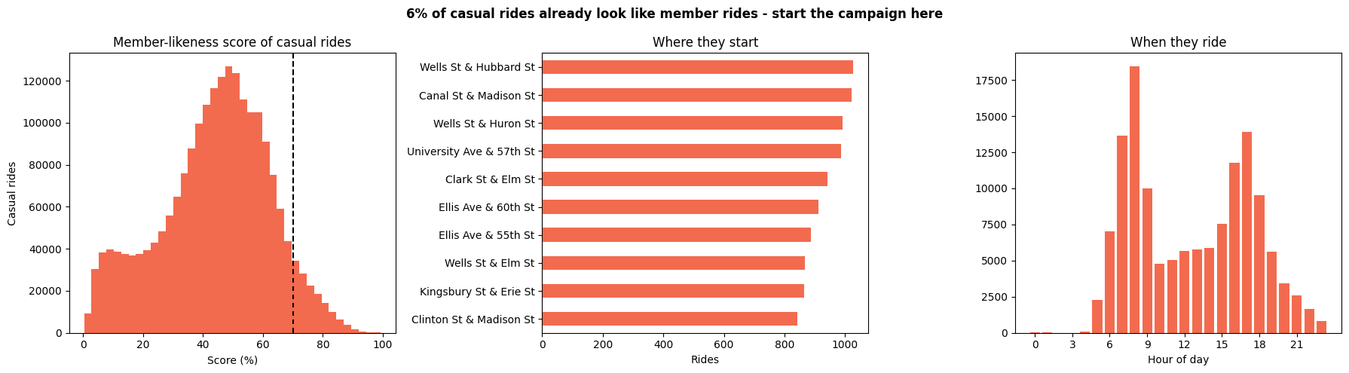



About 6% of casual rides already look like member rides
WHO TO CONVERT FIRST
When
Where
A surprise
8 AM and 5 PM on weekdays, just like members
Wells St & Hubbard St, Canal St & Madison St, Wells St & Huron St, Clark St & Elm St
University Ave & 57th St is in the top five: probably students or university staff
Notes:
Then I used the model to score every casual ride on how member-like it looks. Most land in the middle. But about 6% score 0.7 or higher, and those rides look like commuting: rush hour, business district. One station surprised me, University Ave and 57th Street, right by the University of Chicago, which suggests students or staff riding regularly without a membership. These people don't need convincing to ride. They just need to see that a membership is better value for what they already do.

Slide 14

Three things I'd recommend
ACT
1
2
3
Win over the casual commuters
Give leisure riders a plan that fits
Time the campaign to the season
Target Wells St, Canal St and nearby stations from 7–9 AM and 4–6 PM on weekdays. Show a regular rider what they'd save. Try a student offer near the University of Chicago.
A weekend or summer membership with extra ride time and e-bike minutes, promoted at Navy Pier and the lakefront on weekend afternoons.
Start social and email in April–May, push hardest June to August, and close with a discounted annual offer at the end of summer.
Based on: the model, findings 2 and 3
Based on: findings 1, 2 and 5
Based on: finding 4
Notes:
So, three recommendations. First, start with the people who are closest: the casual commuters. Second, stop trying to sell a commuter product to leisure riders and give them a plan that fits how they actually ride. Third, timing: spend the money when casual riders are actually out on the bikes.

Slide 15




NEXT STEPS
Before we spend the budget
Test it small first
Add anonymised rider IDs
Try the commuter offer at a few stations (an A/B test) before rolling it out city-wide.
Then we could see how often each casual rider rides and what they'd really save.
Look at a second year
Ask the riders
One year of data can't tell us whether these patterns hold every year.
A short survey would tell us why casual riders haven't joined, and which channels reach them.
Thank you. Happy to take questions.
Limitation: no rider IDs, so every result describes rides, not people.
Notes:
One honest caveat before we act. The model points us to the right riders, but it doesn't prove they'll convert. A small test at a few stations would tell us that cheaply. Longer term, anonymised rider IDs, a second year of data and a short survey would answer the questions trip data can't. Thanks for listening. I'm happy to take questions.

