Slide 1

Title: Location-Based Price Recommender System
Student Name: K.V.Koushal
Student ID: 2520030009
Cluster:3
Section: 12
Under the Guidance
of
Dr. N. Chaitanya Kumar
Professor
Department of CSE

Slide 2
Abstract
This project presents a location-based price comparison system developed in Java that enables users to find the most affordable prices for a desired product within their preferred location. The system leverages core Data Structures and Algorithms concepts such as priority queues for price ranking, hash maps for efficient data retrieval, and sorting algorithms to deliver fast and accurate results. By combining location-aware filtering with optimized search techniques, the system minimizes search time while maximizing cost efficiency for the end user. This solution demonstrates the practical application of DSA principles in solving real-world consumer decision-making problems.

Slide 3
Existing System
No unified price comparison
Users must check multiple apps or stores individually to find the lowest price.
Location-based price variation not handled well
Many platforms show product prices but do not compare prices across nearby physical stores in the same area.
Time-consuming for users
People must manually search different shops or websites.
Limited real-time updates
Prices in local stores may change but apps may not update quickly.
Not optimized for local shopping
Many platforms focus on online delivery, not the cheapest store near the user.
No smart filtering
Users cannot easily filter by distance + price + availability together.

Slide 4
Proposed System
Location-based price aggregation
Collects prices from multiple nearby stores and platforms.
Automatic lowest-price detection
System automatically identifies the cheapest available option in the selected area.
Distance + price optimization
Shows stores with the lowest price within a reasonable distance.
Real-time or frequently updated price data
Helps users make more accurate purchase decisions.
Single platform comparison
Users do not need to check many apps.
Smart search
Users enter:
Product name
Desired location
System returns cheapest nearby option.
User-friendly interface
Simple search with clear price ranking.

Slide 5
System Architecture
Input Layer (Main.java) — The entry point of the system where the user interacts via a terminal-based menu. It collects the product name and location as inputs, validates them, and passes them to the core logic layer.
Data Model Layer (Deal.java & Product.java) — Defines the core data structures. Deal holds store, location, and price info while Product groups all deals under a single product name using an ArrayList.
Storage Layer (HashMap in PriceRecommender.java) — All products are stored in a HashMap<String, Product> where the product name (lowercased) is the key, enabling O(1) average-time lookups regardless of how many products exist.
Processing Layer (PriorityQueue / MinHeap) — When a search is triggered, deals matching the given location are inserted into a MinHeap (PriorityQueue) which automatically sorts by price, allowing the system to extract the top 3 cheapest deals in O(n log n) time efficiently.
Display Layer (Main.java) — The results are formatted and presented back to the user with rank medals, capitalized location names, and formatted prices. A TreeMap is also used in the browse feature to display all products alphabetically.

Slide 6
Project Modules
1. User Input Module Accepts product name and desired location from the user.
2. Data Storage Module Stores product, store, and price information using Java data structures such as arrays or lists.
3. Product Search Module Searches for the requested product within the stored data.
4. Location Filter Module Filters stores based on the location entered by the user.
5. Price Comparison Module Uses sorting or minimum search algorithms to determine the lowest price.
6. Result Display Module Displays the stores and highlights the lowest available price.

Slide 7
Objectives
To design and develop a Lowest Price Finder System using Java and Data Structures.
To help users identify the lowest price of a product within a desired location.
To reduce the time and effort required to manually compare prices across multiple stores.
To implement efficient searching and comparison algorithms for price analysis.
To simplify the process of finding affordable products near the user.
To improve decision making by presenting the cheapest available option clearly.

Slide 8
Co’s Attainments - DSA
CO1
Analyze problem statements using asymptotic notation (Big-O, Ω, Θ).
Compare algorithm efficiency based on time and space complexity.
Implement and evaluate searching and sorting algorithms in Java.
CO2
Design and implement Abstract Data Types (ADTs) using arrays and linked lists.
Perform operations such as insertion, deletion, searching, and traversal.
Evaluate advantages and limitations of different data structures.
CO3
Apply stacks and queues to solve real-world workflow problems.
Implement circular queues, deques, heaps, and priority queues.
Analyze performance compared to other linear data structures.
CO4
Design hash-based data structures using hashing techniques.
Implement hash tables with chaining and open addressing.
Utilize Java Collections (List, Queue, Deque, Map) for efficient solutions.
CO5
Develop practical applications using linear data structures.
Implement data structures to solve real-world computational problems.

Slide 9
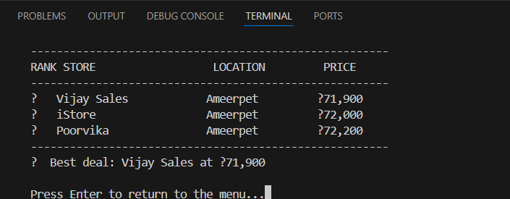
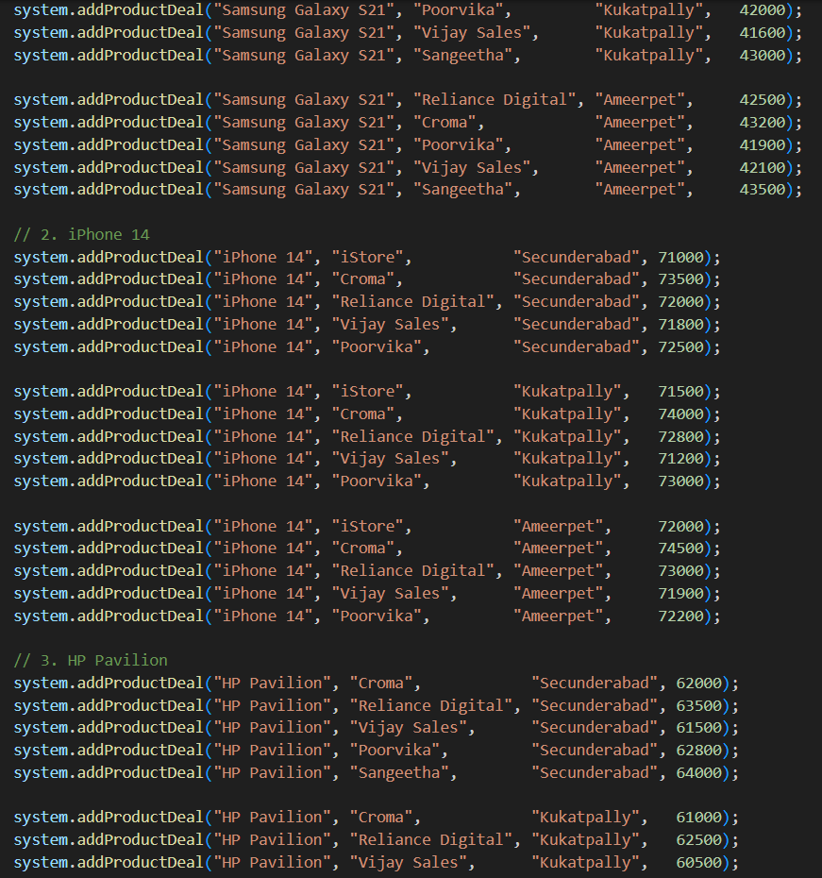
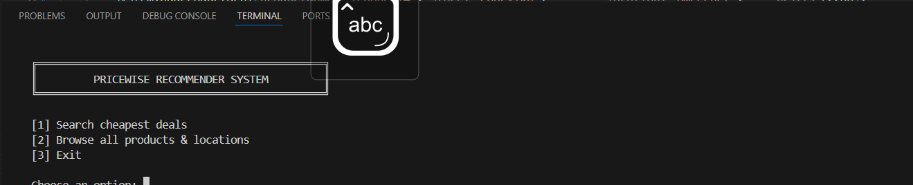
Screenshots for DSA

Slide 10
Conclusion
The PriceWise Recommender System was successfully developed in Java, leveraging core DSA concepts to solve the real-world problem of finding the cheapest product prices across multiple locations. The system efficiently utilizes a HashMap for fast product lookups, a MinHeap PriorityQueue for price ranking, and a TreeMap for alphabetical browsing. A clean terminal-based interface with input validation and case-insensitive search ensures a smooth and user-friendly experience. The architecture is highly scalable, allowing new products, stores, and locations to be added effortlessly without altering the core logic. Overall, this project demonstrates that fundamental data structures and algorithms are the foundation of practical, real-world applications used in everyday consumer decision-making.

Slide 11
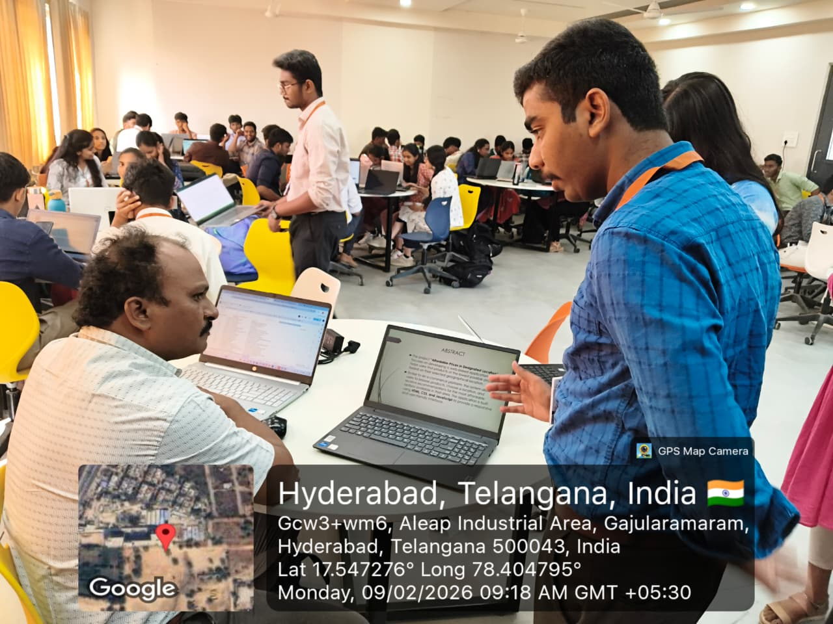
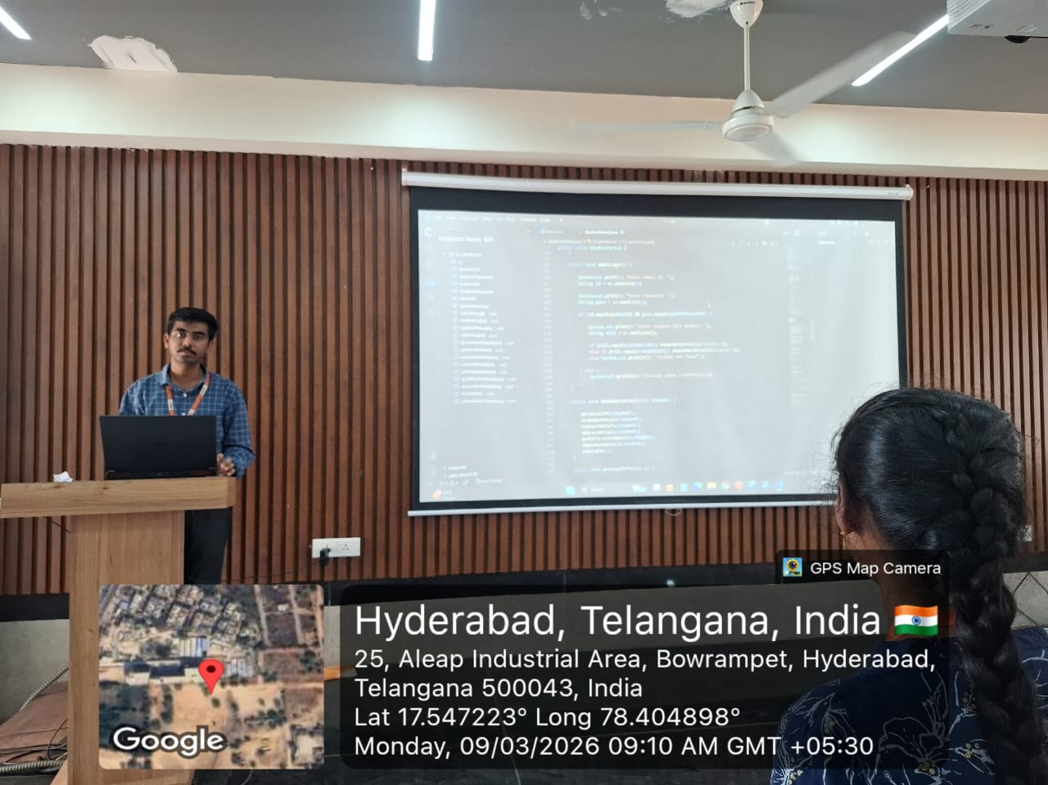
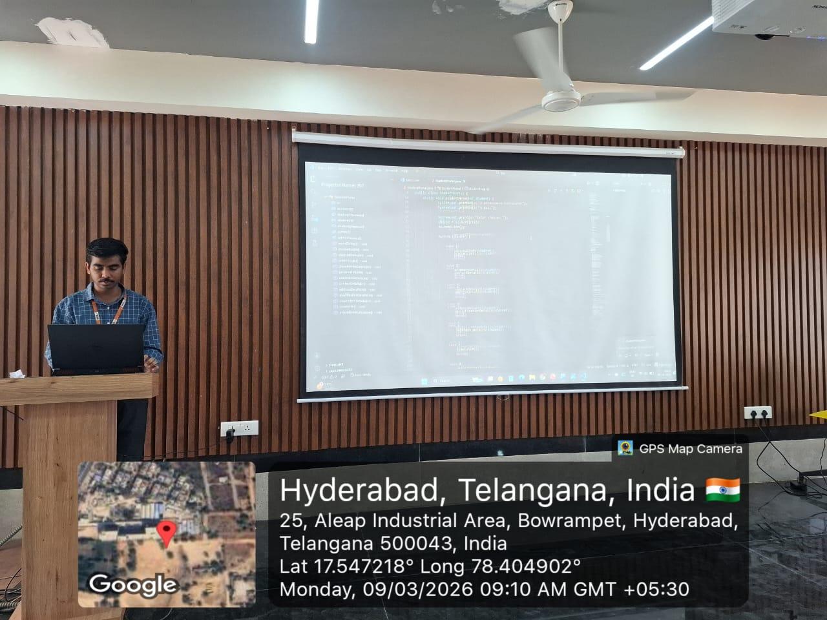
Geo- Tag Photos

Slide 12
THANK YOU

