Slide 1

Title: Affordable Prices In Designated Location
Student Name: K.V.Koushal
Student ID: 2520030009
Cluster:3
Section: 11
Under the Guidance
of
Supervisor Name: T.S.P Madhuri
Assistant Professor
Department of CSE

Slide 2
Abstract
Affordable Prices in Designated Location is a web-based application developed using HTML, CSS, and JavaScript with the aim of helping users find essential items at affordable prices based on their required location. The project focuses on improving accessibility and convenience by allowing users to explore products that are both budget-friendly and available in specific areas, reducing unnecessary search effort and cost uncertainty.
The application emphasizes a clean, user-friendly interface and efficient client-side functionality to ensure smooth interaction and quick results. By combining structured content (HTML), responsive and visually appealing design (CSS), and dynamic behavior with real-time interactions (JavaScript), the project demonstrates a practical implementation of core web development concepts while addressing a real-world problem of cost-effective shopping based on location.

Slide 3
Existing System
No unified price comparison
Users must check multiple apps or stores individually to find the lowest price.
Location-based price variation not handled well
Many platforms show product prices but do not compare prices across nearby physical stores in the same area.
Time-consuming for users
People must manually search different shops or websites.
Limited real-time updates
Prices in local stores may change but apps may not update quickly.
Not optimized for local shopping
Many platforms focus on online delivery, not the cheapest store near the user.
No smart filtering
Users cannot easily filter by distance + price + availability together.

Slide 4
Proposed System
Location-based price aggregation
Collects prices from multiple nearby stores and platforms.
Automatic lowest-price detection
System automatically identifies the cheapest available option in the selected area.
Distance + price optimization
Shows stores with the lowest price within a reasonable distance.
Real-time or frequently updated price data
Helps users make more accurate purchase decisions.
Single platform comparison
Users do not need to check many apps.
Smart search
Users enter:
Product name
Desired location
System returns cheapest nearby option.
User-friendly interface
Simple search with clear price ranking.

Slide 5
System Architecture
User Interface Layer (Frontend) :
Allows users to interact with the system.
Users enter : Product name, Desired location.
Displays : Available stores, lowest prices.
Technologies used : HTML,CSS,JAVASCRIPT.
Application Layer (Backend Logic) :
Processes product search, retrieves price data, compares prices between stores, finds the lowest price.
Main tasks: Request handling, Price comparison algorithm, Filtering by location , Sorting prices.

Slide 6
Project Modules
1. User Input Module Accepts product name and desired location from the user.
2. Data Storage Module Stores product, store, and price information using Java data structures such as arrays or lists.
3. Product Search Module Searches for the requested product within the stored data.
4. Location Filter Module Filters stores based on the location entered by the user.
5. Price Comparison Module Uses sorting or minimum search algorithms to determine the lowest price.
6. Result Display Module Displays the stores and highlights the lowest available price.

Slide 7
Objectives
To design and develop a Lowest Price Finder System using Java and Data Structures.
To help users identify the lowest price of a product within a desired location.
To reduce the time and effort required to manually compare prices across multiple stores.
To implement efficient searching and comparison algorithms for price analysis.
To simplify the process of finding affordable products near the user.
To improve decision making by presenting the cheapest available option clearly.

Slide 8
Co’s Attainments - FWD
CO1
Understand Internet fundamentals, HTTP/HTTPS protocols, and web client-server architecture.
Explain browser functionality, developer tools, web hosting, and domain concepts.
Apply HTML document structure and basic webpage elements such as lists, links, and images.
CO2
Design structured web pages using HTML forms, semantic tags, tables, and media elements.
Apply CSS styling techniques including selectors, typography, colors, and spacing.
Implement modern layout techniques using Flexbox, CSS Grid, and responsive design.
CO3
Apply JavaScript fundamentals including variables, operators, conditions, loops, and functions.
Work with arrays, objects, and ES6 features for efficient programming.
Implement functional programming concepts such as arrow functions and callbacks.
CO4
Perform DOM manipulation and event handling to create dynamic web pages.
Use browser storage such as localStorage and sessionStorage for client-side data.
Implement asynchronous programming using Promises, fetch(), async, and await.
CO5
Implement form validation and API integration using JavaScript.
Apply performance optimization techniques and SEO practices for web applications.
Deploy responsive and interactive web applications with improved usability.

Slide 9
Co’s Attainments - DSA
CO1
Analyze problem statements using asymptotic notation (Big-O, Ω, Θ).
Compare algorithm efficiency based on time and space complexity.
Implement and evaluate searching and sorting algorithms in Java.
CO2
Design and implement Abstract Data Types (ADTs) using arrays and linked lists.
Perform operations such as insertion, deletion, searching, and traversal.
Evaluate advantages and limitations of different data structures.
CO3
Apply stacks and queues to solve real-world workflow problems.
Implement circular queues, deques, heaps, and priority queues.
Analyze performance compared to other linear data structures.
CO4
Design hash-based data structures using hashing techniques.
Implement hash tables with chaining and open addressing.
Utilize Java Collections (List, Queue, Deque, Map) for efficient solutions.
CO5
Develop practical applications using linear data structures.
Implement data structures to solve real-world computational problems.

Slide 10
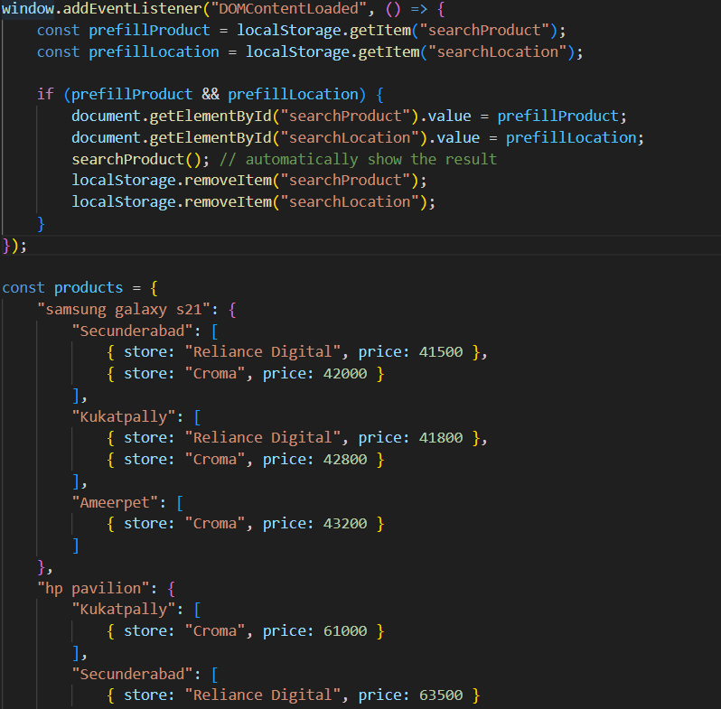
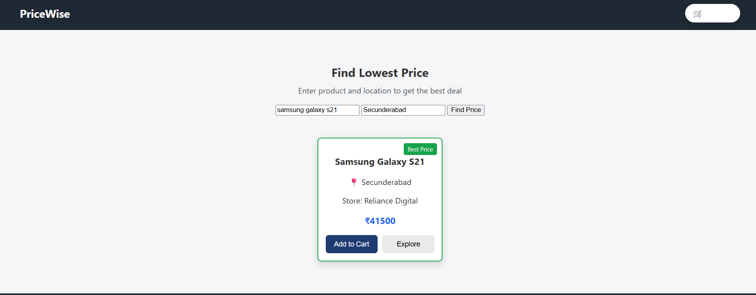
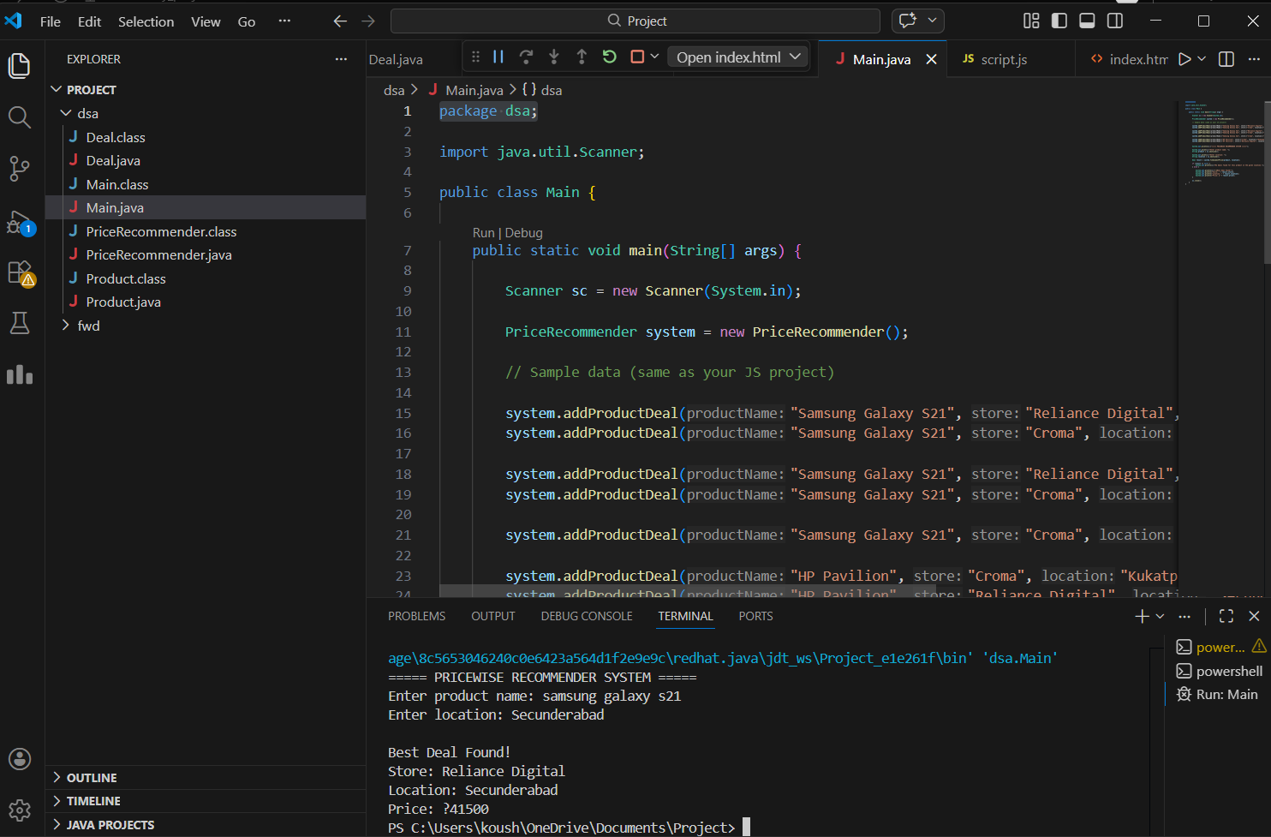
Screenshots for FWD & DSA

Slide 11
Conclusion
The project successfully develops a Lowest Price Finder System using Java, HTML, CSS, and JavaScript.
It provides a simple interface where users can search for products and find the lowest price in their desired location.
The system reduces the effort required to manually compare prices across different stores.
Efficient logic in Java helps in searching and comparing prices quickly.
The use of HTML, CSS, and JavaScript improves the usability and presentation of the system.
Overall, the project demonstrates how combining frontend technologies with Java logic can help users make better and more affordable purchasing decisions.

Slide 12
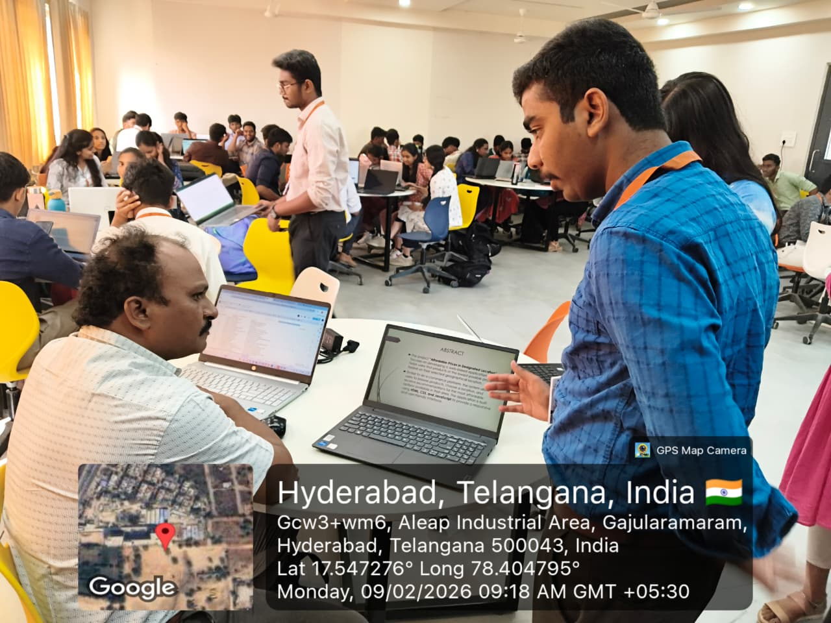
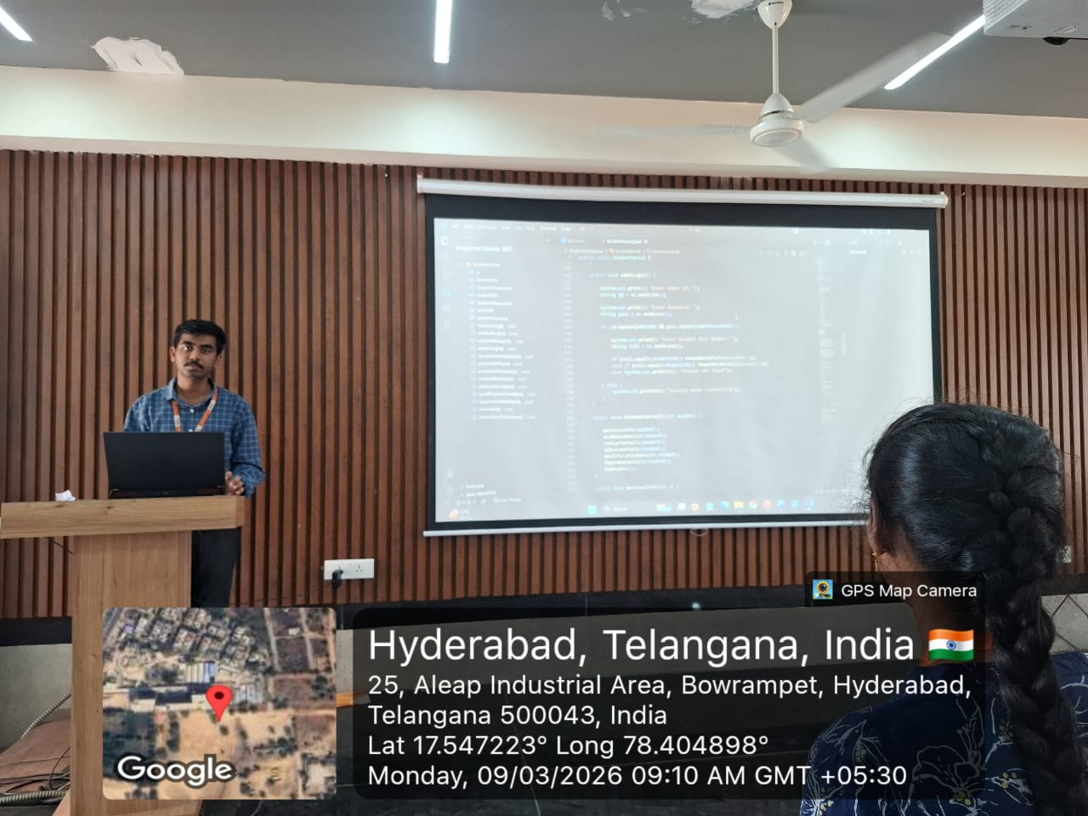
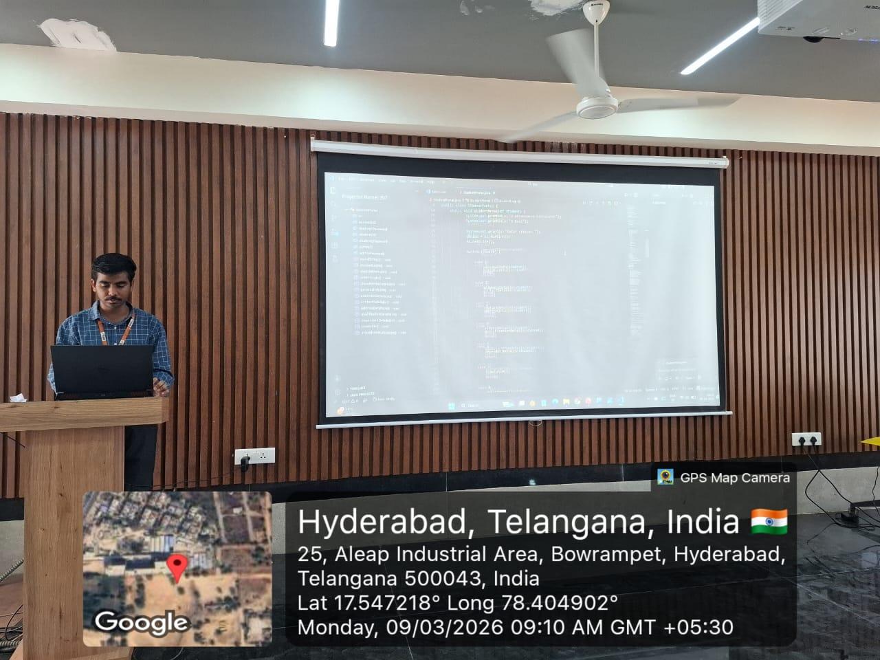
Geo- Tag Photos

Slide 13
THANK YOU

