Slide 1

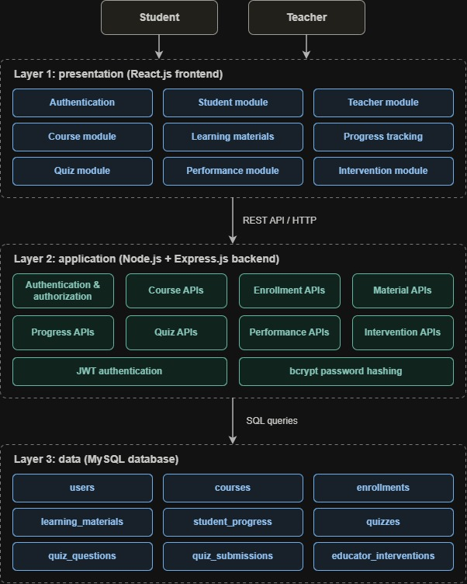
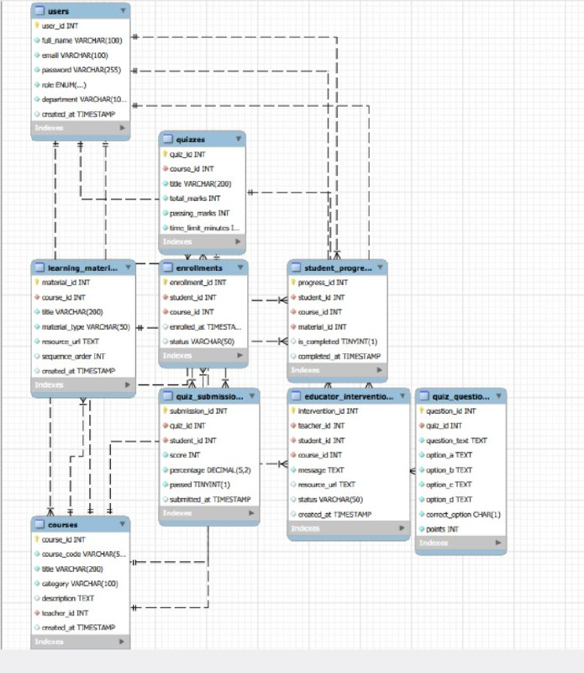
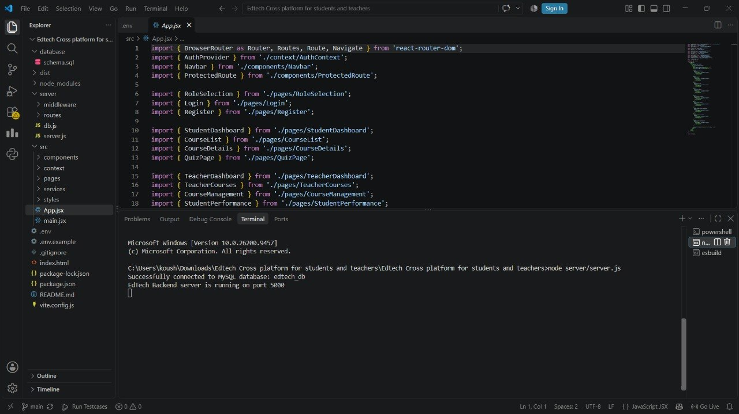
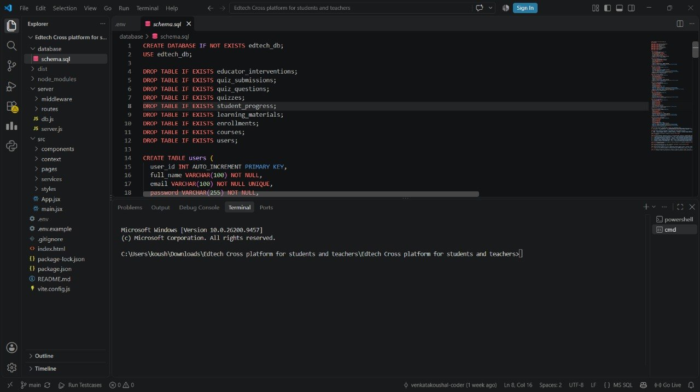

KLH Logo
EDTECH CROSS PLATFORM FOR STUDENTS AND TEACHERS
Team ID: 24 Section: 8 Members: K.V.KOUSHAL(2520030009), Y.CHARAN SAI(2520030173) Guide: DR.RAMYYAKRISHNA DHULIPALLA
Database Systems Engineering and Distributed Backend Development (25CS1302E) KLH Bachupally Campus, CSE PBL 2026-27
Abstract
Tools & Technologies
Cross Platform Course App for Education & EdTech connects students and educators through a simple digital learning platform
Educators can manage courses, monitor student performance, and provide personalized interventions.
Main Outcome: Provides a personalized and effective learning environment by combining student progress tracking with educator support and intervention.
Front-End: React.js HTML, CSS & JavaScript
Back-End: Nodejs, Expressjs, RestApi
Database: MYSQL
Tools: Git & GitHub, VS Code, Draw.io
Problem Statement & Objectives
Problem: Existing learning platforms mainly provide course content but do not effectively support individual student progress monitoring and educator intervention for students who are struggling or inactive.
Objective 1: Enable students to create accounts, enroll in courses, access learning materials, track progress, and receive course notifications.
Objective 2: Enable educators to manage courses and monitor student performance and learning activity.
Objective 3: Provide personalized learning support through additional materials, recommendation
System Architecture
Existing vs Proposed System
Feature | Existing System | Proposed System
Feature 1 | Mainly provides course content and learning resources. | Provides courses along with progress tracking and educator support.
Feature 2 | Limited focus on individual student performance. | Monitors individual student progress, assessments, and learning activity.
Feature 3 | Students mostly learn independently. | Educators can actively intervene and support students.
Feature 4 | Limited personalized recommendations. | Provides additional materials and recommendations based on student needs.
Limitation / Gap | Students may struggle without timely educator support. | Enables educator intervention and direct support.
ER Diagram & Database Design
Feasibility Study
Technical: Requires skills in React.js, HTML, CSS, JavaScript, MySQL, and MongoDB, using tools such as VS Code
Economic: Uses mainly open-source technologies and development tools, keeping project costs low.
Operational: Provides a simple, user-friendly platform for students and educators, with easy course management, progress tracking, and intervention.
Schedule: The project can be developed and completed within the semester timeline by implementing the core modules in stages.
Implementation Screenshots
[Screenshot 1]
[Screenshot 2]
Results & Testing
Conclusion
Future Scope
CRUD: Successfully supports Create, Read, Update, and Delete operations for users, courses, learning materials, and related records.
Validation: Validates user inputs and required fields to maintain accurate and consistent data.
Performance: Provides efficient data storage, retrieval, and progress tracking through the database-backed application.
Key Outcome: Enables students to access courses and track progress while educators can monitor performance and provide interventions.
What was achieved: Developed a learning platform that connects students and educators, supporting course enrollment, learning materials, progress tracking, performance monitoring, and educator intervention.
How it meets the objectives: Students can access and track learning activities, while educators can monitor student performance and provide additional materials, recommendations, and direct support when required.
Enhancement 1: Add AI-based personalized learning recommendations based on student performance and learning activity.
Enhancement 2:Introduce advanced analytics and dashboards for educators to identify struggling or inactive students more effectively..
References: https://klh-bachupally.codetantra.com/secure/home.jsp
https://www.coursera.org/

