Slide 1
Breast Cancer Classification Using Decision Trees and Random Forest
Team Members
K.V.Koushal - 2520030009
Bhavitha Reddy - 2520030120
Faculty / Guide: Dr.Shaik Asif
Department: CSE

Slide 2
NAVIGATION
Contents
A structured walkthrough from problem context to experimental results — each section builds toward a complete, reproducible classification study.
01
02
Introduction
Literature Review
Problem context, motivation, and scope
Eight representative prior studies and their limitations
03
04
Research Gap & Problem Statement
Abstract & Dataset
What is missing and what this project addresses
Project summary and WDBC dataset overview with EDA
05
06
Methodology
Model Evaluation & Results
Decision Tree, Random Forest, and workflow pipeline
Accuracy, ROC-AUC, PR-AUC comparison and conclusion

Slide 3
CHAPTER 1
Introduction
Breast cancer is one of the most prevalent cancers worldwide. Early and accurate classification of tumors — benign (non-cancerous) vs. malignant (cancerous) — is critical to improving patient outcomes. Machine learning offers a data-driven approach to assist clinicians in this classification task at scale and with consistency.
What the Project Classifies
Algorithms Used
Input: 30 diagnostic numerical measurements (radius, texture, perimeter, area, smoothness, etc.)
Output: Tumor class — Benign or Malignant
Dataset: Wisconsin Diagnostic Breast Cancer (WDBC)
Decision Tree — interpretable single-tree baseline classifier
Random Forest — ensemble of multiple decision trees for robustness
Evaluation Metrics
Accuracy
ROC-AUC (Receiver Operating Characteristic)
PR-AUC (Precision-Recall)

Slide 4
CHAPTER 2
Literature Review
Eight studies from 2019–2023 were reviewed. A common limitation across prior work is the over-reliance on accuracy alone and the absence of focused tree-based model analysis.
Author(s) | Year | Methodology | Main Limitation
Sivapriya J. et al. | 2019 | SVM, Logistic Regression, Naive Bayes, Random Forest on WDBC | Only accuracy reported; no ROC-AUC / PR-AUC or cross-validation
Rane, Sunny et al. | 2020 | Naive Bayes, Random Forest, ANN, KNN, SVM, Decision Tree on WDBC | Tree-based models not deeply analyzed; no feature importance or ROC-AUC / PR-AUC
Vijaylaxmi Kochari | 2021 | Linear Regression, Decision Tree, Random Forest on FNA-based data | Limited feature analysis; no ROC-AUC / PR-AUC evaluation
Hamed, Mesleh et al. | 2021 | Random Forest, AdaBoost, Logistic Regression, Decision Tree, Naive Bayes, CNN | No ROC-AUC or PR-AUC; no focused RF vs. Decision Tree comparison
Gaurav Singh | 2020 | KNN, SVM, Logistic Regression, Gaussian Naive Bayes | Small sample size; Random Forest not explored
Rahman et al. | 2022 | XGBoost, AdaBoost, Gradient Boosting with hyperparameter tuning | Only boosting algorithms; Decision Tree and Random Forest not included
Sharma, Garg et al. | 2023 | SVM, Logistic Regression, RF, XGBoost, AdaBoost, KNN, Naive Bayes, ensemble | Too many algorithms without deep analysis of Decision Tree and Random Forest
Sarkar, Ghose | 2023 | Logistic Regression, SVM, Random Forest, Neural Networks | Feature selection discussed but detailed feature importance and PR-AUC not provided

Slide 5

CHAPTER 3
Research Gap & Problem Statement
What Prior Studies Missed
Our Research Gap — What This Project Addresses
A focused, in-depth comparison of Decision Tree and Random Forest on the WDBC dataset, evaluated using three complementary metrics:
Heavy focus on accuracy alone — ROC-AUC and PR-AUC rarely reported
Many algorithms compared without focused analysis of any single approach
Accuracy — overall correctness
ROC-AUC — class separability across thresholds
PR-AUC — performance on malignant (positive) class
Feature importance and interpretability often overlooked in results
Boosting methods and neural networks overshadow simpler tree-based models
Additionally, feature importance analysis is performed to identify which diagnostic measurements contribute most to classification.
Objective
To build and compare Decision Tree and Random Forest models for classifying breast tumors as benign or malignant, with rigorous multi-metric evaluation.

Slide 6
CHAPTER 4
Abstract
A concise summary of the project scope, approach, and evaluation strategy.
1
Dataset
2
Exploratory Data Analysis
The Wisconsin Diagnostic Breast Cancer (WDBC) dataset is used — 569 samples with 30 numerical features derived from digitized Fine Needle Aspiration (FNA) images of cell nuclei.
EDA is performed to understand data structure, class distribution, feature distributions, outliers, and inter-feature correlations before model training.
3
Models
4
Evaluation
Decision Tree serves as an interpretable baseline. Random Forest — an ensemble of multiple trees — is evaluated as the more robust alternative. Both are supervised learning classifiers.
Models are compared on Accuracy, ROC-AUC and PR-AUC. Feature importance is analyzed to identify the most influential diagnostic measurements in predicting malignancy.

Slide 7
CHAPTER 5
Dataset & Exploratory Data Analysis
Dataset Overview
EDA Steps — Performed in Order
Property | Value
Dataset Name | Wisconsin Diagnostic Breast Cancer (WDBC)
Total Samples | 569
Original Columns | 32
Input Features | 30 diagnostic numerical features
Target Variable | Diagnosis: B = Benign, M = Malignant
01
Load & Inspect
Examine first 5 rows, dataset shape, column names, and data types
02
Quality Check
Identify missing values, check for duplicate records, verify data integrity
03
Statistical Summary
Visualizations to be added after training: missing-value heatmap, histograms, box plots, class distribution plot, correlation heatmap.
Generate mean, std, min, and max for all 30 features
04
Visual Analysis
Histograms for distributions, box plots for outliers, class distribution plot, correlation heatmap

Slide 8
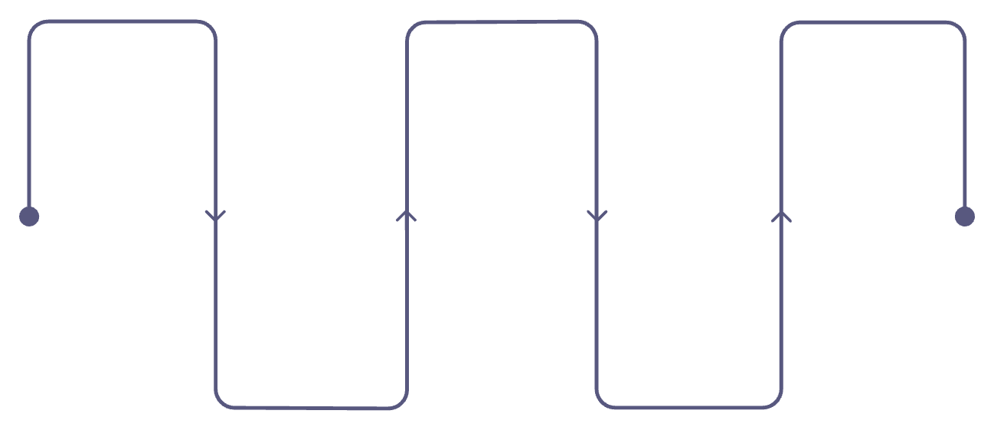

CHAPTER 6
Methodology
Project Workflow
Decision Tree — Baseline Model
A single tree that makes decisions by applying conditions on input features at each node, splitting data until a class label is assigned at the leaf.
Advantage: Easy to understand, visualize, and explain to non-technical stakeholders.
WDBC Dataset
Exploratory Analysis
Models
Breast cancer diagnostic data
Summarize patterns and distributions
Decision Tree and Random Forest
Preprocessing
Train-Test Split
Limitation: Prone to overfitting if tree depth is not controlled — sensitive to small variations in training data.
Load data and clean features
Hold out data for evaluation
Random Forest — Ensemble Model
An ensemble of multiple decision trees, each trained on a different random subset of data and features (bagging + feature randomness).
Final prediction is determined by majority voting across all trees in the forest.
Advantage: More robust, reduces overfitting, and generalizes better than a single decision tree.

Slide 9
CHAPTER 7
Model Evaluation Metrics
Three complementary metrics are used to evaluate and compare model performance. Using multiple metrics gives a more complete and honest picture than accuracy alone.
Accuracy
ROC-AUC
PR-AUC
Formula: (TP + TN) / Total Samples
Receiver Operating Characteristic — Area Under Curve
Precision-Recall — Area Under Curve
Percentage of all predictions that are correct
Simple and intuitive to interpret
Can be misleading when classes are imbalanced
Precision = TP / (TP + FP)
Recall = TP / (TP + FN)
Particularly informative for the malignant (positive) class
Best metric when false negatives are costly (missed cancer)
Plots True Positive Rate vs. False Positive Rate across all thresholds
AUC ranges from 0 to 1; higher = better class separation
Useful for evaluating performance on imbalanced datasets

Slide 10
CHAPTER 8
Results & Comparison
Model performance is compared across all three evaluation metrics below. Results are to be populated after model training and evaluation on the held-out test set.
Metric | Decision Tree | Random Forest
Accuracy | [ADD RESULT] | [ADD RESULT]
ROC-AUC | [ADD RESULT] | [ADD RESULT]
PR-AUC | [ADD RESULT] | [ADD RESULT]
Results to be added after model training and evaluation.
Visualizations to Be Added
Interpretation Guidance
ROC Curves — Decision Tree vs. Random Forest
Precision-Recall Curves — both models overlaid
Feature Importance plot — top 10 features by contribution
Compare all three metrics together — do not rely on accuracy alone
A model with higher ROC-AUC and PR-AUC is preferred for medical use
Feature importance identifies which measurements matter most clinically

Slide 11
CHAPTER 9
Conclusion
This project presents a focused, reproducible comparison of two tree-based supervised learning approaches — Decision Tree and Random Forest — for the task of breast tumor classification using the WDBC dataset.
What Was Built
What Was Measured
What Was Analyzed
An end-to-end ML pipeline covering data loading, EDA, preprocessing, model training, and evaluation for binary tumor classification.
Three metrics — Accuracy, ROC-AUC, and PR-AUC — to provide a complete and honest assessment of each model's performance.
Feature importance to identify which diagnostic cell-nucleus measurements are most predictive of malignancy.
Key Takeaways
Multi-metric evaluation gives a more complete picture than accuracy alone
Decision Tree provides interpretable, explainable decisions — important in clinical settings
Random Forest reduces overfitting through ensemble learning
Feature importance reveals which measurements drive classification most

