Slide 1
Department of Computer Science and Engineering Amrita School of Computing Secure File Storage on Cloud using Hybrid Cryptography
Team Members : Project Guide :
Venkata Krishna Reddy CH.EN.U4CSE19113 Dr. SP Chokkalingam
Ravi Venkat Jayanth CH.EN.U4CSE19136 Associate Professor
Department of CSE

Slide 2
Flow of Presentation
A. Abstract
B. Objective
C. Problem statement
D. Introduction
E. Existing work and Limitations
F. Proposed Work
G. Novelty of the Project
H. Control Flow
I. Encrypting and Decrypting flow
J. Implementation

Slide 3
Abstract
Now a days cloud computing is used in many areas like industries, military, colleges, etc.. to store huge amount of data. Cloud computing is beneficial in terms of low cost and accessibility of data.
Data stored in this cloud can be accessed or retrieved on the users request without direct access to the server computer. But the major concern regarding storage of data online that is on the cloud is the Security.
We are going to build a system where file is being encrypted not by just using one but three encryption algorithm which are AES, DES and RSA. Data is kept secured on cloud server which avoids unauthorized access.

Slide 4
Objective
To create an encrypted and secured file storage system to transfer files within users in a remote location.
To improve the security of file stored on cloud storage using AES, DES, RSA algorithms.
To optimize the speed and efficiency of system by splitting the data in different chunks and storing those parts in different servers on cloud.
To securely store and access data in cloud which is not controlled by the owner of the data.

Slide 5
Problem statement
In cloud the data is stored and handled by unknown servers, the servers can be sometimes accessed by unauthorized persons . Cloud storage gives immediate data exchange, thus giving access to multiple people
Cloud provides security for the data but use single key for encryption and decryption, hence providing less security. Also, user has no control over the data storage when its in cloud.
Data privacy is the most important for any industry, organization and any individual so in order to solve these issues we can store data in distributed manner in encrypted format using hybrid cryptography.

Slide 6
Introduction
Many issues are faced while storing the data , the solution for these issues we are using hybrid cryptography technique.. In this system we use three cryptography algorithms for providing block wise security
Three cryptography techniques we are using are :
RSA Algorithm: It is considered as the most secure way of encryption RSA algorithm is asymmetric cryptography algorithm
Advanced Encryption Standard (AES) Algorithm : It is more popular and widely adopted symmetric encrypt algorithm . It was developed by the National Institute of Standards and Technology
Data Encryption Standard (DES) Algorithm : DES is a symmetric encryption algorithm that was developed by IBM in the 1970s. DES was widely used in the past but due to its small key size.

Slide 7
Literature Survey
1) International Journal of Advanced Research in Science, Communication and Technology (IJARSCT), Issue 2, July 2022
Secure File Storage on Cloud Using Hybrid Cryptography – by Mr. Shrikanta Jogar and Mr. Darshan S Handral
This paper proposes that the cloud is used in many industries, including the military, education, and business, to provide a variety of services and store vast amounts of data. Without having direct access to the server computer, users can request access to or retrieval of data stored in this cloud. New software is made available at a low cost thanks to the IT sectors and organisations fast expanding use of cloud computing. Cloud computing is advantageous in terms of low cost and knowledge accessibility. There are several benefits to cloud computing, including inexpensive costs and easy Internet access to knowledge. Since users frequently store sensitive information with cloud storage providers, but these providers may not be trusted, ensuring the security of cloud computing may be a key consideration for the cloud computing environment.

Slide 8
Literature Survey
2) Secure File Storage On Cloud - by Raghad Alsufaian, Rana Mansour AlAjm
This paper concerns the security of cloud storage against various threats are emerging as a result of the increased reliance on cloud storage by many organisations and entities to retain their most crucial and secret data. The main focus of this work is on the use of hybrid cryptosystems to secure cloud computing and cloud storage. A comparison of the many hybrid cryptosystems suggested for cloud storage will be done.
3) Secure File Storage on Cloud Using Hybrid Cryptography Algorithm – by Mr. Uttam Kumar, Mr. Jay Prakash
Data security in this proposed system is achieved using the 3DES (Triple Data Encryption Standard), RC6 (Rivest Cipher 6), and AES (Advanced Encryption Standard) algorithms. Every algorithm makes use of 128-bit keys. The important information is safely stored using the LSB steganography technique. The encrypted portion of the file's information, the algorithm, and the algorithm's key will all be included in the key information. Three sections of the file are split apart during encryption. With the use of the multithreading approach, each of these distinct file segments will be simultaneously encrypted using a different encryption algorithm.

Slide 9
Existing work and Limitations
In order to store, handle and calculate numerous data, the cloud servers are being used. Large number of applications moves on to cloud computing platforms which has to be handled.
In existing system single algorithm is used for data encrypt and decrypt purpose. But use of single algorithm is not accomplishable for high level security.
If we use public key cryptography algorithm than we have to face security problem for storing public key.
Key transmission problem occur while sharing key into multiuser environment. Public key cryptography algorithms accomplish high security but maximum delay for data encrypt and decrypt.

Slide 10
Proposed work
In our system cloud owner upload the data on cloud server. To enhance security of file in cloud computing source file is break into different parts.
Every part of file is encrypted using each encryption algorithm. Encrypted file is stored on cloud storage
Each part of file is stored in different cloud database server. Each and every cloud server contains only a single part of a particular file of any format uploaded by user which ensures that if any attack takes place no important data is compromised

Slide 11
Novelty of the Project
The file transfer between all entities in the network will be end-to-end encrypted, thus ensuring that no entity will get access to sensitive information.
Moreover, the servers storing the parts doesn’t contain any info of which part of the file is stored.
Parts of the same file will not be stored on same location, thus preventing the attacker from guessing the location of other parts.
The files that are selected for upload by the user will be encrypted at the client side before uploading and will be decrypted after the user downloads it, with the user’s key

Slide 12
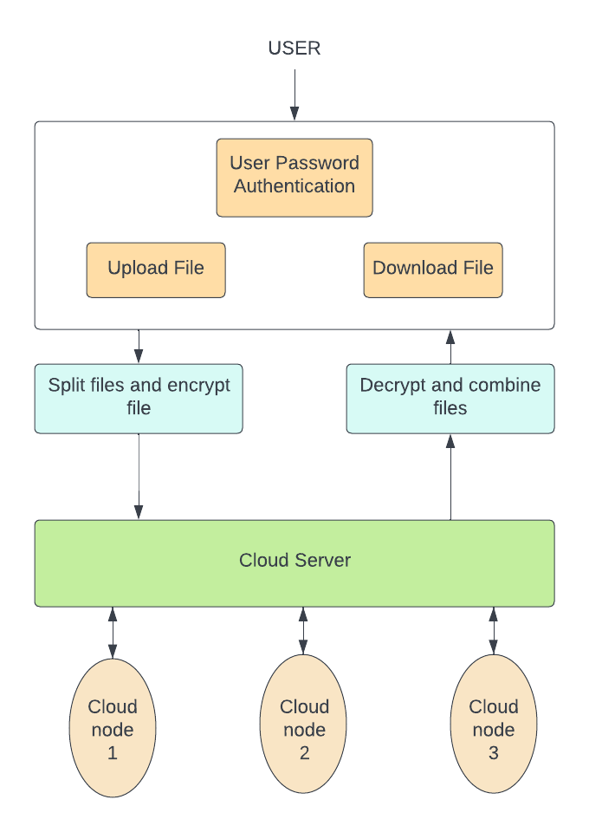
Control Flow

Slide 13
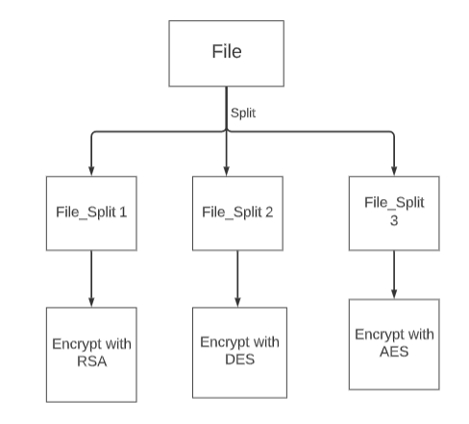
Splitting &Encrypting Files

Slide 14
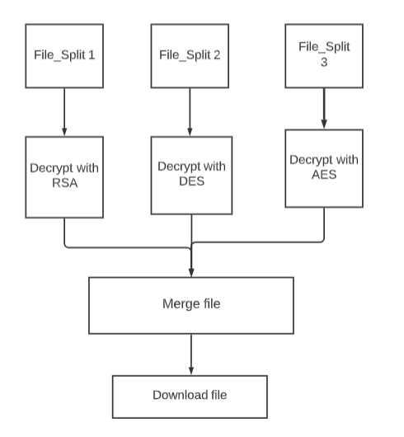
Decrypt & Merging File

Slide 15
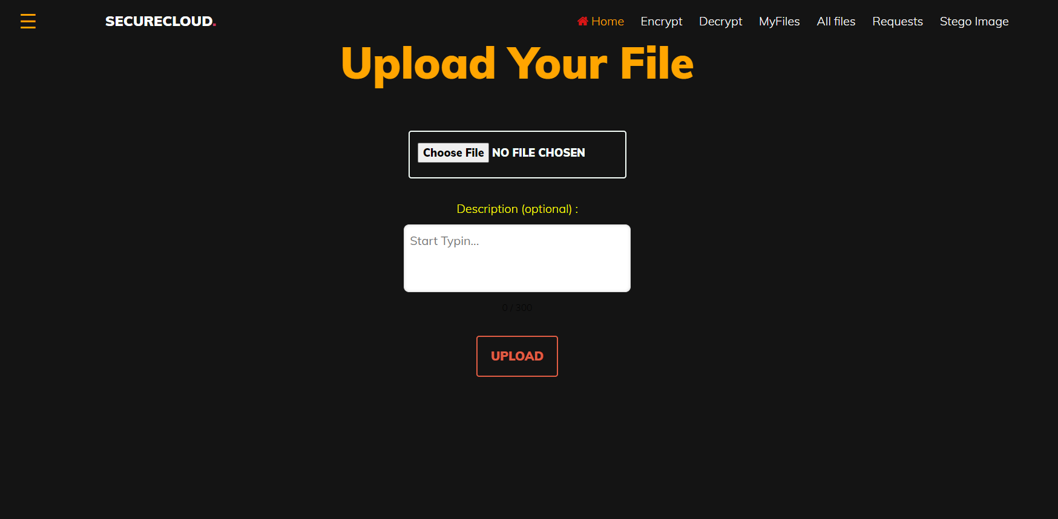
Implementation

Slide 16
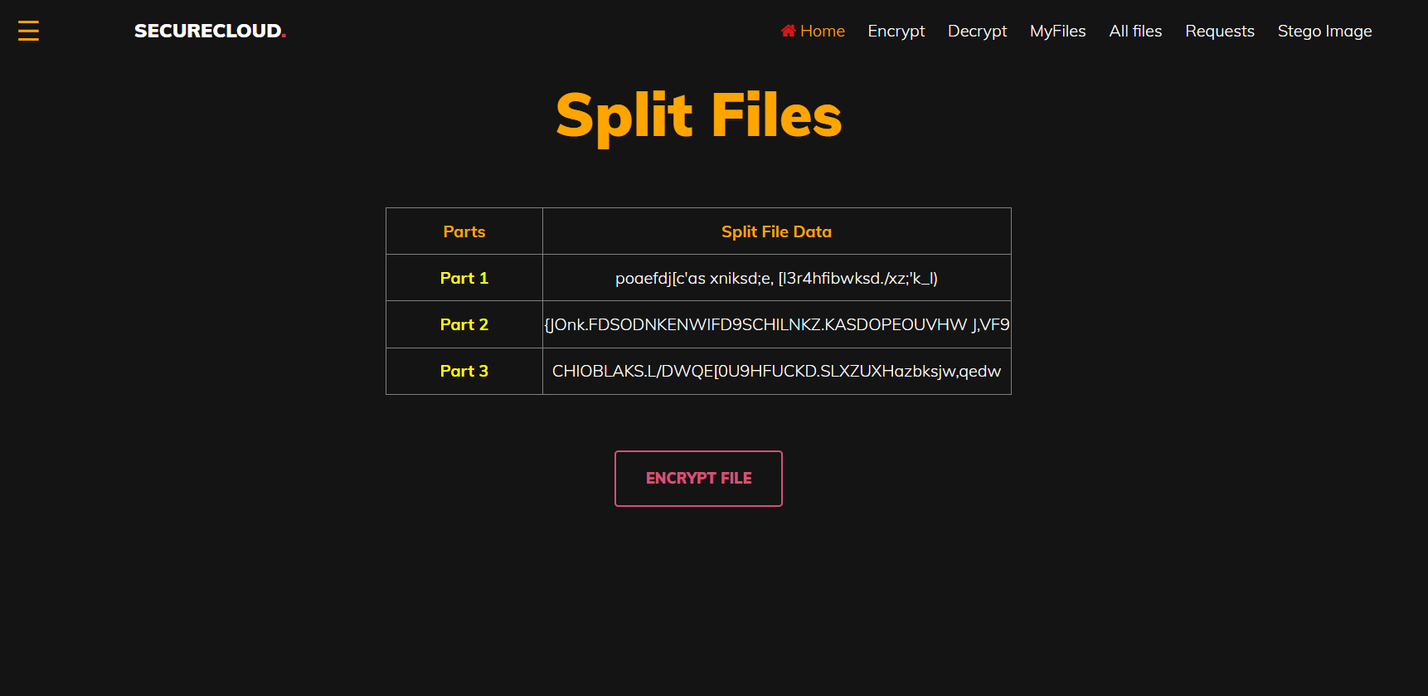
Implementation

Slide 17
Research paper Progress
Completed work
Evaluation of the reference papers is done.
Abstract, Introduction, Methodology is done.
Works to be completed
Architecture diagram
Results
Future Enhancements

Slide 18
Hardware and Software Requirements
Frontend – HTML, CSS, JavaScript
Backend - PHP, MySQL
Cloud Web Server – AWS EC2
Cloud Database server – AWS RDS
Cloud Storage – AWS S3 Bucket

Slide 19
Conclusion and Future Enhancements
Information security is the main concern of todays world.
In order to achieve file security we proposed hybrid cryptography and storing files as shards. We uses mainly tree cryptographic algorithms to provide security.
Each shard is stored in separate database server. Each file can be accessed using a key file which is shared to user .
Future Enhancements:
In this project we only consider the text files only, in future work we can include more file types for securely storing.
Implement better ways to share the key file to user like embedding the key in images, etc..
Adding other cryptography algorithms for better security

Slide 20
Thank You

