Slide 1
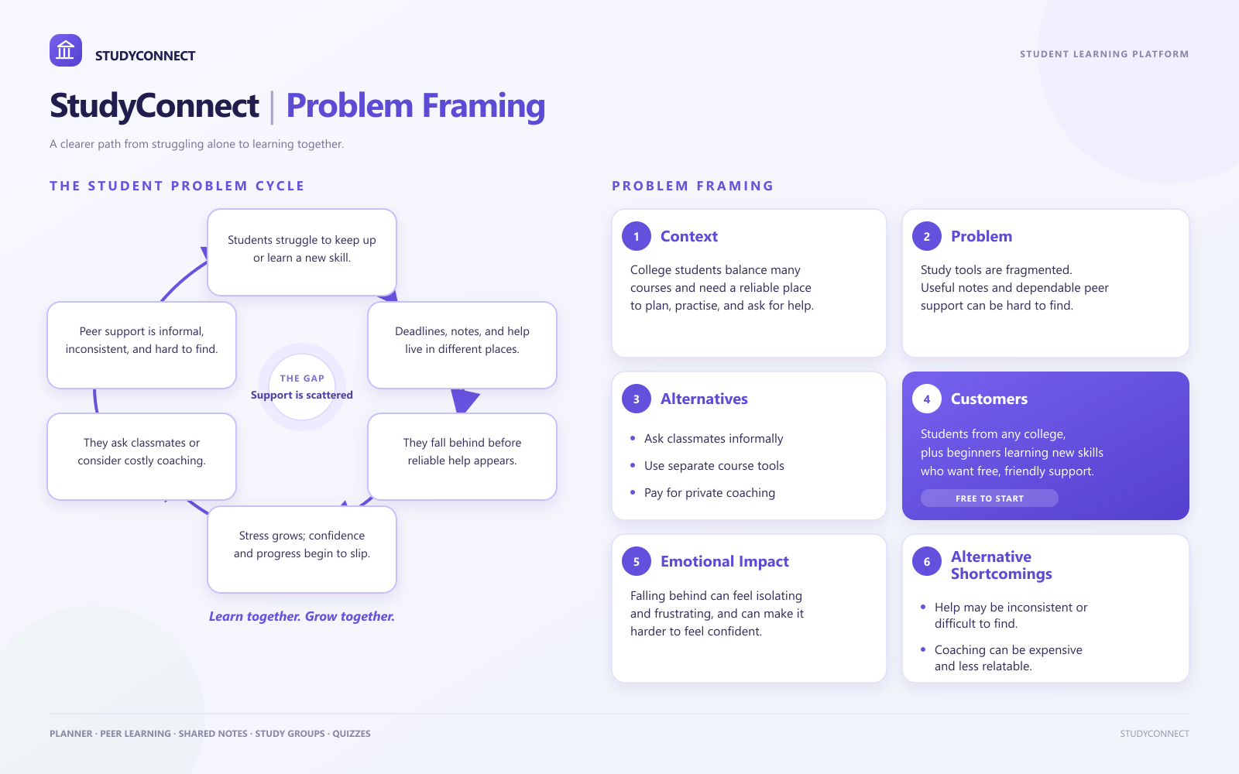
Notes:
StudyConnect problem framing. The graphic presents the student problem cycle and the context, problem, alternatives, customers, emotional impact, and shortcomings. The slide is built from the project infographic supplied for this request.

