Slide 1
INSTRUCTIONS
Use Font size 22 to 28 and Font Style Times New Roman (body)
Do not change the Template: Heading / Title of the slides
Do not change font style or colours
Do not copy paste paragraphs: use only Bullet Points
Maximum slide Limit is 20 only
As per the number of supervisor allotted adopt slide-2 or slide-3
Please display the required meaningful Content or images or tables
Change the footer accordingly using insert tab then click on header & footer tab and edit it
Save the PPT with Register No, Dept and Review no, example: 23xxxxxxxxx_CSE

Slide 2

Title: BUS DELAY AND CROWD REPORTING NETWORK
Student Name: M.V.L.Samhita
Student ID: 2520030509
Cluster:2
Section: 8
Under the Guidance
of
Supervisor Name: Dr. Jayaram Boga
Assistant Professor
Department of CSE

Slide 3
OUTLINE
Abstract
Existing System
Proposed System
System Architecture
Project Modules
Objectives
Co’s Attainments - FWD
Co1
Co2 …….. 5. Co5
Co’s Attainments - DSA
Co1
Co2 …….. 5. Co5
Screen Shots for FWD & DSA
Conclusion
Geo-Tagged Photos

Slide 4
Abstract
Bus delays, overcrowding, and uncertain arrival times often create inconvenience for available bus details and updates. The Admin page is used topassengers. This project presents a platform focused on bus transport where travelers can share and access updates about bus delays, crowd levels, and route information. The platform includes two main sections: a User page and an Admin page. Through the User page, passengers can submit reports about delays and crowd conditions while also viewing monitor and manage the submitted information. By combining passenger contributions with organized bus information, the platform helps commuters stay informed and plan their travel more efficiently.

Slide 5
Existing System
Moovit – Offers route planning, live arrival information, and some crowd reports, but it mainly depends on transport agency data and limited user reports.
Transit – Shows schedules, nearby stops, and real-time vehicle tracking, but passenger-based reporting of delays or crowd levels is limited.
Many transport websites only provide fixed timetables and route information, which may not reflect actual delays or bus crowd situations.
Passengers usually ask other commuters or bus staff for delay information.

Slide 6
Proposed System
Develop a bus transport platform focused on delay and crowd reporting.
Passengers can submit reports about bus delays and crowd levels
System includes two main sections: User Page and Admin Page.
Other users can view updated information before boarding a bus.
User Page: submit reports, check bus information and updates.
Admin Page: monitor reports and maintain system data.
Helps passengers make better travel decisions and reduce waiting time.

Slide 7
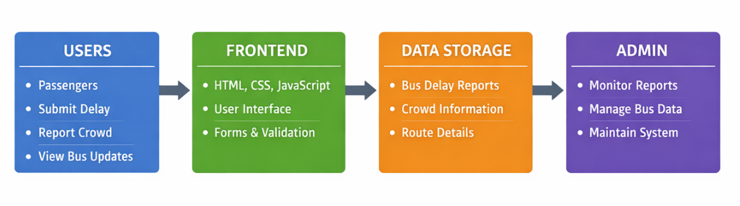
System Architecture

Slide 8
Project Modules
1. User Interface Module
Allows passengers to access the platform
Displays bus routes, delay updates, and crowd information
2. Delay Reporting Module
Enables users to submit reports about bus delays
Updates delay information for other passengers
3. Crowd Reporting Module
Allows passengers to report bus crowd levels
Helps other users know the bus occupancy before boarding
4. Information Display Module
Shows submitted delay and crowd updates
Displays bus route and travel information
5. Admin Module
Monitors submitted reports
Manages and maintains system information

Slide 9
Objectives
To develop a platform that enables passengers to report bus delays and crowd conditions.
To provide updated bus information that helps travelers make better travel decisions.
To create an easy interface where users can share and access transport-related updates.
To reduce waiting time and uncertainty for passengers at bus stops.
To encourage passenger participation in sharing real-time travel conditions.
To organize delay and crowd information in a single accessible platform.
To implement an Admin section for monitoring and managing submitted reports.
To improve awareness of bus availability and travel conditions for commuters.

Slide 10

Co’s Attainments - FWD
Syllabus
Topics Covered
CO1-Internet fundamentals, HTML document structure, headings, paragraphs, links, introductory CSS styling, selectors, typography, colors , spacing.
CO2-HTML forms, form elements, input types, validation, semantic content, CSS layouts and styling.
CO3-JavaScript fundamentals including expressions, conditions, loops, functions, objects and arrays.
CO1-HTML page structure, headings, text content, links, CSS styling, fonts, colors, margin, padding, border for webpage design.
CO2-Form for reporting bus delays, input fields, submit button, basic form validation, CSS layout for organizing the form.
CO3-JavaScript variables, functions, conditions, arrays and objects used to store and manage bus delay reports.

Slide 11
Co’s Attainments - FWD
Syllabus
Topics Covered
CO4-DOM manipulation, event handling, browser storage and asynchronous programming.
CO5-Advanced web development concepts including validation, API integration, optimization and deployment.
Event handling for form submission, DOM manipulation to dynamically display delay reports on the webpage.
JavaScript validation, handling user input dynamically, use of meta tags and basic page optimization.

Slide 12
Co’s Attainments - DSA
Syllabus
Topics Covered
CO1-Focuses on analyzing problem statements and evaluating algorithm efficiency using asymptotic notations (Big-O, Ω, Θ). It also includes implementation and comparison of classical searching and sorting algorithms.
CO2-Covers design and implementation of Abstract Data Types (ADTs) using arrays and linked lists. It includes operations such as insertion, deletion, searching, traversal, and analyzing their trade-offs.
CO3-Deals with application of stacks and queues to model real-world workflows. It also introduces heaps and priority queues for handling prioritized processing tasks.
Basic problem analysis and logical design of the bus delay reporting workflow. No major searching/sorting algorithms implemented, but logical conditions are used to process delay reports.
Use of arrays / collections to store multiple bus delay records and traversal of records to display reports.
Queue-like behavior when multiple users submit delay reports which are processed and displayed sequentially.

Slide 13
Co’s Attainments - DSA
Syllabus
Topics Covered
CO4-Hash-based data structures and Java Collections (List, Queue, Deque, Map).
CO5-Design, develop, and evaluate practical applications using linear data structures..
CO6-Develop programming skills to create applications using Data Structures and implement real-world solutions..
Use of Java collections such as ArrayList or List to store and manage bus objects and delay data efficiently.
The Bus Delay Reporting System itself acts as a practical application where data structures manage real-time delay information.
Implementation of the complete application using Java classes, objects, and data structures to handle bus data and display reports.

Slide 14
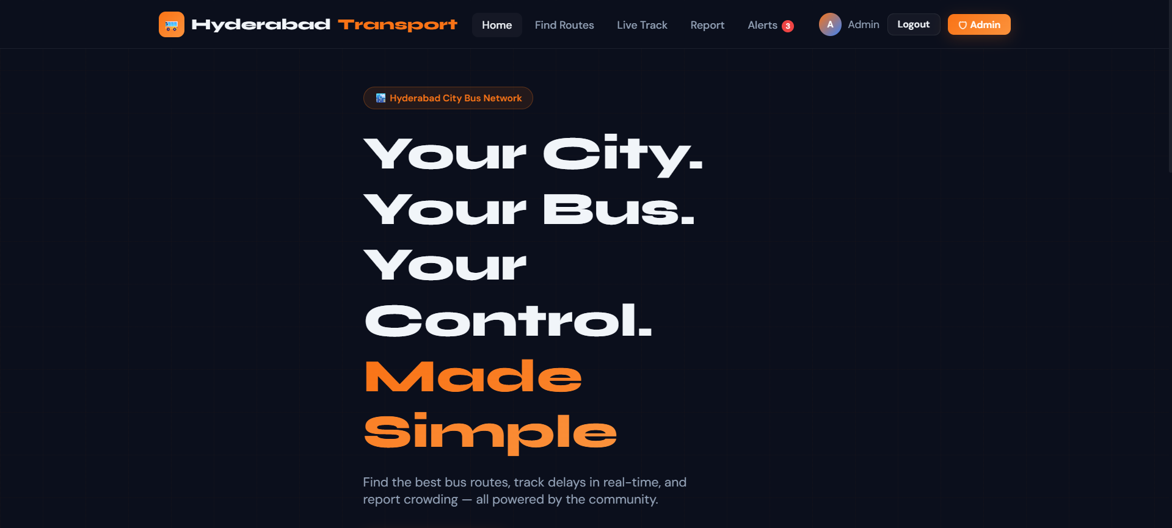
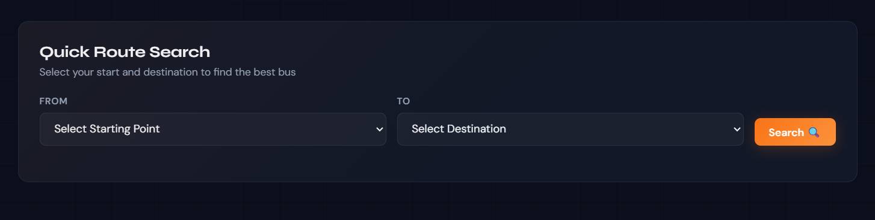
Screenshots for FWD

Slide 15
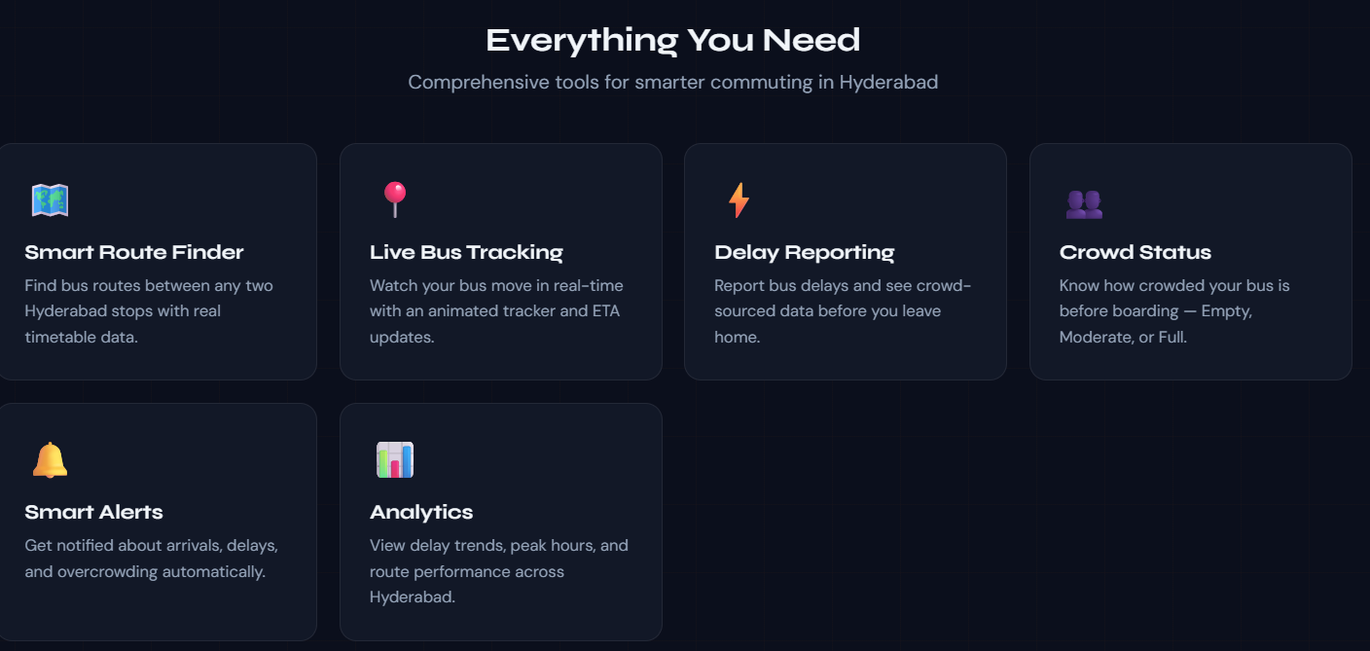
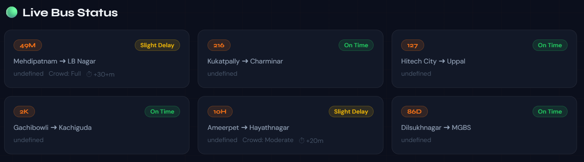

Slide 16
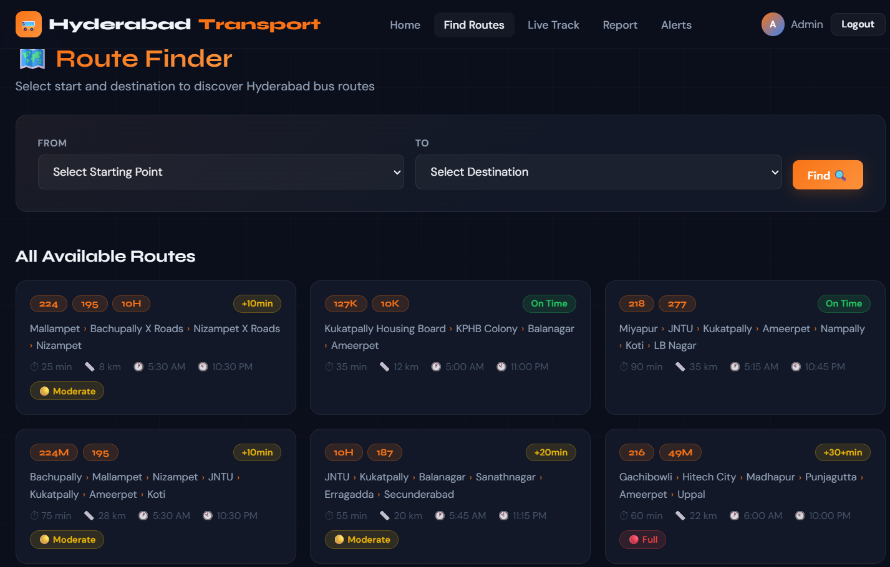

Slide 17
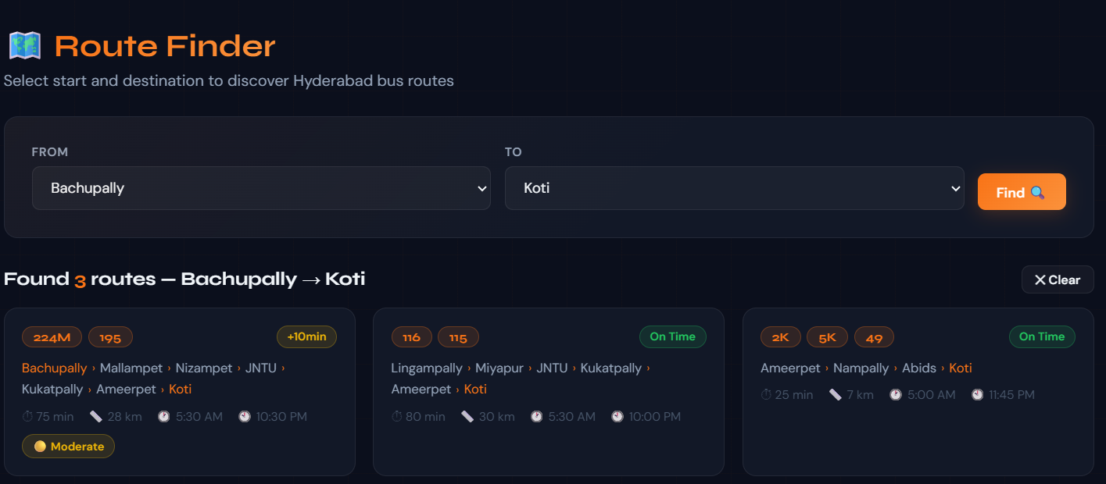
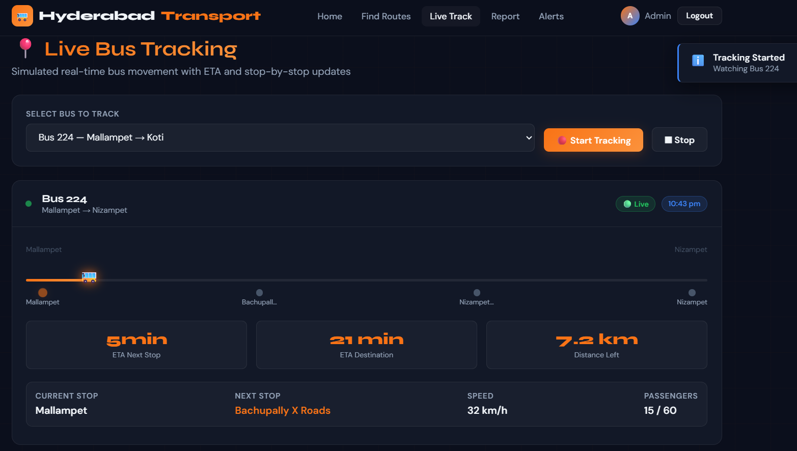
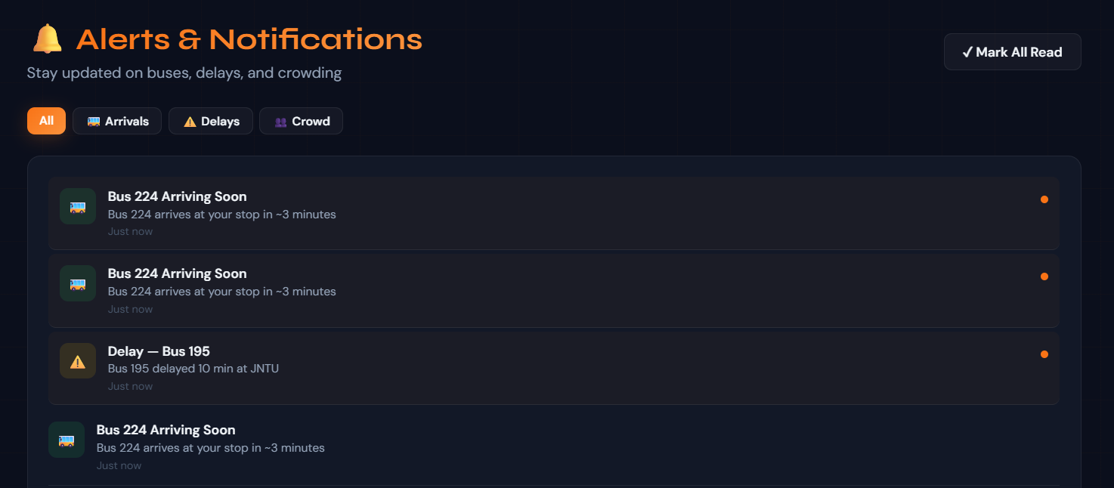

Slide 18
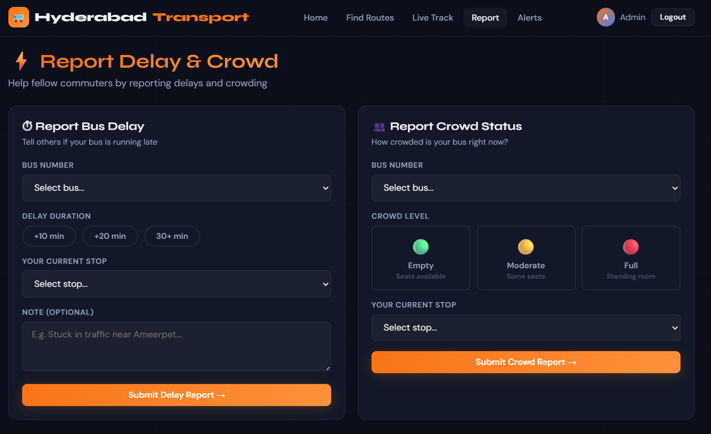

Slide 19
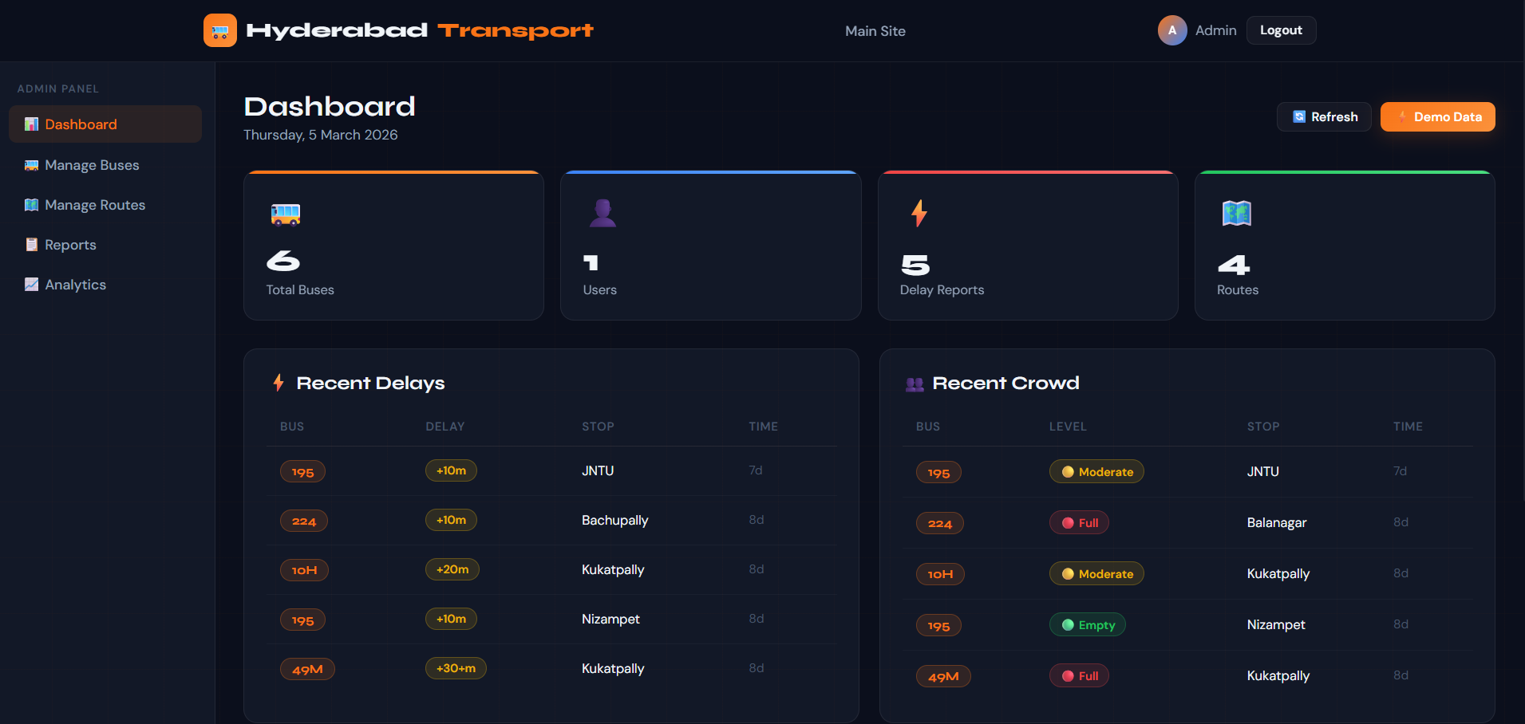

Slide 20
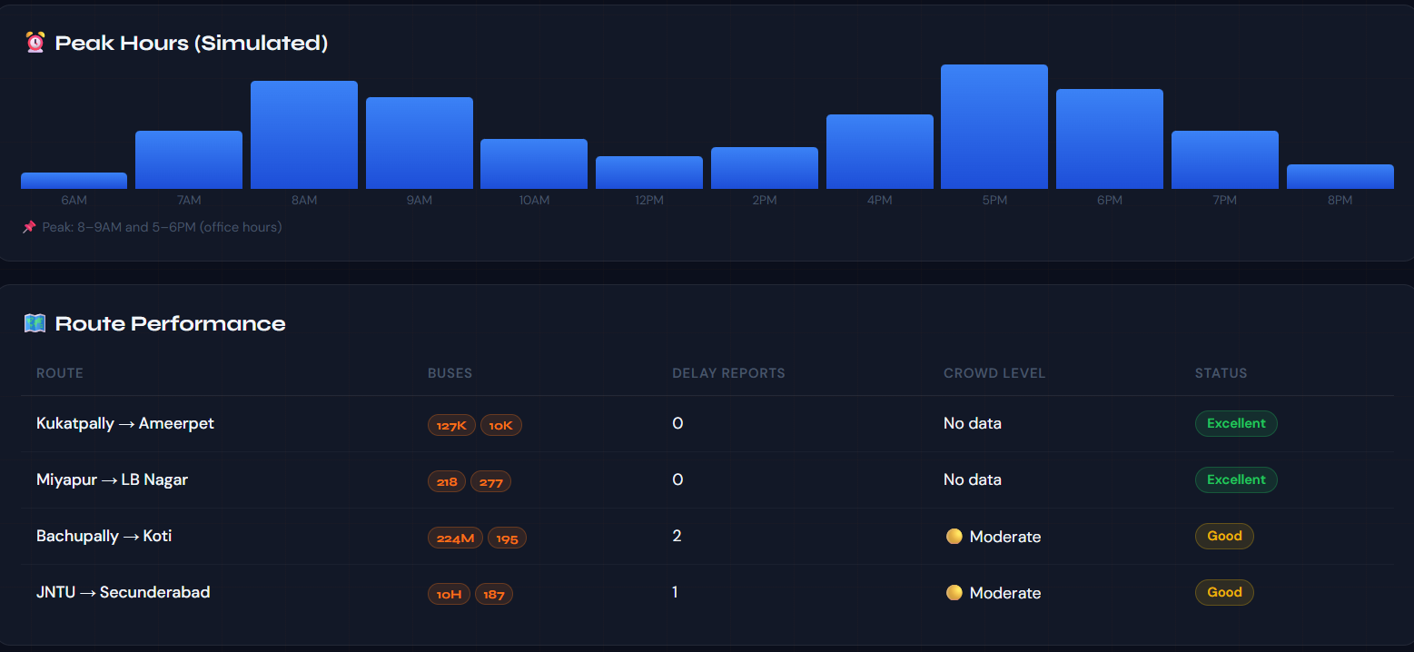
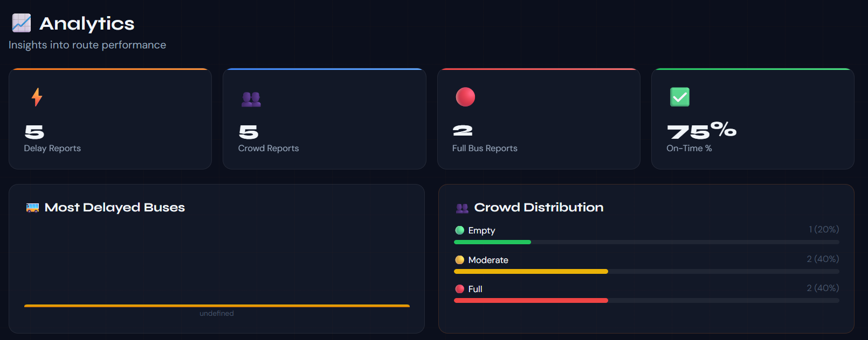

Slide 21
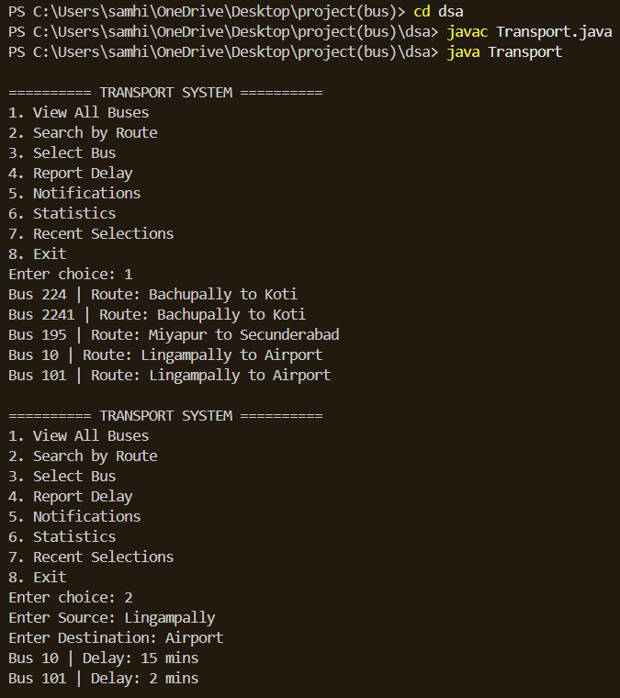
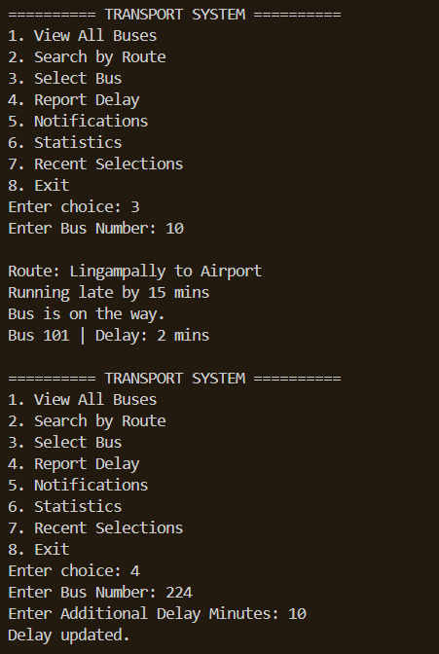
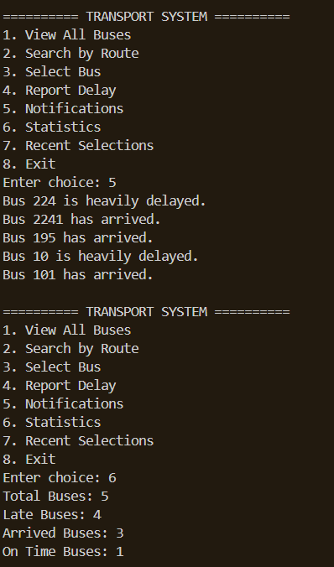
Screenshots of DSA

Slide 22
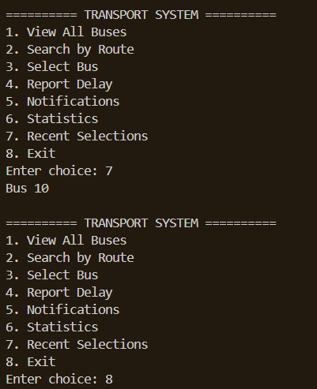
Screenshots of DSA

Slide 23
Conclusion
The project provides a platform for passengers to share and access information about bus delays and crowd conditions.
It helps commuters stay informed and plan their travel more efficiently.
The system enables passenger participation in reporting real-time travel conditions.
The User and Admin sections help manage and maintain the information effectively.
Overall, the platform improves awareness of bus availability and reduces uncertainty during travel.

Slide 24
Geo- Tag Photos

Slide 25
THANK YOU

