Slide 1

Title: Smart Weather Forecast Data Analyzer
Student Name: D.Venkata Mahith
Student ID: 2520030497
Cluster: 03
Section: 9
Under the Guidance
of
Supervisor Name: Sri Lakshmi
Assistant Professor
Department of CSE

Slide 2
OUTLINE
Abstract
Existing System
Proposed System
System Architecture
Project Modules
Objectives
Co’s Attainments - FWD
Co1
Co2 …….. 5. Co5
Co’s Attainments - DSA
Co1
Co2 …….. 5. Co5
Screen Shots for FWD & DSA
Conclusion
Geo-Tagged Photos

Slide 3
Abstract
Smart Weather Forecast Data Analyzer is a system that analyzes weather data to predict future weather conditions accurately.
It collects historical and real-time weather data such as temperature, humidity, rainfall, and wind speed from various sources.
The collected data is processed and analyzed using data analysis techniques and algorithms.
The system identifies patterns and trends in weather conditions to generate reliable forecasts.
It provides users with easy-to-understand weather reports and predictions.
The system can help in agriculture planning, disaster management, and daily activity planning.
It improves the accuracy and efficiency of traditional weather forecasting methods.
Overall, the system helps users make better decisions by providing timely and accurate weather information.

Slide 4
Existing System
Traditional weather forecasting depends heavily on meteorological experts.
Weather data is collected through satellites and weather stations.
Forecasting sometimes requires complex manual analysis.
Some systems provide limited access to local weather information.
Weather prediction accuracy may vary due to limited data analysis.
Existing systems may not provide real-time updates for all locations.
Visualization of weather data may not be user-friendly.
Some systems require expensive equipment and infrastructure.
Data processing can be slow when handling large datasets.
Limited integration with modern data analytics technologies.

Slide 5
Proposed System
It automatically collects weather data from online sources or APIs.
The system processes large amounts of weather data efficiently.
Data analysis techniques are used to identify patterns and trends.
Weather predictions are generated based on analyzed data.
The system provides real-time weather updates.
Users can easily access weather information through a web interface.
Visual charts and graphs help users understand weather patterns.
The system improves prediction accuracy and efficiency.
It can be expanded with machine learning for better predictions.

Slide 6
System Architecture
Data Source Layer collects weather data from APIs or sensors.
Data Storage Layer stores historical and real-time weather data.
Data Processing Layer cleans and organizes the collected data.
Data Analysis Layer performs statistical analysis on the data.
Prediction Layer generates weather forecasts.
Application Layer displays weather data to users.
User Interface Layer provides an interactive dashboard.
Communication between modules ensures smooth data flow.
The architecture supports scalability and real-time updates.

Slide 7
Project Modules
Data Collection Module
Collects weather data from APIs or online weather services.
Retrieves parameters like temperature, humidity, and wind speed.
Stores collected data in the database.
Data Preprocessing Module
Cleans and filters unnecessary data.
Removes missing or duplicate values.
Converts raw data into structured format.
Data Analysis Module
Analyzes patterns in weather data.
Uses statistical methods for analysis.
Identifies trends in weather conditions.

Slide 8
Objectives
To design a smart system for weather data analysis.
To collect and analyze real-time weather information.
To improve the accuracy of weather predictions.
To provide easy access to weather forecasts for users.
To develop a user-friendly web-based application.
To display weather data using graphs and charts.
To assist users in planning activities based on weather conditions.
To support agriculture and disaster management planning.
To apply data analysis techniques in real-world applications.

Slide 9
Co’s Attainments - FWD
CO1
Understand the fundamentals of web development.
CO2
Design responsive web pages using HTML and CSS.
CO3
Implement dynamic functionality using JavaScript.
CO4
Integrate APIs to fetch real-time weather data.
CO5
Develop a complete front-end interface for the application

Slide 10
Co’s Attainments - DSA
CO1
Understand data structures used in data management.
CO2
Apply algorithms for processing large datasets.
CO3
Use searching and sorting techniques for data analysis.
CO4
Optimize data processing efficiency.
CO5
Apply problem-solving techniques using algorithms.

Slide 11
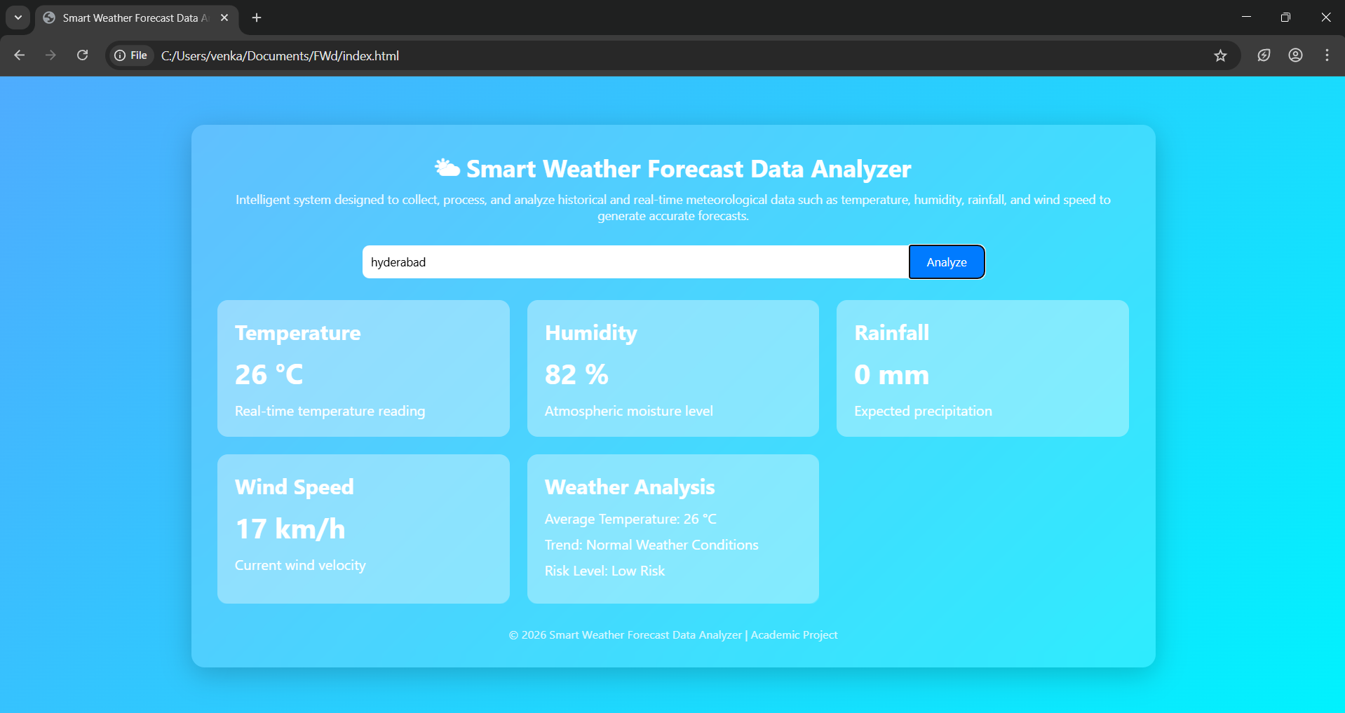
Screenshots for FWD & DSA

Slide 12
Conclusion
Smart Weather Forecast Data Analyzer improves weather prediction accuracy.
It uses data analysis techniques to process weather information efficiently.
The system provides real-time weather updates for users.
It helps users make informed decisions based on weather forecasts.
The application is useful for agriculture, travel, and disaster management.
Future improvements can include machine learning models.
The system can be integrated with mobile applications for wider accessibility.

Slide 13
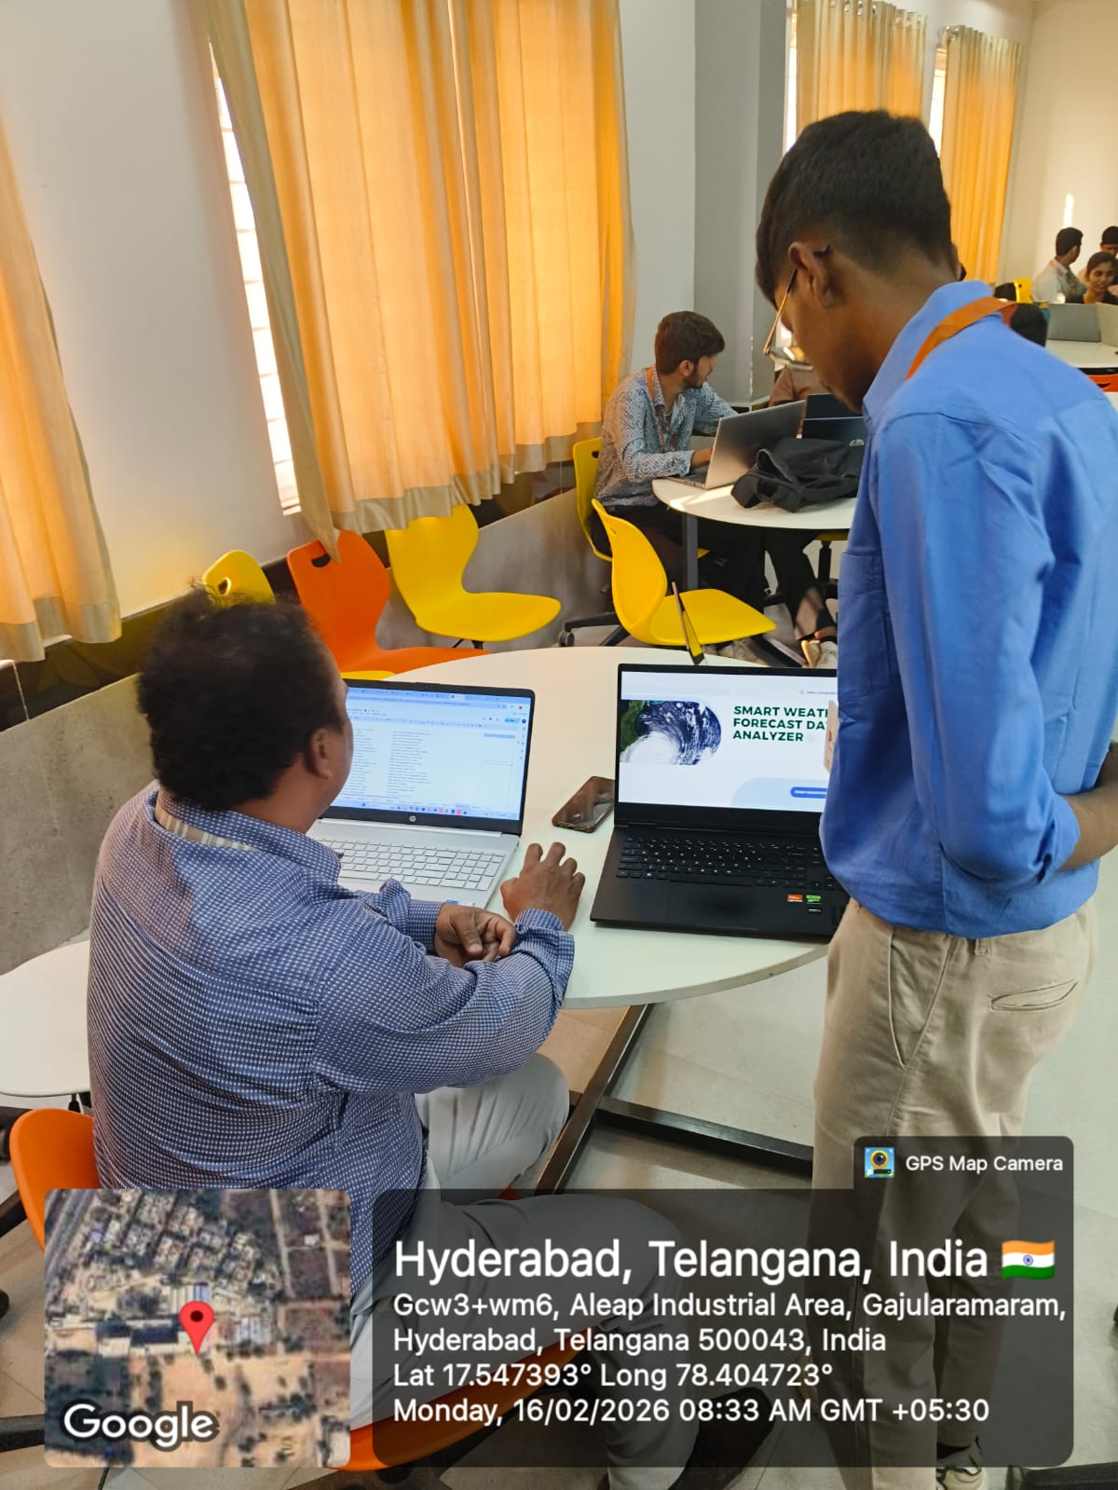
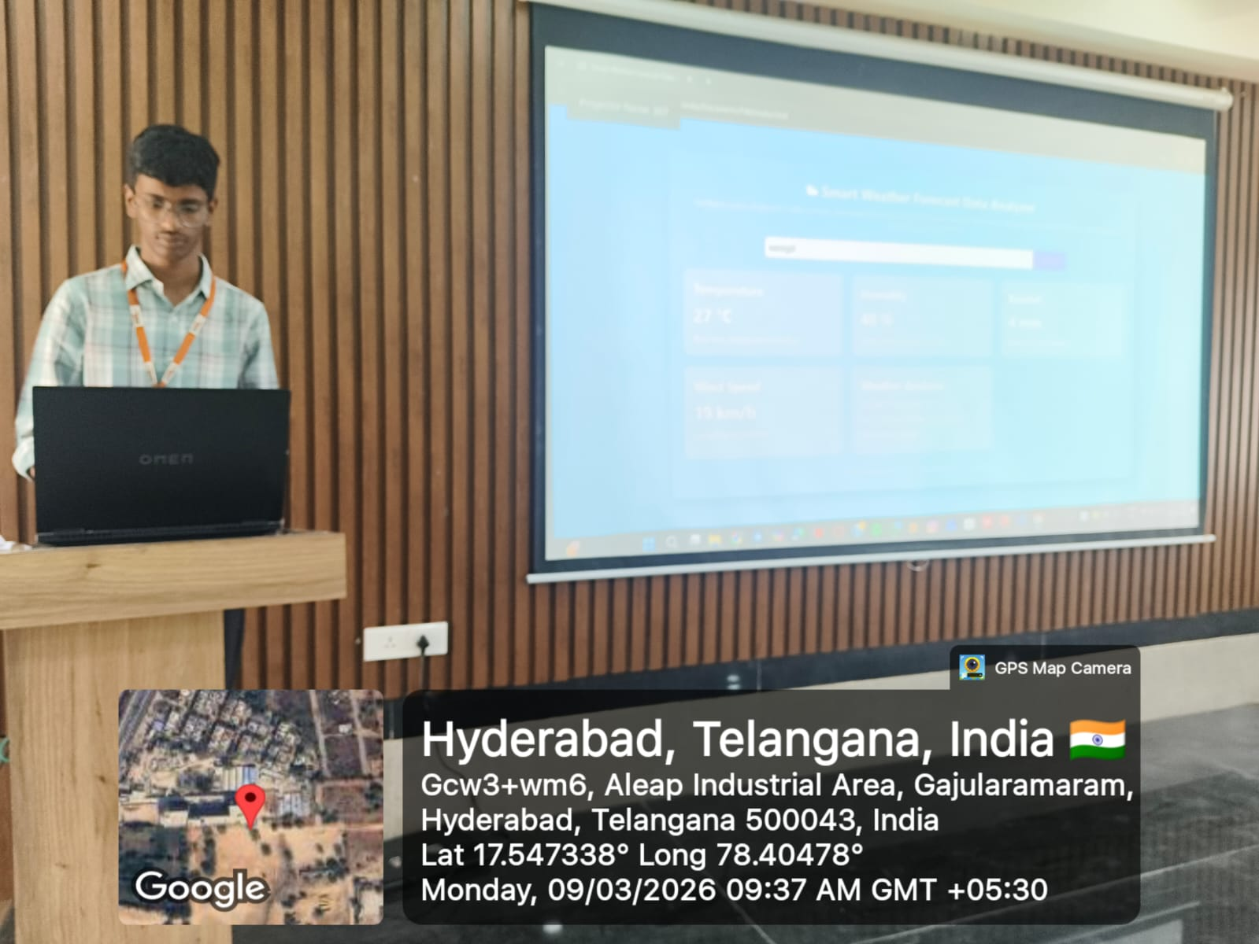
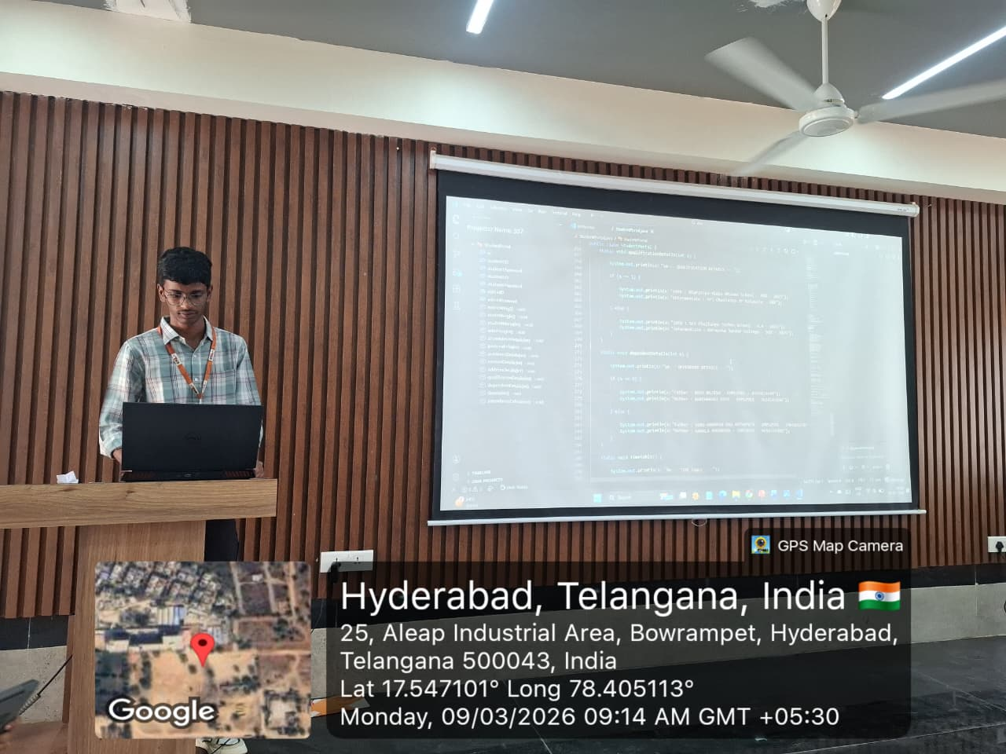
Geo- Tag Photos

Slide 14
THANK YOU

