Slide 1
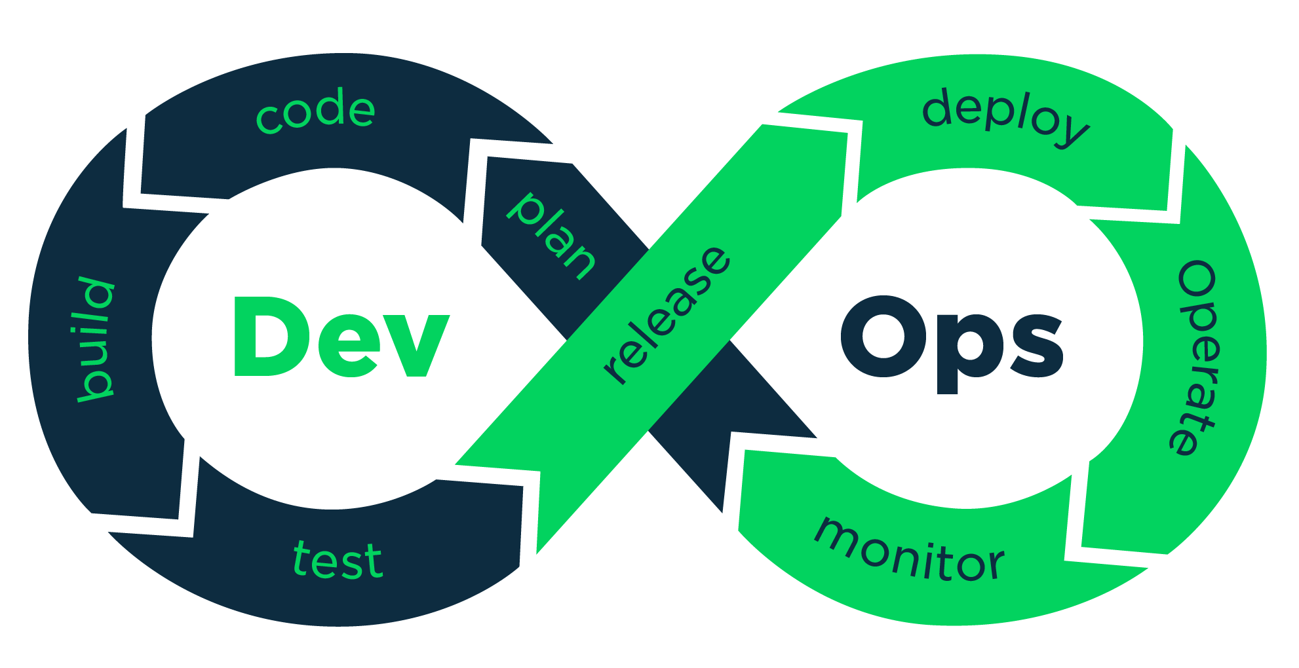
Install Notepad++ & Configure

Slide 2
Install Notepad++
Go
Go to Google and download Notepad++
Run
Run the Executable File of NotePad ++
Configure
Configure Notepad++ in System Variables

Slide 3
Configure Notepad++ in Git
Open Git Bash
Create file .bash_profile notepad++ .bash_profile
Configure NotePad++ with GIT. git config --global core.editor "\"C:\Program Files (x86)\Notepad++\notepad++.exe\""
Exit and relaunch the GitBash

Slide 4
Configure Notepad++ in Git
Verify Configuration cat ~/.gitconfig
git config –global – list

Slide 5


