Slide 1
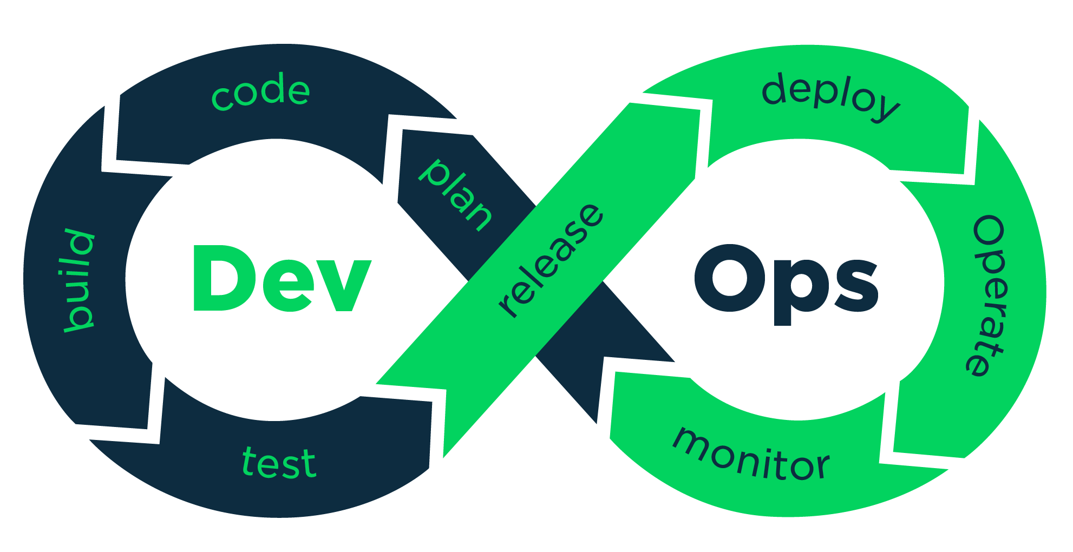
Fixing Common Mistakes in GIT

Slide 2


