Slide 1
◈ CodeCompass
HACKFRONT INDIA 2026 · THEME T1 · PS T1.1
Read the code.
Then ask why.
SUPERSEDES
A graph-native answer engine for the reasoning that walks out of the door. Every answer carries the commit, the thread, the person and the date — or it refuses.
6,183
8,982
13/13
commits
graph nodes
trust cases
no model in the loop
Notes:
Open with the problem, not the tech. "Every team has one person who knows why. CodeCompass makes that knowledge queryable, with evidence."

Slide 2
02
THE PROBLEM
The reasoning is not in the code.
“
A new developer can read code. They cannot read intent. The why lives in commits, closed PRs, incident threads and one senior engineer’s head.
In every engineering team there is one person who knows why. Why the retry limit is three. Why that service was never migrated. When that engineer leaves, the codebase stays and the reasoning walks out of the door.
01
Docs drift; commits keep telling the truth.
Documentation is written once and edited rarely. The commit that changed the behaviour keeps its reason — if you can find it.
02
A reversed decision still looks authoritative.
A patch from 2025 sits in history next to its own revert. Search quotes the dead one.
03
Search returns mentions, not decisions.
— problem statement, T1.1
Vector search finds text that talks about the topic. It does not find the line of code that the incident changed.
414 identities
in this one repository’s history
CodeCompass
hackFront India 2026 · PS T1.1
Notes:
Do not read the quote. Let the judge read it. Say: the knowledge is real, it is just not addressable.

Slide 3
03
THE PRODUCT
Four behaviours, not a chat box.
The question is compiled into a path through decisions. The graph, not a model, chooses the evidence.
01
02
03
04
Link
Walk
Resolve
Answer
One entity per concept. res.sendfile and res.sendFile resolve to the same node.
→
Typed edges: CHANGED, AUTHORED_BY, IN_PR, REFERENCES, DOCUMENTS.
→
REVERTS and SUPERSEDES decide what is live before anything is quoted.
→
Quote the commit, the thread, the person, the date — or refuse.
Deterministic · offline · no API keys
No typed path → no answer
The refusal is a graph result, not a prompt instruction. A shared word is never enough.
CodeCompass
hackFront India 2026 · PS T1.1
Notes:
This slide is the mental model. Point at the branch: refusal is designed, not an error state.

Slide 4
04
THE MODEL
The graph is the product.
The same module carries different names across years; the same question crosses commits, threads and people. That is a graph, not a text index.
8,982
config key
person
nodes
CHANGED
AUTHORED_BY
commit
30,597
typed edges
IN_PR / REFERENCES
API member
CHANGED
PR / issue
DOCUMENTS
96
code entities
release note
REVERTS
1,312
doc lines
revert commit
Only commits reachable from HEAD can govern shipped code. An unmerged x-powered-by removal is excluded, on purpose.
CodeCompass
hackFront India 2026 · PS T1.1
Notes:
If asked about Neo4j: the model exports to AuraDB with one command. The demo runs embedded for offline determinism.

Slide 5
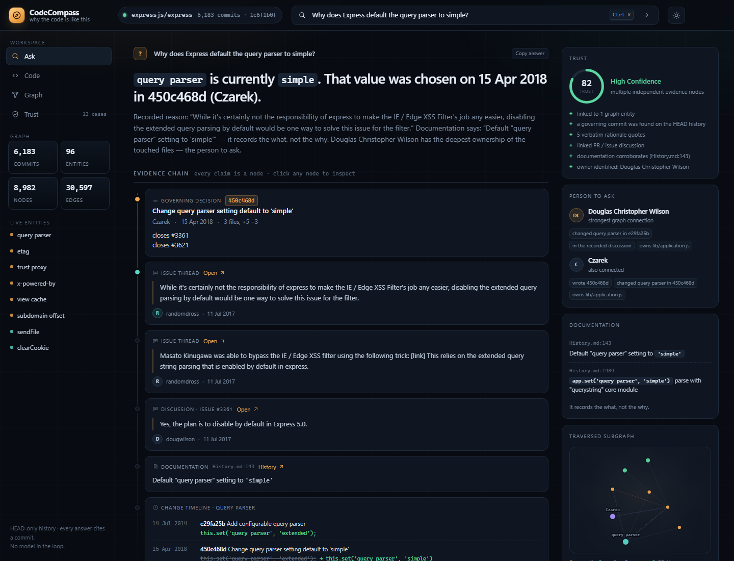
05
DEMO · A REAL DECISION
Why does the query parser default to simple?
THE GOVERNING COMMIT
450c468d · Czarek · 15 Apr 2018. It replaced the 2014 default of extended.
THE DISCUSSION
Issue #3361: an XSS-filter bypass through extended query parsing.
THE GAP
History.md records the new default. It never records the reason.
“disabling the extended query parsing by default would be one way to solve this issue for the filter.”
randomdross · issue #3361 · 11 Jul 2017
LIVE UI · Confidence 82 · 5 verbatim quotes · owner: Douglas Christopher Wilson
CodeCompass
hackFront India 2026 · PS T1.1
Notes:
Point at the chain, not the verdict. The value of the product is that the chain is clickable.

Slide 6
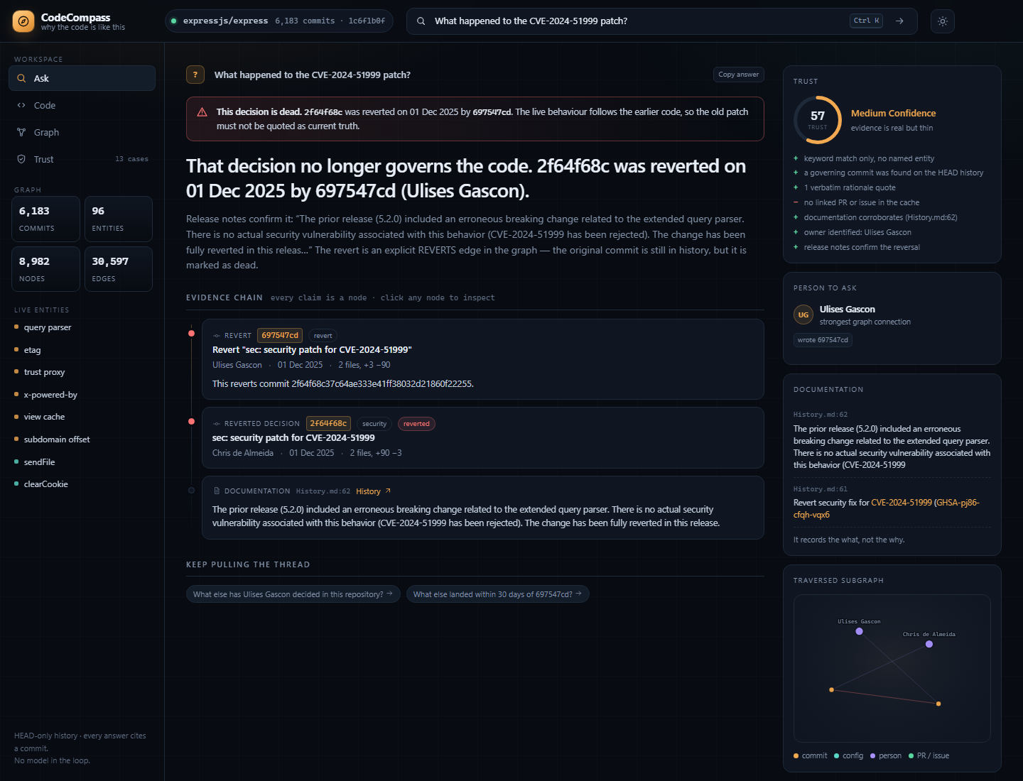
06
DEMO · SUPERSESSION
A dead decision, caught before it is quoted.
THE PATCH
2f64f68c · 01 Dec 2025. A security fix for CVE-2024-51999.
THE REVERT
697547cd · same day. The graph carries an explicit REVERTS edge.
THE RECORD
History.md 5.2.1: the CVE was rejected and the change fully reverted.
“There is no actual security vulnerability associated with this behavior. CVE-2024-51999 has been rejected.”
History.md · express 5.2.1
LIVE UI · the answer leads with the reversal · old patch shown, never presented as current
CodeCompass
hackFront India 2026 · PS T1.1
Notes:
This is the exact failure mode T1.1 names. A reversed decision sits in the archive looking authoritative.

Slide 7
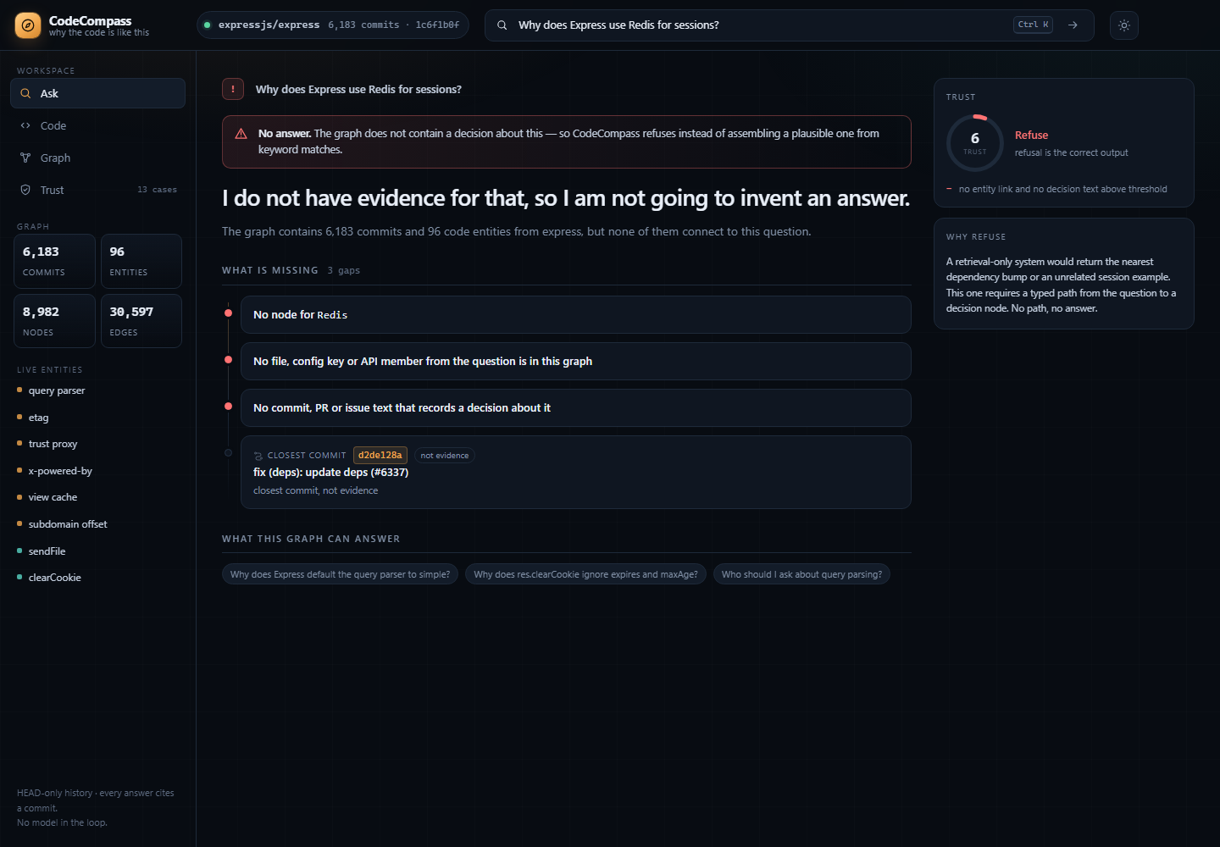
07
DEMO · REFUSAL
The answer is sometimes no.
“Why does Express use Redis for sessions?”
No entity
Redis is not a node in this graph.
No code path
No config key, API member or file connects to the question.
No decision
No commit, PR or issue records a choice about it.
A vector search would return the nearest dependency commit. That is the bug, not the feature.
LIVE UI · trust 6 · three named gaps · closest commit labelled “not evidence”
CodeCompass
hackFront India 2026 · PS T1.1
Notes:
This is the honesty slide. Do not apologise for the refusal; it is the product decision.

Slide 8
08
TRUST HARNESS
Trust is part of the demo.
The same 13 cases run at request time. Two of them must refuse; the low-confidence one must stay low.
LINE 715
res.clearCookie = function clearCookie(name, options) {
13/13
CASE | EXPECTED EVIDENCE | RESULT
Query parser default | 450c468d + XSS quote | PASS
clearCookie ignore | 82fc12a4 + reason | PASS
CVE-2024-51999 | reversal + “rejected” | PASS
sendfile → sendFile | one entity, retired name | PASS
Redis sessions | refusal | PASS
Retry limit three | refusal | PASS
Line 715 | author ≠ governing commit | PASS
WRITTEN BY
cases passing
bb53b20d · 2015
GOVERNED BY
30/30
82fc12a4 · 2024
The text is older than its behaviour. A signature diff misses it; blame over the function span does not.
engine assertions
Every case is visible, including the ones designed to fail.
trust 82
CodeCompass
hackFront India 2026 · PS T1.1
Notes:
Open /api/eval on request if a judge wants to see the raw results.

Slide 9
09
UNDER THE HOOD
How it is built.
Three git passes, one graph file, a deterministic reasoner. No service dependency in the demo path.
GIT HISTORY
GRAPH
REASONER
ANSWER
6,183 commits
8,982 / 30,597
link · walk · score
quote or refuse
metadata · numstat · patch
renames · blame · release notes
→
commits, entities, people,
PRs, issues, docs, markers
→
entity resolution, supersession,
confidence, refusal
→
extractive; every sentence has
author, date and URL
7 MB
~110 ms
30–70 ms
0
graph file
boot (warm)
per question
API keys
Neo4j AuraDB path: npm run export:cypher → CSVs + idempotent import + the same traversals in Cypher. The demo runs embedded so it stays offline and reproducible.
CodeCompass
hackFront India 2026 · PS T1.1
Notes:
Say explicitly: no model call, no network. If asked about scale, the ingest is linear in commits; the graph is 7 MB for 17 years of Express.

Slide 10
Ask it something
it cannot answer.
The refusal is the feature. 6,183 commits, 30,597 edges, and still no invented answers.
6,183
commits reachable from HEAD
CodeCompass
13/13
trust cases, refusals included
hackFront India 2026
Theme T1 · PS T1.1
Express · 2009 → 2026
0
model calls in the demo
no model in the loop
Notes:
End on the refusal line. It is the most memorable claim and it is demonstrable.

