Slide 1


Used cars in Mumbai

Slide 2

About me
K. Venakata Narsimha Chary
Bsc(maths)
Non coding background, intrust in maths and curious mind set , Data science is like big umbrella lot of opportunities inside it
fresher
K. Gopinadh
Msc(organic chemistry)
Non coding background, but intrusted in logical thinking
fresher

Slide 3

Ajenda
Collecting the data from selected website
Cleaning the data
Visualize the data
Create insights from the data
NEVER
SETTLE

Slide 4
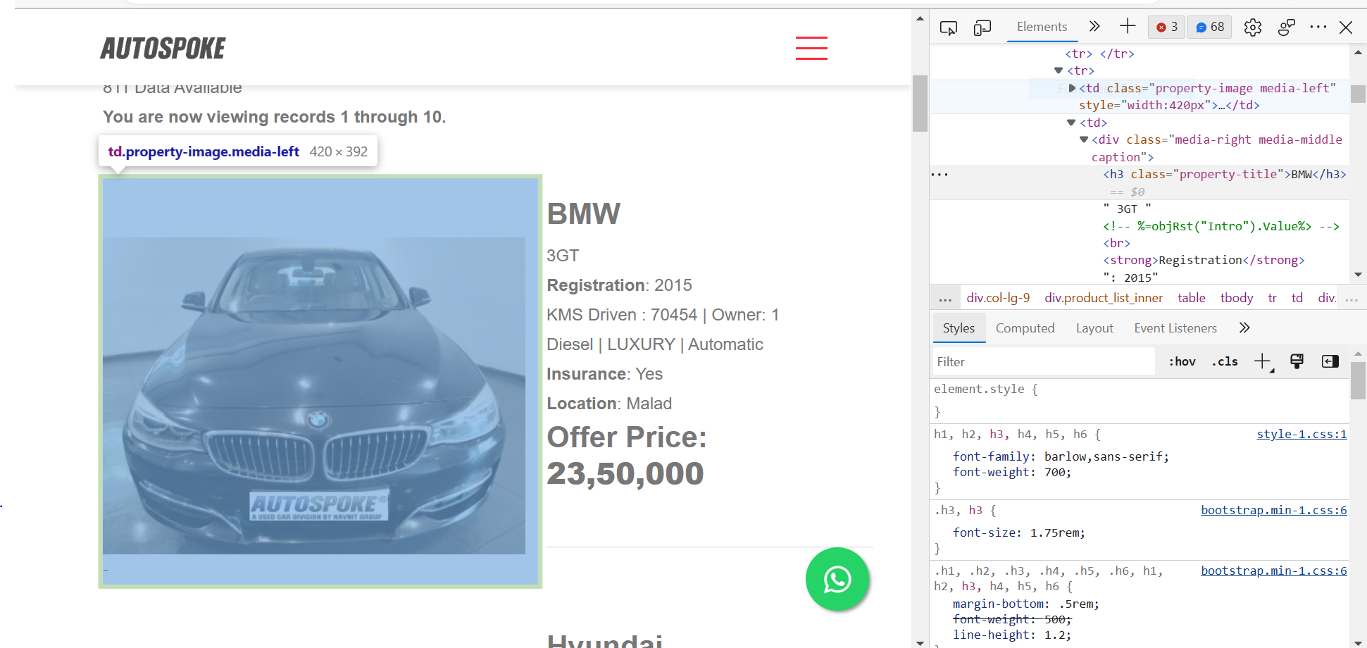
Website :AUTOSPOKE
https://autospoke.com/PreOwnedCars/Used-Cars-Mumbai-Autospoke-listing.asp?sortid=ID&sorttype=DESC&NAV=1

Slide 5
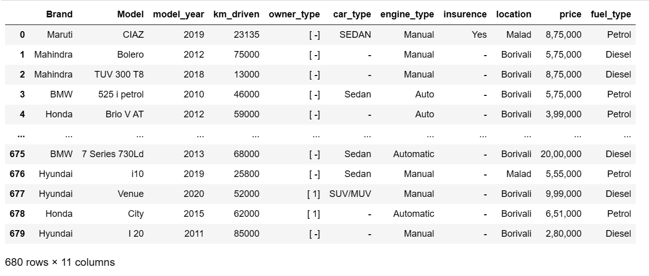

Data Collection
Raw data
Python
-Beautifulsoup
-Seleniun

Slide 6
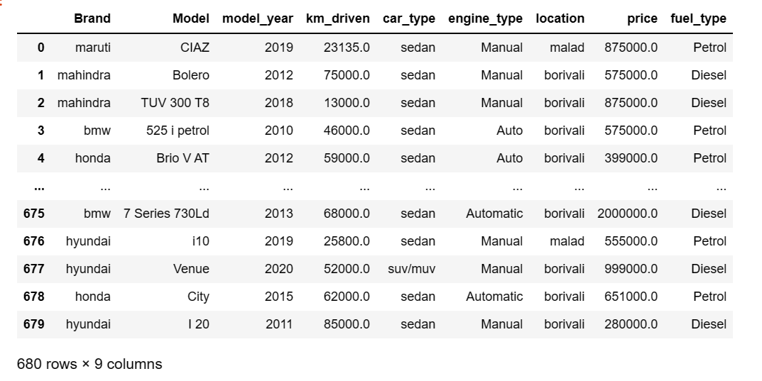

Cleaning data
Pandas
EDA
♦ Drop the duplicates
♦ Finding the corrucpted values
♦ Replacing symbols
♦ Finding the missing values
♦ Filling the missing values
♦ Finding the out layers
♦ Handling the out layers

Slide 7
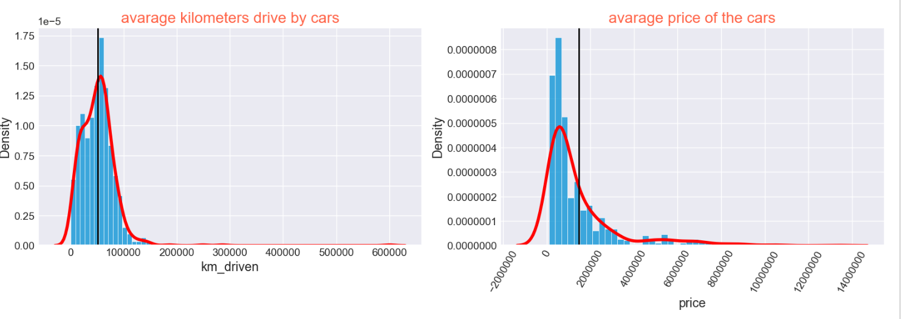
Univariate analysis
observations
the 1st plot shows that most of the cars falls under the range of 5 to 8 lakhs
the 2nd plot shows that most of the cars driven under the range of 50 thousand to 70 thousand

Slide 8
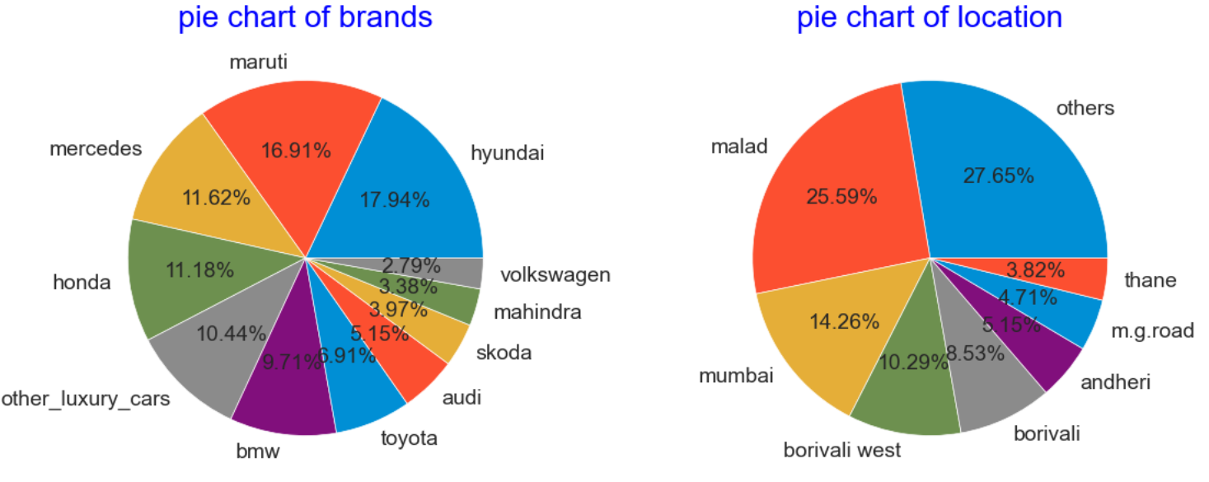
Slide 2:
observations
first pie chart shows that hundai and maruthi cars are more in sales
second pie chart shows that malad and mumbai more cars in sales

Slide 9
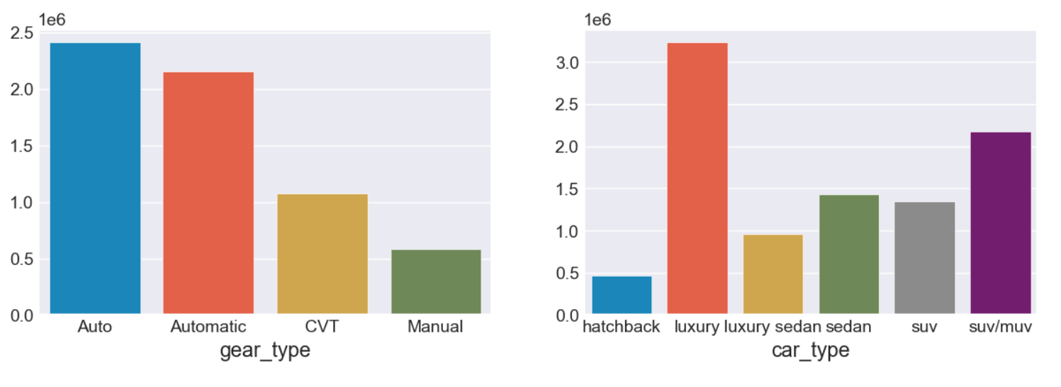
Bivariate analysis
Comparision b/w gear_type and average price
Comparision b/w car_type and average price
observations
in the 1st plot the average price of the Auto gear type cars is high and manual gear type is low
in the 2nd plot the average price of the luxury and suv/muv car types are high and also hatchback is low

Slide 10
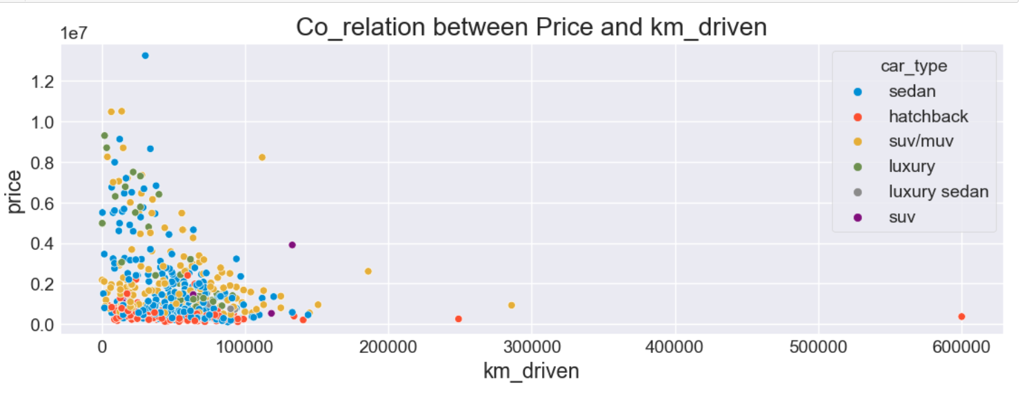
Multi-variate analysis:
observations
the above fig shows that when the number of kilometers driven by the car is decreases then the price of the car increases

Slide 11
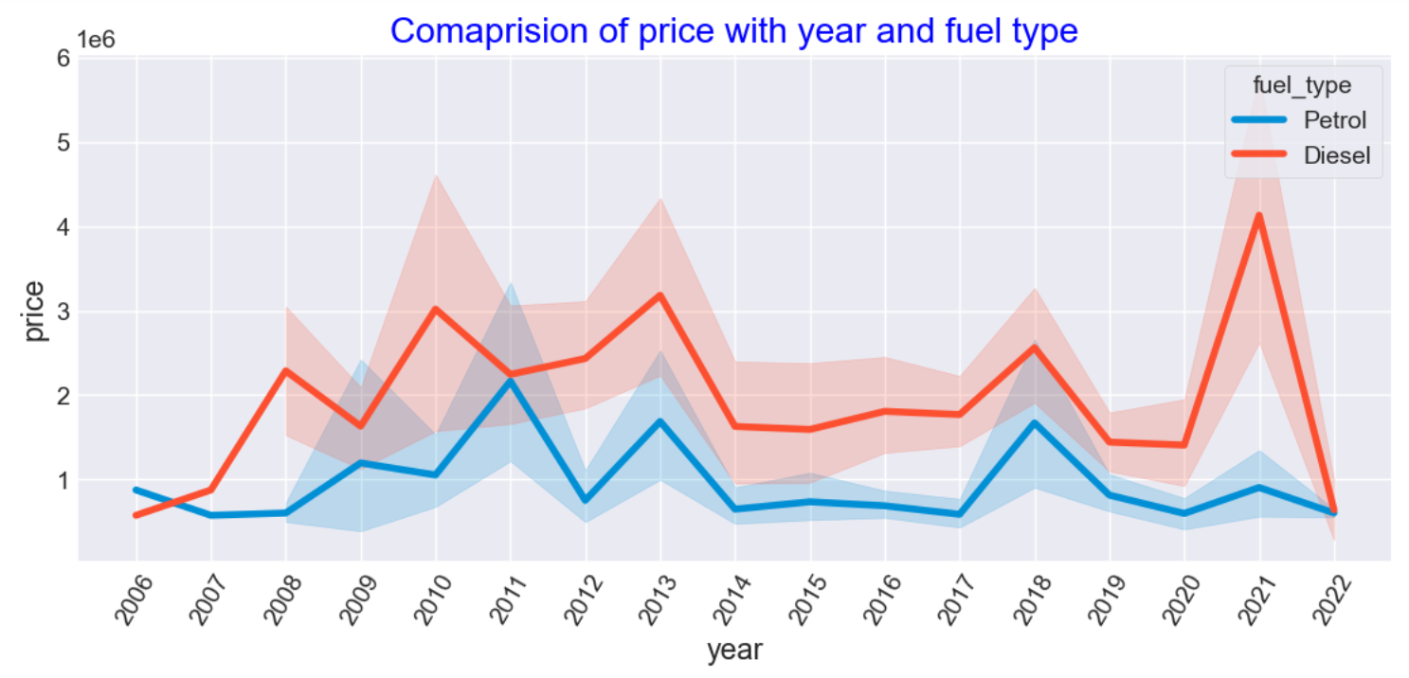
Slide 2:
observations
the above graph clearly show that the new model vehicles are highly cost ,and diesel vehicles high cost compared to petrol vehicles

Slide 12

Business Questions
♣ What type of cars is beneficials to buy in second hand
♣ which type cars has more resale values
♣ what is the most available car brand in Mumbai

Slide 13

conclusion
♠ 20% of cars in Mumbai are luxury cars price range on average 70 lakhs on high end cars
♠ if u want buy super car in Mumbai go for Mercedes
diesel car with geartype auto ,cartype suv/muv , sell it within 4 to 5 years under 600000 km driven cars are best resale values
if u are looking for a cheap car go for petrol in fuel type,
Hatchback in car type , and manual in gear type ,above 100000km driven bikes are cheaper
I think the car with 3 to 4 years old and petrol as a fuel type
And sedan or suv with gear type automatics is best option to buy a second hand car in mumbai

Slide 14

ANY QUESTIONS

Slide 15

THANK YOU

