Slide 1
RLS-Enabled Regional Sales
& Profit Analytics
Power BI Project-Based Assignment | ExcellenC
Prepared by: Pranay Yannaru

Slide 2
Project Background & Objective
Background
Acting as BI Analyst for a retail organization selling technology and office supplies across India, this project builds a secure, interactive Power BI dashboard to monitor sales, profit, customer behavior, and shipping performance — with region-wise manager access controlled via Row-Level Security.
Objectives
Interactive Power BI Sales & Profit dashboard across 4 pages
Row-Level Security (RLS) so each Regional Manager views only their region
Drill-down, drill-through, custom tooltips & bookmark navigation
Insights across Category, Region, Customer & Product levels
Data-driven business recommendations from visual analytics

Slide 3
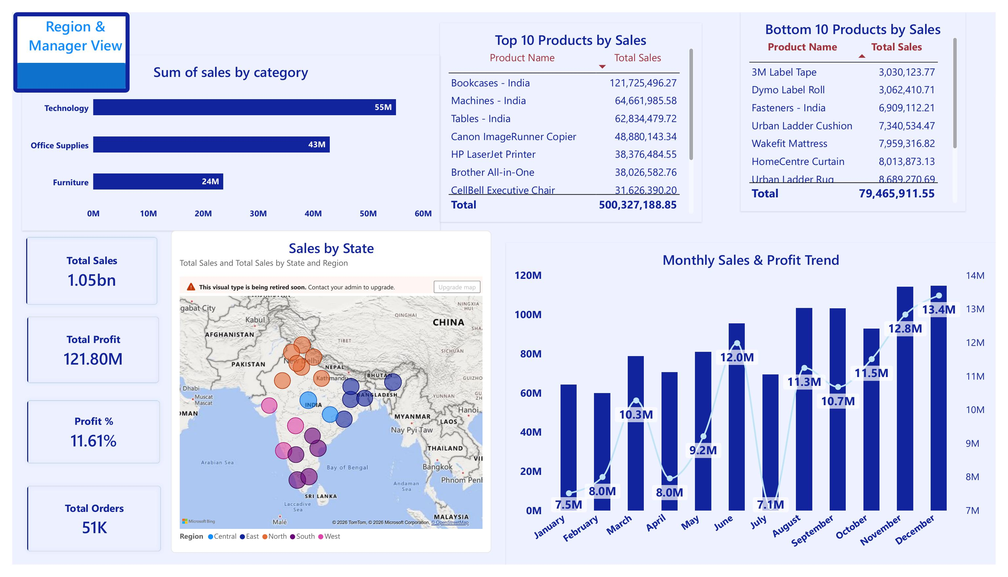
Sales Overview
Key Insights
Technology leads all categories at 55M in sales, ahead of Office Supplies (43M) and Furniture (24M)
North, Delhi-NCR and nearby northern states drive the largest share of revenue on the map
Monthly sales show a choppy pattern with dips in April and July, then strong recovery peaking at 13.4M in December
Overall book: 1.05bn in sales, 121.80M profit (11.61% margin) across 51K orders

Slide 4
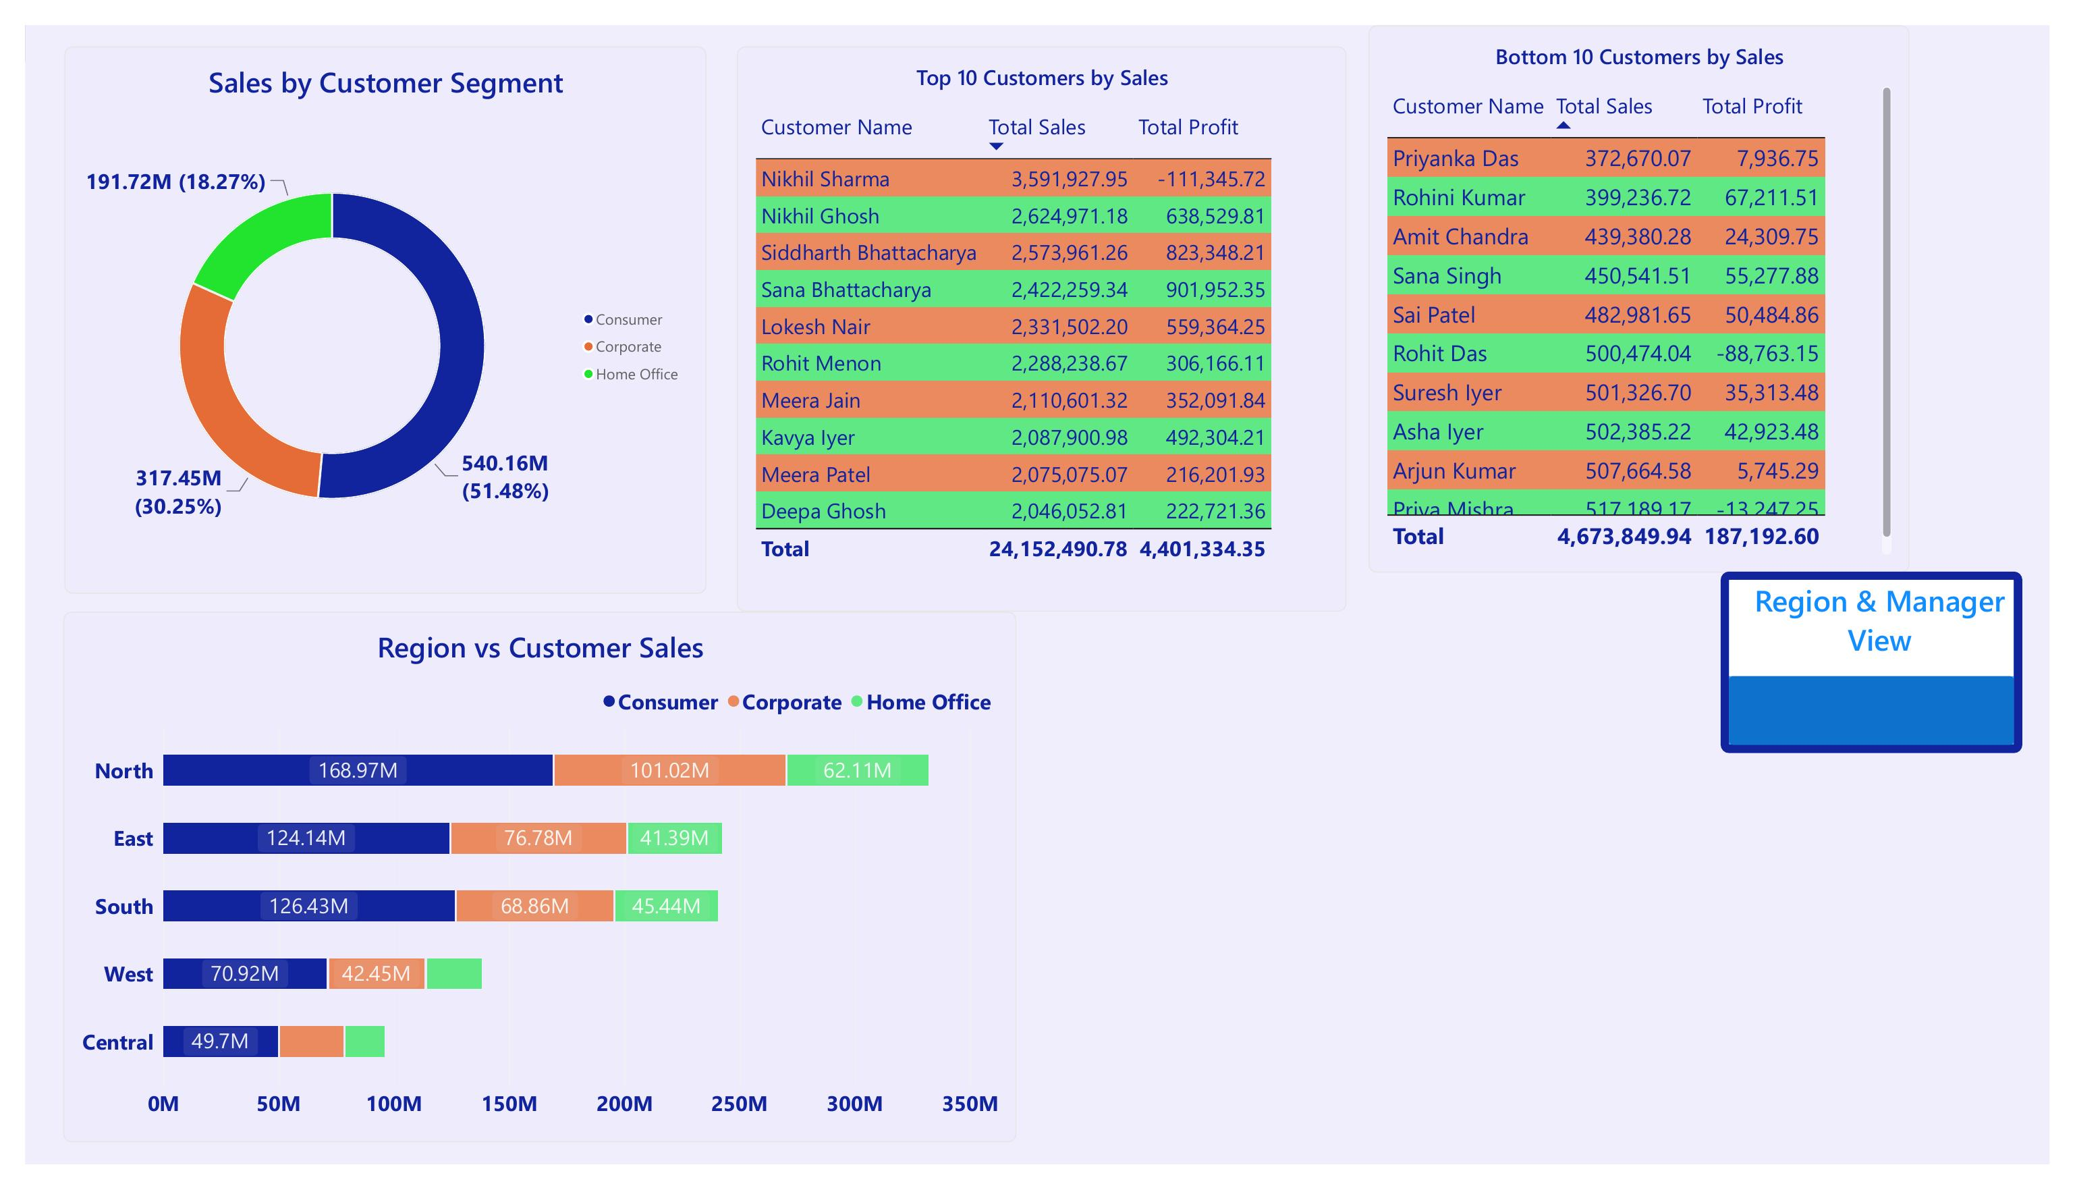
Customer Insights
Key Insights
Consumer segment drives 51.5% of sales (540M), more than Corporate (30%) and Home Office (18%) combined
Nikhil Sharma is the top customer by sales, though his orders are currently loss-making overall
North region leads customer sales across all three segments; Central lags furthest behind
Drill-through enabled: right-click any customer to open a full Customer Profile page

Slide 5
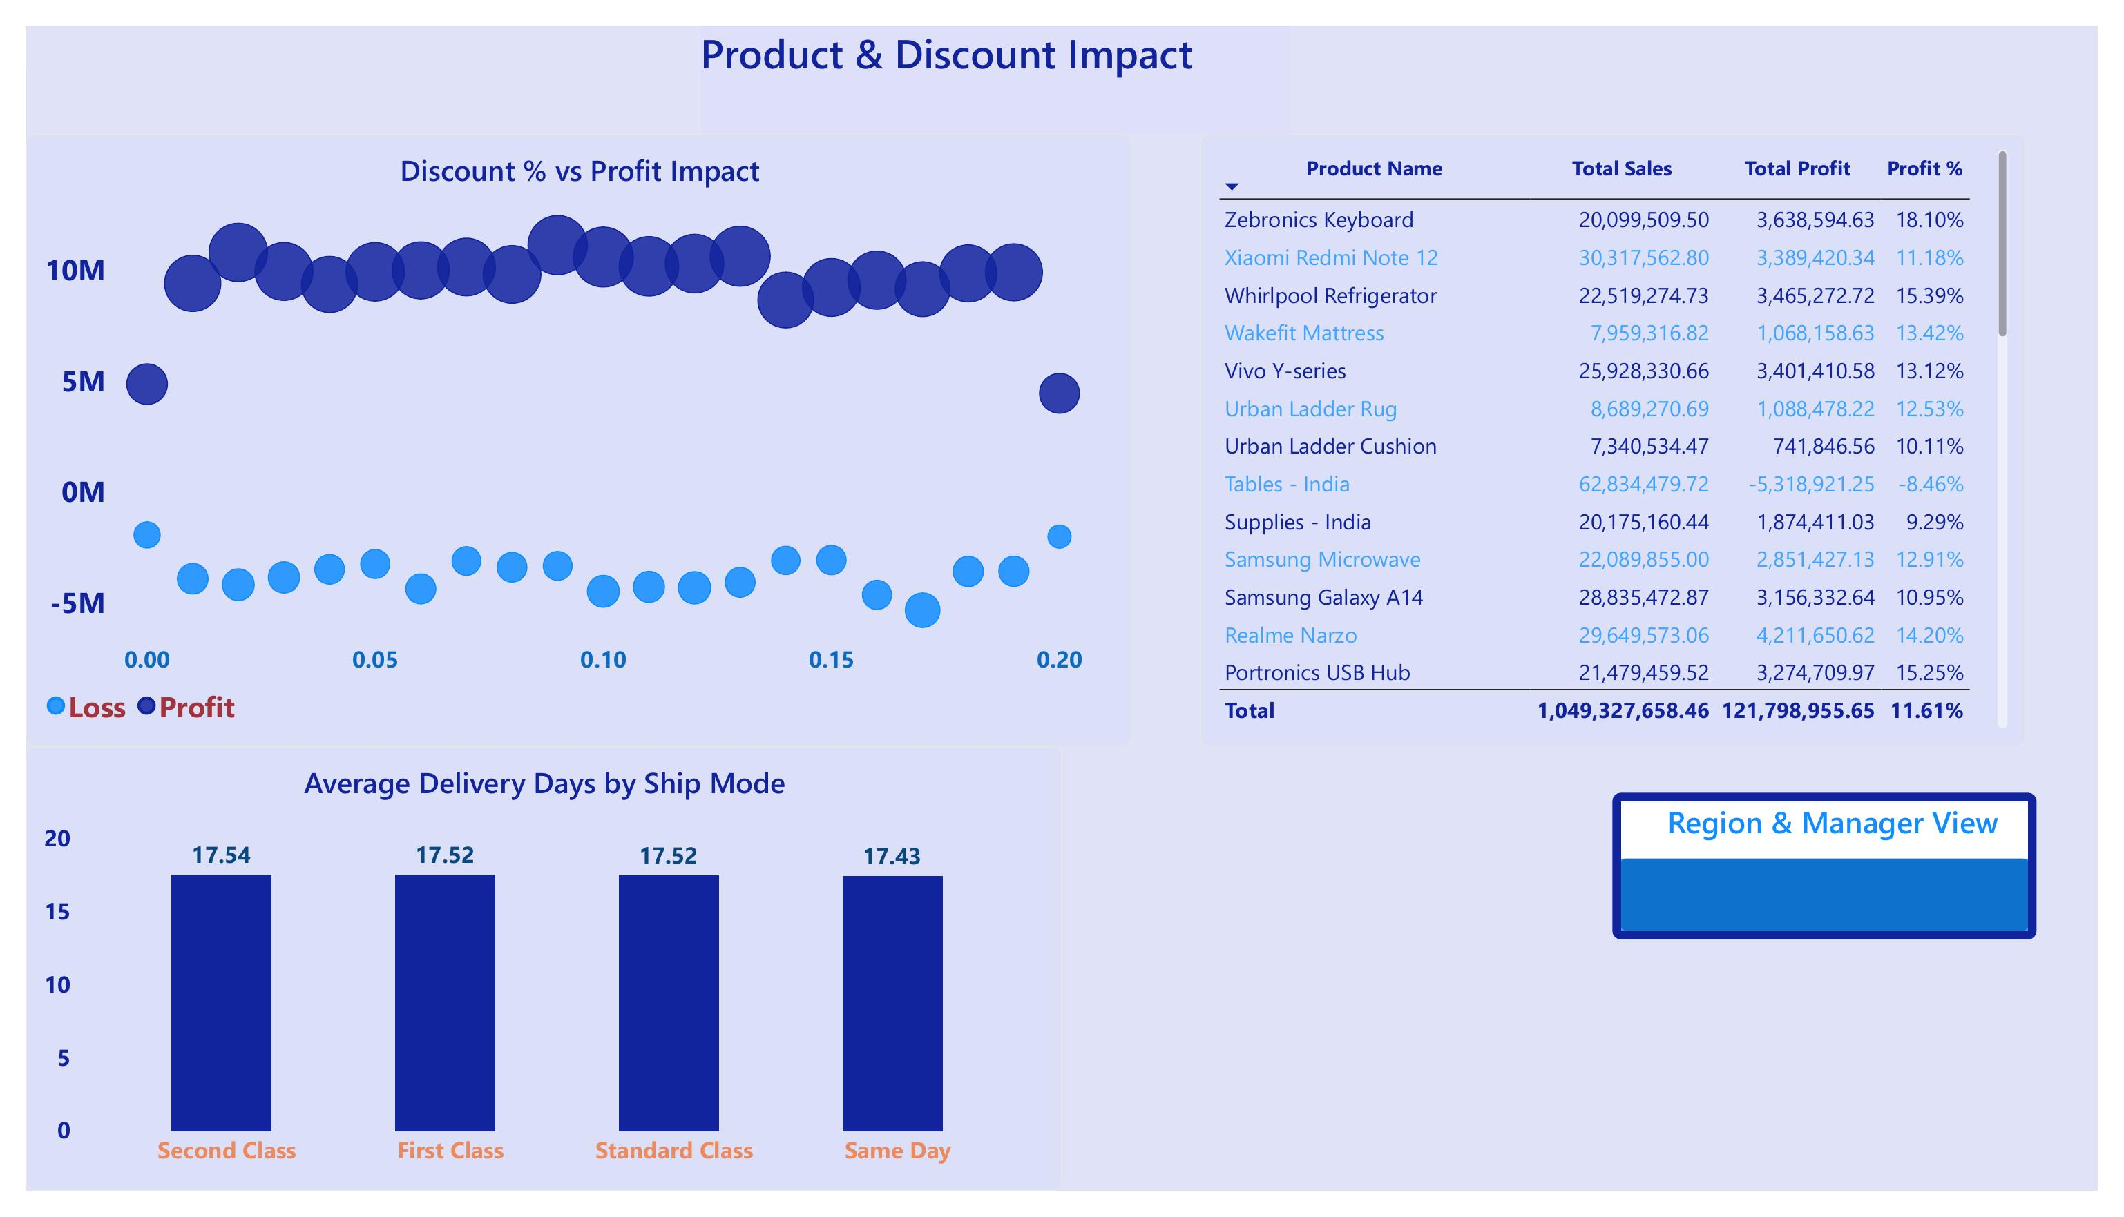
Product & Discount Impact
Key Insights
High discounts don't clearly predict losses — both loss and profit bands span the full 0-20% discount range
Tables - India is the one high-volume product operating at a loss (-8.46% margin) despite 62.8M in sales
All four shipping modes average ~17.5 delivery days — "Same Day" is not meaningfully faster than Standard Class
Zebronics Keyboard and Realme Narzo post the strongest profit percentages among top sellers
Average delivery days are nearly identical (~17–18 days) across all four ship modes, including Same Day — the Ship Mode field likely doesn't reflect real shipping speed in this dataset

Slide 6
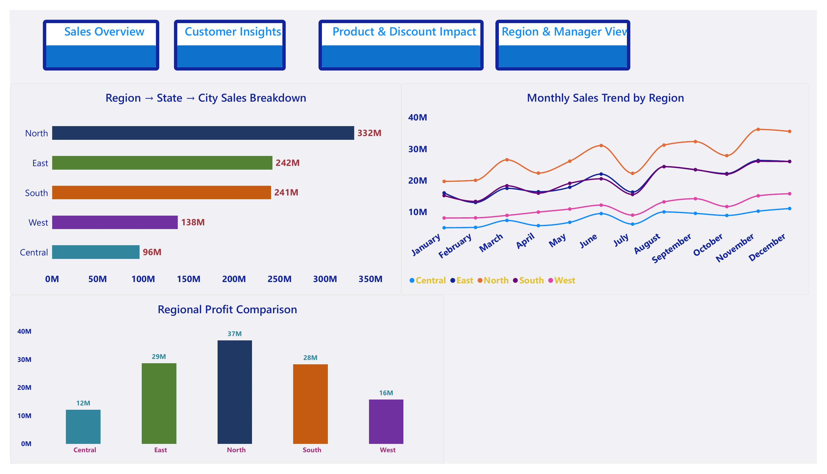
Region & Manager View
Key Insights
North region leads in both sales (332M) and profit (37M), managed by Aniket Sharma
Central region is the weakest performer (96M sales, 12M profit), managed by Nithin Chaturvedi
East and South are closely matched in both sales and profit, suggesting stable mid-tier performance
Navigation buttons (bookmarks) let users jump instantly between all 4 report pages

Slide 7
Interactive Features Summary
Mandatory Phase 4 capabilities implemented across the report
Bookmarks & Navigation
Drill-Through
4 styled buttons let users jump instantly between Sales Overview, Customer Insights, Product & Discount Impact, and Region & Manager View from any page.
Two drill-through pages: right-clicking any customer name opens a Customer Profile page (KPIs + full order history), and right-clicking any region opens a Region Detail page (KPIs filtered to that region alone).
Custom Tooltip
Static RLS
Hovering over any product in the ranking table or scatter plot reveals a rich tooltip card with Product, Sales, Profit, and Profit %.
5 security roles (one per Regional Manager) restrict each manager's view to their own region only, verified via "View as Roles."

Slide 8
Key Business Recommendations
Review discounting policy for underperforming SKUs like Tables - India, since discount level alone does not explain its losses
Investigate delivery operations — all shipping tiers average ~17.5 days, so "Same Day" shipping is not delivering its promised speed advantage
Prioritize a regional turnaround plan for Central, the lowest-performing region on both sales and profit, in partnership with Nithin Chaturvedi
Study and replicate North's success factors (top region under Aniket Sharma) across East, South, and West
Deepen engagement with the Consumer segment (51% of sales) while growing Home Office, currently the smallest contributor at 18%

Slide 9
Thank You
Deliverables: Power BI report (.pbix) | Client-style PPT deck | Final insight summary
Questions & Discussion

