Slide 1
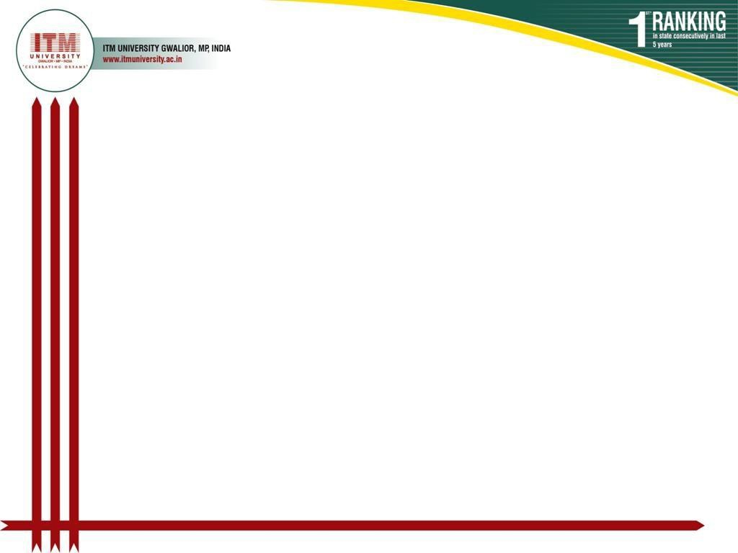

A Minor Project
Transportation & Logistics
Management System
Submitted to :
Submitted by:
PRAGYA JAIN
Assistant Professor, Dept. of CSA, SOET,
ITM University, Gwalior
M. R. V. V. Ramana (Betn1ai23053)
G. Manikanta (BETN1AI23064)
Under the Supervision of: Dr. Aravendra Sharma | Dept. of CSA, ITM University

Slide 2
Table of Contents
1. Broad Area of Work
2. Introduction
3. Literature Survey
4. Existing Gaps
5. Objectives
6. Proposed Methodology
7. Expected Outcome
8. Future Scope
9. References

Slide 3
Broad Area of Work
Domain: Transportation & Logistics Management Systems Field: Supply Chain Management & Information Systems
Vehicle Management
Driver Management
Track and manage fleet information efficiently
Assign drivers and maintain driver records
Shipment Tracking
Route Optimization
Monitor shipment and delivery status
Plan and optimize delivery routes

Slide 4
Introduction
1
Transportation and logistics play a crucial role in the movement of goods from one place to another.
2
Many logistics companies still rely on manual processes, causing delivery delays, poor route planning, and lack of vehicle monitoring.
3
Automated logistics systems can help organizations manage operations through a centralized platform.
4
The proposed system aims to develop a smart Transportation & Logistics Management System that improves efficiency and reduces operational costs.

Slide 5
Literature Survey
System Type | Features | Limitations
Traditional Manual Systems | Simple record-keeping, easy to implement | Error-prone, slow, inefficient
GPS Tracking Systems | Real-time vehicle tracking | High cost, complex setup
Route Optimization Tools | Improved delivery scheduling | Limited integration with other modules
Enterprise TMS | Full supply chain integration | Very expensive, not SME-friendly

Slide 6
Existing Gaps
High Cost
Poor Integration
01
02
Implementation and maintenance costs are prohibitive for small companies
Tracking and route optimization systems lack seamless integration
Limited Accessibility
Complex UI
03
04
Solutions are inaccessible to small and medium logistics companies
Difficult user interfaces hinder day-to-day operations
Weak Analytics
05
Limited reporting capabilities for performance monitoring

Slide 7
Objectives
1
Design and develop a Transportation & Logistics Management System
2
Manage vehicle and driver information efficiently
3
Optimize delivery routes and reduce travel time
4
Monitor shipment and delivery status in real-time
5
Generate reports for better logistics management and decision-making

Slide 8
Proposed Methodology
1
2
3
4
5
6
Requirement
Analysis
System
Design
Database
Design
Frontend
Development
Backend
Development
Testing &
Deployment
Technology Stack
HTML / CSS
JavaScript
Backend Logic
SQL Database
Route Algorithms

Slide 9
Expected Outcome
Efficient Route Planning
Reduced Delivery Delays
Centralized Monitoring
Optimal delivery routes reducing time and fuel costs
Automated scheduling and monitoring minimizes delays
Single dashboard to track all logistics operations
Reduced Manual Work
Better Decision Making
Lower Operational Costs
Digital workflows replace time-consuming manual processes
Data-driven reports support strategic logistics planning
Optimized resources lead to significant cost savings

Slide 10
Future Scope
01 GPS Real-Time Tracking
02 Mobile Applications
Live vehicle location tracking using GPS technology for instant fleet visibility
Dedicated apps for drivers and managers enabling on-the-go operations
03 AI Route Optimization
04 Warehouse Integration
Artificial intelligence to predict and optimize delivery routes dynamically
Full integration with warehouse and inventory management systems

Slide 11
References
[1]
Chopra, S., & Meindl, P. — Supply Chain Management: Strategy, Planning, and Operation. Pearson Education.
[2]
Christopher, M. — Logistics and Supply Chain Management. Pearson.
[3]
Research papers on Transportation Management Systems from IEEE and Google Scholar.
[4]
Online resources related to logistics, supply chain technologies, and route optimization algorithms.

Slide 12
Thank You !

