Slide 1
Case Study
Case study on Lending Club

Slide 2
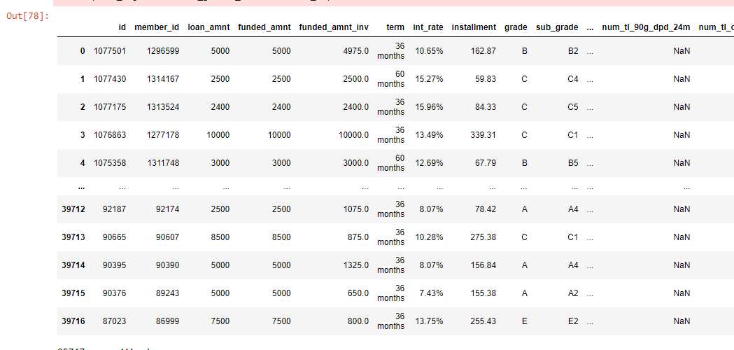
Uploading Data to Analyze
import numpy as np
import pandas as pd
import seaborn as sns
import matplotlib.pylab as plt
df = pd.read_csv("C:\Lending_Class\loan\loan1.csv")
df

Slide 3
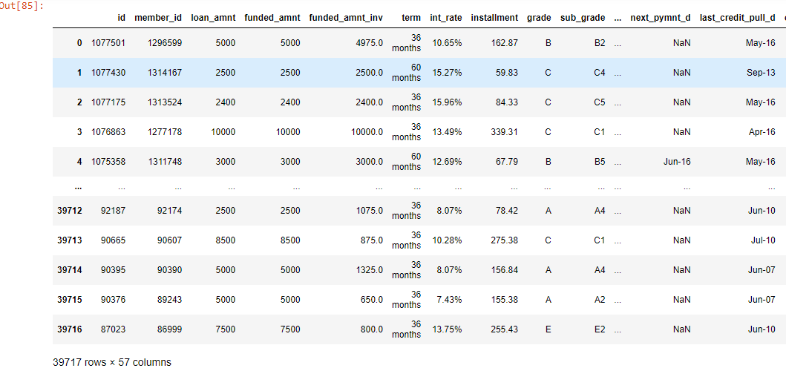
Data cleaning
# delete the rows where the column contains the NAN values
# By cleaning this table about 45 columns would be removed
# it make the analysis little bit handy
# lets use df_1 dataframe for our analysis
cols_to_ignore = ['emp_length']
#df_1=df.dropna(axis=1)
df_1=df.dropna(axis=1,how='all')
df_1

Slide 4
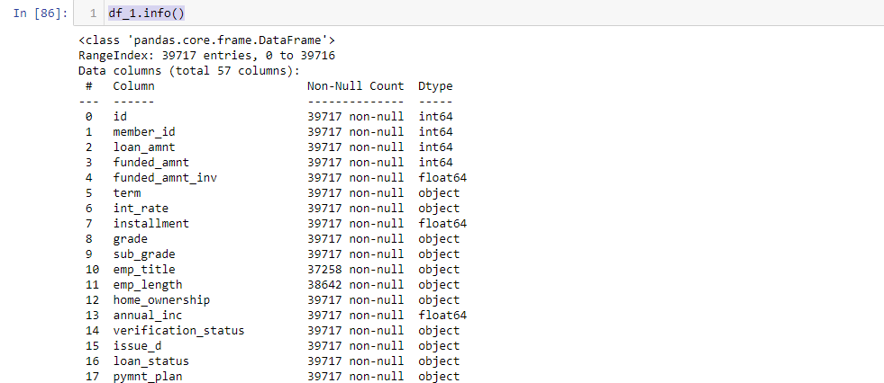
Columns Details
## Data Sourcing - 2
# lets try to understand the columns usage
# data types of the column

Slide 5
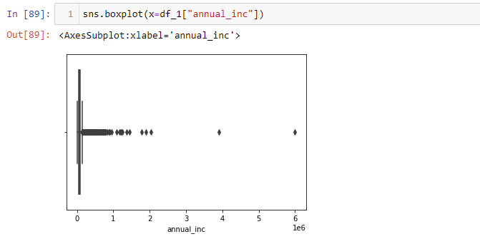
Finding Outliers
#### EDA : Explanatory Data Analysis
# from the above annual data, very very few employees earns 60 Lacs
# this will lay outlayres
# now lets us find the out layers

Slide 6
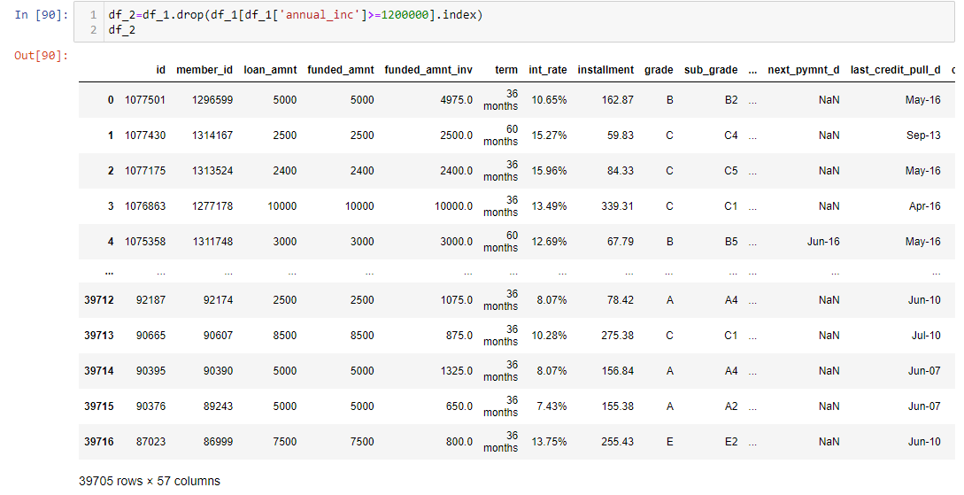
Removing Outliers
## from the above out layers chart,
# Max number of employees are earning less than 10 Lacs
# calculating loan eligibililty based on annual income will not give oppertunity to the employess having less annual income
# compared to the max earner.
### Considering the employees who are earing more than 12 lacs as outliers
# Now our dataframe is df_2

Slide 7
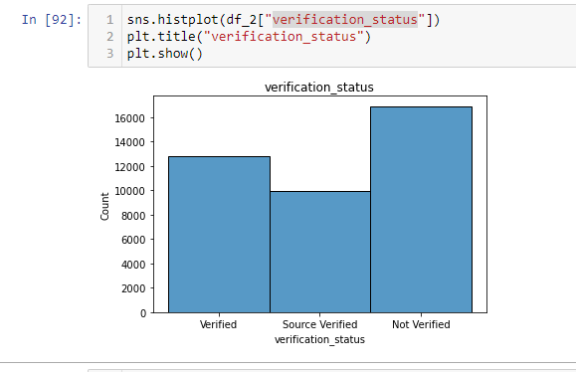
Univariate Analysis with Verification Status
### Univariate Analysis
# Get the chart for Verified users
# Get the char for loan_status# Get the chart for Verified users
# Get the char for loan_status

Slide 8
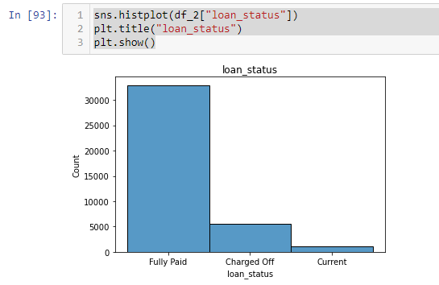
Univariate Analysis on Loan_Status
To get the percentage of loan status

Slide 9
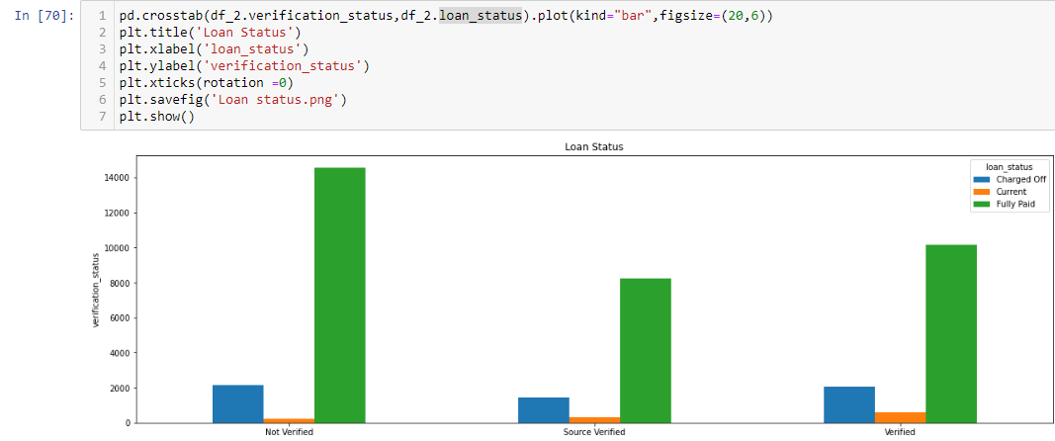
Bivariate Analysis
## Analysis made between the loan_status with respect to verification_status
# this is to understand how many verified user are not defaulters
# We can see max number of applicants are paid their depts promptly irrespective of verification status

Slide 10
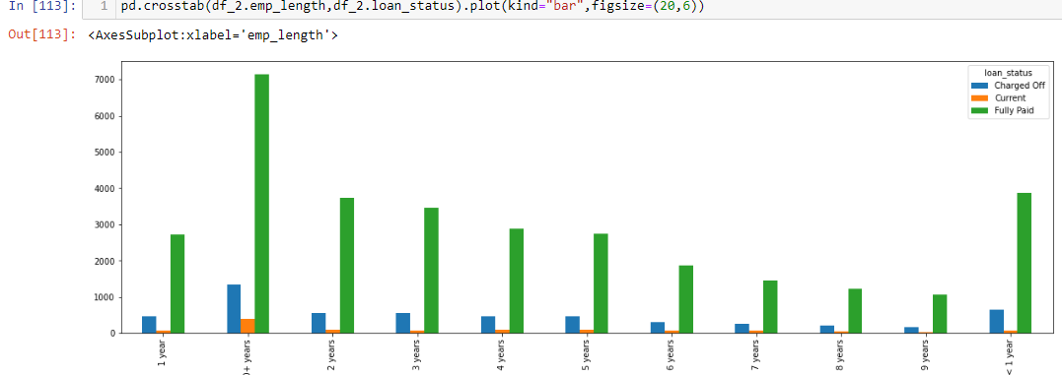
Bivariate Analysis between loan-status wrt Exp
# In the below Bar plots with respect to Annual_Income and Loan_status along with candiates work experience
# We can see higer number of applicants paid fully, at the same time we can notice quitly some high defaulters in all exp levels.
# in such case we can have trade-off for charged_off canditates

Slide 11
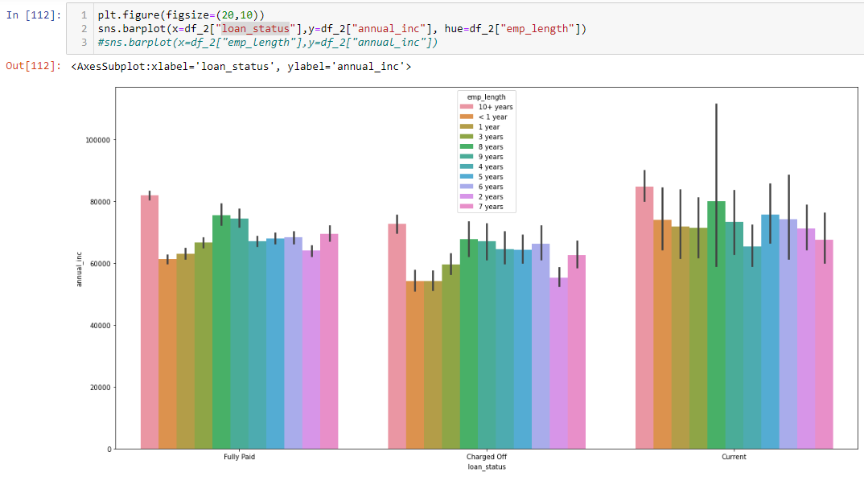
Trade-Off decision
# The trade-off for applicants having charged_off value can be set,
# the loan sanction can be considered for the applicants who are haveing >60K as annual income with trade-off condition
### Condtions
# 1. defaulters : missed payment not more than 3 monthts
# 2. Current loan : 40% of (applicants monthly_income - current_emi)
# 3. Fully Paid : requested amount can be granted

Slide 12
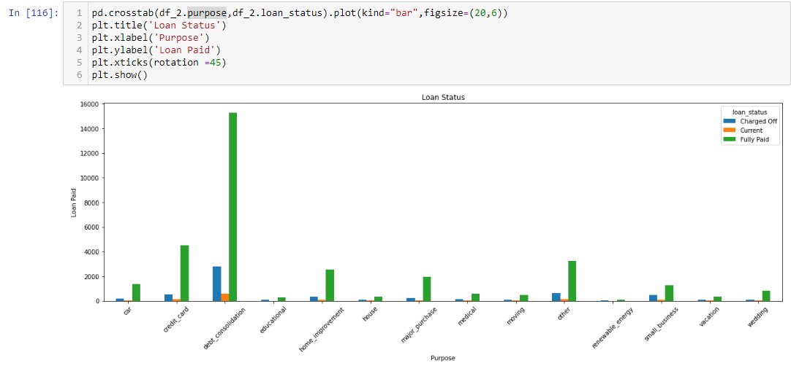
Understanding on Loan Recovery
## From the below gragh we can notice loan recovery is high for Balance Transfer applicants

Slide 13
Thank You

