Slide 1

CAMPUS ASSET CUSTODY & RECOVERY
EYE OF ODIN
An AI recovery engine for the campus Lost & Found Item Tracker — built to
recognize objects, not people.
TEAM 17
Bandla Vinay 2520030437 · Hansika Reddy Gunapati 2520030237 · Teja Hasini 2520030048
Guide: Dr. S. Spandana
PHASES 0 – 4 · PROTOTYPE REVIEW

Slide 2
THE PROBLEM
Every campus has one.
Ours remembers.
✕
Reports vanish
Forms and spreadsheets nobody revisits.
Every college eventually builds a lost-and-found tracker — a form, a spreadsheet, a bulletin board nobody checks. It solves nothing. Items sit in a drawer until someone happens to notice a match by chance.
We asked a different question: what if the system itself could recognize a lost object the moment someone reports finding it? Not by watching people — by recognizing things, described and photographed the way a student would actually describe them to a friend.
✕
No memory
Matching depends entirely on luck and timing.
✕
Zero intelligence
Every generic tracker looks and works the same.
02

Slide 3

THE CONCEPT
Meet the engine behind
the registry.
Eye of Odin isn’t a separate app — it’s the intelligence layer quietly running underneath every report filed. Upload a photo and a few details, and the engine extracts a visual and textual fingerprint for that object, searchable against everything already reported.
The inspiration came from fictional systems that correlate scattered data into an answer — minus the surveillance. We build for objects, not people: no faces, no tracking, no watching. Just a system that notices better than a bulletin board ever could.
03

Slide 4
PHASE 0
The Skeleton
Before any intelligence, the registry needed a spine: a locked schema of ten fields, eight item categories, ten campus zones. A tested FastAPI backend handling reports and image uploads. A frontend shell simple enough to submit and browse. No shortcuts — every endpoint was verified against real data before a single line of AI code was written.
01
02
03
Schema
Backend
Frontend
10 fields, locked taxonomy
FastAPI CRUD, tested
Submit, browse, filter
04

Slide 5
PHASE 1
Teaching it to recognize
Every uploaded photo becomes a 512-dimension embedding via CLIP — a numeric fingerprint of what the object looks like. A fusion formula blends that visual signal with category, color, and description matches into one confidence score.
Tested against a labeled set of true and false matches, the formula separated real pairs from false ones by nearly fifty points.
A 96% vs. 47% gap is the whole product — the difference between a hunch and an answer.
05

Slide 6
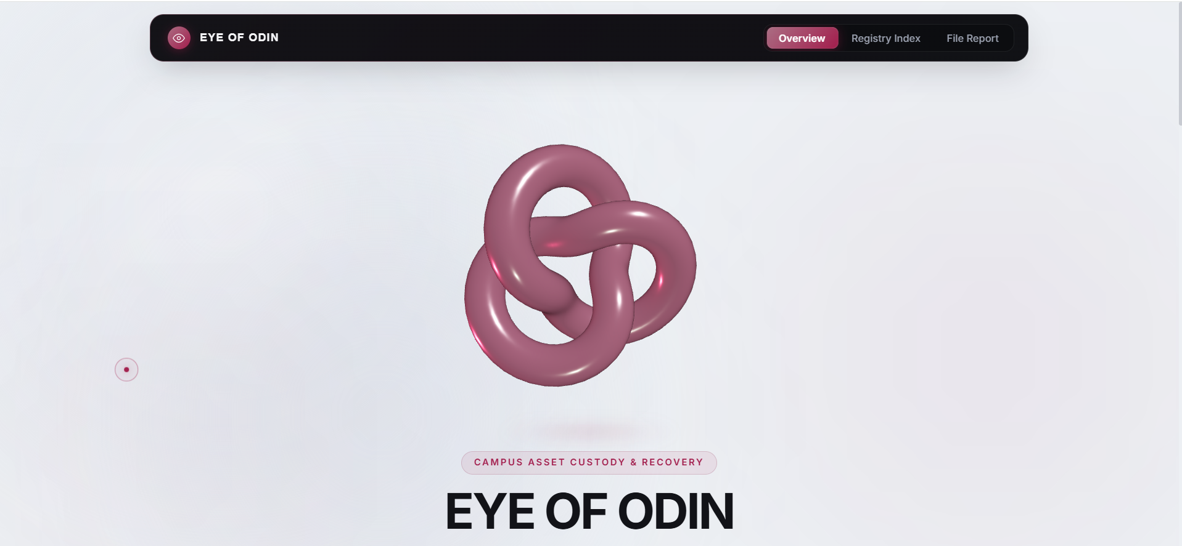
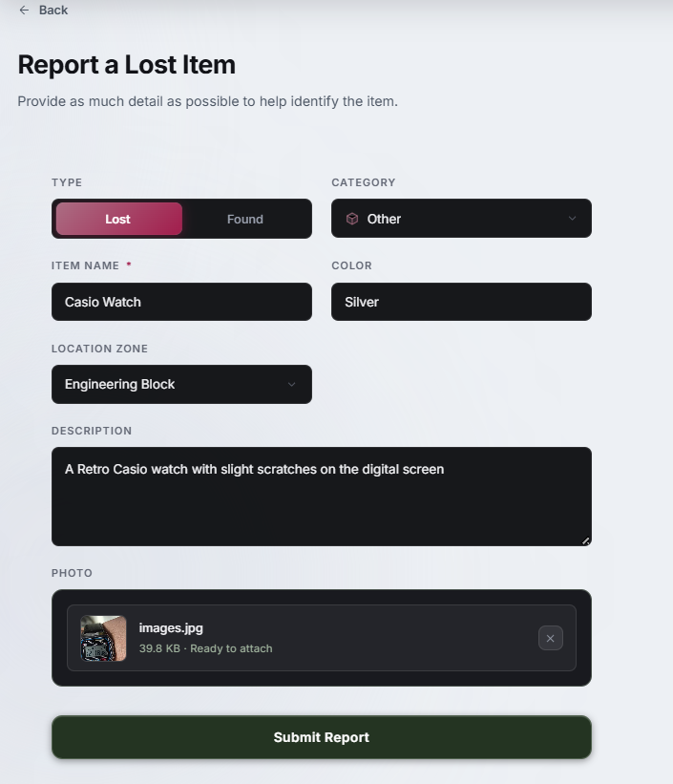
INSIDE THE REGISTRY
What it actually looks like
The Overview — first impression, zero clutter.
Filing a report — every field the engine actually uses.
06

Slide 7
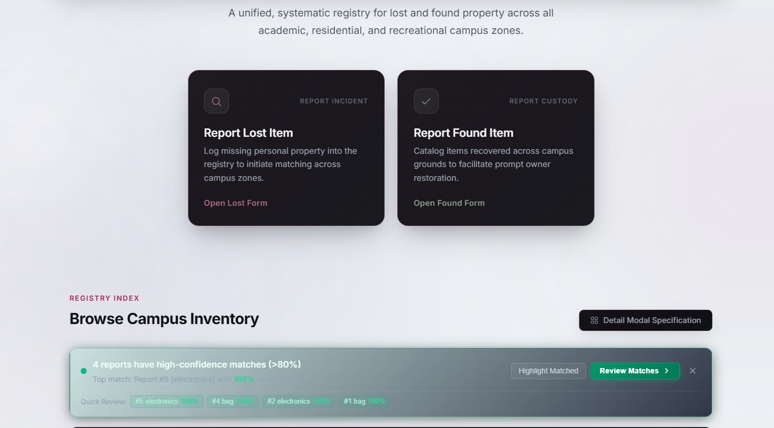
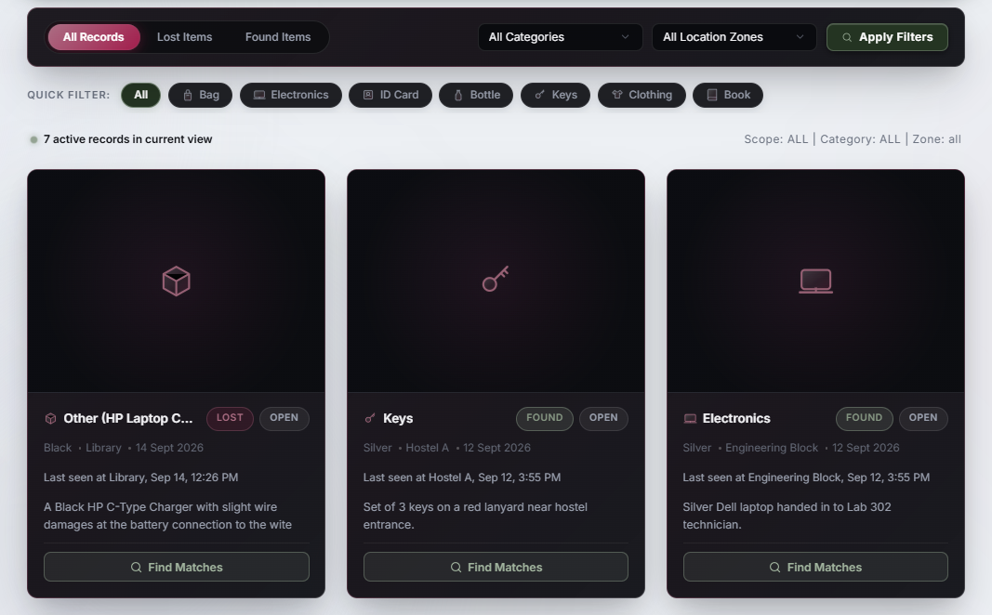
PHASE 2
Making it feel alive
Polish isn’t decoration — it’s confidence. Reports now read “last seen at Library, Sep 14, 12:26 PM” instead of a raw timestamp. A consistency pass unified every card and badge into one visual language. And when a report crosses 80% confidence, the registry surfaces it before anyone goes looking — four items were already waiting the day this was tested.
The system speaks first — high-confidence matches surfaced automatically.
Registry Index — browsing lost and
found side by side.
07

Slide 8
PHASE 3
Where we drew the line
The original inspiration flirted with camera-fed surveillance. We didn’t build that — and we’re not going to. What we built instead: a prototype pipeline of frame extraction, detection, tracking, and embedding, proven entirely on public datasets, never on real campus footage.
!
No institutional sign-off exists for real footage, and none should be assumed.
If this project ever approaches a university about camera access, it happens after this document — not instead of it.
08

Slide 9
PHASE 4
Privacy by design, not
by afterthought
None of this was bolted on after a demo. It exists because a system built to find objects should never quietly become a system that tracks people — and provable boundaries matter more than promised ones.
▤
▣
☷
Retention Policy
Access Control
Audit Log Design
What’s stored, and for how long.
Who can see a full report, and when.
Every sensitive action, traceable.
09

Slide 10
EXECUTION
Three people, no idle hands
The heaviest, most failure-prone work — matching accuracy and visual polish — stayed with the core builder, verified end-to-end with real precision numbers, not assumptions. Nobody waited on anybody. Nothing touched real surveillance data at any point.
A
B
C
Core Build
CV Prototype
Ethics Docs
Matching engine verified, dashboard polish, notifications.
Camera pipeline proven on public data — zero legal exposure.
Retention, access control, and audit logging — the work most teams skip.
10

Slide 11
BEYOND THE SEMESTER
Strip away the classroom deadline and the same matching engine still works — for lab equipment that walks off, library books, conference lost-and-founds, even insurance verification of where an item actually was.
This was never really about lost backpacks. It’s a provenance engine for physical objects — one that happens to start, quietly and ethically, with a campus that’s tired of a drawer nobody checks.
EYE OF ODIN

