Slide 1
MACHINE LEARNING · 25SC2107E · Y25 TRIMESTER 4
MATCH STATE
Multi-Class Match Result Prediction Using Multinomial Logistic Regression
SECTION NO.
TEAM NO.
09
21
PROJECT TEAM
PROJECT GUIDE
Vinay Bandla
Roll No. 2520030437
S. Pujith Pavan Kumar
Roll No. 2520030029
Rani Medidha
KL University · Department of CSE

Slide 2
01
THE PROBLEM
Sports prediction is usually guesswork — broadcasters and fantasy platforms lean on gut feel, not data.
3
OUTCOME CLASSES
Match State replaces intuition with Multinomial Logistic Regression — a statistical classifier that scores three outcomes at once (Win, Loss, Draw) instead of forcing a binary call. Trained on historical fixtures using team form, head-to-head records, and home advantage, it learns feature–outcome relationships and outputs calibrated probabilities for any future match. The pipeline spans pre-processing, feature engineering, training, and evaluation via accuracy, precision, recall, and confusion matrices — surfaced through an explainable, interactive interface.
Win · Draw · Loss modelled as a single softmax distribution — not three separate guesses.
MATCH STATE
02

Slide 3
02
SYSTEM ARCHITECTURE
Raw fixture data flows through feature engineering into a softmax-activated multinomial estimator, producing live win / draw / loss probabilities.
Kaggle / SQLite Historical Data
Feature Extraction & Standardizer
Home / Away Advantage
Recent Form Momentum
Head-to-Head Ratio
Softmax Linear Layer
Multinomial Estimator
Win
Draw
Loss
Streamlit Interactive Interface
MATCH STATE
03

Slide 4
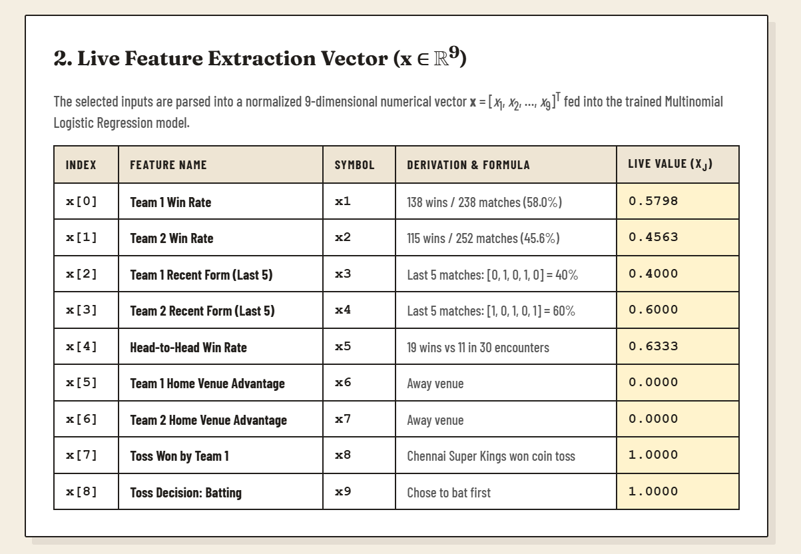
03
FEATURE VECTOR — X ∈ ℝ⁹
Nine standardized signals — win rates, recent form, head-to-head ratio, home advantage, and toss outcome — are packed into one input vector before the model ever sees a fixture.
MATCH STATE
04

Slide 5
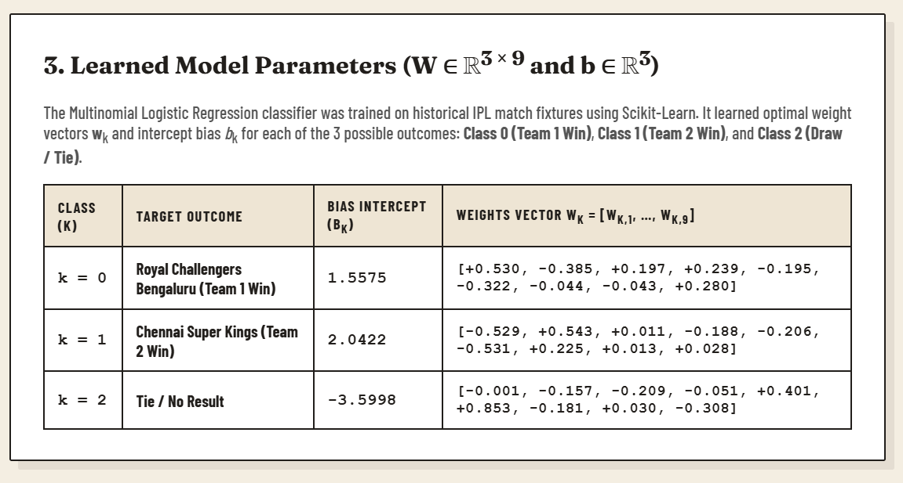
04
LEARNED MODEL PARAMETERS
Scikit-learn fits a 3×9 weight matrix and three bias terms — one row per class — mapping every feature to its pull on Win, Draw, and Loss.
MATCH STATE
05

Slide 6
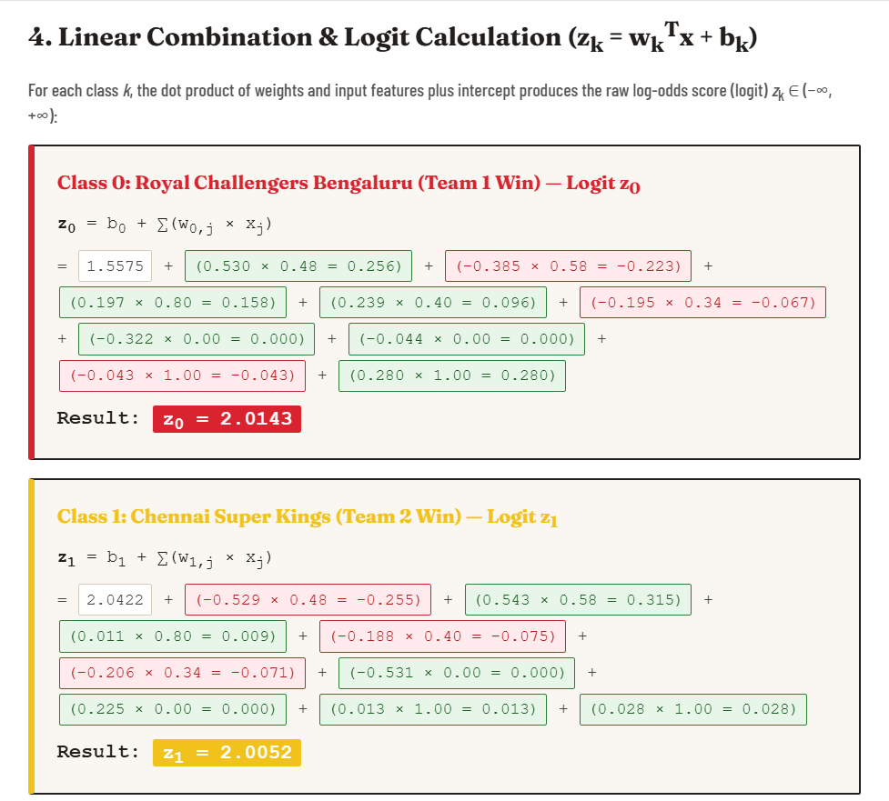
05
LOGIT CALCULATION
Each class score zₖ is a weighted sum of the nine features plus a bias — the raw, unbounded log-odds before probability enters the picture.
MATCH STATE
06

Slide 7
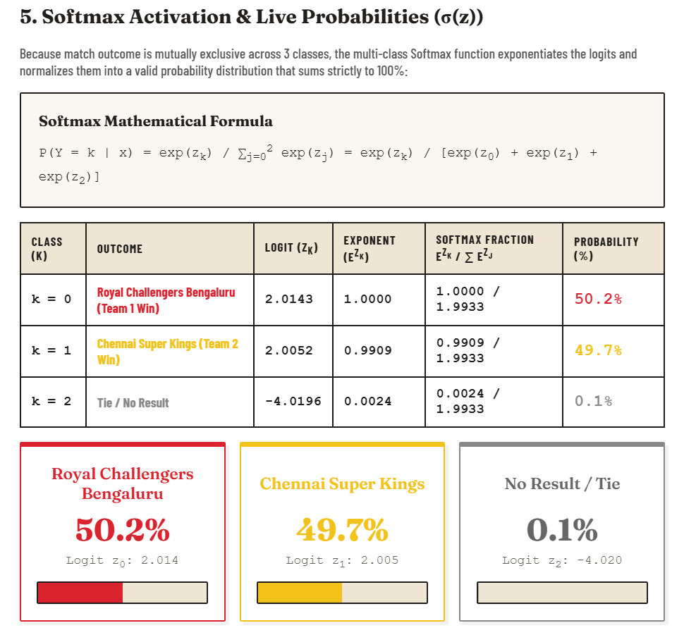
06
SOFTMAX PROBABILITIES
Softmax exponentiates and normalizes the three logits into probabilities that sum to exactly 100% — RCB 50.2%, CSK 49.7%, tie a razor-thin 0.1%.
MATCH STATE
07

Slide 8
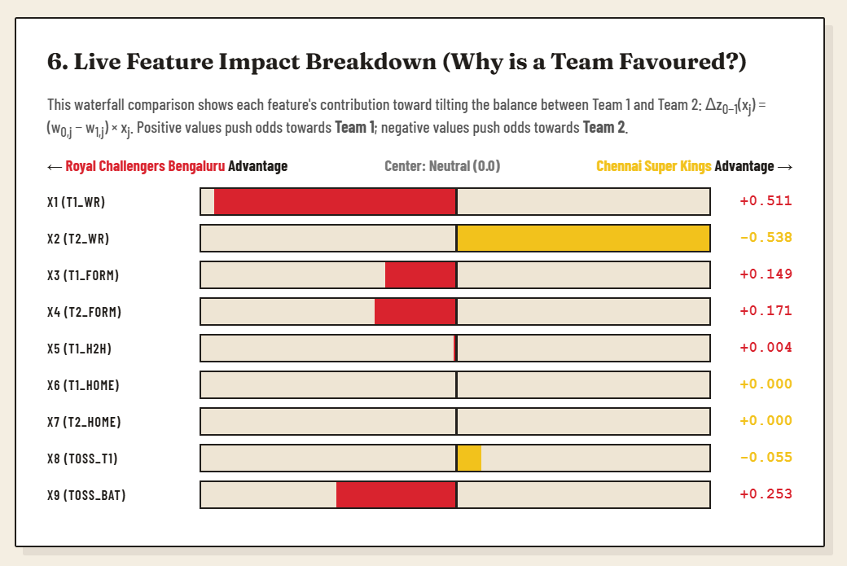
07
FEATURE IMPACT BREAKDOWN
A live waterfall shows exactly which feature tilts the game — Team 1 win rate and toss-to-bat favour RCB, Team 2 win rate pulls hardest toward CSK.
MATCH STATE
08

Slide 9
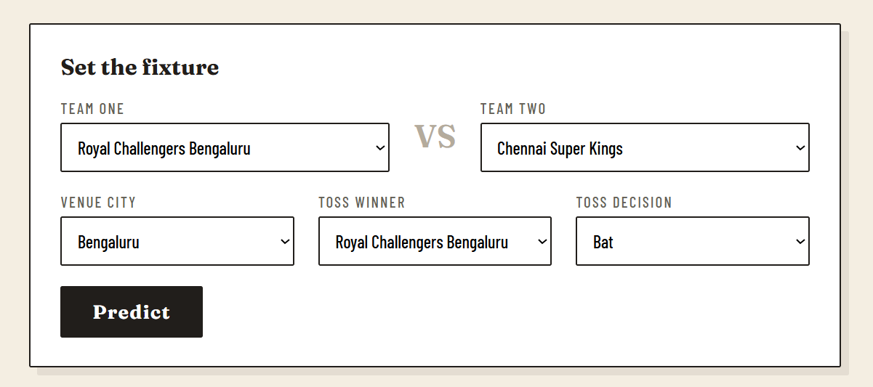
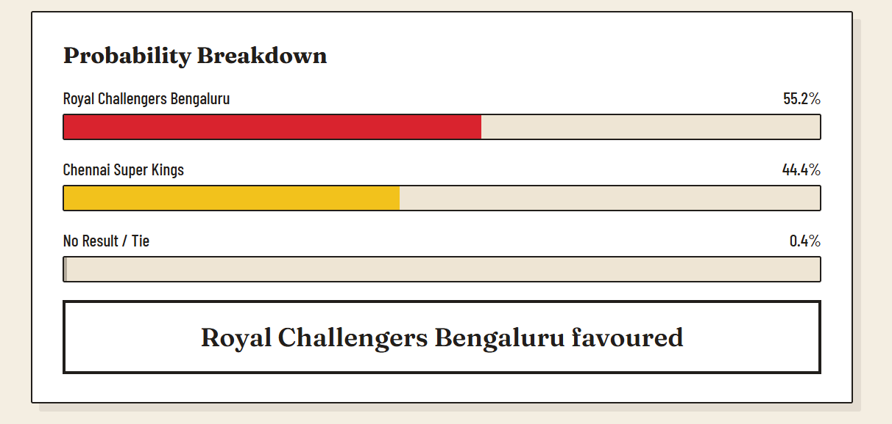
08
LIVE PREDICTION DEMO
Set any fixture, venue, toss winner, and decision — Match State returns instant, explainable win probabilities through a clean Streamlit interface.
MATCH STATE
09

Slide 10
THANK YOU
Questions on the math, the data, or the deployment — happy to walk through any layer.
TECH STACK
Python · NumPy / Pandas · Scikit-learn · Streamlit · SQLite · Git & GitHub
PROJECT TEAM · SEC 09 · TEAM 21
Vinay Bandla
2520030437
S. Pujith Pavan Kumar
2520030029
KL University · Machine Learning (25SC2107E) · Y25 — 2026-2027 Trimester 4

