Slide 1

Programming with Java
Instructor : Neelima Gupta
Notes:
First Class: Introduction, Prerequisites, Advices, Syllabus
Lab 1: Create a Java Project, Compile, and Run.
Show syntax errors
Print program
Capture screen shots, and save it in Word, and print it.
Homework One: Check in the class randomly.

Slide 2
Introduction to Java
What Is Java?
Getting Started With Java Programming
  Create, Compile and Running a Java Application

Slide 3
Characteristics of Java
Java is simple
Java is object-oriented
Java is distributed
Java is interpreted
Java is robust
Java is secure
Java is architecture-neutral
Java is portable
Java’s performance
Java is multithreaded
Java is dynamic

Slide 4
Getting Started with Java Programming
A Simple Java Application
Compiling Programs
Executing Applications

Slide 5
A Simple Application
Example 1.1
//This application program prints Welcome
//to Java!
package chapter1;
public class Welcome {
public static void main(String[] args) {
System.out.println("Welcome to Java!");
}
}

Slide 6
Anatomy of a Java Program
Comments
Reserved words
Modifiers
Statements
Blocks
Classes
Methods
The main method
The exit method

Slide 7
Comments
In Java, comments are preceded by two slashes (//) in a line, or enclosed between /* and */ in one or multiple lines. When the compiler sees //, it ignores all text after // in the same line. When it sees /*, it scans for the next */ and ignores any text between /* and */.

Slide 8
Reserved Words
Reserved words or keywords are words that have a specific meaning to the compiler and cannot be used for other purposes in the program. For example, when the compiler sees the word class, it understands that the word after class is the name for the class. Other reserved words in Example 1.1 are public, static, and void. Their use will be introduced later.

Slide 9
Modifiers
Java uses certain reserved words called modifiers that specify the properties of the data, methods, and classes and how they can be used. Examples of modifiers are public and static. Other modifiers are private, final, abstract, and protected. A public datum, method, or class can be accessed by other programs. A private datum or method cannot be accessed by other programs.

Slide 10
Statements
A statement represents an action or a sequence of actions. The statement System.out.println("Welcome to Java!"); in the program in Example 1.1 is a statement to display the greeting "Welcome to Java!" Every statement in Java ends with a semicolon (;).

Slide 11

Blocks
A pair of braces in a program forms a block that groups components of a program.

Slide 12
Classes
The class is the essential Java construct. A class is a template or blueprint for objects.
A java program is defined by using one or more classes.

Slide 13
Methods
What is System.out.println? It is a method: a collection of statements that performs a sequence of operations to display a message on the console.
It can be used even without fully understanding the details of how it works.
It is used by invoking a statement with a string argument. The string argument is enclosed within parentheses. In this case, the argument is "Welcome to Java!"
You can call the same println method with a different argument to print a different message.

Slide 14
main Method
The main method provides the control of program flow. The Java interpreter executes the application by invoking the main method.
The main method looks like this:
public static void main(String[] args) {
// Statements;
}

Slide 15
The exit Method
Use Exit to terminate the program and stop all threads.
When your program starts, a thread is spawned to run the program. To terminate the thread, you have to invoke the exit method.

Slide 16
Primitive Data Types and Operations
Introduce Programming with an Example
Identifiers, Variables, and Constants
Primitive Data Types
  byte, short, int, long, float, double, char, boolean
Expressions
Operators, Precedence, Associativity, Operand Evaluation Order: ++, --, *, /, %, +=, -=, *=, /=, %=, ^, &, |, +, -,
Getting Input from Input Dialog Boxes
Case Studies (Computing Mortgage, and Computing Changes)
Style and Documentation Guidelines
Syntax Errors, Runtime Errors, and Logic Errors

Slide 17
Identifiers
An identifier is a sequence of characters that consist of letters, digits, underscores (_), and dollar signs ($).
An identifier must start with a letter, an underscore (_), or a dollar sign ($). It cannot start with a digit.
An identifier cannot be a reserved word. (See Appendix A, “Java Keywords,” for a list of reserved words).
An identifier cannot be true, false, or
null.
An identifier can be of any length.

Slide 18
Variables
// Compute the first area
radius = 1.0;
area = radius*radius*3.14159;
System.out.println("The area is “ + area + " for radius "+radius);
// Compute the second area
radius = 2.0;
area = radius*radius*3.14159;
System.out.println("The area is “ + area + " for radius "+radius);

Slide 19
Declaring Variables
int x; // Declare x to be an
// integer variable;
double radius; // Declare radius to
// be a double variable;
char a; // Declare a to be a
// character variable;

Slide 20
Numerical Data Types (p.33)
byte 8 bits
short 16 bits
int 32 bits
long 64 bits
float 32 bits
double 64 bits

Slide 21
Assignment Statements
x = 1; // Assign 1 to x;
radius = 1.0; // Assign 1.0 to radius;
a = 'A'; // Assign 'A' to a;

Slide 22
Declaring and Initializing in One Step
int x = 1;
double d = 1.4;
float f = 1.4;
Is this statement correct?

Slide 23
Constants
final datatype CONSTANTNAME = VALUE;
final double PI = 3.14159;
final int SIZE = 3;

Slide 24
Operators
+, -, *, /, and %
5/2 yields an integer 2.
5.0/2 yields a double value 2.5
5 % 2 yields 1 (the remainder of the division)
5.0 % 2 is not defined : modulo is defined only for integers.

Slide 25
NOTE
Calculations involving floating-point numbers are approximated because these numbers are not stored with complete accuracy. For example,
System.out.println(1 - 0.1 - 0.1 - 0.1 - 0.1 - 0.1);
displays 0.5000000000000001, not 0.5, and
System.out.println(1.0 - 0.9);
displays 0.09999999999999998, not 0.1. Integers are stored precisely. Therefore, calculations with integers yield a precise integer result.

Slide 26
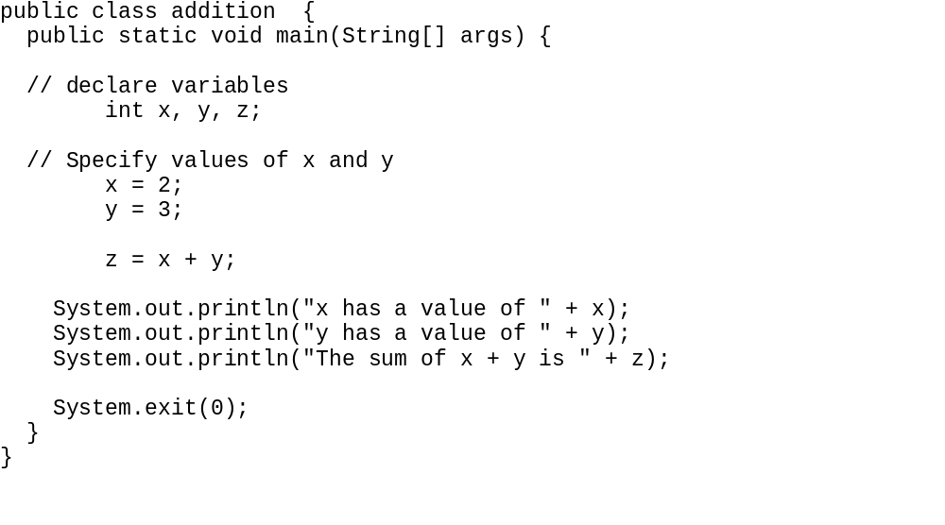
Example Program 1: Addition

Slide 27
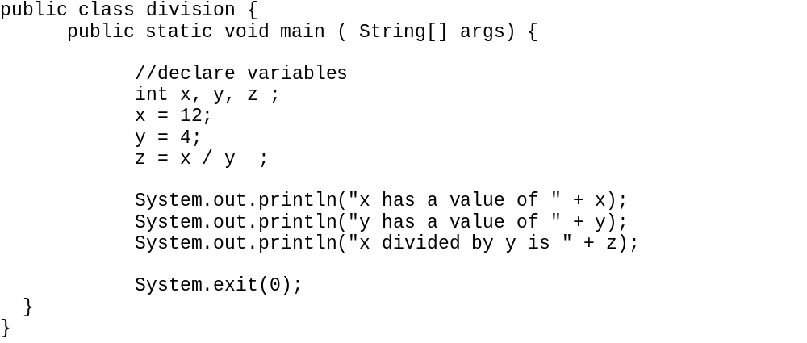
Example Program 2 : Division

Slide 28
Download Java
From www.java.sun.com/j2se
Click on j2se 5.0
See on your right (popular downloads) ..click on j2se 5.0
Click on download jdk 5.0 update 3
Accept the agreement and continue
Download the version as per your platform
For example, for Windows click on Windows offline installation – this will download the required file .. This will take a lot of time .. depending upon the speed of your line .. Once downloaded ..run this file to install Java

Slide 29
Compiling and Running a Java Program
Java source code files (files with a .java extension) are compiled into a format called bytecode (files with a .class extension), which can then be executed by a Java interpreter. Compiled Java code can run on most computers because Java interpreters and runtime environments, known as Java Virtual Machines (VMs), exist for most operating systems, including UNIX, the MACintosh OS, and Windows. Bytecode can also be converted directly into machine language instructions by a just-in-time compiler (JIT).

Slide 30
For Example
Create a file named say .. addition.java using some editor say wordpad.
From the command line type the following
  javac addition.java (java code compiled to a bytecode)
A file called addition.class(bytecode) is created,
Now type
  java addition (bytecode being executed by java interpreter)
  And you will get the results

Slide 31
Number Literals
A literal is a constant value that appears directly in the program. For example, 34, 1,000,000, and 5.0 are literals in the following statements:
int i = 34;
long l = 1000000;
double d = 5.0;

Slide 32
Integer Literals
An integer literal can be assigned to an integer variable as long as it can fit into the variable. A compilation error would occur if the literal were too large for the variable to hold. For example, the statement byte b = 1000 would cause a compilation error, because 1000 cannot be stored in a variable of the byte type.
An integer literal is assumed to be of the int type, whose value is between -2³¹ (-2147483648) to 2³¹–1 (2147483647). To denote an integer literal of the long type, append it with the letter L or l. L is preferred because l (lowercase L) can easily be confused with 1 (the digit one).

Slide 33
Floating-Point Literals
Floating-point literals are written with a decimal point. By default, a floating-point literal is treated as a double type value. For example, 5.0 is considered a double value, not a float value. You can make a number a float by appending the letter f or F, and make a number a double by appending the letter d or D. For example, you can use 100.2f or 100.2F for a float number, and 100.2d or 100.2D for a double number.

Slide 34
Scientific Notation
Floating-point literals can also be specified in scientific notation, for example, 1.23456e+2, same as 1.23456e2, is equivalent to 123.456, and 1.23456e-2 is equivalent to 0.0123456. E (or e) represents an exponent and it can be either in lowercase or uppercase.

Slide 35

Arithmetic Expressions
is translated to
(3+4*x)/5 – 10*(y-5)*(a+b+c)/x + 9*(4/x + (9+x)/y)

Slide 36
Shortcut Assignment Operators
Operator Example Equivalent
+= i+=8 i = i+8
-= f-=8.0 f = f-8.0
*= i*=8 i = i*8
/= i/=8 i = i/8
%= i%=8 i = i%8

Slide 37
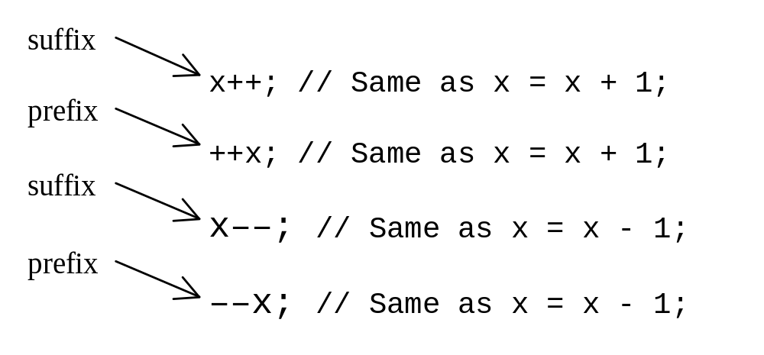
Increment and
Decrement Operators

Slide 38
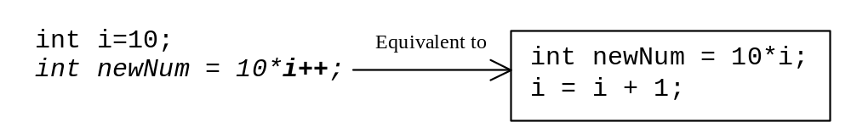
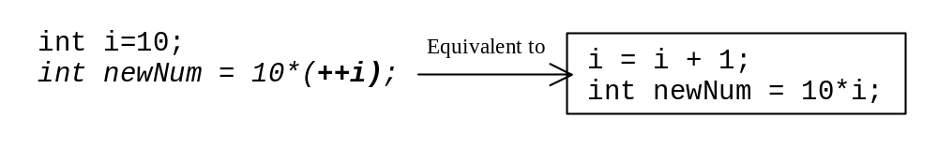
Increment and
Decrement Operators, cont.

Slide 39
Increment and
Decrement Operators, cont.
Using increment and decrement operators makes expressions short,
but it also makes them complex and difficult to read.
Avoid using these operators in expressions that modify multiple variables, or the same variable for multiple times such as this: int k = ++i + i. Its not a good programming practice.

Slide 40
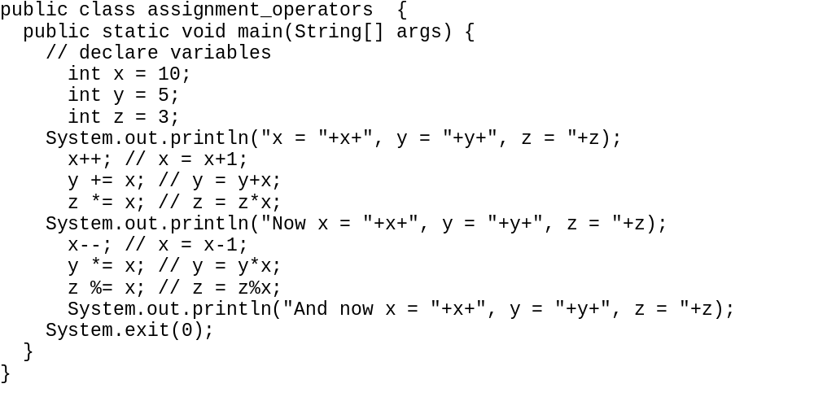

Slide 41
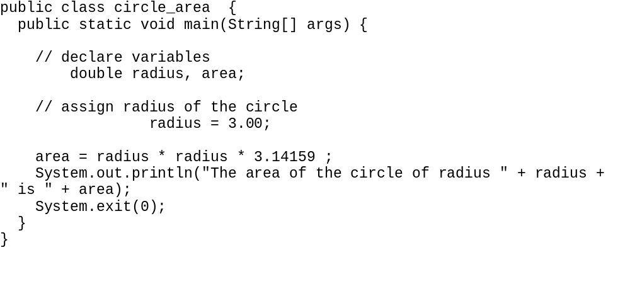

Slide 42
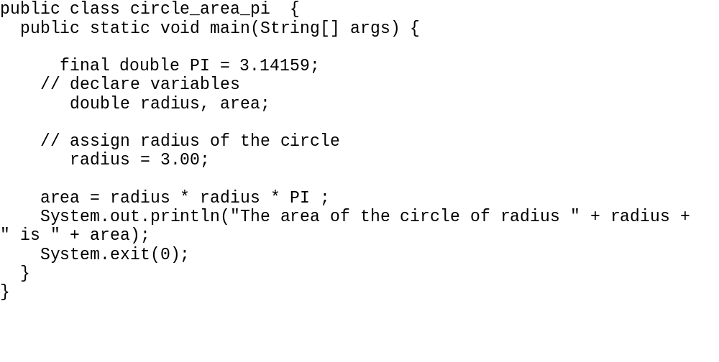

Slide 43
Assignment Expressions and Assignment Statements
Prior to Java 2, all the expressions can be used as statements. Since Java 2, only the following types of expressions can be statements:
variable op= expression; // Where op is +, -, *, /, or %
++variable;
variable++;
--variable;
variable--;

Slide 44
Numeric Type Conversion
Consider the following statements:
byte i = 100;
long k = i*3+4;
double d = i*3.1+k/2;
int x = k; //(Wrong)
long k = x; //(fine,implicit casting)

Slide 45
Type Casting
double
float
long
int
short
byte

Slide 46
Type Casting, cont.
Implicit casting
double d = 3; (type widening)
Explicit casting
int i = (int)3.0; (type narrowing)
What is wrong? int x = 5/2.0;

Slide 47
Answer
Needs explicit type cast
int x = (int) 5/2.0;

Slide 48
Character Data Type
char letter = 'A'; (ASCII)
char numChar = '4'; (ASCII)
char letter = '\u0041'; (Unicode)
char numChar = '\u0034'; (Unicode)
Special characters
char tab = ‘\t’;

Slide 49
Unicode Format
Description Escape Sequence Unicode
Backspace \b \u0008
Tab \t \u0009
Linefeed \n \u000a
Carriage return \r \u000d

Slide 50

Appendix B: ASCII Character Set
ASCII Character Set is a subset of the Unicode from \u0000 to \u007f

Slide 51

ASCII Character Set, cont.
ASCII Character Set is a subset of the Unicode from \u0000 to \u007f

Slide 52
Casting between char and Numeric Types
int i = 'a'; // Same as int i = (int)'a';
char c = 97; // Same as char c = (char)97;

Slide 53
The boolean Type and Operators
boolean lightsOn = true;
boolean lightsOn = false;
boolean b = (1 > 2);
&& (and) (1 < x) && (x < 100)
|| (or) (lightsOn) || (isDayTime)
! (not) !(isStopped)

Slide 54
Comparison Operators
Operator Name
< less than
<= less than or equal to
> greater than
>= greater than or equal to
== equal to
!= not equal to

Slide 55
Boolean Operators
Operator Name
! not
&& and
|| or
^ exclusive or

Slide 56
Truth Table for Operator !
Truth Table for Operator !
Operand !Operand
true false
false true

Slide 57
Truth Table for Operator &&
Operand1 Operand2 Operand1 && Operand2
false false false
false true false
true false false
true true true

Slide 58
Truth Table for Operator ||
Operand1 Operand2 Operand1 || Operand2
false false false
false true true
true false true
true true true

Slide 59
Operator Precedence
How to evaluate
3 + 4 * 4 > 5 * (4 + 3) - ++i

Slide 60
Operator Precedence
var++, var--
+, - (Unary plus and minus), ++var,--var
(type) Casting
! (Not)
*, /, % (Multiplication, division, and modulus)
+, - (Binary addition and subtraction)
<, <=, >, >= (Comparison)
==, !=; (Equality)
& (Unconditional AND)
^ (Exclusive OR)
| (Unconditional OR)
&& (Conditional AND) Short-circuit AND
|| (Conditional OR) Short-circuit OR
=, +=, -=, *=, /=, %= (Assignment operator)

Slide 61
Operator Associativity
When two operators with the same precedence are evaluated, the associativity of the operators determines the order of evaluation. All binary operators except assignment operators are left-associative.
a – b + c – d is equivalent to ((a – b) + c) – d
Assignment operators are right-associative. Therefore, the expression
a = b += c = 5 is equivalent to a = (b += (c = 5))

Slide 62
Operand Evaluation Order
The precedence and associativity rules specify the order of the operators, but do not specify the order in which the operands of a binary operator are evaluated. Operands are evaluated from left to right in Java.
The left-hand operand of a binary operator is evaluated before any part of the right-hand operand is evaluated.

Slide 63
Operand Evaluation Order, cont.
If no operands have side effects that change the value of a variable, the order of operand evaluation is irrelevant. Interesting cases arise when operands do have a side effect. For example, x becomes 1 in the following code, because a is evaluated to 0 before ++a is evaluated to 1.
  int a = 0;
  int x = a + (++a);
But x becomes 2 in the following code, because ++a is evaluated to 1, then a is evaluated to 1.
  int a = 0;
  int x = ++a + a;

Slide 64
Operator Precedence
How to evaluate
3 + 4 * 4 > 5 * (4 + 3) - ++i
Lets parenthisize
(3 + (4 * 4) ) > ( (5 * (4 + 3)) – (++i ) )
This is evaluates to
19 > (35 – (++i))
This evaluates to true if the value of i just before this expression is > 15

Slide 65
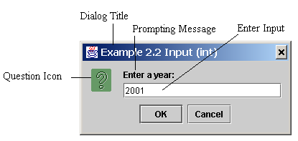
Getting Input from Input Dialog Boxes
String string = JOptionPane.showInputDialog(
null, “Prompt Message”, “Dialog Title”,
JOptionPane.QUESTION_MESSAGE));
where x is a string for the prompting message and y is a string for the title of the input dialog box.

Slide 66
Convertting Strings to Integers
The input returned from the input dialog box is a string. If you enter a numeric value such as 123, it returns “123”. To obtain the input as a number, you have to convert a string into a number.
To convert a string into an int value, you can use the static parseInt method in the Integer class as follows:
int intValue = Integer.parseInt(intString);
where intString is a numeric string such as “123”.

Slide 67
Convertting Strings to Doubles
To convert a string into a double value, you can use the static parseDouble method in the Double class as follows:
double doubleValue =Double.parseDouble(doubleString);
where doubleString is a numeric string such as “123.45”.

Slide 68
Example 2.2
Entering Input from Dialog Boxes
This program first prompts the user to enter a year as an int value and checks if it is a leap year, it then prompts you to enter a double value and checks if it is positive.
A year is a leap year if it is divisible by 4 but not by 100, or it is divisible by 400.

Slide 69
Example 2.4
Computing Changes
This program lets the user enter the amount in decimal representing dollars and cents and output a report listing the monetary equivalent in single dollars, quarters, dimes, nickels, and pennies. Your program should report maximum number of dollars, then the maximum number of quarters, and so on, in this order.

Slide 70
Programming Style and Documentation
Appropriate Comments
Naming Conventions
Proper Indentation and Spacing Lines
Block Styles

Slide 71
Appropriate Comments
Include a summary at the beginning of the program to explain what the program does, its key features, its supporting data structures, and any unique techniques it uses.
Include your name, class section, instruction, date, and a brief description at the beginning of the program.

Slide 72
Naming Conventions
Choose meaningful and descriptive names.
Variables and method names:
  Use lowercase. If the name consists of several words, concatenate all in one, use lowercase for the first word, and capitalize the first letter of each subsequent word in the name. For example, the variables radius and area, and the method computeArea.

Slide 73
Naming Conventions, cont.
Class names:
  Capitalize the first letter of each word in the name. For example, the class name ComputeArea.
Constants:
  Capitalize all letters in constants. For example, the constant PI.

Slide 74
Proper Indentation and Spacing
Indentation
  Indent two spaces.
Spacing
  Use blank line to separate segments of the code.

Slide 75

Block Styles
Use end-of-line style for braces.

Slide 76
Programming Errors
Syntax Errors
  Detected by the compiler
Runtime Errors
  Causes the program to abort
Logic Errors
  Produces incorrect result

Slide 77
Compilation Errors
public class ShowSyntaxErrors {
public static void main(String[] args) {
i = 30
System.out.println(i+4);
}

Slide 78
Runtime Errors
public class ShowRuntimeErrors {
public static void main(String[] args) {
int i = 1 / 0;
}
}

Slide 79
Logic Errors
public class ShowLogicErrors {
// Determine if a number is between 1 and 100 inclusively
public static void main(String[] args) {
// Prompt the user to enter a number
String input = JOptionPane.showInputDialog(null,
"Please enter an integer:",
"ShowLogicErrors", JOptionPane.QUESTION_MESSAGE);
int number = Integer.parseInt(input);
// Display the result
System.out.println("The number is between 1 and 100, " +
"inclusively? " + ((1 < number) && (number < 100)));
System.exit(0);
}
}

