Slide 1
AV 1.0 – Traditional Autonomous Driving Approach
SENSORS
PERCEPTION
PREDICTION
PLANNING
CONTROL
Lane Detection
Camera
Route Planning
Traffic Light Detection
Movement Prediction
PID Control
Radar
Sign Recognition
Behavior Planning
Future Map Prediction
Lidar
Object Detection + Tracking
Model Predictive Control
Trajectory Planning
Traffic Agent
Free Space Detection
GPS
HD Map
Localization

Slide 2
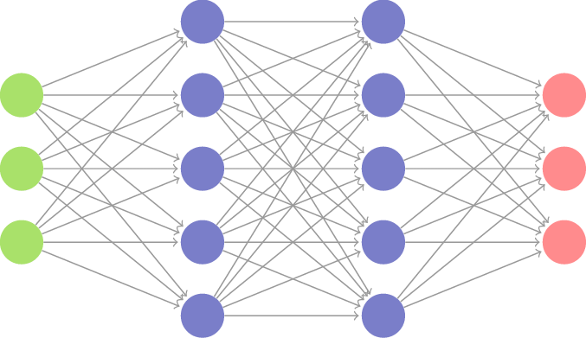
AV 2.0 – End-to-End Model for Autonomous Driving
SENSORS
PLANNING + PREDICTION + PLANNING
CONTROL
Camera
Steering
Radar
Acceleration
Lidar
Deacceleration
GPS

Slide 3
Sensors
End-to-End AI
Control
Camera
Verified Motion Plan
Radar
Drive by Wire
Lidar
GPS

Slide 4
Vision Language Actions Model
World Models
Occupancy Networks

