Slide 1
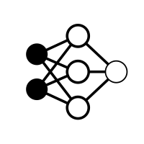



torch.compile(
)
Frontend
TorchDynamo
Forward Graph
FXGraph in Torch IR
Graph Acquisition
AOT AutoGrad
Forward Graph & Backward Graph
FXGraph in Atten/Core Atten/Prims IR
Graph Lowering
Backend
Torch Inductor
Optimizations – Operator Fusion, Memory Planning, …
Graph Compilation
C++ / OpenMP IR
TRITON IR
Custom Compiler
PTX
Assembly
CPU/GPU/ASIC Code Generation
GPU
ASIC
CPU

