Slide 1

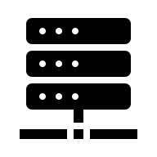
”Technology Free” Core
Interface Description
UI Adapter
Use case implementations in the shell & orchestration
Technology dependent
I/O Implementation
Driving Ports
Diven Ports
Functional Core
Immutable Domain Model + Pure Functions
Driving Ports
Adapter
Database
REST Adapter
Driven Ports
Requests to
our system
Queries from
out system

