Slide 1
Lecture 12: Physical layer - Media Access Control (MAC)
Lecturer: Venkat Arun
From chapters 2.6 and 2.7 in the book

Slide 2
Logistics
Assignment 2 is due tomorrow

Slide 3
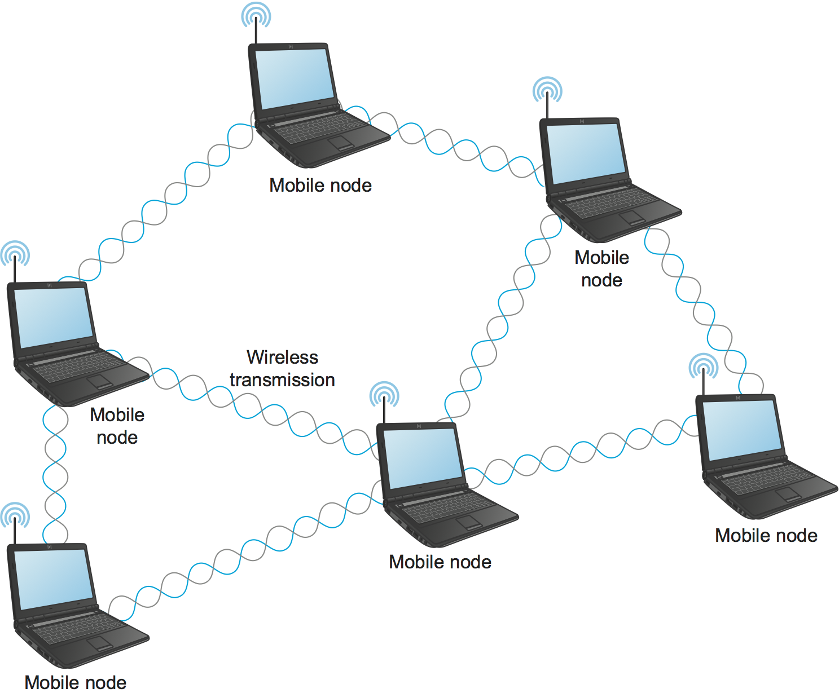
Sharing a medium
Wireless media are always shared.
Wired media can be shared too, for example if multiple nodes connect to the same piece of copper. However, it is uncommon today since it creates unnecessary contention

Slide 4

Sharing a medium: only one node can talk at a time
A
Suppose A wants to transmit to B
There is no wire connecting them. Thus, A must "shout". It says "The following message is intended for B: <message>"
Every node within earshot listens to it. For efficiency, they only process messages that are addressed to them.
Note: they can choose to snoop on all messages. This is made useless by encryption, which we will discuss later
Problem: No one else can talk while A and B are talking
B

Slide 5
Centralized and Decentralized ways to share a medium
Decentralized
Centralized
Eg. used in WiFi
Nodes transmit whenever they like
Sometimes two nodes transmit at once and both packets are lost 🤷
There are distributed protocols to try and ensure this does not happen all the time
E.g. used in cellular networks
There is a dictator node(s), like the cellular base station(s), that controls all transmissions
It periodically broadcasts a message telling everyone exactly who may transmit at which time slot

Slide 6
Point to note: How does the dictator know who wants to transmit?
Option 1: Be conservative and always allocate time for everyone
This was used for landline telephones, which made sense because when you are on a call, you are always talking and using the same amount of bandwidth.
Does not work for modern applications which communicate intermittently and unpredictably.
This was particularly problematic in the "dial-up internet" era where telephone lines were used to connect to the internet. You'd have to pay as if you were constantly talking on the phone even when you were just reading a website and not downloading anything
I lied a little: It did "frequency-division multiplexing", not time-division multiplexing, but the fundamental idea is the same
Option 2: When nodes want to transmit, they send a short packet requesting time to send their longer packet
Used in cellular networks
Still needs decentralized Media Access Control protocols in case everyone wants to send this request at once

Slide 7
Point to note: Who is the dictator? ATT, Verizon, TMobile, the government...? Do they control all transmissions in the world?
As we discussed earlier, transmission rights are divided by frequency. Thanks to physics, transmissions sent on different frequencies do not mix
ATT base stations are the dictators for ATT's frequencies, Verizon's base stations are the dictators for their frequencies etc.
Nobody is a dictator for WiFi frequencies. In fact these frequencies are also shared with bluetooth, microwave ovens etc. This is done in a fully decentralized way

Slide 8
Media Access Control: prototype 1
Notation:
Wants to transmit
Is transmitting
All the intelligence for all our prototypes will be on the sender. The receiver just passively listens to everything
Carrier Sense: Each node listens to see if anyone else is transmitting. If not, it starts transmitting
Node 1
Node 2

Slide 9
Problem with prototype 1
Notation:
Wants to transmit
Is transmitting
Colliding
If two nodes want to transmit, both packets get lost... every single time
Node 1
Node 2
Node 3
Both keep retrying and always collide
Notes:
Alt text: If two nodes want to transmit, both packets get lost... every single time. This is because as soon as the air clears up, everyone waiting will transmit

Slide 10
Prototype 2
Notation:
Wants to transmit
Is transmitting
Colliding
Same as prototype 1, but they retransmit with a smaller probability p (say 33%)
Node 1
Node 2
Node 3
Chose to transmit
Chose to wait
Chose to transmit
Notes:
Alt text: Because both nodes wait with some probability, it is likely that there will be a time when only one node sends

Slide 11
Prototype 2
Notation:
Wants to transmit
Is transmitting
Colliding
Same as prototype 1, but they retransmit with a smaller probability p (say 50%)
Note: collisions are possible, but will happen with probability < 1
Thus, the system will eventually succeed
Chose to transmit
Node 1
Node 2
Node 3
Chose to transmit
Chose to transmit
Chose to wait
Chose to transmit

Slide 12
Improvement to prototype 2
Notation:
Wants to transmit
Is transmitting
Colliding
If collision occurs, stop transmitting (I'm hiding details here. See https://www.geeksforgeeks.org/collision-detection-csmacd/ if you are interested)
Not used in WiFi because detecting collisions is hard: when I'm yelling at the top of my voice, I cannot listen
Nevertheless, I will draw small collision boxes because we I am running of screen space on the slide :)
Chose to transmit
Node 1
Node 2
Node 3
Chose to transmit
Chose to transmit
Chose to wait
Chose to transmit

Slide 13
Improvement to prototype 2
Notation:
Wants to transmit
Is transmitting
Colliding
If collision occurs, stop transmitting (I'm hiding details here. See https://www.geeksforgeeks.org/collision-detection-csmacd/ if you are interested)
Not used in WiFi because detecting collisions is hard: when I'm yelling at the top of my voice, I cannot listen
Nevertheless, I will draw small collision boxes because we I am running of screen space on the slide :)
Note: Collision detection was used in wired ethernet back when they still had multi-node copper wires.
Even though, collision detection may be possible in WiFi, it is hard to do. Plus, it leads to the hidden terminal problem anyway, which we will discuss later
Chose to transmit
Node 1
Node 2
Node 3
Chose to transmit
Chose to transmit
Chose to wait
Chose to transmit

Slide 14
Problem with prototype 2
Notation:
Wants to transmit
Is transmitting
Colliding
If there are more than 2 senders waiting (or more generally, 1/p senders), collisions will almost always occur
If p is small, nodes wait unnecessarily even when there is no contention
If it is large, then lots of collusions occur when there are > 1/p nodes
Node 1
Node 2
Node 3
Node 4
Node 5

Slide 15
Prototype 3
This is used in WiFi and is called Carrier Sense Multiple Access/Collision Avoidance (CSMA/CA)
Start with a large p, say p = ½
Every time a collision occurs, halve p
Analysis: If there are n waiting nodes, we are guaranteed to reach p < 1/n in O(log(n)) steps. If there are not a lot of waiting nodes, p remains small

Slide 16
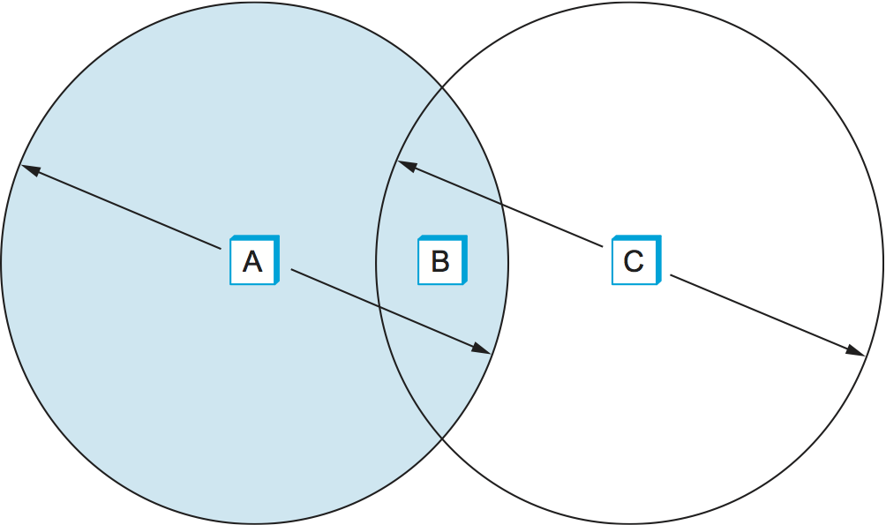
We're done... almost. The hidden node problem
A and C cannot hear each other, but B can hear them both
Suppose A wants to talk to B. It transmits. C cannot hear A, so it transmits too. However, B cannot decipher A's packet because C keeps talking
Solution: To know if a collision happened, wait for an acknowledgment from the receiver. Side benefit: helps with detecting errors that occur even without collisions

Slide 17
One last improvement. Then we'll be done
Instead of sending full-sized packets and waiting for them to collide, send small packets first.
In WiFi, this is called RTS/CTS: Request To Send/Clear To Send
Anyone who hears either packet will not send for some time while the two nodes communicate

Slide 18
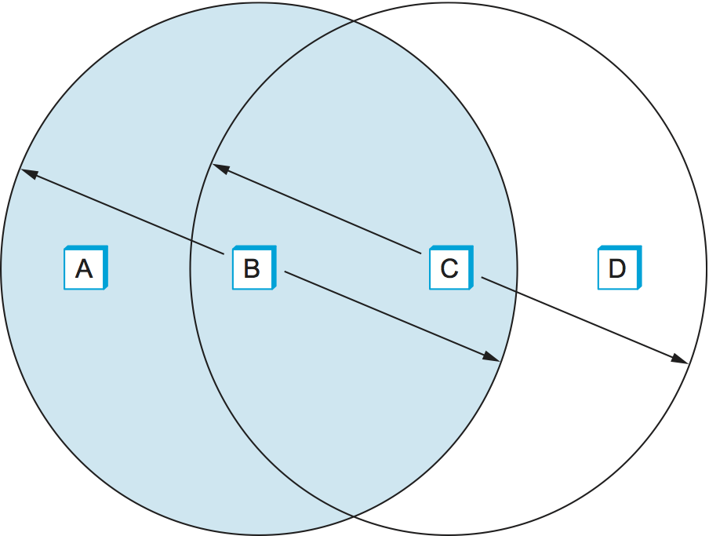
A final problem: exposed node problem
Here, suppose immediate neighbors can hear each other, but others cannot
If B is transmitting to A, C may incorrectly conclude that it is unsafe to send to D. However, this is not the case, since both A and D can hear without a problem
In WiFi, we largely accept this inefficiency

