Slide 1
Quiz recap and error correction
Lecturer: Venkat Arun

Slide 2
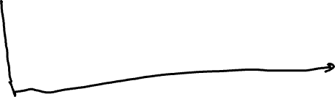
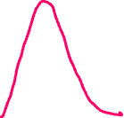
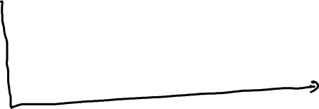


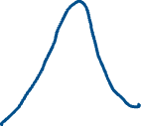

Simple model for why errors happen
What sender sent
PDF
0V becomes approx. [-0.25, 0.25] V
What receiver got (probability density function)
PDF

Slide 3


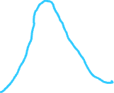
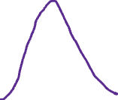
Simple model for why errors happen
Encodes 00 01 10 11
What sender sent
PDF
What receiver got (probability density function)
PDF
Enough overlap that bits get confused

Slide 4
What errors look like in the digital world
Bit that is sent
Bit that is received
1
1 - p
1
p
p
0
0
1 - p
The values on the edges denote the probability that the transmitted bit is received as a 0 or a 1

Slide 5
What errors look like in the digital world
Bit that is sent
Bit that is received
1
1 - p
1
p
Key takeaway: probability of error is p
If p < 0.5, when a sequence of bits is sent, 1-bit errors are more likely than 2-bit errors which are more likely than 3-bit errors
p
0
0
1 - p
The values on the edges denote the probability that the transmitted bit is received as a 0 or a 1

Slide 6
Example of an error correcting code: triple repetition
Data I want to transmit | How I encode the data
0 | 000
1 | 111
What I receive | What I interpret it as
000 | 0
111 | 1

Slide 7
Example of an error correcting code: triple repetition
Data I want to transmit | How I encode the data
0 | 000
1 | 111
What I receive | What I interpret it as
000 | 0
111 | 1
001 | ??

Slide 8
Example of an error correcting code: triple repetition
Data I want to transmit | How I encode the data
0 | 000
1 | 111
What I receive | What I interpret it as
000 | 0
111 | 1
001 | 0
011 | ??

Slide 9
Example of an error correcting code: triple repetition
Data I want to transmit | How I encode the data
0 | 000
1 | 111
What I receive | What I interpret it as
000 | 0
111 | 1
001 | 0
011 | 1
101 | 1
100 | 0

Slide 10
A longer error correcting code
Data I want to transmit | How I encode the data (codeword)
0 0 0 0 | 0 0 0 0 0 0 0
0 0 0 1 | 1 1 0 1 0 0 1
0 0 1 0 | 0 1 0 1 0 1 0
0 0 1 1 | 1 0 0 0 0 1 1
0 1 0 0 | 1 0 0 1 1 0 0
0 1 0 1 | 0 0 1 1 0 0 1
0 1 1 0 | 1 1 0 0 1 1 0
0 1 1 1 | 0 0 0 1 1 1 1
1 0 0 0 | 1 1 1 0 0 0 0
1 0 0 1 | 0 1 0 0 1 0 1
1 0 1 0 | 1 0 1 1 0 1 0
1 0 1 1 | 0 1 1 0 0 1 1
1 1 0 0 | 0 1 1 1 1 0 0
1 1 0 1 | 1 0 1 0 1 0 1
1 1 1 0 | 0 0 1 0 1 1 0
1 1 1 1 | 1 1 1 1 1 1 1
Points to note
Every bit-string on the right differs from every other bit-string by at least 3 bits. This is called as having a “hamming distance” of at least 3
This means that if one bit of any codeword is flipped, its distance to every other codeword is >= 2. Its distance to the original codeword is of course 1. Thus, it can be decoded
If two bits are flipped, it cannot be corrected, but the error can be detected since no two codewords differ by 2 bits
How do we come up with this table? This is called a hamming code and is out of scope of this course. It is simple enough to understand though

Slide 11
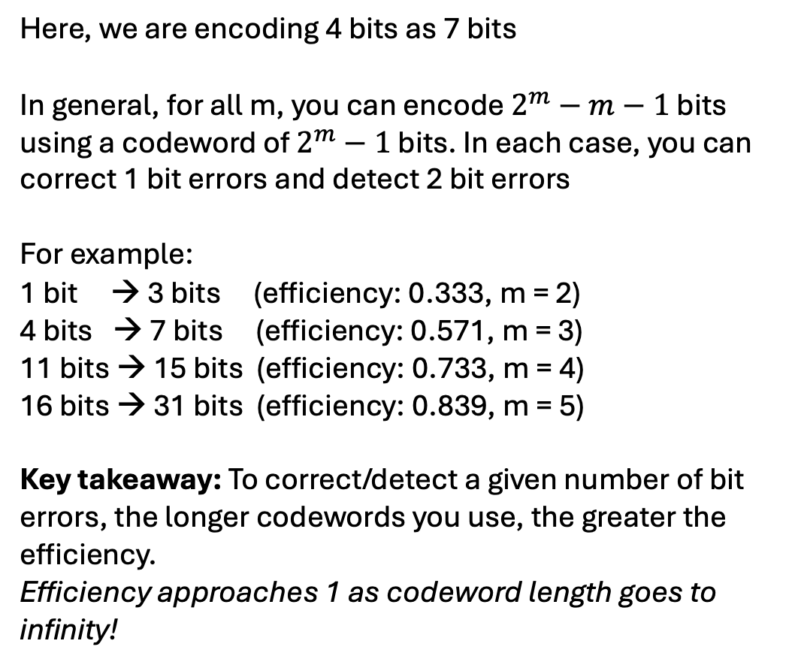
A longer error correcting code
Data I want to transmit | How I encode the data (codeword)
0 0 0 0 | 0 0 0 0 0 0 0
0 0 0 1 | 1 1 0 1 0 0 1
0 0 1 0 | 0 1 0 1 0 1 0
0 0 1 1 | 1 0 0 0 0 1 1
0 1 0 0 | 1 0 0 1 1 0 0
0 1 0 1 | 0 0 1 1 0 0 1
0 1 1 0 | 1 1 0 0 1 1 0
0 1 1 1 | 0 0 0 1 1 1 1
1 0 0 0 | 1 1 1 0 0 0 0
1 0 0 1 | 0 1 0 0 1 0 1
1 0 1 0 | 1 0 1 1 0 1 0
1 0 1 1 | 0 1 1 0 0 1 1
1 1 0 0 | 0 1 1 1 1 0 0
1 1 0 1 | 1 0 1 0 1 0 1
1 1 1 0 | 0 0 1 0 1 1 0
1 1 1 1 | 1 1 1 1 1 1 1
Here, we are encoding 4 bits as 7 bits
In general, for all m, you can encode $2^{m}−m−1$ bits using a codeword of $2^{m}−1$ bits. In each case, you can correct 1 bit errors and detect 2 bit errors
For example:
1 bit → 3 bits (efficiency: 0.333, m = 2)
4 bits → 7 bits (efficiency: 0.571, m = 3)
11 bits → 15 bits (efficiency: 0.733, m = 4)
16 bits → 31 bits (efficiency: 0.839, m = 5)
Key takeaway: To correct/detect a given number of bit errors, the longer codewords you use, the greater the efficiency.
Efficiency approaches 1 as codeword length goes to infinity!

Slide 12
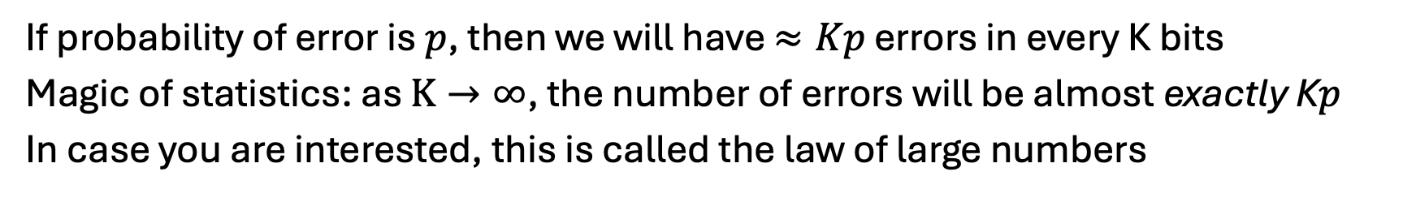
Multi-bit correction: How much error correction do we need?
Bit that is sent
Bit that is received
1
1 - p
1
p
p
0
0
1 - p
If probability of error is $p$, then we will have $≈Kp$ errors in every K bits
Magic of statistics: as $K→∞$, the number of errors will be almost exactly K$p$
In case you are interested, this is called the law of large numbers

Slide 13
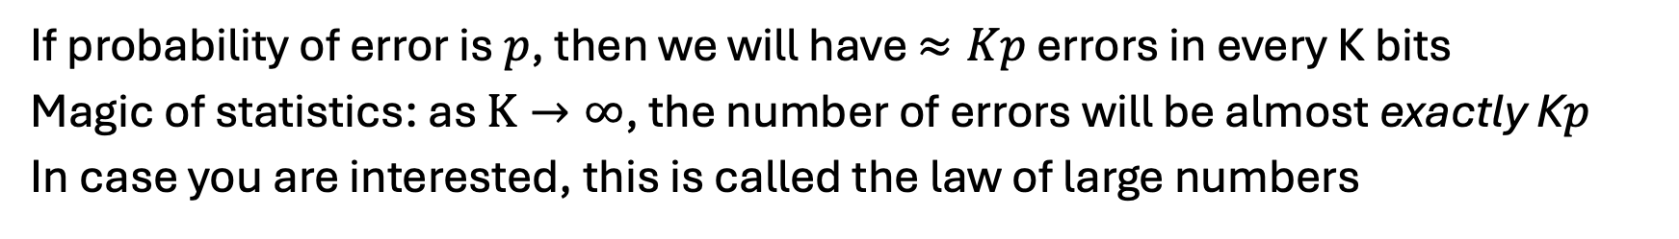
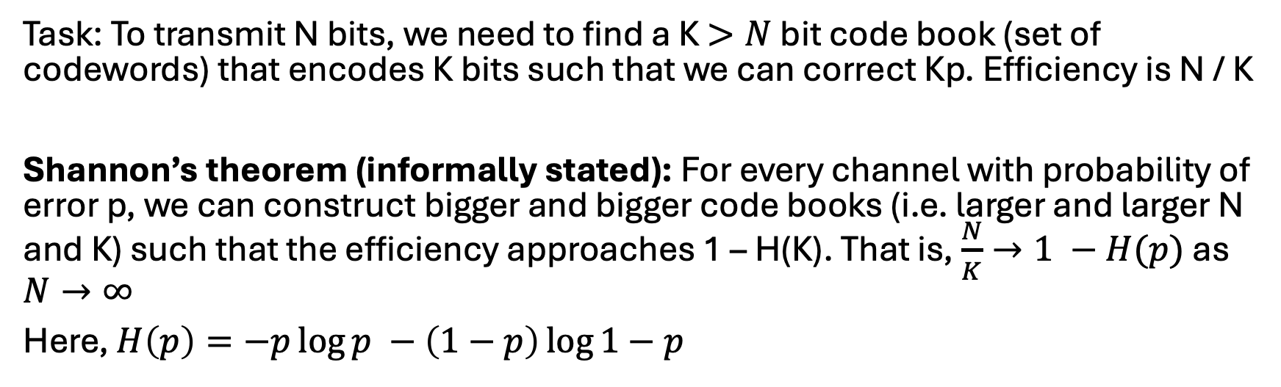
Multi-bit correction: How much error correction do we need?
If probability of error is $p$, then we will have $≈Kp$ errors in every K bits
Magic of statistics: as $K→∞$, the number of errors will be almost exactly K$p$
In case you are interested, this is called the law of large numbers
Task: To transmit N bits, we need to find a K$>N$ bit code book (set of codewords) that encodes K bits such that we can correct Kp. Efficiency is N / K
Shannon’s theorem (informally stated): For every channel with probability of error p, we can construct bigger and bigger code books (i.e. larger and larger N and K) such that the efficiency approaches 1 – H(K). That is, $\frac{N}{K}→1 −H(p)$ as $N→∞$
Here, $H\left(p\right)=−p\log{p −\left(1−p\right)\log{1−p}}$

Slide 14
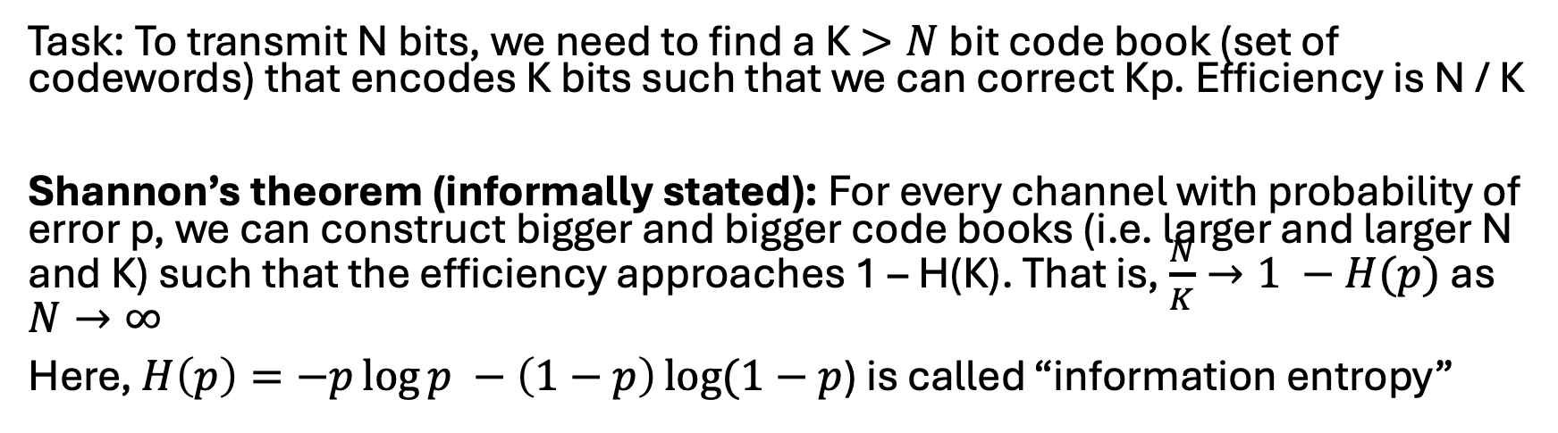
Multi-bit correction: How much error correction do we need?
If probability of error is $p$, then we will have $≈Kp$ errors in every K bits
Magic of statistics: as $K→∞$, the number of errors will be almost exactly K$p$
In case you are interested, this is called the law of large numbers
Task: To transmit N bits, we need to find a K$>N$ bit code book (set of codewords) that encodes K bits such that we can correct Kp. Efficiency is N / K
Shannon’s theorem (informally stated): For every channel with probability of error p, we can construct bigger and bigger code books (i.e. larger and larger N and K) such that the efficiency approaches 1 – H(K). That is, $\frac{N}{K}→1 −H(p)$ as $N→∞$
Here, $H\left(p\right)=−p\log{p −\left(1−p\right)\log{(1−p}}$) is called “information entropy”

Slide 15
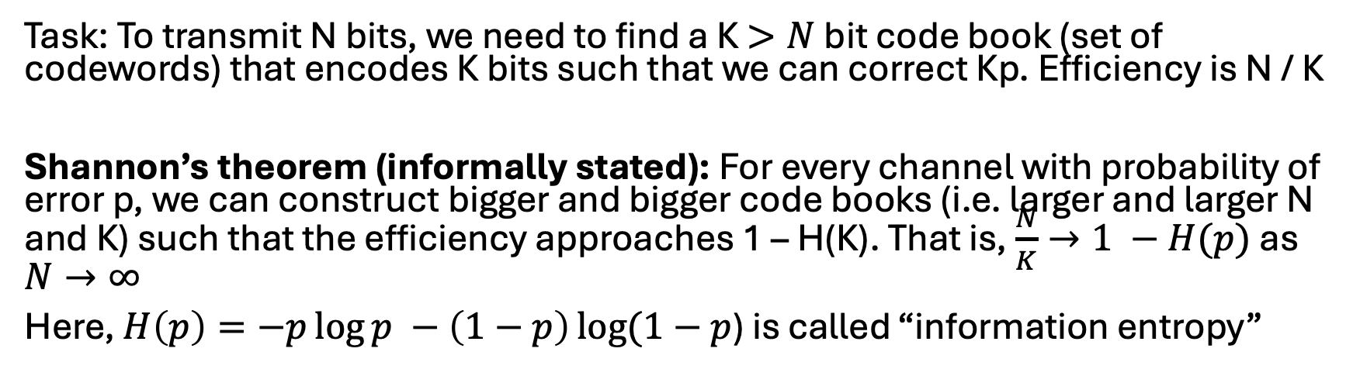

Multi-bit correction: How much error correction do we need?
Task: To transmit N bits, we need to find a K$>N$ bit code book (set of codewords) that encodes K bits such that we can correct Kp. Efficiency is N / K
Shannon’s theorem (informally stated): For every channel with probability of error p, we can construct bigger and bigger code books (i.e. larger and larger N and K) such that the efficiency approaches 1 – H(K). That is, $\frac{N}{K}→1 −H(p)$ as $N→∞$
Here, $H\left(p\right)=−p\log{p −\left(1−p\right)\log{(1−p}}$) is called “information entropy”
Strategy: Pick a very large $K$ and pick $N = \left(1 – H\left(p\right)\right)K$

Slide 16
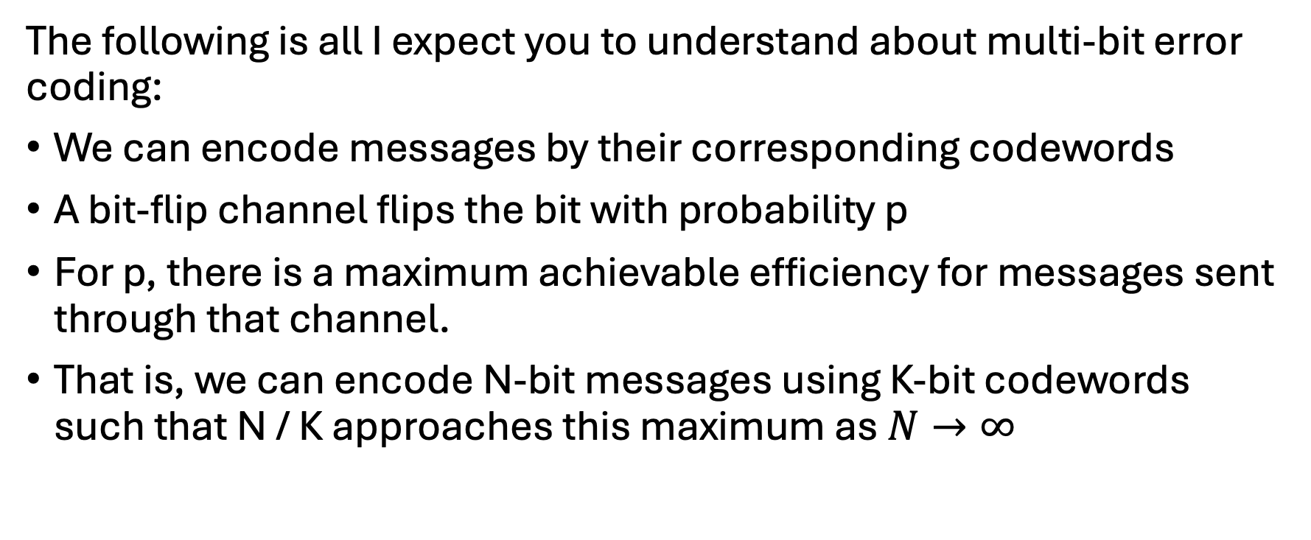
Key takeaways
The following is all I expect you to understand about multi-bit error coding:
We can encode messages by their corresponding codewords
A bit-flip channel flips the bit with probability p
For p, there is a maximum achievable efficiency for messages sent through that channel.
That is, we can encode N-bit messages using K-bit codewords such that N / K approaches this maximum as $N→∞$

Slide 17
Fun aside: How do we correct more bit errors?
Shannon’s code: For every N-bit message, pick a random K-bit string as the codeword. Let this mapping from message to codeword be C(m). The sender and receiver need to agree on this function
Decoding strategy: given a received value of x, find a message m such that the hamming distance between x and C(m) is minimized. m will be the most likely transmitted message
What is the computational complexity of this decoding process?

Slide 18

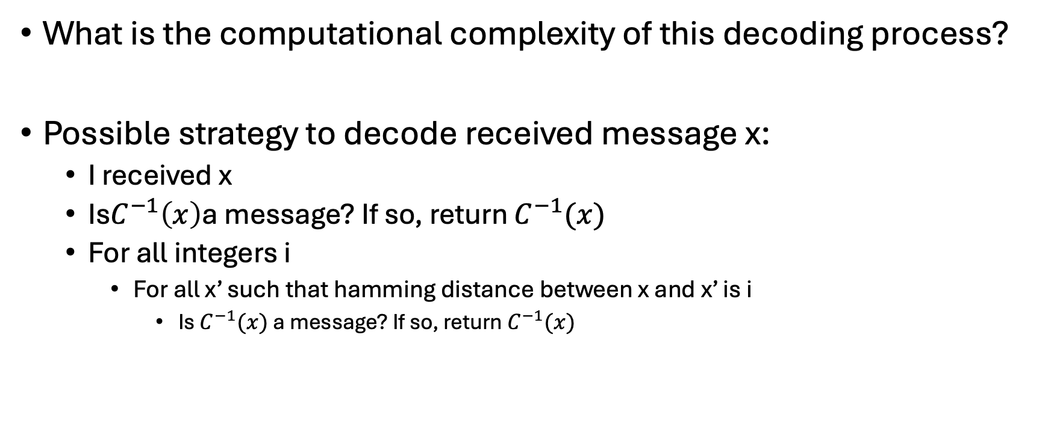
Fun aside: How do we correct more bit errors?
What is the computational complexity of this decoding process?
Possible strategy to decode received message x:
I received x
Is$C^{−1}\left(x\right)$a message? If so, return $C^{−1}(x)$
For all integers i
For all x’ such that hamming distance between x and x’ is i
Is $C^{−1}(x)$ a message? If so, return $C^{−1}(x)$
Complexity: there are $2^{i}$ such x’!

Slide 19
Key takeaways and some history
Decoding Shannon codes has exponential complexity
Shannon published his ground-breaking work, including the Shannon code, in 1948
However, for a long time we did not have a coding scheme that approached the theoretical limit and could be decoded in efficiently (note the two different types of efficiency here).
In the 1990s, we started studying the first solutions to this problem (called Turbo codes and LDPC codes)
This revolutionized cellular and WiFi networks because, for the first time, they were able to approach the theoretical optimal message transmission rates! This was quickly adopted everywhere
Side note: Turbo codes were patent protected until a few years ago. This made LDPC codes more popular in some places

Slide 20
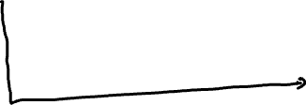




Key takeaways and some history
Thanks to these new coding schemes, we could start packing bits more tightly. This way, errors were more likely to happen, but we had efficient methods to correct them. This is what allowed wireless networks to achieve greater efficiency
Tighter, more aggressive encoding
More conservative encoding that prevented errors

