Slide 1
Lecture 23 – Datacenter Networks
Lecturer: Venkat Arun

Slide 2
Course so far
We have covered all the main layers
Now you largely know how the internet works
Starting from this lecture, we will cover some special topics

Slide 3
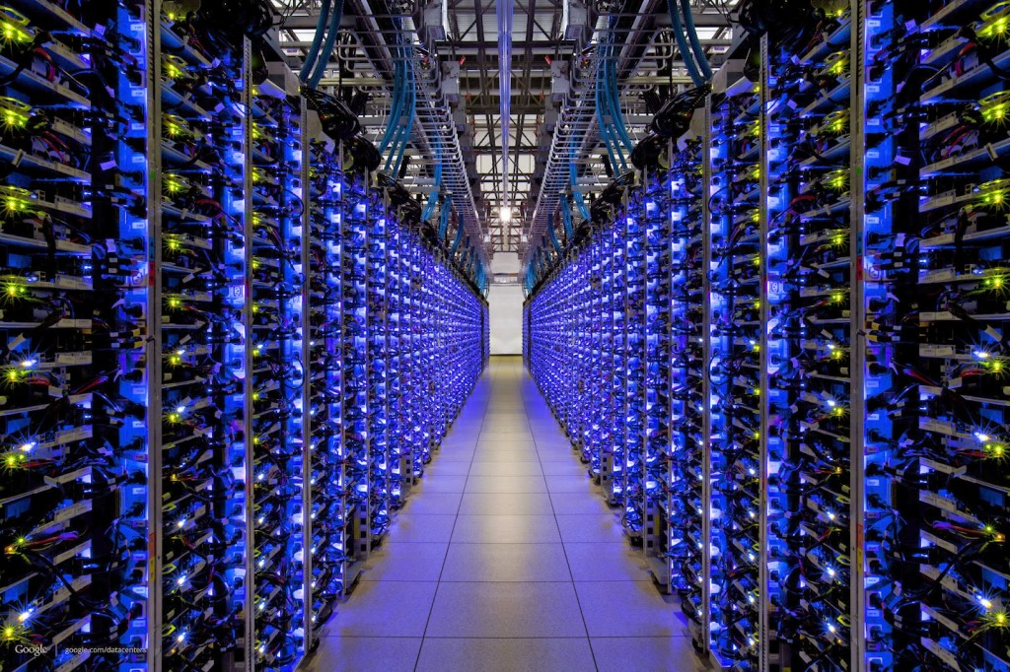
What are datacenters?
A massive warehouses of servers with reliable power, cooling and a a superfast network

Slide 4
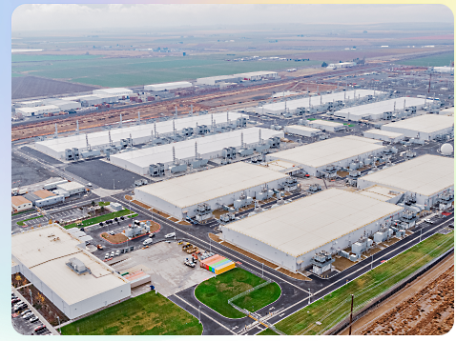
Often, they are multiple warehouses of servers
This is a picture of a Microsoft datacenter complex: https://azure.microsoft.com/en-us/explore/global-infrastructure/geographies/

Slide 5
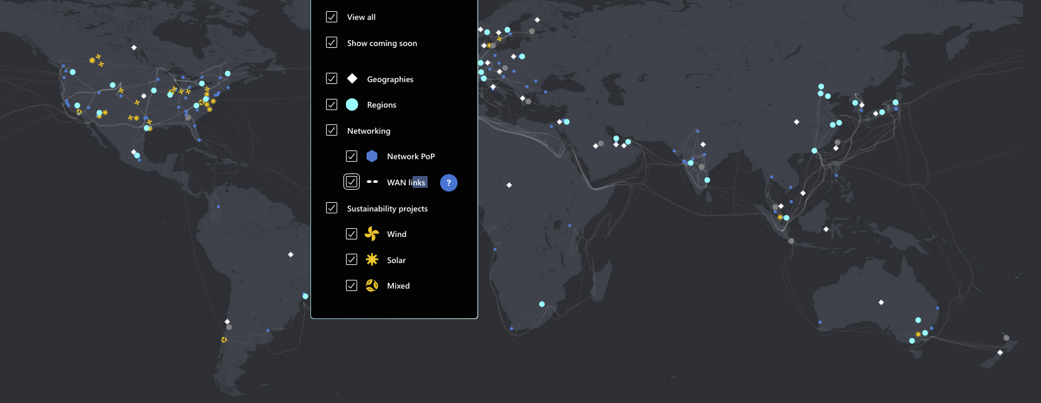
Some statistics: Microsoft datacenters

Slide 6
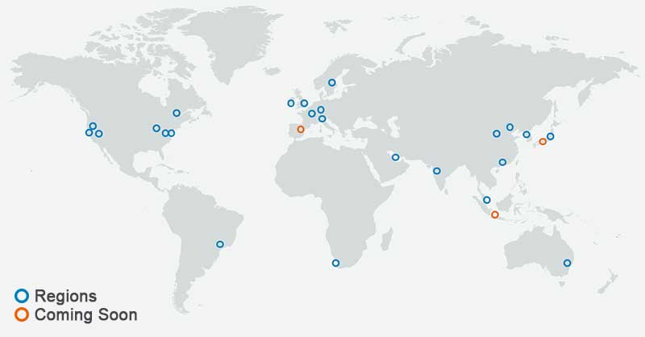
Some statistics: Amazon’s datacenter locations

Slide 7
Some statistics
One datacenter can have over 50,000 servers
Amazon spent $35 billion on its largest datacenter site in N Virginia (https://www.datacenterfrontier.com/cloud/article/11427911/aws-has-spent-35-billion-on-its-northern-virginia-data-centers)
Globally, datacenters have been estimated to use 1-2% of the total energy consumption of the world
Locations are chosen based on energy availability, proximity to internet “Points of Presence (POPs)” and industrial requirements like power and water. Sometimes, they even prefer colder temperatures to offset cooling costs

Slide 8
Public and Private Clouds
Note: When people talk about “cloud computing” they usually mean that the servers are in a datacenter
Organizations that need cloud computing (e.g. UT Austin, Visa, and airlines) have two options:
Build their own datacenter (private cloud)
Rent machines in someone else’s datacenter (public cloud).
Today, most public clouds are maintained by large organizations
Amazon, Microsoft and Google have the biggest market shares
Smaller public clouds also exist for various niches
CloudLab is an example of a public cloud

Slide 9
Benefits of a public cloud
Everyone does not need to maintain their own physical infrastructure that ensures reliable power, network connectivity and maintenance in case some machines break
In large datacenters, there are so many servers that some server is always breaking down
For small organizations (like startups), a public cloud offers a low-cost way to get started. Maintaining infrastructure is expensive
Organizations only need to rent as many machines as they need. This can change with time (e.g. video traffic peaks around 8PM), so they only pay for what they use
Since public clouds have such a large number of servers, from the point of view of most non-massive organizations, they effectively have an infinite number of machines to rent

Slide 10
Benefits of a private cloud
Organizations control their own hardware. This helps if they have very specialized needs
Some privacy compliance laws place restrictions on how data can be shared. This may require organizations like banks to own their own compute infrastructure
Since there are only three large players in the market today, public cloud can sometimes be expensive to use

Slide 11
Datacenter network topology
Unlike the public internet, the fact that all the servers are in the same room and can be physically arranged as per convenience means that datacenter topologies are much more uniform
Wide area networks tend to be less uniform because the computers’ locations are determined independently of the internet (e.g. people build apartments/buildings/datacenters based on other physical constraints)
Further, wiring is determined by where you can dig the ground to lay cables. Influenced by roads, pipelines, etc

Slide 12
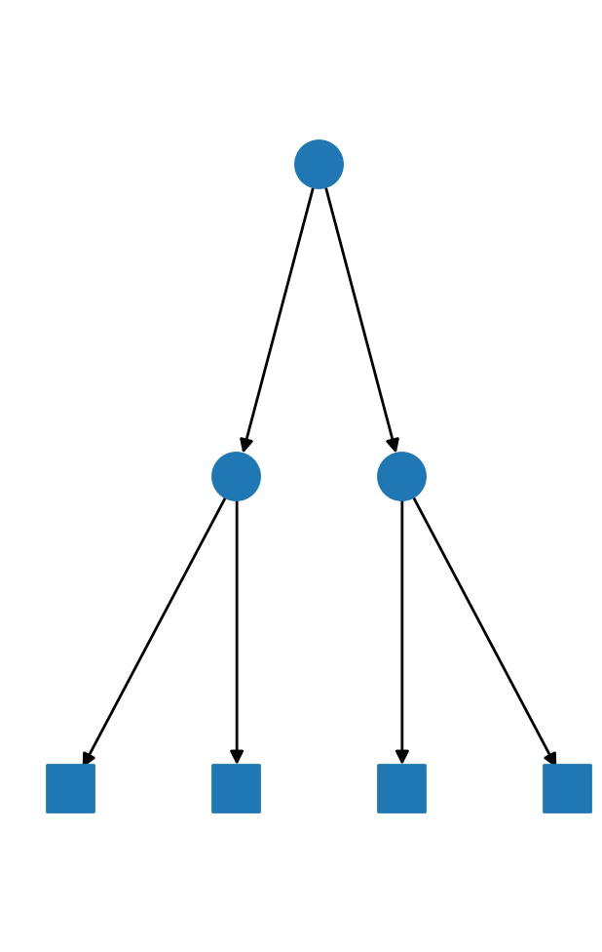
Tree Topology
The bottom layer has servers and the inner layers have routers
Advantage: simple
Disadvantages:
Routers higher up in the hierarchy need to be faster
There is only one path between any two nodes. This creates two problems:
If something in that path fails, the two nodes cannot communicate
If a link in that path is congested, the two nodes cannot communicate fast

Slide 13
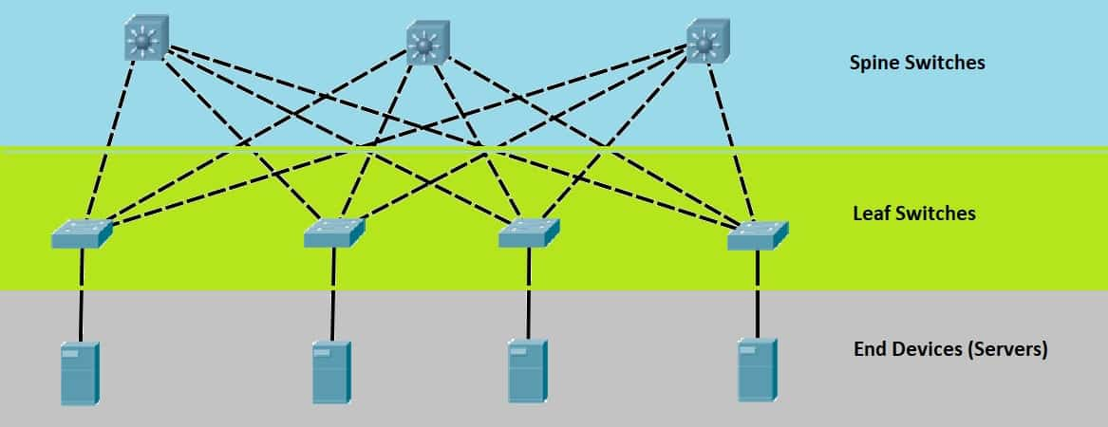
Fat tree topology (aka Clos topology, leaf-spine topology)
Advantages:
Each router can have the same number of ports and operate at the same speed. Thus they can all be identical. Scale is achieved by adding more routers
There are multiple paths between any two servers. This means if one path is broken/congested, servers can pick a different path
Internet is connected to the spine
Most datacenter network designs today use some version of a fat tree topology

Slide 14
Other things a datacenter network must do
Security:
Not all servers need to talk to the internet. Firewall rules prevent internet packets from reaching such servers
In a public cloud, servers rented by different organizations rarely need to talk to each other. Firewall rules prevent such communication unless explicitly permitted
Performance isolation
One user overusing a link should not affect another user too much if they are both paying the same amount
Addressing
Public clouds must make it easy for servers to find each other’s IP addresses
Sometimes, virtual machines move from one physical server to another. Ideally, this should not change its IP address

Slide 15
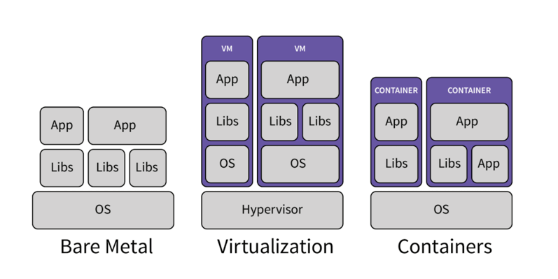
Virtual Machines/Containers
You rarely rent physical servers in a datacenter since they are often too big (64/128 cores) for most needs. They also make management difficult for the datacenter operator (e.g. to implement security/performance isolation)
Instead, you rent a Virtual Machine (VM) or a container that tricks your software into thinking it is running on a (often smaller) physical machine, but in fact fits multiple VMs into the same physical machine

Slide 16
Microservice Applications: How do you create an application for the datacenter
Most of the content we have discussed thus far in this course are “timeless”. They have been around for decades and it is likely that they will be around for a long time in the future.
Opinion: Microservices are an exception. They became a fad ~10 years ago, and are likely to die out soon. However, they are so common today, that we should discuss them. Plus, so much software has been written this way that it will take a long time to get phased out
Also, this architecture will always be there, but in a less extreme fashion

Slide 17
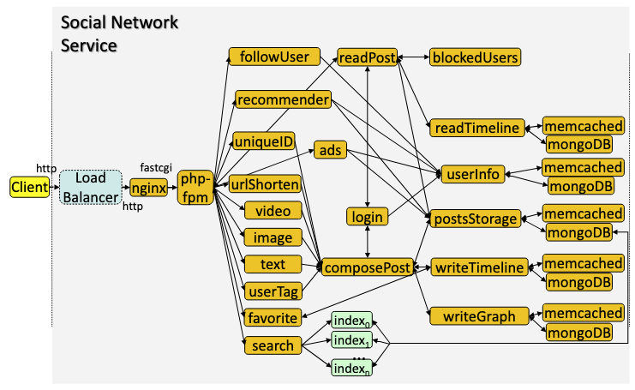
Example Microservice application
Image taken from the DeathStarBench paper

Slide 18
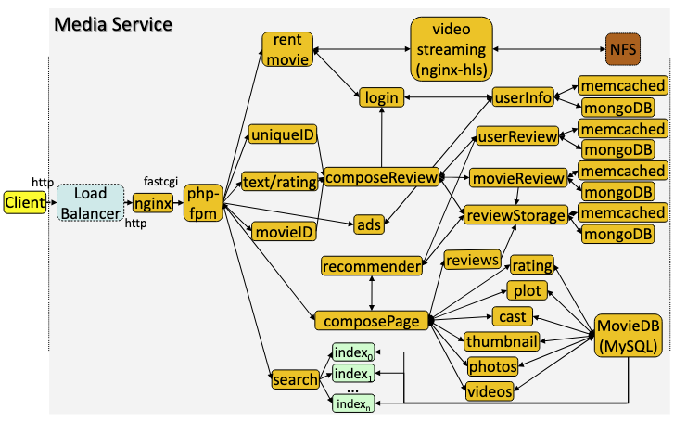
Example Microservice application
Image taken from the DeathStarBench paper

