Slide 1
Lecture 26: IP address scarcity and overlay networks
Lecturer: Venkat Arun
Some slides taken from the Kurose & Ross book “Computer networking: a top-down approach” and from the Peterson and Davie book

Slide 2
The IP Address Scarcity
There are only 2^32 ~ 4 billion IP addresses, but there are more devices connected to the internet. How?
Plus, like most resources on this planet, IP addresses are not distributed evenly
Solutions
IPv6 has 128-bit addresses
Theoretically enough to address every grain of sand on earth. Since it is unlikely we will want to do that in the foreseeable future, we allocate addresses to prioritize convenience over efficiency
Network Address Translation (NAT)
Key Idea: Use port numbers (16 bit) in addition to the 32-bit IPv4 address

Slide 3

NAT: network address translation
NAT: all devices in local network share just one IPv4 address as far as outside world is concerned
rest of
Internet
local network (e.g., home network) 10.0.0/24
10.0.0.1
138.76.29.7
10.0.0.4
10.0.0.2
10.0.0.3
all datagrams leaving local network have same source NAT IP address: 138.76.29.7, but different source port numbers
datagrams with source or destination in this network have 10.0.0/24 address for source, destination (as usual)

Slide 4
NAT: network address translation
all devices in local network have 32-bit addresses in a special “private” IP address space (10/8, 172.16/12, 192.168/16 prefixes) that can only be used in local network. These cannot be used in the public internet
advantages:
Just one IP address needed from provider ISP for all devices
Security: we will discuss why NAT improves security 3 slides later

Slide 5
NAT: network address translation
implementation: NAT router must (transparently):
outgoing datagrams: replace (source IP address, port #) of every outgoing datagram to (NAT IP address, new port #)
remote clients/servers will respond using (NAT IP address, new port #) as destination address
remember (in NAT translation table) every (source IP address, port #) to (NAT IP address, new port #) translation pair
incoming datagrams: replace (NAT IP address, new port #) in destination fields of every incoming datagram with corresponding (source IP address, port #) stored in NAT table

Slide 6
NAT: network address translation
NAT translation table
WAN side addr LAN side addr
2: NAT router changes datagram source address from 10.0.0.1, 3345 to 138.76.29.7, 5001,
updates table
1: host 10.0.0.1 sends datagram to 128.119.40.186, 80
138.76.29.7, 5001 10.0.0.1, 3345
…… ……
S: 10.0.0.1, 3345
D: 128.119.40.186, 80
10.0.0.1
1
2
S: 138.76.29.7, 5001
D: 128.119.40.186, 80
10.0.0.4
10.0.0.2
138.76.29.7
S: 128.119.40.186, 80
D: 10.0.0.1, 3345
4
S: 128.119.40.186, 80
D: 138.76.29.7, 5001
3
10.0.0.3
3: reply arrives, destination address: 138.76.29.7, 5001

Slide 7
NAT improves security!
Devices outside the local network cannot initiate a connection to one inside the network. Why?
The NAT table is only populated when a packet from inside goes outside. Until then, the NAT device does not know which to local IP/port it should forward an incoming packet
Even organizations that have an abundance of IP addresses (e.g., US universities) use NATs to improve security

Slide 8
Instapoll: Can a server run behind a NET
Suppose your ISP uses a NAT,
Q1: how would you know?
Q2: If you run a web server on your personal computer, can people outside open the website you are hosting?
A1: If the IP address assigned by the DHCP is in one of the local prefixes (10/8, 172.16/12, 192.168/16 prefixes), it is a big clue that you are behind a NAT. This is the IP address you see when you run “ifconfig” as in assignment 1
A2: No, because clients initiate connections to a website’s server. This is not possible if the server is behind a NAT. To understand why, look at how NAT works again

Slide 9
NAT: good or bad?
NAT has been controversial:
routers “should” only process up to layer 3
address “shortage” should be solved by IPv6
violates end-to-end argument (port # manipulation by network-layer device)
NAT traversal: what if client wants to connect to server behind NAT?
but NAT is here to stay:
extensively used in home and institutional nets, 4G/5G cellular nets

Slide 10
IPv6: Let there be more addresses
IPv6 uses an “overlay network” to enable a smooth transition from IPv4

Slide 11
IPv6: motivation
initial motivation: 32-bit IPv4 address space would be completely allocated
additional motivation:
speed processing/forwarding: 40-byte fixed length header
enable different network-layer treatment of “flows”

Slide 12
IPv6 datagram format
flow label: identify datagrams in same "flow.” (concept of “flow” not well defined).
32 bits
priority: identify priority among datagrams in flow
ver
pri
flow label
payload len
next hdr
hop limit
source address
(128 bits)
128-bit
IPv6 addresses
destination address
(128 bits)
payload (data)
What’s missing (compared with IPv4):
no checksum (to speed processing at routers)
no fragmentation/reassembly (we did not cover this in class)
no options (available as upper-layer, next-header protocol at router)

Slide 13
Transition from IPv4 to IPv6
not all routers can be upgraded simultaneously
no “flag days”
how will network operate with mixed IPv4 and IPv6 routers?
tunneling: IPv6 datagram carried as payload in IPv4 datagram among IPv4 routers (“packet within a packet”)
tunneling used extensively in other contexts (4G/5G)
IPv4 header fields
IPv6 header fields
IPv4 payload
IPv4 source, dest addr
IPv6 source dest addr
UDP/TCP payload
IPv6 datagram
IPv4 datagram

Slide 14
Tunneling and encapsulation
Ethernet connecting two IPv6 routers:
A
B
Ethernet connects two IPv6 routers
E
F
IPv6
IPv6
IPv6
IPv6
IPv6 datagram
Link-layer frame
The usual: datagram as payload in link-layer frame
IPv4 network connecting two IPv6 routers
A
B
E
F
IPv6
IPv6/v4
IPv6/v4
IPv6
IPv4 network

Slide 15
Tunneling and encapsulation
Ethernet connecting two IPv6 routers:
A
B
Ethernet connects two IPv6 routers
E
F
IPv6
IPv6
IPv6
IPv6
IPv6 datagram
Link-layer frame
The usual: datagram as payload in link-layer frame
IPv4 tunnel connecting two IPv6 routers
A
B
IPv4 tunnel
connecting IPv6 routers
E
F
IPv6
IPv6/v4
IPv6/v4
IPv6
IPv6 datagram
IPv4 datagram
tunneling: IPv6 datagram as payload in a IPv4 datagram

Slide 16
Tunneling
A
B
IPv4 tunnel
connecting IPv6 routers
E
F
logical view:
IPv6
IPv6/v4
IPv6/v4
IPv6
A
B
C
D
E
F
physical view:
IPv6
IPv6/v4
IPv4
IPv4
IPv6/v4
IPv6
flow: X
src: A
dest: F
data
src:B
dest: E
src:B
dest: E
src:B
dest: E
flow: X
src: A
dest: F
data
Flow: X
Src: A
Dest: F
data
Flow: X
Src: A
Dest: F
data
Flow: X
Src: A
Dest: F
data
Note source and destination addresses!
A-to-B:
IPv6
B-to-C:
IPv6 inside
IPv4
B-to-C:
IPv6 inside
IPv4
B-to-C:
IPv6 inside
IPv4
E-to-F:
IPv6

Slide 17
How do two IPv6 routers discover each other?
A large suite of protocols we will not cover in class, but the following methods are broadly used
Manual
Put the 32-bit IPv4 address in an IPv6 address so the IPv6 routers can discover each other while being transparent to the IPv4 routers
(Somewhat) centralized databases that can be discovered by each IPv6 endpoint and keeps track of everyone else in the network.

Slide 18
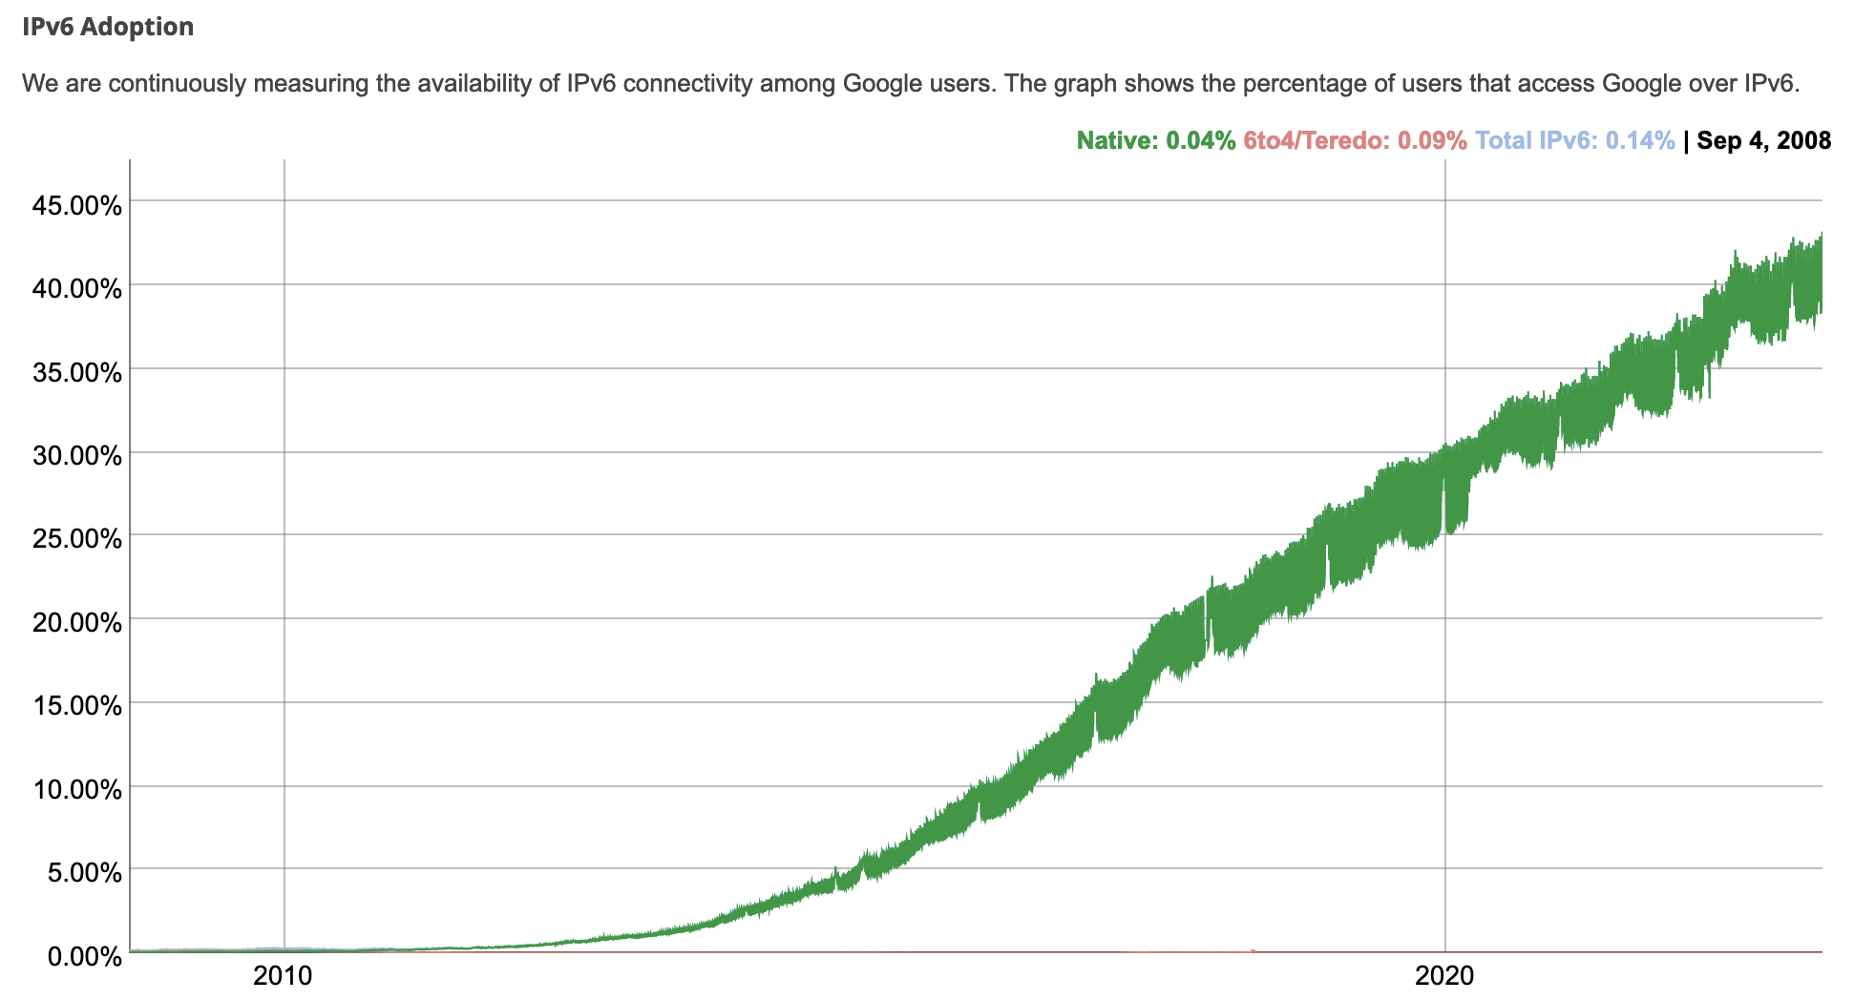
IPv6: adoption
Google¹: ~ 40% of clients access services via IPv6 (2023)
NIST: 1/3 of all US government domains are IPv6 capable

Slide 19
IPv6: adoption
Google¹: ~ 40% of clients access services via IPv6 (2023)
NIST: 1/3 of all US government domains are IPv6 capable
Long (long!) time for deployment, use
25 years and counting!
think of application-level changes in last 25 years: WWW, social media, streaming media, gaming, telepresence, …
Why?
¹ https://www.google.com/intl/en/ipv6/statistics.html

Slide 20
Overlay Networks
Overlay networks are a general way to deploy new protocols in a backwards compatible way
P&D chapter 9

Slide 21
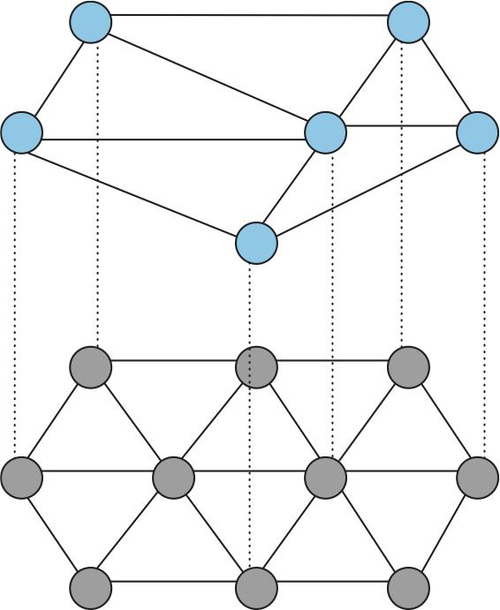
Overlay Networks
Suppose the brown (lower) network already exists, but does not support your fancy new protocol X
One option is to force everyone to support X. This is never going to happen in the real world
The other option is to make participation optional. Nodes that participate form an overlay network (blue/top) on top of the physical network (gray/bottom)
The blue nodes are not connected by physical links. Instead, they use the gray network to form virtual links

Slide 22

We have already seen several overlay networks
IPv6
CDNs can be organized as an overlay network. Only some nodes participate. These cache whatever objects are most popular with the clients that they talk to
The internet originally began as an overlay over the telephone network. To participate, you bought a “dial-up modem” that send data instead of human voice. This is why you head “beep bops” on the phone. A modem on the other end understood those messages.
Sound produced by a dial-up modem

