Slide 1




CRIME RATE ANALYSIS AND PREDICTION USING MACHINE LEARNING
Under The Guidance of :
Mr.D.PAVAN KUMAR, B. Tech, M.Tech, (Ph.D).,
TEAM MEMBERS:
BANDARUPALLI PRIYANKA PALLAPOTHU BINDU MADHAVI CHIRUMAMILLA BALA VENKATA SAI JANGALA RAJESH
22NE1A1208
22NE1A1239
22NE1A1231
22NE1A1256

Slide 2

CRIME RATE ANALYSIS AND PREDICTION USING MACHINE LEARNING

Slide 3

CONTENTS
Introduction
Objective
Literature survey
Abstract
Problem Statement
Existing System
Propsed System
Modules
Advantages
Software/Hardware Requirements
Reference

Slide 4
INTRODUCTION
Crime is one of the major challenges affecting the safety, economic growth, and social stability of society. With the rapid increase in crime data, traditional analysis methods have become inefficient and time-consuming. Machine learning provides advanced techniques to analyze large volumes of crime data and discover hidden patterns. This project focuses on analyzing and predicting crime rates using real-world datasets.
By applying data preprocessing and feature selection, meaningful information is extracted from raw crime records. Various machine learning models are trained to classify and predict crime types accurately. A web-based interface is developed to allow users to input data and obtain predictions in real time. Visualization techniques are used to represent crime trends and patterns effectively. The system helps identify crime-prone areas and time periods.

Slide 5
OBJECTIVE
The objective of this project to construct a model for identifying the crime types, uncovering the crime patterns and predicting the future crime occurrences.

Slide 6
LITERATURE SURVEY
Several studies have explored the use of data mining and machine learning techniques for crime analysis and prediction. De Bruin et al. proposed a framework for identifying crime trends by clustering individuals based on their profiles. Manish Gupta et al. discussed crime analysis systems used by Indian police and highlighted the use of data mining on NCRB datasets to identify crime hotspots. Sutapat Thiprungsri applied clustering techniques for fraud and discrepancy detection, showing the effectiveness of unsupervised learning.
Recent research focuses on supervised learning algorithms such as Logistic Regression, Decision Tree, and Random Forest for accurate crime classification. These studies demonstrate that machine learning improves crime prediction efficiency and supports law enforcement decision-making.

Slide 7
ABSTRACT
Crime analysis and prediction using machine learning aims to identify crime patterns and forecast potential criminal activities based on historical data. This project utilizes real-world crime datasets containing attributes such as city, victim age, Gender, weapon used, and police deployment to analyze crime trends. Data preprocessing and feature selection techniques are applied to enhance data quality and model efficiency, .
The trained model predicts the probable type of crime for given inputs through a user-friendly web interface developed using Flask. Visualization techniques such as graphs, accuracy charts, and confusion matrices are used to interpret results effectively.

Slide 8
PROBLEM STATEMENT
Crime rates are increasing in many regions, making it difficult for law enforcement agencies to allocate resources effectively. Traditional crime analysis methods rely on manual analysis and historical reports, which are time consuming and often inaccurate.
There is a need for an automated system that can analyze past crime data and predict future crime trends using machine learning techniques to support proactive crime prevention.

Slide 9
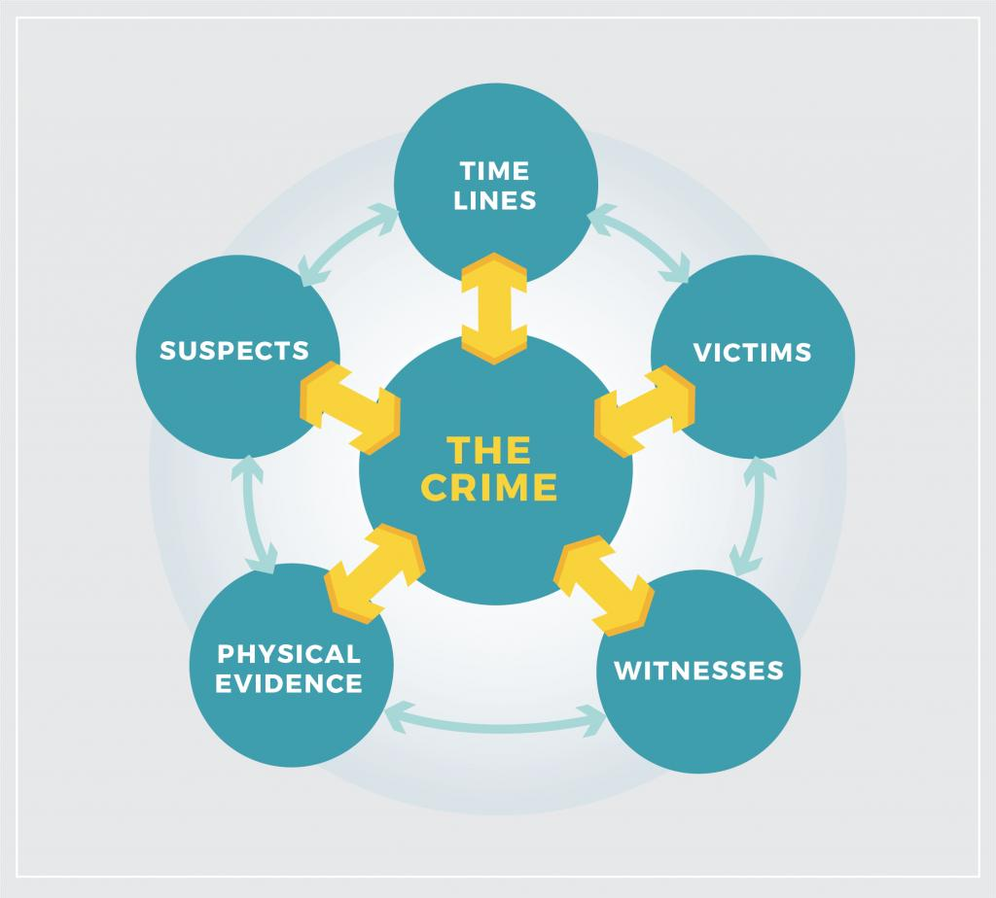

Slide 10
EXISTING SYSTEM
The existing crime analysis systems mainly rely on traditional statistical methods and manual analysis of crime records. Data mining techniques such as clustering are used to identify crime trends and hotspots from historical crime data. Most systems focus on post-crime analysis rather than real-time prediction.
The process is time-consuming and requires human intervention for data interpretation. Existing systems also lack accuracy due to limited feature selection and outdated tools. As a result, timely crime prediction and preventive action become difficult for law enforcement agencies.

Slide 11
DISADVANTAGES
Increase in crime information that has to be stored and analyzed.
Analysis of data is difficult since data is incomplete and inconsistent.
Public Trust Issues
Limitation in getting crime Enforcement department
Dependence on Data Quality
High Implementation Cost
data records from the Law

Slide 12
PROPOSED SYSTEM
The proposed system uses machine learning techniques to analyze and predict crime patterns efficiently. Real-world crime data is collected and preprocessed to remove inconsistencies and improve accuracy. Important features such as city, age, gender, weapon used, and police deployment are selected .
Multiple classification algorithms like Logistic Regression, Decision Tree, and Random Forest are evaluated to choose the best- performing model. The system provides accurate crime predictions through a user-friendly web interface. Visualizations such as accuracy graphs and confusion matrices help in understanding crime trends and model performance.

Slide 13
MODULES
Logistic Regression: is a supervised machine learning algorithm used for binary classification. It predicts the probability of an outcome using the sigmoid (logistic) function, which outputs values between 0 and 1.
Keypoints:
Used for Yes/No, True/False, 0/1 problems
Example: Spam vs Not Spam, Disease vs No Disease
Despite the name, it is used for classification, not regression

Slide 14
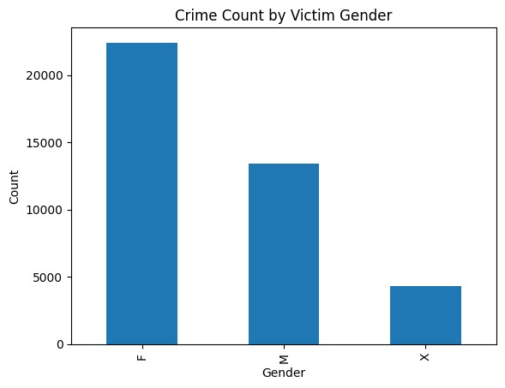
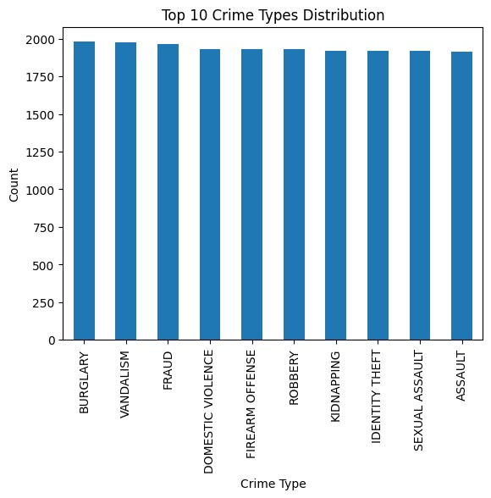

Slide 15
Decision Tree is a supervised machine learning algorithm that uses a tree-like structure to make decisions. It splits data into branches based on feature conditions, leading to a final decision or class label at the leaf nodes.
Decision Tree:
Keypoints:
Easy to understand and interpret
Can be used for classification and regression
Example: Loan approval, weather prediction

Slide 16
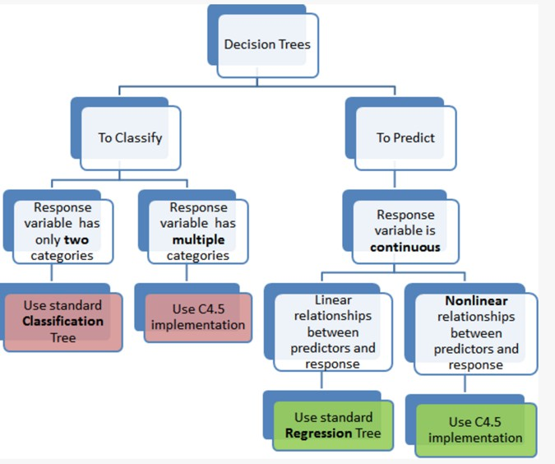

Slide 17






















Random Forest:
Random Forest is an ensemble learning algorithm that combines multiple decision trees to improve prediction accuracy. The final output is obtained by majority voting (classification) or average (regression).

Slide 18
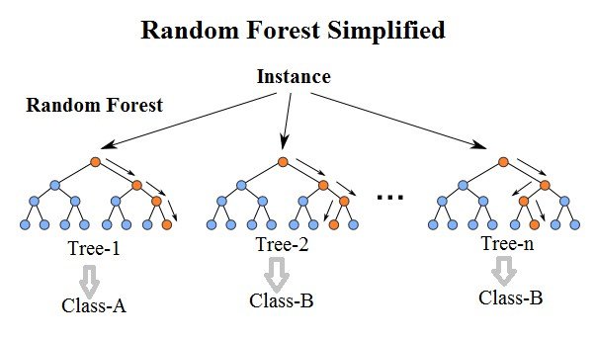

Slide 19
ADVANTAGES
Identifying the crime hotspots.
Accurate Crime prediction
Real-Time Crime Analysis
Reduced Crime Rates
Improved Public Safety
Handling Large Datasets
Faster Investigations
Predicting the future crime occurrences

Slide 20
APPLICATIONS
Real-time data integration.
GIS mapping.
AI-based alert systems.
Crime prevention
Law enforcement support.
Public safety improvement.

Slide 21
SOFTWARE REQUIREMENT
Operating System Technology
Web Technologies
IDE
: Windows
: Python
: Html, CSS
: Visual studio code

Slide 22
HARDWARE REQUIREMENTS
Processor
Speed
RAM
: Intel Core i5
: 3.6 GHz
: 8GB
Hard Disk : 516GB
Input Devices : Keyboard,Mouse

Slide 23
REFERENCE
[1] A. Sarkar, A. K. Mishra, U. P. Singh et al., “Real-Time Crime Prediction in India Using Machine Learning,” International Journal for Research in Applied Science & Engineering Technology, vol. 13, 2025.
[2] I. Singh, G. Bhandari, S. Khatwani, “Predictive Crime Rate Analysis System,” International Journal for Research in Applied Science & Engineering Technology, 2025.
[3] A. Karkhur and R. Dubey, “A Study on Predicting Crime Rates through Machine Learning,” International Journal for Research in Applied Science & Engineering Technology, 2025.

Slide 24


THANK YOU
.

