Slide 1

Shelter Animal Outcomes
Help improve outcomes for shelter animals
Presented by
Venkata Saikiran Melam

Slide 2
Contest Description
Every year, approximately 7.6 million companion animals end up in US shelters. Many animals are given up as unwanted by their owners, while others are picked up after getting lost or taken out of cruelty situations.
Many of these animals find forever families to take them home, but just as many are not so lucky. 2.7 million dogs and cats are euthanized in the US every year.
The Objective : Using a dataset of intake information including breed, color, sex, and age from the Austin Animal Center Predicting the Outcome_Type of an Animal going out of shelter home“
These outcomes include: Adoption, Died, Euthanasia, Return to owner, and Transfer.
Training Data : 26730
Testing Data : 11456
Evaluation Metric : Multi Class Logarithmic Loss.

Slide 3
Kaggle Notebooks Comparison :
Loss Cat 0.5, Dog 0.9 | Split Classifier
Log loss : 0.75305
Model: GradientBoostingClassifier
Stacking 2 Algorithms for final predictions
animal-ML
Log Loss : 0.83626
Model :
GradientBoostingClassifier
Shelter outcomes : Machine Learning End-to-End
Log Loss :0.84458
Model :
RandomForestClassifier
Key Differences :
1. One of them Made hypothesis that OutcomeType distribution is different between cats and dogs.
2. Different Models with Different Hyperparameters tuning.
3. Different Pre Processing Techniques Followed Like :
A) Creating Customs Functions for Creating new Variables
B) Grouping of Data to create new columns
C) Created Bins

Slide 4
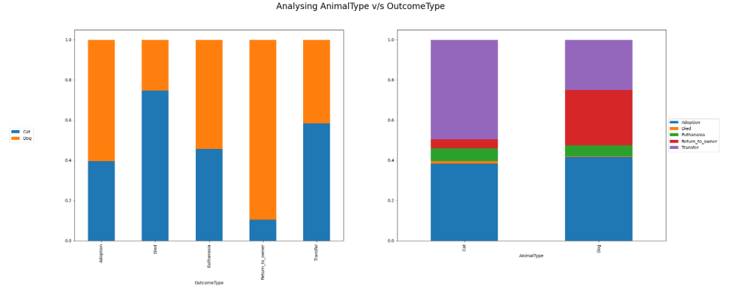
Exploratory Data Analysis
More percentage of dogs are Adopted than cats and the relationship for Transfer is opposite
Majority percentage of Return to owner is for Dogs.
Cat has a more probability of dying than the dogs

Slide 5
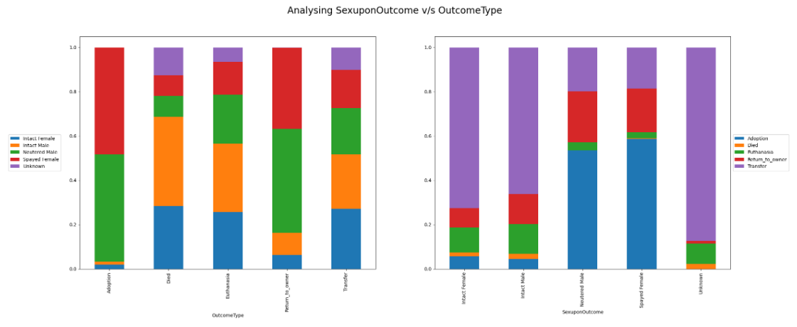
Interestingly, Adoption is clearly having a much bigger percentage in the cases of Neutered Male and Spayed Female.
Seldom do Unknown category of intake goes back to the owner.
Adoption of Intact Female is rather low.

Slide 6
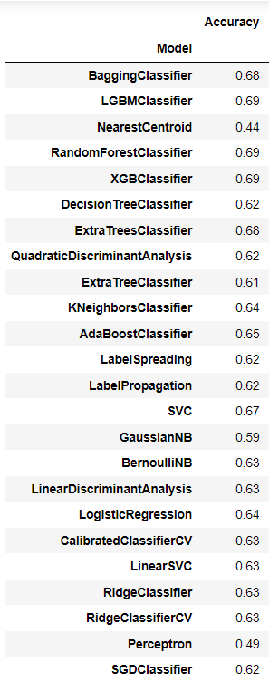
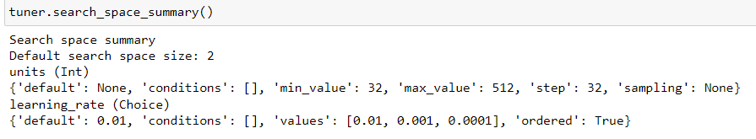
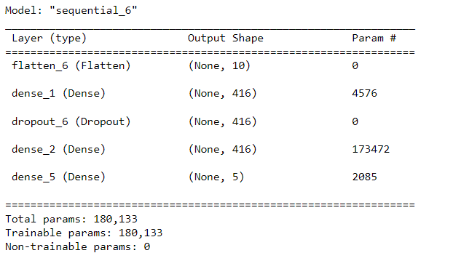
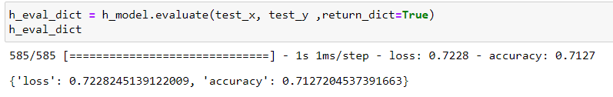
Modeling

Slide 7
Key Take Aways
Structured approach to a problem
Questioning About Data
Data Preparation is 75 % and Modelling is 25 %
Data Preparation :
Null values
Outliers
Feature Elimination / Feature Selection
Transformations for Skewed Data
Categorical encoding
New Features creation using Custom logic
Modelling :
Trying all Possible models
GridsearchCV and KerasTuner for Hyperparameter tuning

Slide 8
QUESTIONS ?

