Slide 1
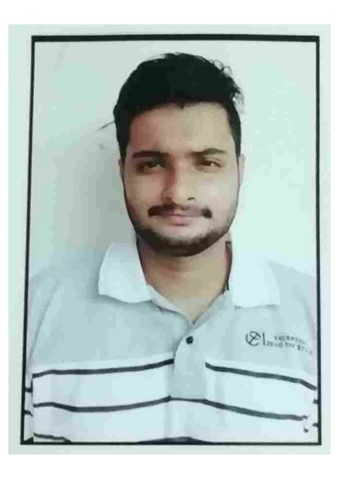




Venkata Sai Naveen Divi
Education and Certificates
Bachelor of Engineering
Computer Science Engineering: 2016 2020
Analyst/Software Engineer
Skills
Core Java
SQL
HTML,CSS
Base Location:
Bangalore
Email ID: Mobile No:
venkata-sai-naveen.divi@capgemini.com
:6301761885
v
A4
Grade:
Emp ID: 46215151
Database:
SQL database
Strengths
Software Engineer who is Strong in design and integration with intuitive problem-solving skills. Passionate about implementing and launching new projects.
Ready to learn new technologies and implement them to further improve my knowledge.
Eager to work in a team of dedicated people and serve a
key role in the enhancement and development of the project.
I have knowledge on core java, SQL, HTML, CSS and Javascript on an intermediate level.
Achivement
AWS cloud practitioner Certified:
I achieved AWS CCP Certification.
Additional Details:
Leadership Quick Learner
Team management
Completed Introduction to AWS cloud practitioner in
Coursera platform.
Areas of intrest and hobbies:
Playing Cricket Riding
Reading Books

